Slide 1
Sistem Terdistribusi
Replication & Consistency

Slide 2
Masalah yang terjadi pada Sistem
Bagaimana agar sistem reliable?
Bagaimana agar sistem memiliki performance yang baik?
Bagaimana agar sistem dapat diakses dengan mudah kapan saja?
Solusi?
– REPLICATION

Slide 3
Replication
Process sharing information to ensure consistency between redundant resources such as software/hardware components to improve reliability, fault- tolerance, or accessibility
Make copies of services on multiple machines

Slide 4
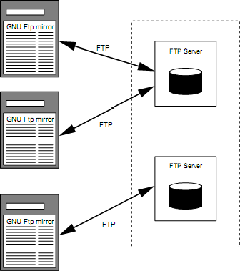
Server Replication

Slide 5
Why Replication?
Reliability: dapat diandalkan
Performance: performanya tetap baik
Scalability: dapat diperluas
Availability: tetap dapat diakses

Slide 6
Reasons detail
Reliability:
  If a replica crashes, system can continue working
by switching to other replicas.
  Avoid corrupted data:
    can protect against a single, failing write operation.
Improving Performance
  Important for distributed systems over large geographical areas.
  Divide the work over a number of servers.
  Place data in the proximity of clients.

Slide 7
Reasons detail
Scalability:
  Data dapat ditambahkan hingga besar
  Walau data besar, namun data tetap dapat ditampung karena data dapat dipecah dan direplikasi
  Sistem dapat diperluas
Availability:
  Karena data tersebar dengan replikasi, maka data akan selalu ada jika diakses
  Masing-masing replika dapat saling menggantikan jika terjadi kerusakan

Slide 8
Example: DNS
DNS (Domain Name Service) allows owner of a domain to replicate name database
Same two reasons:
  Data dapat dibagi-bagi agar lebih dekat ke client
  Sistem memiliki backup data sehingga dapat diandalkan
Also need
  Scaling technique

Slide 9
Issue-issue
Updates
  Consistency?
    Whenever a copy is modified, it becomes different from the rest.
  Sinkronisasi dan Locking?
Replica placement
  How many?
  Where?
Redirection / Routing
  Which replica should be used by client?

Slide 10
Replication
Data centric
  Focus on data in all replicas
  Try to keep data consistent across replicas
Client centric
  Focus on single client
  Only maintain consistency for each client separately

Slide 11
General Approach
Update a single item in local replica
  Atomically
  Time-stamp – e.g., logical clock
Replica propagates update to all of its other replicas
  Periodically (polling)
Receiving replica merges update with its own copy
  Conflicting updates resolved arbitrarily to latest time-stamp

Slide 12
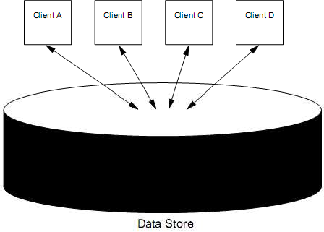
Model

Slide 13
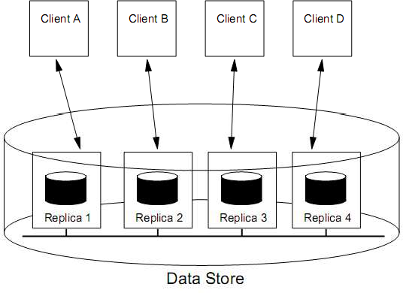
The truth

Slide 14
Rules
Why replicate?
  Reliability
    Avoid single points of failure
  Performance
    Scalability in numbers and geographic area
Why not replicate?
  Replication transparency
    Consistency issues
  Updates are costly
    Availability may suffer if not careful

Slide 15
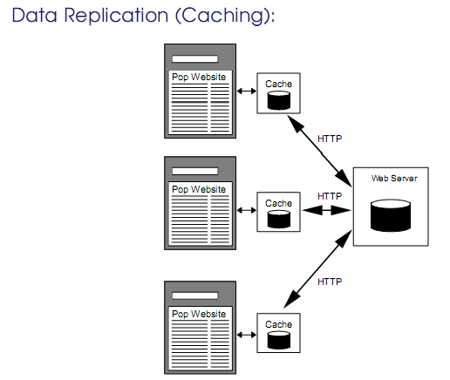
Caching
Penyimpanan data2 yang sering diakses di tempat penyimpanan sementara

Slide 16
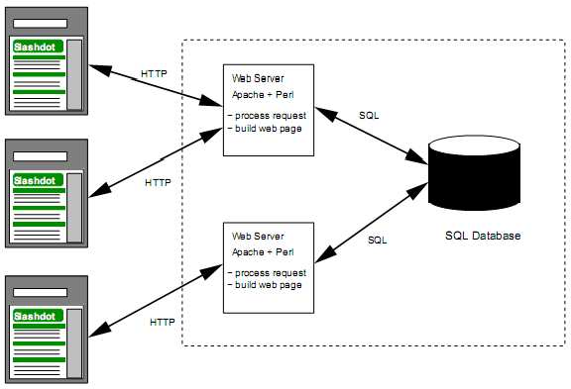
Control Replication
Replikasi difokuskan pada software server

Slide 17
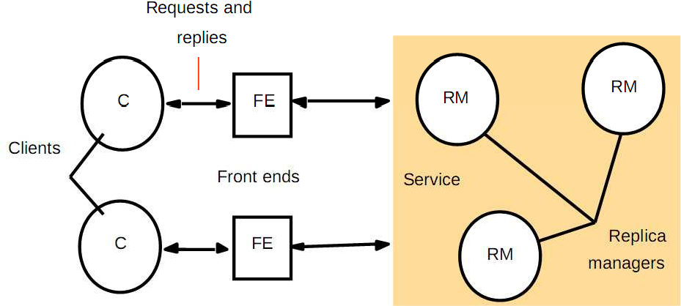
Arsitektur Replikasi

Slide 18
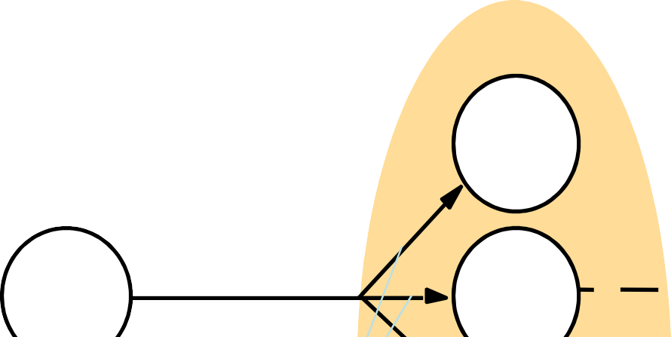
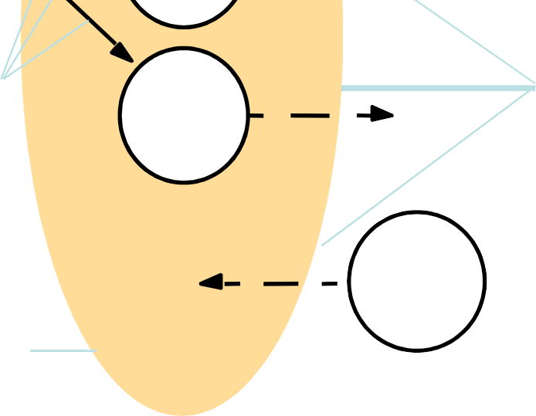
Services provided for process groups
Group address expansion
Group send
Leave
Multicast communication
Group membership management
Fail
Join
Process group

Slide 19



View-synchronous group communication
a (allowed).
b (allowed).
p crashes p crashes
p
p
q
q
r
r
view (p, q, r)
view (q, r)
view (p, q, r)
view (q, r)
c (disallowed).
d (disallowed).
p crashes
p crashes
p
p
q
q
r
r
view (p, q, r)
view (q, r)
view (p, q, r)
view (q, r)

Slide 20
Replication Management
Front End: request communication
  Requests can be made to a single RM or to multiple RMs
Coordination: RMs decide
  whether the request is to be applied
  the order of requests
Execution: The RMs execute the request tentatively.
Agreement: The RMs attempt to reach consensus on the effect of the request.
Response
  One or more RMs responds to the front end.

Slide 21
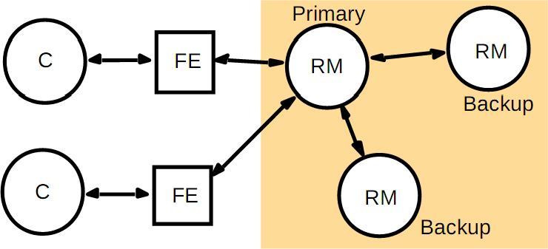
Passive Replication

Slide 22
Passive Replication
If primary server is down, pick one backup to be primary
Disadvantage: big overhead (primary must wait until all data is propagated to backups)
Variant: FE sent all read request directly to backups
Example: Sun Network Information System (NIS)

Slide 23
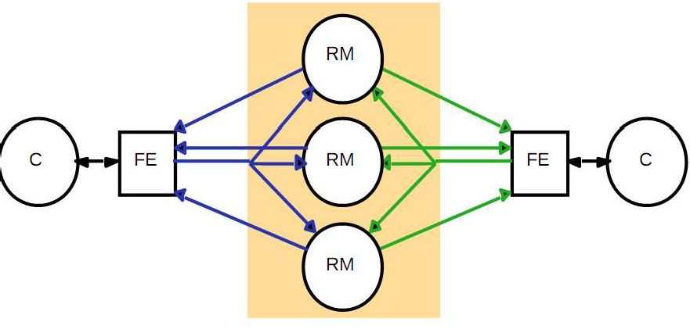
Active Replication

Slide 24
Active Replication
Request
  FE send multicast request to RM
  Read access only to one RM
  Write request goes to all RM in sequential orders
Coordination
  Group communication system send request
to each RM

Slide 25
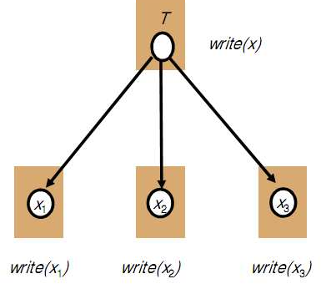
Physical & Logical Object
There are physical copies of logical objects in the system.
Operations are specified on logical objects, but
translated to operate on physical objects.

Slide 26



Transactions on replicated data
Client + front end
Client + front end
R
U
deposit(B,3);
getBalance(A)
B
Replica managers
Replica managers
A
A
A
B
B
B

Slide 27





vailable copies
Client + front end
R
U
Client + front end
getBalance(B) deposit(A,3);
getBalance(A) deposit(B,3);
Replica managers
B
Replica managers
M
A
A
B
B
X
Y
P
N

Slide 28
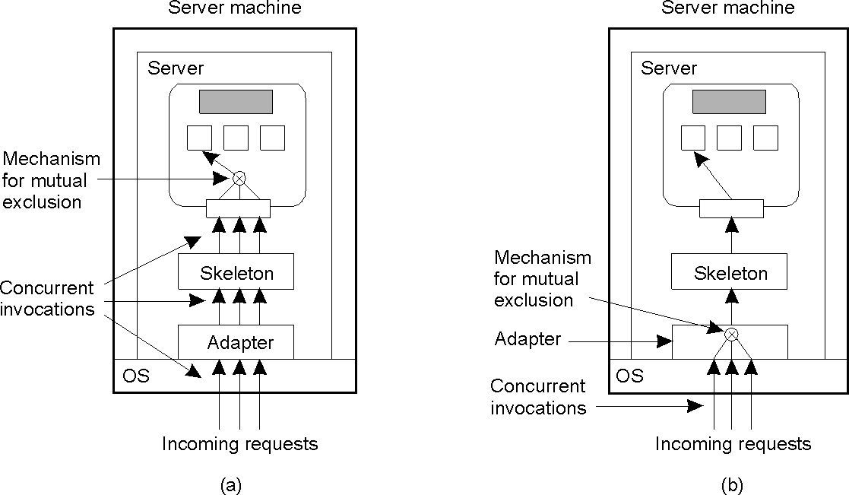
Object Replication
A remote object capable of handling concurrent invocations on its own.
A remote object for which an object adapter is required to handle concurrent invocations
Concurrency-aware objects vs system-managed concurrency

Slide 29
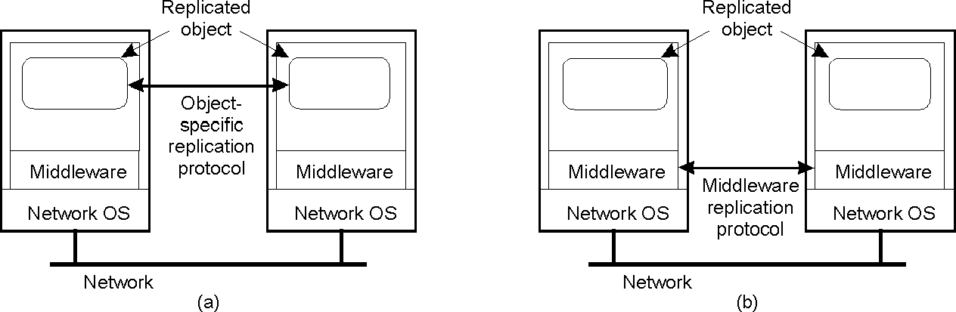
Object Replication
Replication-aware objects can adopt object-specific policies
Replication-aware distributed objects.
A distributed system responsible for replica management

Slide 30
Operation on data store
Read. Ri(x)b -> Client i performs a read for data item x and it returns b
Write. Wi(x)a -> Client i performs write on data item x setting it to a
Operations depends on:
  Time of issue (when request is sent by client)
  Time of execution (when request is executed at a replica)
  Time of completion (when reply is received by client)

Slide 31
Inconsistency
Data:
  How old is the data?
  How old is the data allowed to be?
  Time modified
  Versions
Operation order:
  Were operations performed in the right order?
  What orderings are allowed?

Slide 32
Consistency
Clients can modify resource on any of the replicas.
What happens if another client requests resource before replica has informed others of modification, as in cache consistency in distributed file systems?
– Answer depends upon application...

Slide 33
Consistency
Non-distributed data store:
  Program order is maintained
Updates and concurrency may result in
conflicting operations
Conflicting Operations:
  Read-write conflict (only 1 write)
  Write-write conflict (multiple concurrent writes)
Consistency:
  The order in which conflicting operations are performed affects consistency

Slide 34
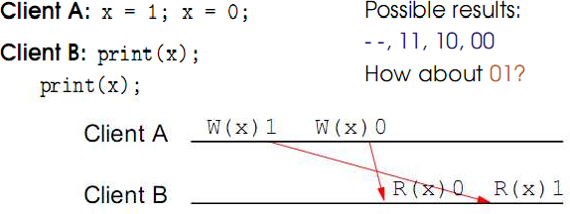
Contoh

Slide 35
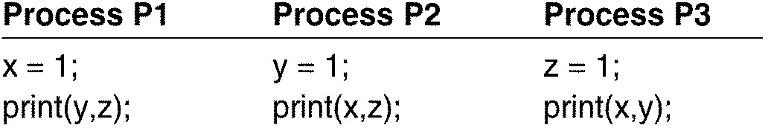
Consider three processes
Three shared variables: x, y, z
– Initialized to zero
Each updates one variable, and then reads and prints other two

Slide 36
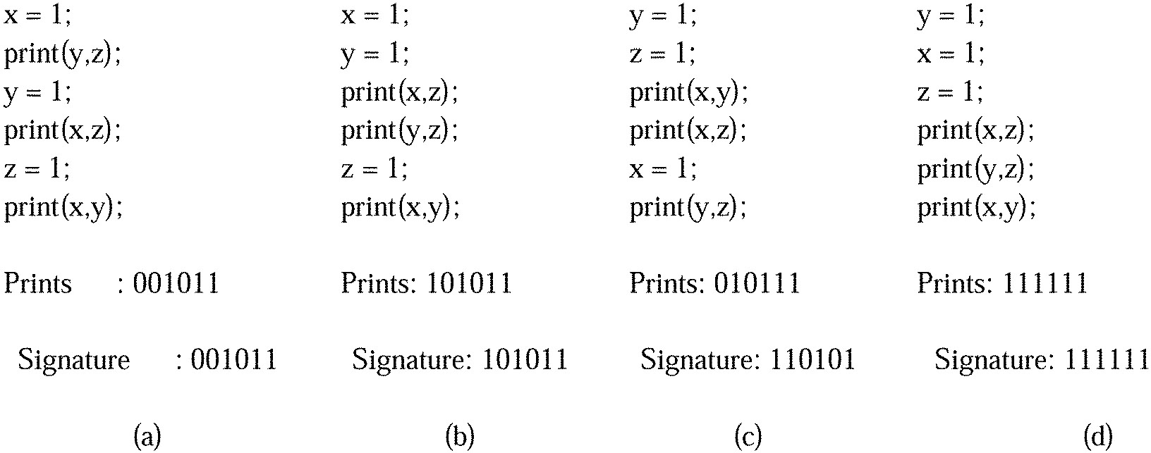
Four Valid Execution Sequences

Slide 37
Coherence vs Cosistency
Data Coherence: ordering of operations for single data item
  e.g. a read of x will return the most recently
written value
Data Consistency: ordering of operations for whole data store
  includes ordering of operations on other data
items too

Slide 38
Consistency Model
Data centric
  Strict consistency
  Sequential consistency
  Release consistency
  Lazy release consistency
Client centric
  Monotonic reads
  Monotonic writes
  Read your writes
  Write follows read

Slide 39
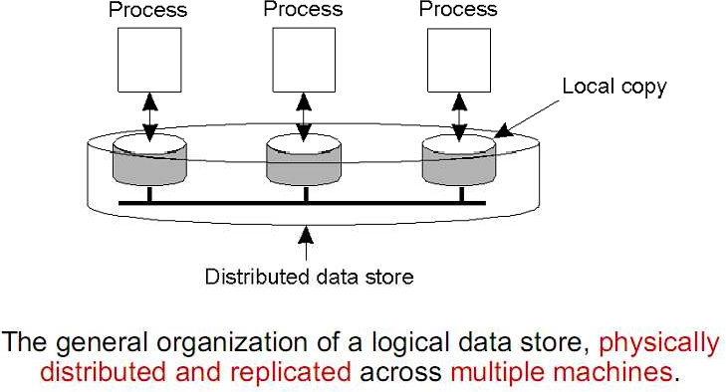
Data centric consistency model

Slide 40
Data centric
Contract between processes and the data store. If processes obey certain rules, data store will work correctly
Normally one would like: “read returns the result of most recent write”
However: No global clock! What is most recent (last) write?
Conflict: Two operations in the same interval on the same data item and at least one is a write.

Slide 41
Simbol
W(x) a, berarti client tertentu menulis sesuatu bernilai a
  Ex: x = a
Tanda panah merah, berarti client tertentu menulis di tempat client lain, sehingga bisa menyebabkan ketidak konsisten an
R(x) a, berarti client tertentu membaca nilai variabel a
  Ex: print(x) -> a

Slide 42
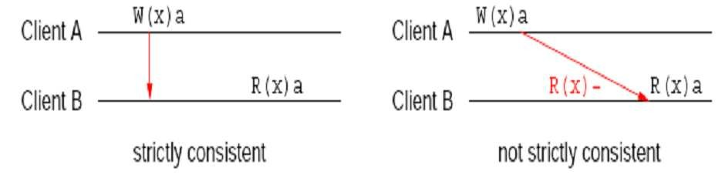
Strict consistency
Any read on data item x returns a value corresponding to the results of the most recent write on x
Implicitly assumes the presence of a global clock
A write is immediately visible to all processes
Hard to implement on distributed system because of “most recent” due to network delays and no global clock

Slide 43
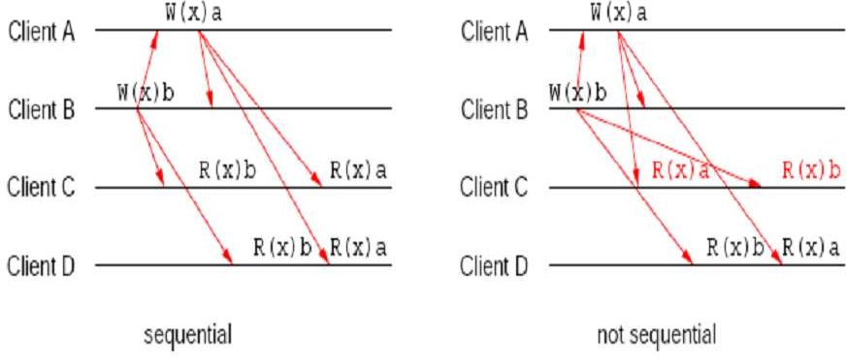
Sequential Consistency
All write operation are done sequentially
Not ordered according to “time”

Slide 44
Release consistency
Explicit separation of synchronization task
  Acquire -> proses pengaksesan data ter-up-to- date
  Release -> proses melepas semua data yg dipegangnya
Orders are FIFO
Release only after all read/write by client is completed
Read/write only after all acquire by client is completed

Slide 45
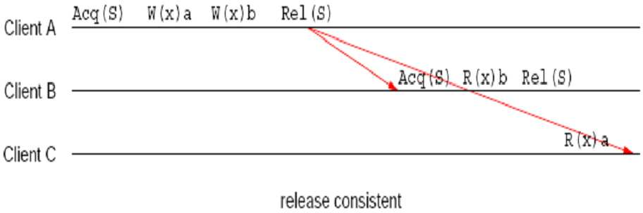
Eager Release consistency

Slide 46
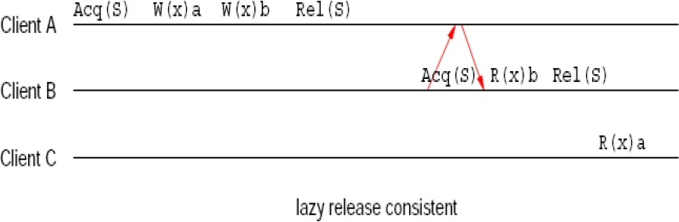
Lazy Release Consistency
Don't send updates on release
Acquire cause clients get newest state
Done by client -> more efficient

Slide 47
Client Centric
Provides guarantees about ordering of operation for single client
Single client access data store
Client accesses different replicas
Data isn't shared by clients
Each client will see different orderings
Effects on operation depends on the clients itself and also from historical operations the client has performed

Slide 48
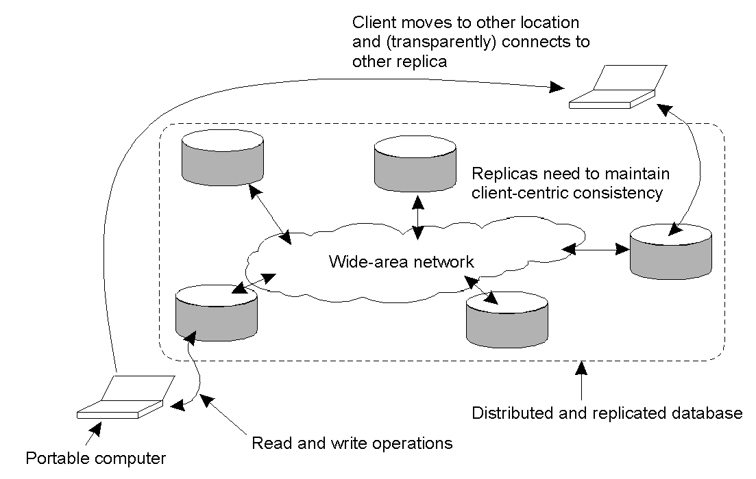
Client Centric : Mobile Users
Mobile users present a challenge
Client may access replica 1, make some updates
Client moves, accesses replica 2
Modifications to replica 1 may not have migrated to replica 2 yet!

Slide 49
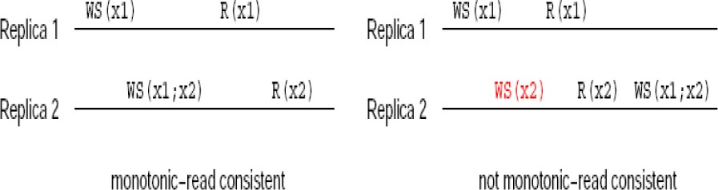
Monotonic Reads
The read operations performed by a single process P at two different local copies (R1 and r2) of the same data store.
If a client has seen a value of x at a time t, it will never see older version of x in the future
Reading incoming email messages will fetches the latest updates
Automatically reading your personal calendar updates from different servers. Monotonic Reads guarantees that the user sees all updates, no matter from which server the automatic reading takes place.

Slide 50
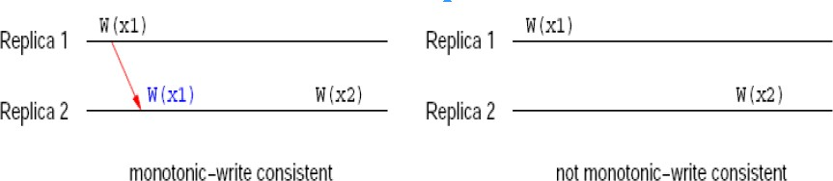
Monotonic Write
The write operations performed by a single process P
at two different local copies of the same data store
A write operation on data item x is completed before any successive write on x by the same client
All writes by single client are sequentially ordered
Eg.: maintaining version of replicated files in correct order everywhere

Slide 51
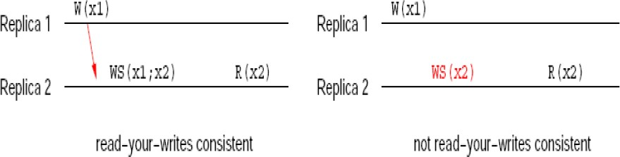
Read your Write
Effect of a write on x will always be seen by a
successive read of x by same client
Ex: editor and browser, if not integrated, you may not read-your-writes of an HTML page

Slide 52
Write follow reads
A write operation on x will be performed on a copy of x that is up to date with the values most recently read by the same client
Ex: comments on news group, let A an article read recently, R the response to that article, then R must follows A.

Slide 53
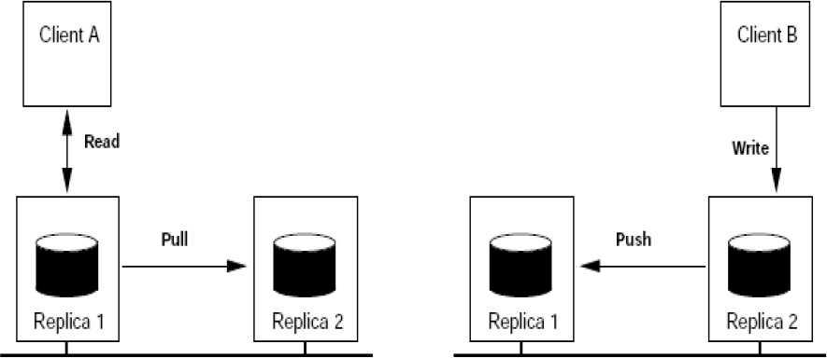
Update propagation

Slide 54
Pull dan Push
Pull
  On request by read
  Client-based pull
  client requests another server to send it any updates it has at that moment.
  R/W low (depends on read frequently)
  polling delay
Push
  When client writes, it pushes to all replicas
  updates are propagated to other copies actively
  Server-based push
  Have to keep track all replicas
  R < W
  Use lease time

Slide 55


Perbedaan
Issue | Push-based | Pull-based
State of server | List of client replicas and caches | None
Messages sent | Update to all clients | Poll and update
Response time at client | Immediate (or fetch-update time) | Fetch-update time

