Slide 1
Data Warehousing Design And Implementation
Notes:
September 98
1
Chapter Name

Slide 2
Tahapan Dalam Design Datawarehouse
Conceptual design
  Business requirement, scope of application
Logical design
  Define the types of information you need
Physical design
  Creation of the data warehouse with SQL statements

Slide 3
Designing Data Warehouses
To begin a data warehouse project, need to find answers for questions such as:
  Which user requirements are most important and which data should be considered first?
  Should project be scaled down into something more manageable?
  Should infrastructure for a scaled down project be capable of ultimately delivering a full-scale enterprise-wide data warehouse?

Slide 4
Designing Data Warehouses
For many enterprises, the way to avoid the complexities associated with designing a data warehouse is to start by building one or more data marts.
Data marts allow designers to build something that is far simpler and achievable for a specific group of users.

Slide 5
Designing Data Warehouses
Requirements collection and analysis stage of a data warehouse project involves interviewing appropriate members of staff (such as marketing users, finance users, and sales users) to enable identification of prioritized set of requirements that data warehouse must meet.

Slide 6
Designing Data Warehouses
At same time, interviews are conducted with members of staff responsible for operational systems to identify which data sources can provide clean, valid, and consistent data that will remain supported over next few years.

Slide 7
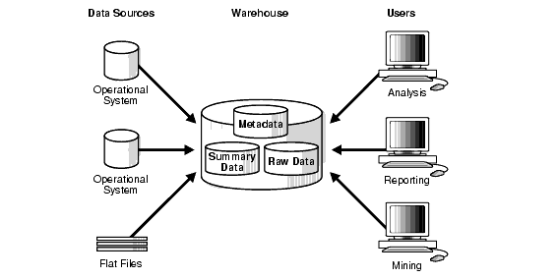
Designing Data Warehouses
Architecture of a data warehouse

Slide 8
Designing Data Warehouses
Interviews provide the necessary information for the top-down view (user requirements) and the bottom-up view (which data sources are available) of the data warehouse.
A data warehouse can be described by using a technique called dimensional modeling.

Slide 9
Dimensional Modeling
Logical design technique that aims to present the data in a standard, intuitive form that allows for high-performance access
Every dimensional model (DM) is composed of one table with a composite primary key, called the fact table, and a set of smaller tables called dimension tables.

Slide 10
Dimensional Modeling
Each dimension table has a simple (non-composite) primary key that corresponds exactly to one of the components of the composite key in the fact table.
Forms ‘star-like’ structure, which is called a star schema or star join.

Slide 11
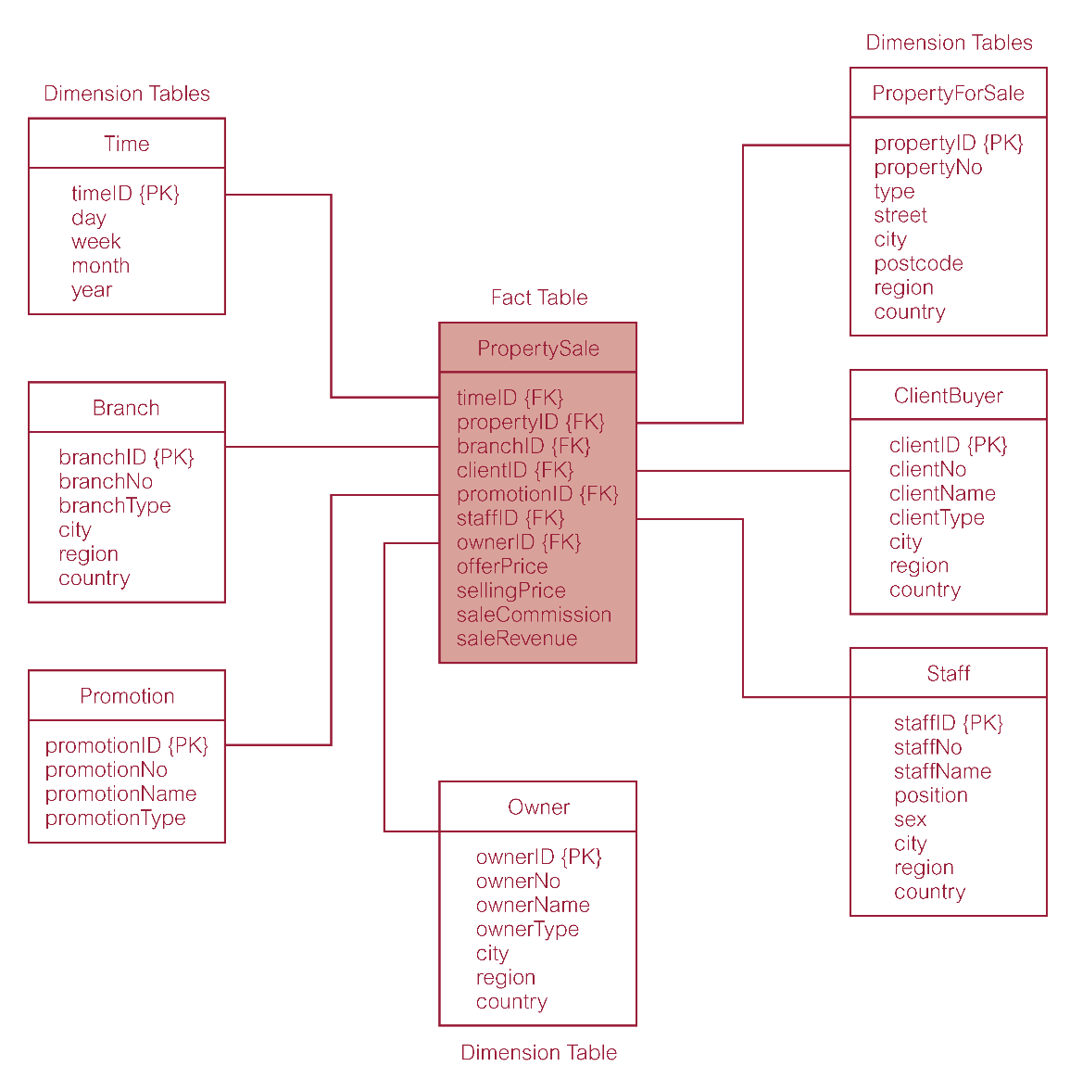
Star Schema for Property Sales of DreamHome

Slide 12
Dimensionality Modeling
Bulk of data in data warehouse is in fact tables, which can be extremely large.
Most useful fact tables contain one or more numerical measures, or ‘facts’ that occur for each record and are numeric and additive.

Slide 13
Dimensionality Modeling
Dimension tables usually contain descriptive textual information.
Dimension attributes are used as the constraints in data warehouse queries.

Slide 14
Design Methodology for Data Warehouses
Four steps:
  Choosing a business process to model
  Choosing the grain
  Identifying the dimensions
  Choosing the measure

Slide 15
Step 1: Choosing The Process
The process (function) refers to the subject matter of a particular data mart.
First data mart built should be the one that is most likely to be delivered on time, within budget, and to answer the most commercially important business questions.

Slide 16
Step 2: Choosing The Grain
Decide what a record of the fact table is to represent.
Also include time as a core dimension, which is always present in star schemas.

Slide 17
Step 3: Identifying and Conforming the Dimensions
Dimensions set the context for asking questions about the facts in the fact table.
If any dimension occurs in two data marts, they must be exactly the same dimension, or one must be a mathematical subset of the other.

Slide 18
Step 4: Choosing The Measure of Facts
Typical measures are numeric additive quamtities like dollars_sold and unit_sold.

Slide 19
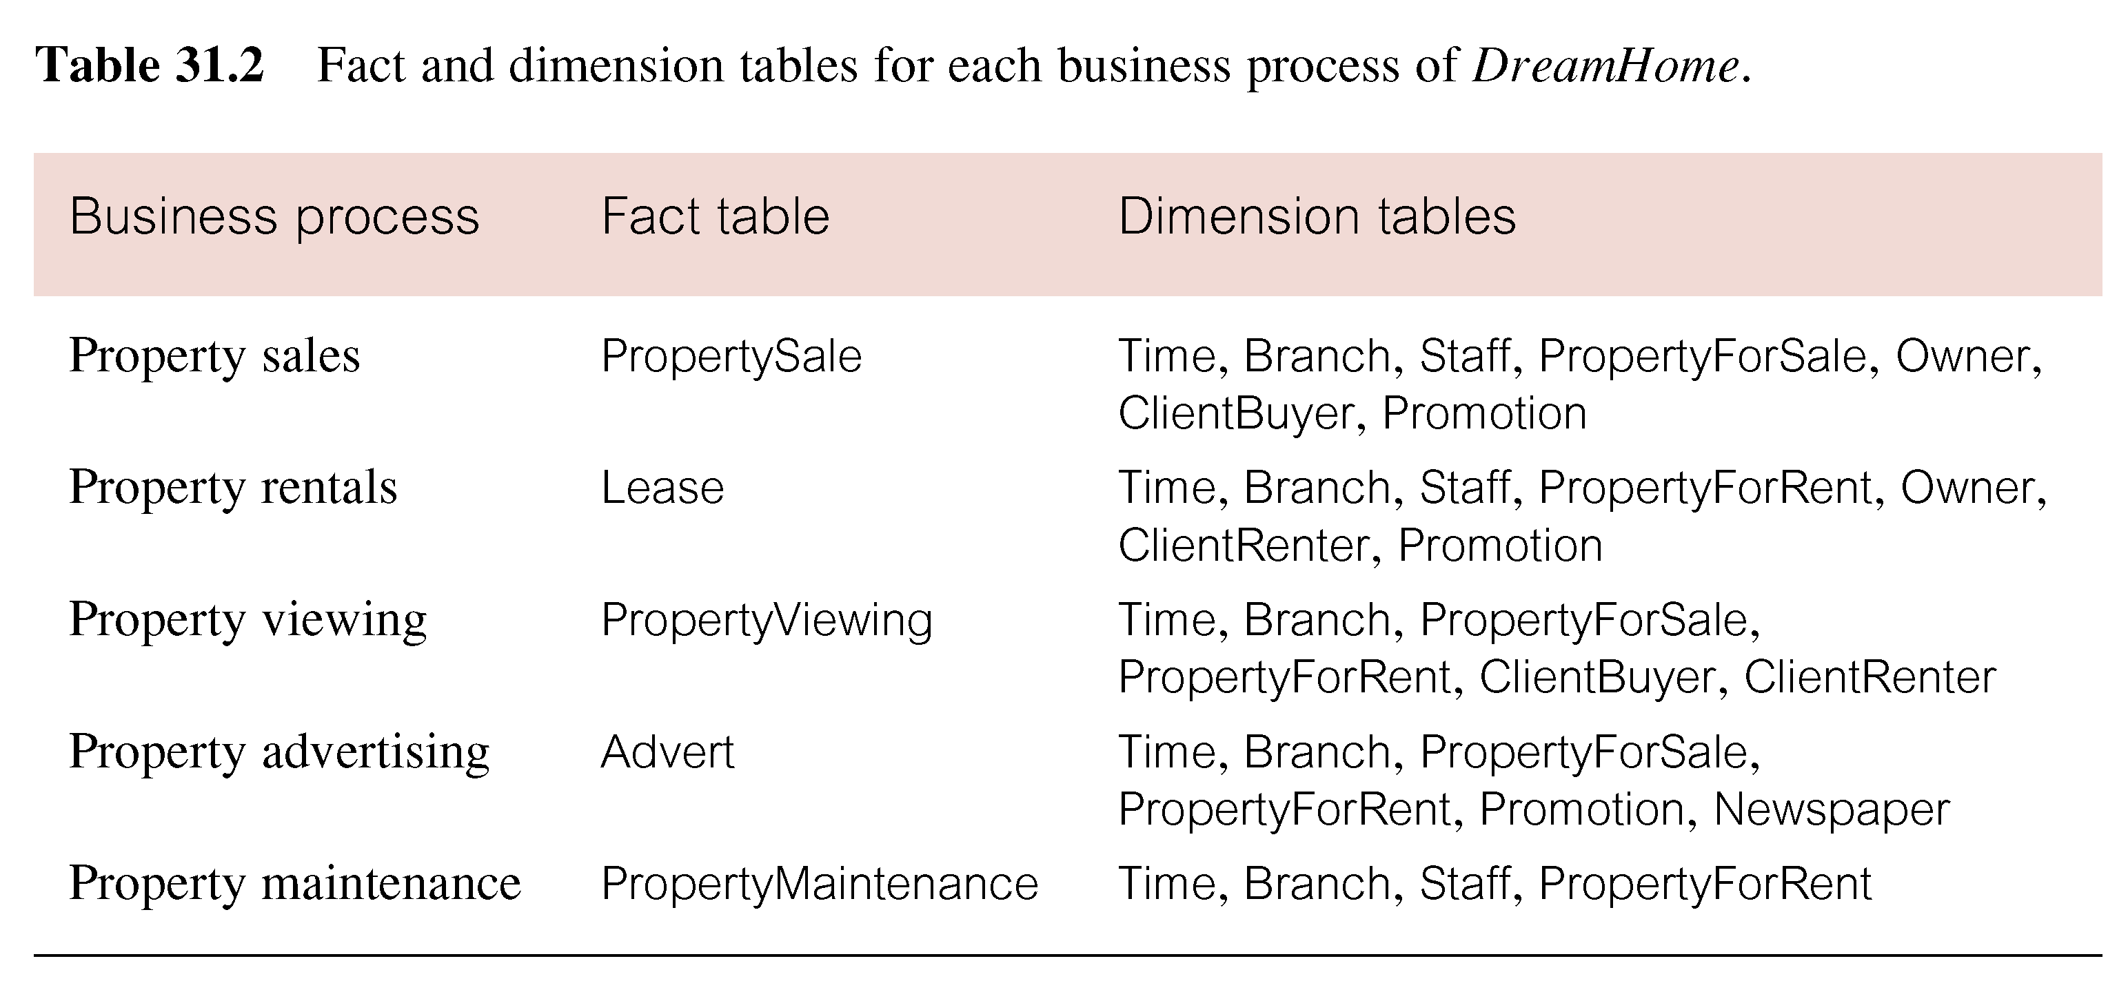
Fact and Dimension Tables for each Business Process of DreamHome

Slide 20
Physical Design
Translate schemas into actual database structures
  Entities to tables
  Relationships to foreign key constraints
  Attributes to columns
  Primary unique identifiers to primary key constraints

Slide 21
Physical Design
Most critical physical design issues affecting the end-user’s perception includes:
  physical sort order of the fact table on disk;
  presence of pre-stored summaries or aggregations.
  Indexing

Slide 22
Physical Design
Simple example:
STORE
PRODUCT
SALES
CUSTOMER
TIME

Slide 23
Physical Design
Dimension Table:
  create table customer
  (csid varchar(30),
  cname varchar(20) not null,
  gender varchar(10),
  primary key (csid));

Slide 24
Physical Design
Fact Table:
  create table Sales
  (customer_id varchar(30),
  product_id varchar(50),
  store_id varchar(50),
  date_id varchar(50),
  unit_sold real,
  unit_price real,
  total_price real,
  primary key (customer_id,product_id,store_id,date_id),
  foreign key (customer_id) references customer (csid),
  foreign key (product_id) references products (pid),
  foreign key (store_id) references store (name),
  foreign key (date_id) references time (tid));

Slide 25
Physical Design
Dimension - A dimension is a schema object that defines hierarchical relationships between columns or column sets.
CREATE DIMENSION time_dim
LEVEL day IS time.tid
LEVEL month IS time.month
LEVEL year IS time.year
HIERARCHY cal_rollup (
day CHILD OF
month CHILD OF
year
);

Slide 26
Physical Design
Materialized View - you can use materialized views to precompute and store aggregated data such as the sum of sales.
CREATE MATERIALIZED VIEW product_sales as
SELECT p.pname, SUM(s.unit_sold) AS totalsale
FROM sales s, products p WHERE s.product_id =p.pid
GROUP BY p.pname;

Slide 27
Physical Design
Bitmap Index – Good for low cardinality column.
create bitmap index customer_gender on customer (gender);

