Slide 1
CHAPTER 3
DESIGNING CLASSROOM LANGUAGE TESTS
Sub: Some Practical Steps to Test Construction
By Entika Fani Prastikawati, S.Pd.,M.Pd

Slide 2
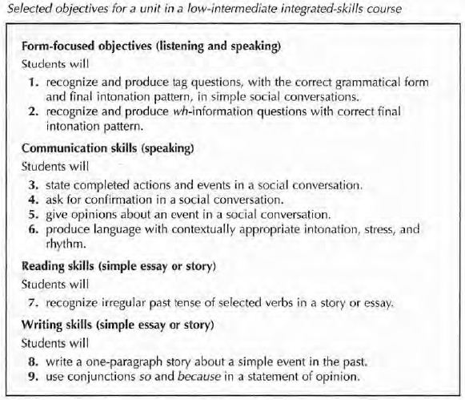
Assessing clear, Unambiguous Objectives
The test makers must clearly define the purpose of the test created.
The test is not just given because it is the fourth week of the month.
You need to examine the objective for the unit you are testing.

Slide 3
Drawing Up Test Specification
A broad outline of the test: (a) outline of the test, (b) skills to be included, (c) item types and tasks..
What skills you will test.
What the items will look like
You need to consider the time of the test, what skills, and spoken/written test

Slide 4
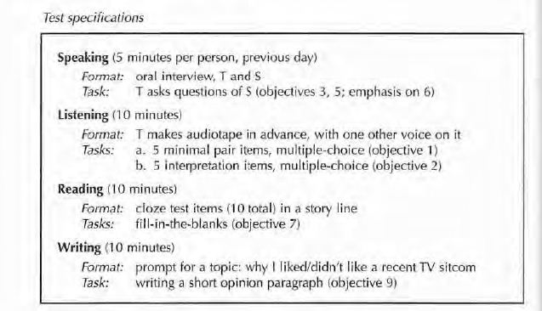
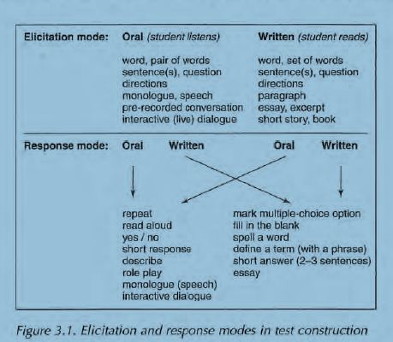

Slide 5
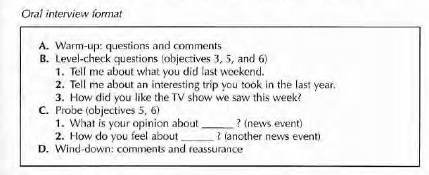
Devising Test Tasks

Slide 6
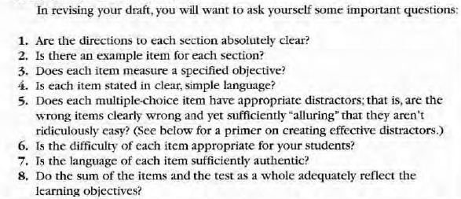

Slide 7
Designing Multiple-Choice Items
Some weaknesses are:
MC only tests recognition knowledge
It may be effected by guessing
The technique severrly restricts what can be tested
Difficult to write/create the successful items
Washback may be harmful
Cheating may be facilitated

Slide 8
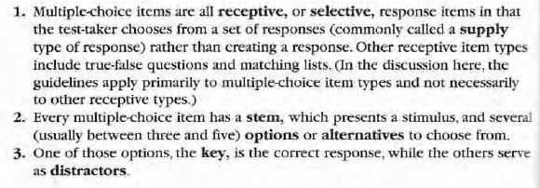
A primer on MC terminology

Slide 9
Guidelines for Designing Multiple Choice
Design each item to measure a specific objective
State both stem and options as simply and directly as possible
Make certain that the intended answer is clearly the only correct one
Use item indices to accept, discard, or revised items (Item Facility, Item Discrimination, Distractor Efficiency,)

Slide 10
SCORING, GRADING, AND GIVING FEEDBACK
Designing a classroom test need a clear scoring and graded system.
Grading must be well consulted (see page 62)
Giving feedback to students is a beneficial washback

