Slide 1
building accoustic
INTRODUCTION

Slide 2
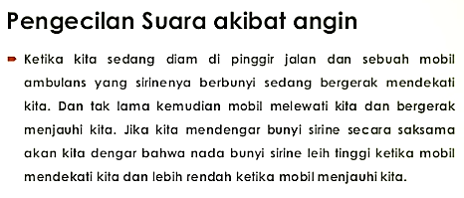

Slide 3
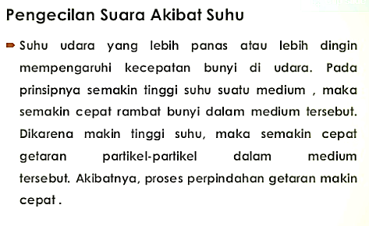

Slide 4
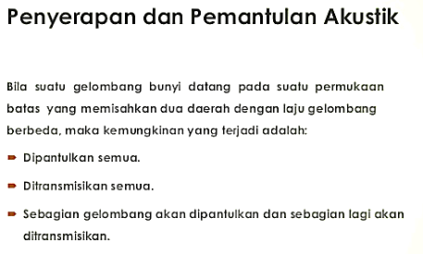

Slide 5
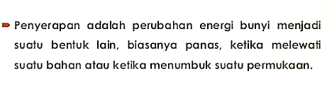
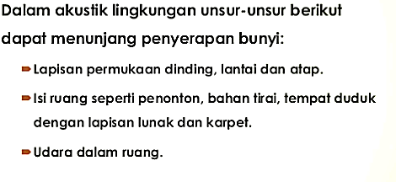
PENYERAPAN SUARA

Slide 6
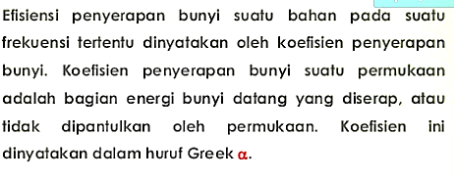
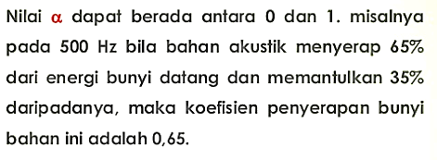

Slide 7
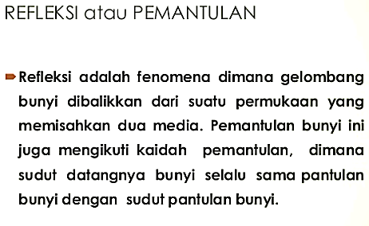
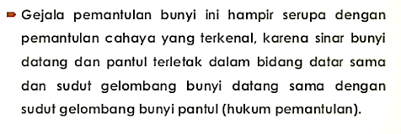

Slide 8
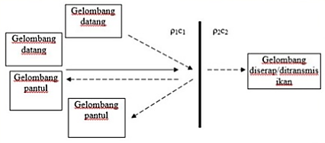

Slide 10
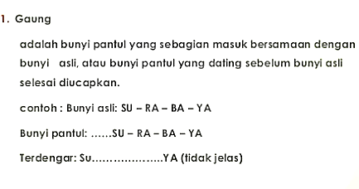
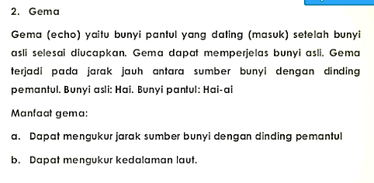
MACAM-MACAM BUNYI PANTUL

Slide 11
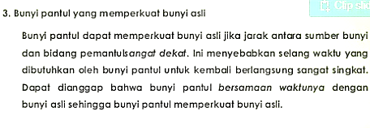
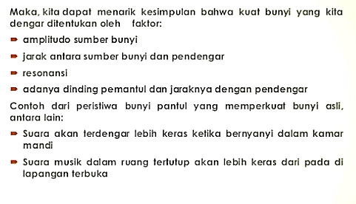

Slide 12
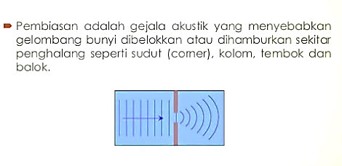
DIFRAKSI ATAU PEMBIASAN

Slide 13
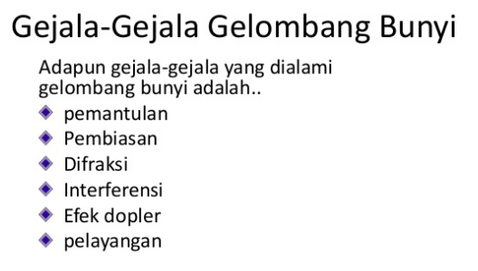

Slide 14
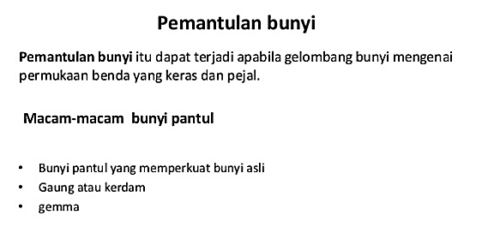

Slide 15
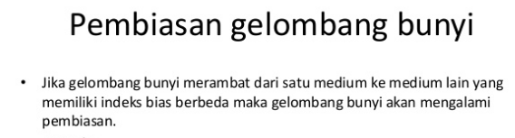
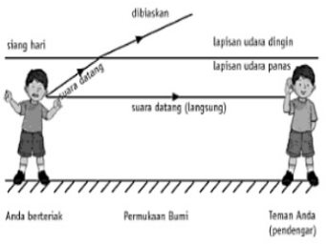
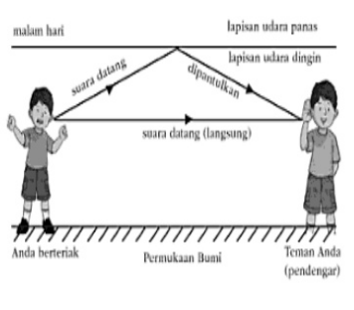

Slide 16
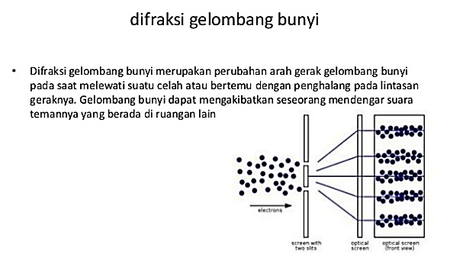

Slide 17
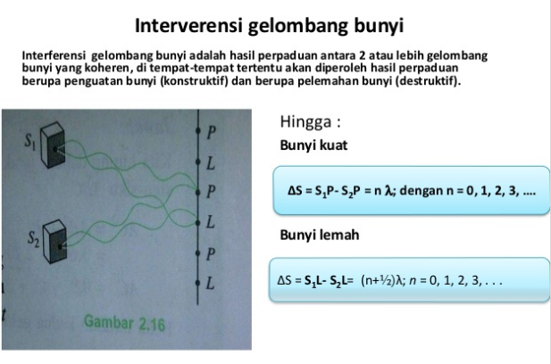

Slide 18
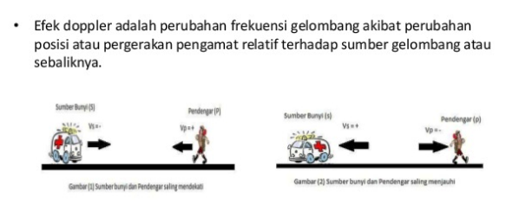
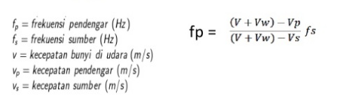
Efek Dopler

Slide 21
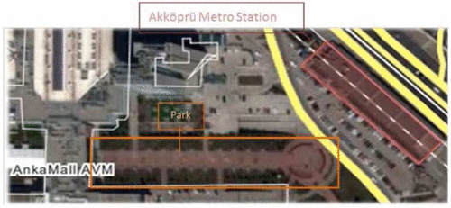
Understanding the indoor soundscape in public transport spaces
A case study in Akköprü metro station, Ankara
http://journals.sagepub.com/doi/full/10.1177/1351010X17741742
Metro stations can be included in the indoor soundscape literature. This study examines the relationship between space recognition and soundmarks.
ISO/TC 43/SC1/WG 54 working group proposed Part 1 of the standard ISO 12913 with basic definitions, where a soundscape is defined as the following: “[An] acoustic environment as perceived and experienced and understood by people, in context.”

