Slide 1
PERPINDAHAN PANAS KONVEKSI

Slide 2
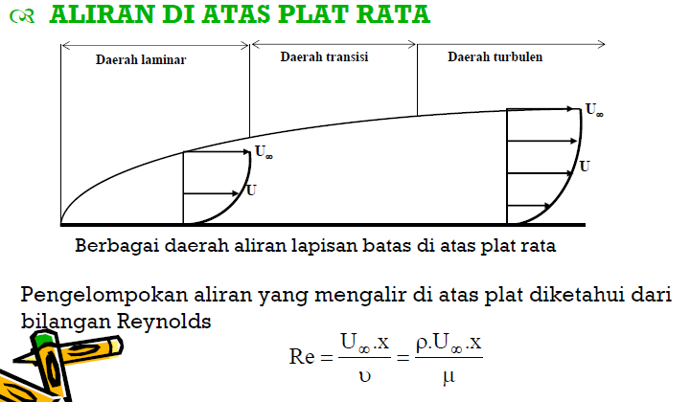
KONVEKSI PAKSA
(FORCED CONVECTION FLOW SYSTEM

Slide 3

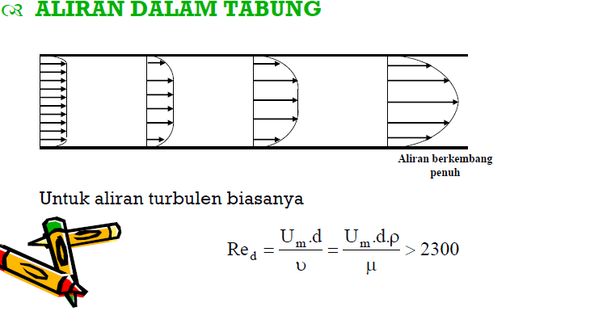

Slide 4
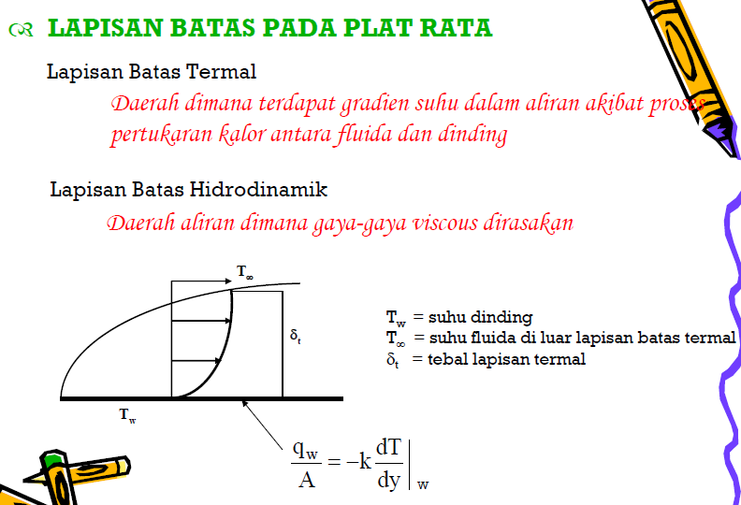

Slide 5
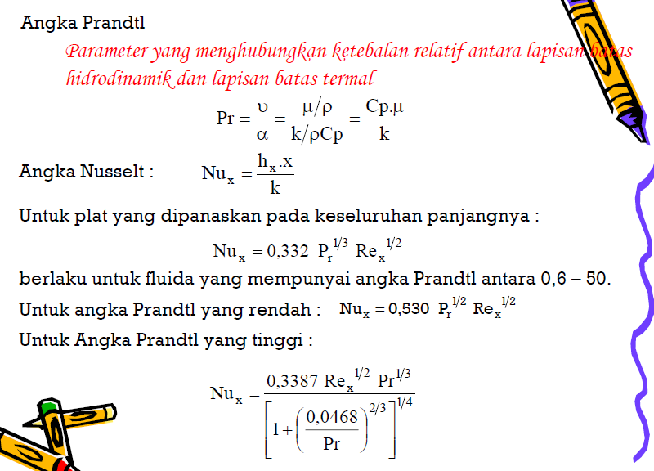

Slide 6
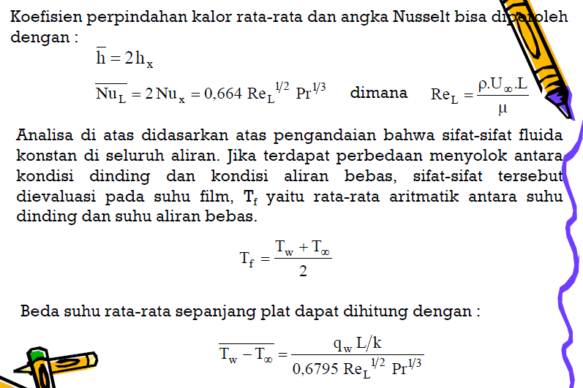

Slide 7
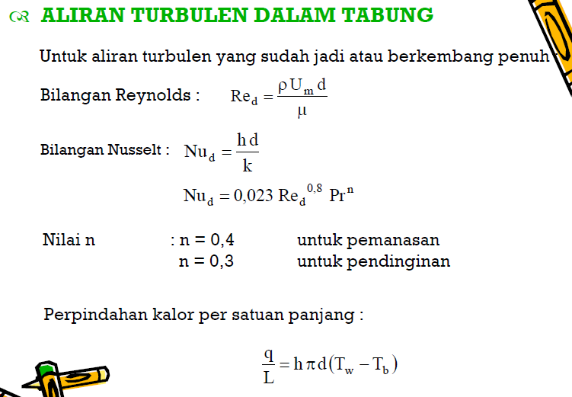

Slide 8




Slide 9
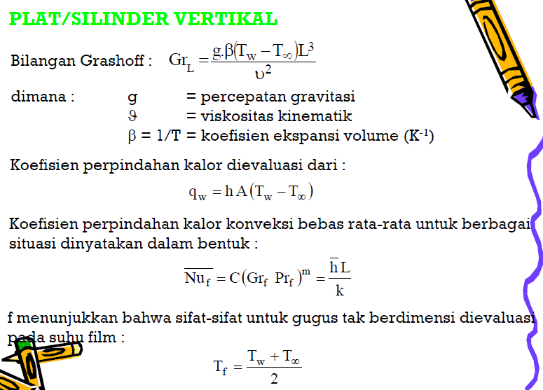

Slide 10
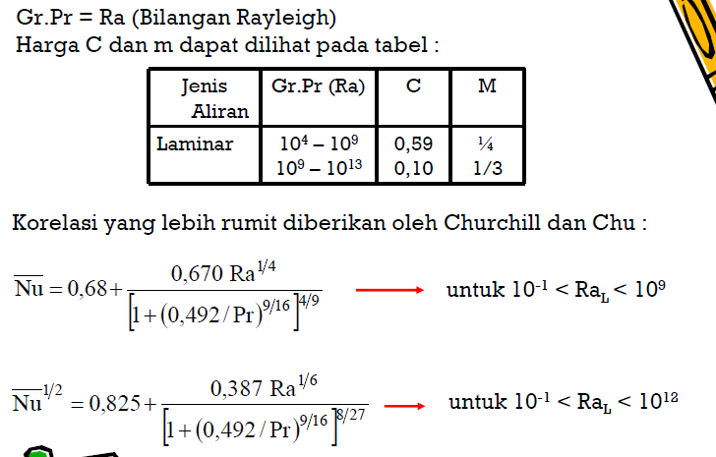

Slide 11
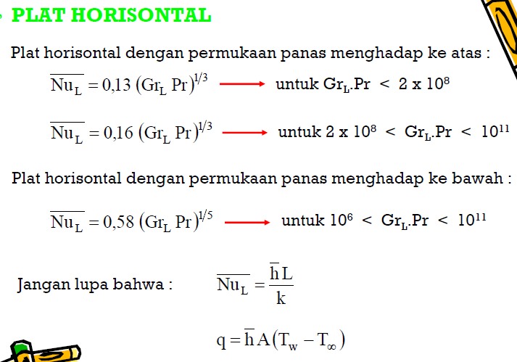

Slide 12


