Slide 2
CONTENTS
1. LP series introduction
1-1. LP SERIES
1-2. LP SERIES?
1-3. Major feature
1-4. Application
1-5. Competitors comparison
1-6. Model information
1-7. Display/control performance
1-8. I/O performance
1-9. Part description
4. Program
4-1. Program download
4-2. Program requirements
7. Smart Studio Program
7-1. Download example of LP instruction
7-2. Basic I/O Contact and Alternate Instruction
7-3. AND Contact Instruction
7-4. OR Contact Instruction
7-5. Self-locking circuit
7-6. SET & RESET
7-7. Circuit Alternate Instruction
7-8. Step controller Instruction
7-9. Counter
7-10. Timer
7-11. Comparison Instruction
7-12. Transfer Instruction
7-13. Exchange Instruction
7-14. Rotation Instruction
7-15. Shift Instruction
7-16. Arithmetic Instruction
7-17. Master Control Instruction
7-18. Conversion Instruction
7-19. 7 Segment Instruction
7-20. Motion Instruction
5. Smart-Studio
5-1. Smart-Studio?
5-2. Screen Layout
5-3. Project New/Save/Open
2. Program Structure & Operation
2-1. Program structure
2-2. Program operation
6. Program up/download
6-1. RS232 Interface
6-2. ETHERNET Interface
6-3. USB Interface
6-4. Smart-Studio Download
6-5. Smart-Studio Upload
3. Device
3-1. Device list
3-2. X device
3-3. Y device
3-4. S device
3-5. M device
3-6. D device
3-7. R device
3-8. C device
3-9. T device
3-10. Z device
3-11. F device
3-12. L device
8. Other
8-1. Download example of LP Motion instruction

Slide 3



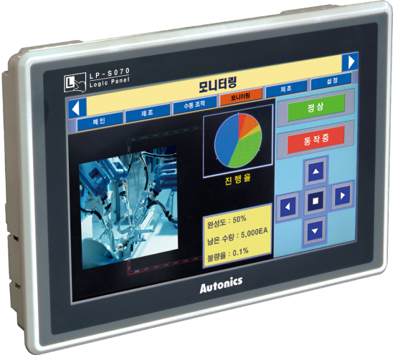
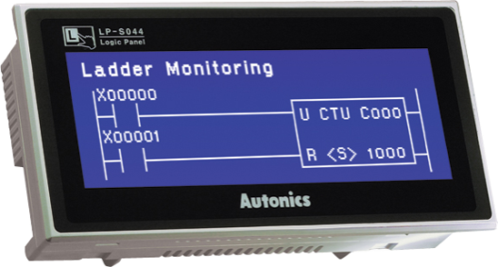
1. LP Series INTRODUCTION
1-1. LP SERIES
Touch Screen LCD TYPE Logic Pannel
[ PLC + HMI + I/O Module ]
LP-S044 SERIES
LP-S070 SERIES
External IO Input
(16Point, Output 16Point)
- 16,777,216 True Color !
- GP-EDITOR, SMART-STUDIO
- Position Control Function !
External unit RS232/RS485
Communication
- Analog Touch Type !

Slide 4
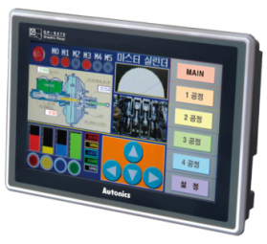

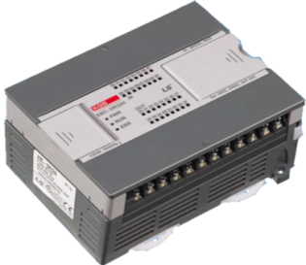
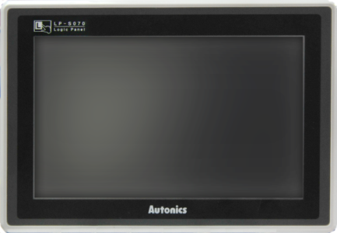
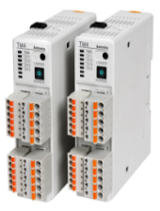



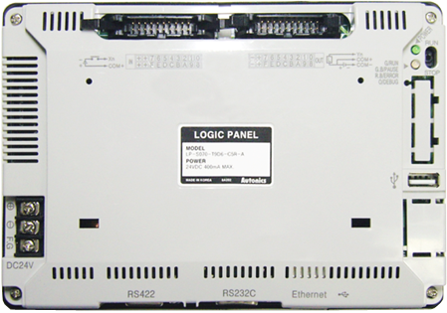
1. LP Series INTRODUCTION
1-2. LP(LOGIC PANNEL)?
HMI
PLC
Motion Controller
※ Only LP-S070 SERIES
Communication
Digital I/O
- Reducing cost, wire, space & Provides easy operation by integrating GP, PLC
- Supports edit function for 100% through serial communication of GP & GP-Editor
- PLC ladder/mnemonic edit function ☞ Smart-Studio(Supporting approx. 250 of commands)
Able to individually monitor & control input/output devices of sensor, button, lamp, motor and etc. through
built-in I/O terminal.
- 2 channels of motion controller function is equipped. (※Only LP-S070)

Slide 5


1. LP Series INTRODUCTION
1-3. Major Feature
Feature
Function
1
PLC+HMI+ I/O modules in one body
COST & SPACE Saving Multi Solution
1
Easy S/W upgrade at Website
Firmware, GP Editor, SmartStudio
2
Monitoring function of other type controller
Monitors and controls the variable
3
Multilingual Supports
Korean, English, Chinese
Japanese, Russian
4
Various Communication Ports available
USB, Ethernet, RS232, RS422
5
Printers & Barcode Readers Connection
Alarm list printing,
Barcode Reading
6
Various data display
Numbers, Graphs, Meters
7
8
Simultaneous output as max.100KHz pulse 2 points
Positioning Function

Slide 6
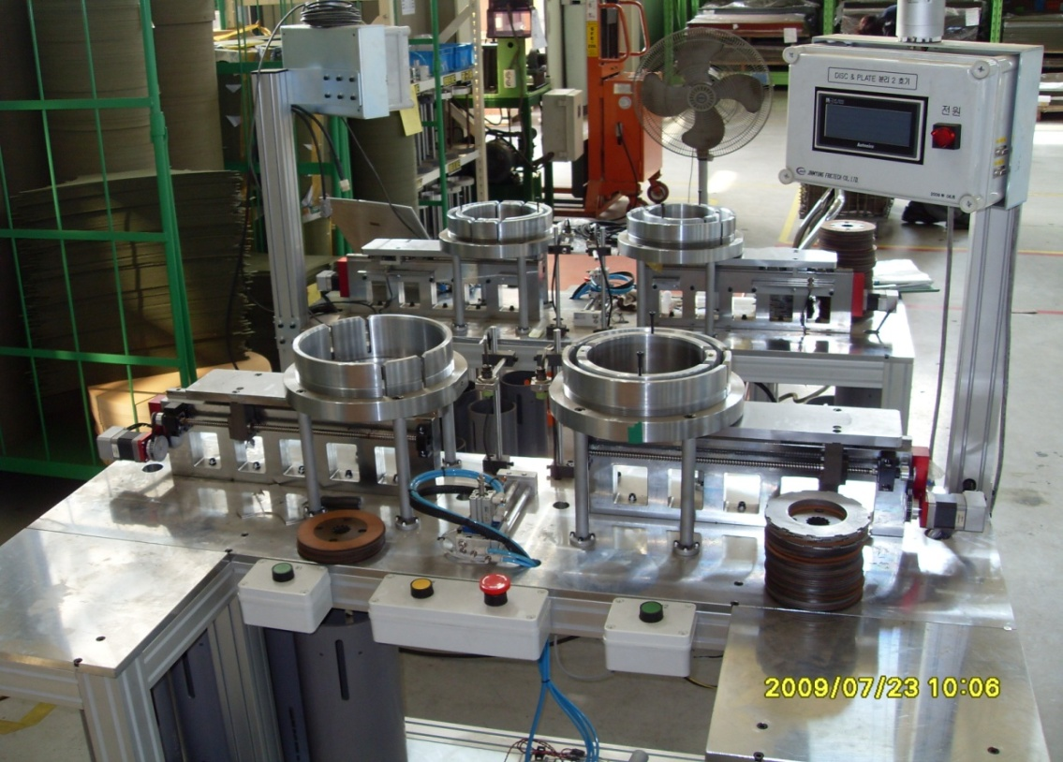
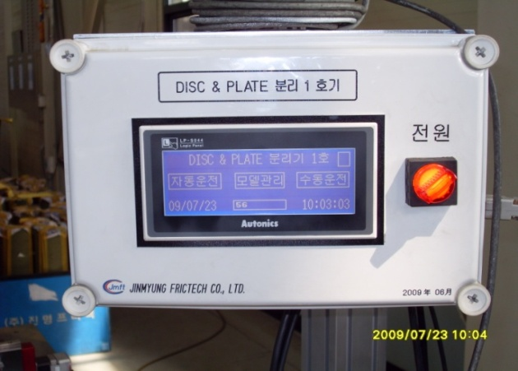
1. LP Series INTRODUCTION
1-4. Application
Disk & Plate Separator

Slide 7
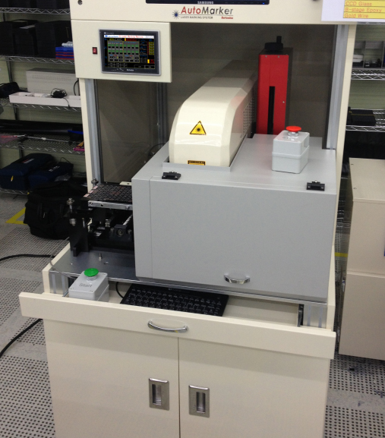
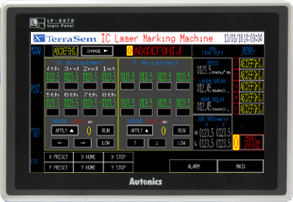
1. LP Series INTRODUCTION
1-4. Application
8 Point IC laser Making machine

Slide 8
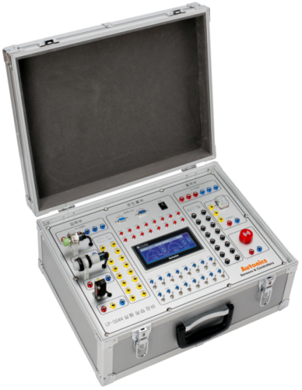
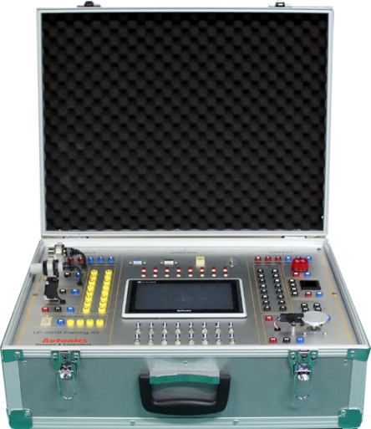
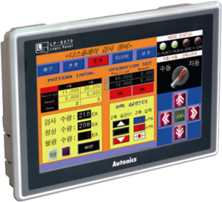
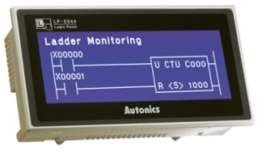
1. LP Series INTRODUCTION
1-4. Application
Training Kit(For sale)
<LP-S044 Training Kit>
<LP-S070 Training Kit>
Practical training
PLC training
Proximity sensor training
Photo sensor training
Relay training
Buzzer training
※ Able to application as external training
Practical training
PLC training
Proximity sensor training
Photo sensor training
Digital switch, Display unit training
Stepping Motor training
※ Able to application as external training

Slide 9
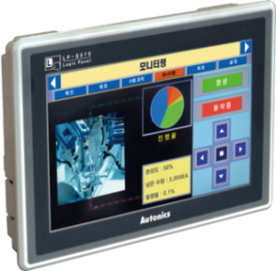
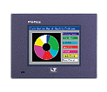
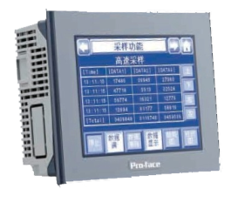
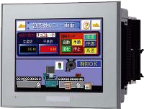


1. LP Series INTRODUCTION
1-5. Competitors comparison
Pro-face
Pro-face
Pro-face
LP S070
LP S044
LT 3201-A1-D24-K
LT3300-S1-D24-K
GLC150-SC41
-XY325k-24V
7 inch
4.4 inch
3.8 inch
5.7 inch
5.7 inch
TFT Color
STN Mono
STN Mono
STN Mono
STN Mono
16 MB
512 KB
6 MB
6 MB
1 MB
RS 232 / RS 422 /
USB / Ethernet
RS 232 / RS 422
USB
RS232 / RS 422 /
USB / Ethernet
RS232 /
RS 422/Exclusive communication
※model / display size / LCD type / drawing memory /communication

Slide 10
1. LP Series INTRODUCTION
1-6. Model Information
LP
S
070
T
9
D
6
C
5
T
T | Terminal block connector
R | Ribbon cable connector
5 | IN : 16 points, OUT : 16points
C | All-in one type
0 | RS232C, RS422 (1 each)
1 | RS232C (2ea)
6 | RS232C, RS-422, USB HOST, USB DEVICE, Ethernet
7 | RS232C (2ea), USB HOST, USB DEVICE, Ethernet
D | 24VDC
1 | MONO (Blue, White)
9 | 16,777,216 color (True Color)
S | STN LCD
T | TFT LCD
044 | 4.4″
070 | 7.0″
S | S Series
LP | Logic Panel

Slide 11
1. LP Series INTRODUCTION
1-7. Display/Control Performance
Display Performance
Model | LP-S070 SERIES | LP-S044 SERIES
LCD Type | TFT Color | STN Blue Negative
Resolution | 800 X 480 Dots | 240 X 80 Dots
Display area | 152.4mm X 94.44mm | 112.8mm X 37.6mm
Color | True Color(16,777,216 색) | MONO(Blue, White)
LCD view angle | Up/down/left/right within 50°/60°/65°/65° | Up/down/left/right within 30°
Backlight | WHITE LED
Brightness | Adjustable by software
Control Performance
Model | LP-S070 SERIES | LP-S044 SERIES
Instruction | Basic instruction: 28, Application instruction: 233 | Basic instruction: 28, Application instruction: 220
Program capacity | 8K Steps
Processing time | Average: 2 ㎲/basic instruction, application instruction | Average: 6~7 ㎲/basic instruction, application instruction
I/O control type | Batch processing
Operation control mode | Repeated-doubling method, interrupt processing, Device range
Special function | Positioning function | -

Slide 12
1. LP Series INTRODUCTION
1-8. I/O Performance
I/O Performance
LP-S044, LP-S070 SERIES common
Input Performance |  | Output Performance
Input Contact | 16 Contacts | Output Contact | 16 Contacts
Insulation | Photo coupler insulation | Power Supply | DC 24V
Input Voltage | DC 24V | Insulation | Photo coupler insulation
Input Current | X0~X5: Approx. 10mA X6~XF: Approx. 4mA | Operating load voltage | DC 24VDC
Operating voltage | DC 19.2~28.8V | Max. load current | 0.1A/1Contact, 1.6A/1COM
Input Resistance | X0~X5: 2.2㏀ X6~XF: 5.6㏀ | Max. voltage drop (ON) | Max. 0.2VDC
Response Time | 1ms | Response Time | 1ms
Common type | 16 Contacts / 1COM | Common type | 16 Contacts / 1COM
※ Only LP-S070 SERIES

Slide 13
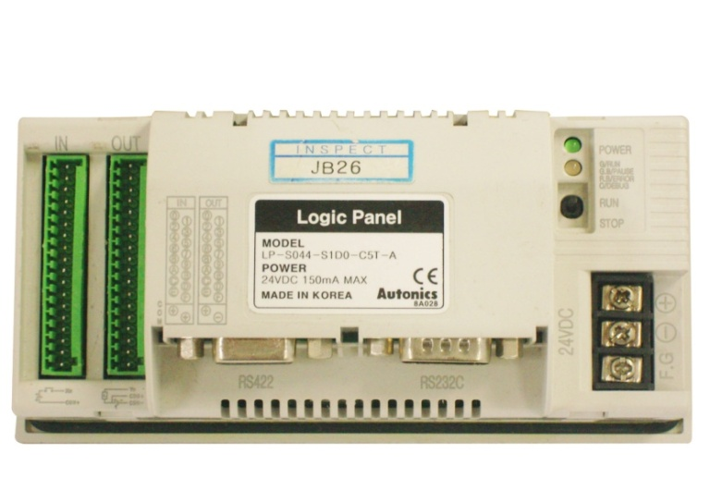
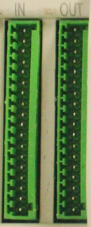
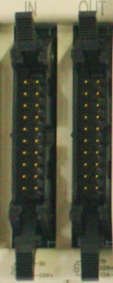
1. LP Series INTRODUCTION
1-9. Part description◈ LP-S044 SERIES
<Back side>
- Description
①
②
⑥
① | Input Terminal
② | Output Terminal
③ | Power Terminal block
④ | RS422/RS232 Port
⑤ | RS232 Port
⑥ | Run/Stop Switch, State LED
④
⑤
③
※External I/O connector
- LED Operation
Power LED | Green | Power ON
 | Off | Power OFF
State LED | Green | Run
 | Green Flickering | Pause
 | Orange | Debug
 | Red Flickering | Error
 | Off | STOP
Terminal Block
Ribbon Cable

Slide 14
1. LP Series INTRODUCTION
1-9. Part description ◈ LP-S070 SERIES
- description
① | Input Terminal
② | Output Terminal
③ | Power Terminal block
④ | RS422/RS232 Port
⑤ | RS232 Port
⑥ | Ethernet
⑦ | USB Host
⑧ | USB Device
⑨ | Run/Stop Switch
⑩ | LED
<Back side>
⑨
①
②
⑩
⑧
③
- LED Operation
Power LED | Green | Power ON
 | Off | Power OFF
State LED | Green | Run
 | Green Flickering | Pause
 | Orange | Debug
 | Red Flickering | Error
 | Off | STOP
④
⑤
⑥
⑦

Slide 15
2. Program Structure & Operation
2-1. Program Structure
The program consists of all functional features required to execute a specific control, and it is saved embodied RAM of
CPU module or flash memory. Generally these functional features are classified as below.
Functions | Program Processing Details
Scan Program | Process the signal which is repeated in every scan unit.
Time-driven Interrupt Program | Executes the program according to the set time interval when required to process time conditions as follows. • When faster processing time is required than average processing time of one scan • When longer time interval is required than average processing time of one scan • When the program is required to be processed with designated time interval
Subroutine Program | Execute the program only if certain conditions are met. EX) Execute the program on if CALL instruction is ON.

Slide 16
2. Program Structure & Operation
2-2. Program Operation
This program processes the operation according to the following procedures.
Subroutine
Program
Start
Operation
Time-driven
Interrupt Program
Scan
Program
Executes only when the certain
conditions are fulfilled.
END Processing

Slide 17
3. Device
3-1. Device List
 | Description | Bit range | Word range | GP Device(UB) | GP Device(UW)
X | Input Device | X0 ~ X255F | X0 ~ X255 | UB70000 ~ UB7255F | UW7000 ~ UW7255
Y | Output Device | Y0 ~ Y255F | Y0 ~ Y255 | UB80000 ~ UB8255F | UW8000 ~ UW8255
M | Auxiliary Device | M0 ~M999F | M0 ~M999 | UB200000 ~ UB29999F | UW20000 ~ UW29999
S | Step Device | S0.0 ~ S255.99
D | Data Device |  | D0 ~ D9999 |  | UW40000 ~ UW49999
T | Timer contact | T0 ~ T255F |  | UB100000 ~ UB10015F | UW10000 ~ UW10015
T | Timer present value |  | T0 ~ T255 | UB110000 ~ UB11255F | UW11000 ~ UW11255
T | Timer setting value |  |  | UB130000 ~ UB13255F | UW13000 ~ UW13255
C | Counter contact | C0 ~ C255F |  | UB150000 ~ UB15015F | UW15000 ~ UW15015
C | Counter present value |  | C0 ~ C255 | UB160000 ~ UB16255F | UW16000 ~ UW16255
C | Counter setting value |  |  | UB180000 ~ UB18255F | UW18000 ~ UW18255
Z | Index Device | Z0 ~ Z255F | Z0 ~ Z255 | UB067000 ~ UB06955F | UW06700 ~ UW06955
F | Special Device | F0 ~ F255F | F0 ~ F255 | UB64000 ~ UB6655F | UW6400 ~ UW6655
V | Virtual Device | V0 ~ V255F | V0 ~ V255 | UB061000 ~ UB06355F | UW06100 ~ UW06355
L | Link Device | L0 ~ L999F | L0 ~ L999 |  | UW38000 ~UW38999
R | File Device | R0 ~ R3999F | R0 ~ R3999 | UB020000 ~ UB05999F | UW02000 ~ UW05999
UW/UB | READ AREA |  |  | UB000000 ~ UB00014F | UW00000 ~ UW00014
UW/UB | WRITE AREA |  |  | UB000015 ~ UB00029F | UW00015 ~ UW00029
UW/UB | USER AREA |  |  | UB000030 ~ UB01999F | UW00030 ~ UB01999

Slide 18
3. Device
3-2. X-Device
A device that transfers the signal inputted from an external switch or a button to CPU.
- A(Normally Open) or B(Normally Closed)Contacts selectable in the program.
- Pulse inputs for the contact.
< Ladder Program >
< Switches-Lamps Connection >
* X input device, which is not connected with input terminal, is able to be used as the same function
as an inner auxiliary device(M Device).

Slide 19
3. Device
3-3. Y-Device
A device that transfers the inner processing result to externally connected output devices
< Ladder Program >
< Switches-Lamps Connection >
※ Y device, which is not connected with output terminal, is able to be used as the same function
as an inner auxiliary device(M Device).
※ In case the output device is allocated to an actual external contact and the same output contact
is used more than twice to the operand of out instruction in a program, the last used output is output to outside.

Slide 20
3. Device
3-4. S-Device
It is a step device.
It is a device to control step and used with OUT, SET and RESET instructions.
When it is used with SET or RESET instruction, the previous step must be performed first to execute the current step.
When it is used with OUT instruction, it executes the last step turned ‘ON’ regardless of the order of step.
It is unavailable to be used as a word device, only can be used as a bit device.
It is available to be used as a memory protection device by setting ‘Device Latch Range Settings’.
The clear condition, SET XXX.00 , is able to execute anytime regardless of the processing steps.
3-5. M-Device
It is an inner auxiliary device of LP.
It is only able to perform in the program, not able to directly output to outside of LP.
It is available to be used as a memory protection device by setting ‘Device Latch Range Settings’.

Slide 21
3. Device
3-6. D-Device
It is a data device of LP.
It is only able to be used as a word bit, not able to be used as a bit device.
When it is used as the 32 bit instruction, D word is operated as lower 16 bit and D+1 word is operated as upper 16 bit
as following picture.
It is available to be used as a memory protection device by setting ‘Device Latch Range Settings’.
32 Bit
Upper 16bit
Lower 16bit
(Dn + 1 Word)
(Dn Word)
3-7. R-Device
It is a device used when using the recipe function of graphic panel in LP series.
It is available to be used as a memory protection device by setting ‘Device Latch Range Settings’.

Slide 22
3. Device
3-8 C-Device
It is a device used with the instructions related to Counter.
It consists of three parts; counter contact, counter setting value, and counter present value.
Counter contact performs ON/OFF functions according to the result of counter instructions, and also available to be used
as counter and input instructions.
Counter setting value is a place where a boundary value for the result of count is stored, and is available to be used with counter and
application instructions.
Counter present value is a place where a present value is stored while counter is operating, and user can not set it up directly.
When as following picture,
if inputting 100 to “C0” setting value device, “C0” contact device turns ON when “C0” present value device becomes 100.
Counter instructions, related to LP Series are CTD, CTU, CTUD and CTR, and even the same counter device is operated
differently depending on each instruction.
CTU C0 100
CTU 2nd offer land setting value
OP2 → 100
Counter current value device
C0 = UW 16000
X0
C0
Counter contact device

Slide 23
3. Device
3-9. T-Device
It is a device used with instructions related to Timer.
It consists of three parts; timer contact, timer setting value, timer present value.
Timer contact performs ON/OFF functions according to the result of timer instruction and also available to be used
as timer and input instructions.
Timer setting value is a place where a boundary value for the result of timer is saved, and is available to be used
with timer and application instructions.
Timer present value is a place where a present value is stored while timer is operating, and user can not set it up directly.
When as following picture,
TON T0 100
TON 2nd offer land setting value
OP2 → 100
Timer current value device
T0 → UW 11000
X0
T0
Timer contact device
if inputting 100 to “T0” setting value device, “T0” timer contact device turns ON when “T0” present value
device becomes 100.
Timer instructions, related to LP Series are TON, TOFF, TMON, TRTG and TMR, and even the same timer device is operated
differently depending on each instruction.
The basic cycle of timer device is 10ms, but it is available to be operated in 10ms or 100ms by setting up the device
range in parameters.
It is available to be used as a memory protection device by setting ‘Device Latch Range Settings’
For further details of timer device, refer to [Application instruction][Timer instruction] in instruction manual.

Slide 24
3. Device
3-10. Z-Device
It is a device that is able to designate indirectly a device with using other word device.
When as following picture,
MOV 100 Z0
MOV D0 D0Z0
if “D0” device value is 10, the value 10 stored in “D0” is transferred to D(0+Z0) device, namely D100 device.
In other words, MOV D0 D0Z0 is interpreted as below.
MOV D0 D(Value of 0 + Z0)
MOV D0 D(0+100)
MOV D0 D100
For another example, if MOV D0 D40Z0 it could be interpreted as below.
MOV D0 D(Value of 40 + Z0)
MOV D0 D(40+100)
MOV D0 D140
→ It is possible to designate a device address indirectly according to the change of Z device.

Slide 25
3. Device
3-11. F-Device
It is a device that sets up the status and operation of LP.
It designates a device that is able to be used separately in input and output instructions, and not able to be used as a memory protection area.
Name | Device | Name | Device | Name | Device | Name | Device
Run mode | F00000 | Back-up battery errors (Retaining) | F0002D | 100ms clock | F00057 | PLC series and model code | F100
Stop mode | F00001 | Error occurrence | F00030 | 200ms clock | F00025 | System version | F101
Pause mode | F00002 | Errors related to PLC program | F00034 | 500ms clock | F00026 | Released date of the version (Year) | F106
Debug mode | F00003 | Time-driven operation error | F00035 | 1s clock | F0005A | Released date of the version (Month, date) | F107
Normally ON | F00010 | Time setting error flag | F00036 | 2s clock | F0005B | Present scan time | F110
Normally OFF | F00011 | Communication errors | F00038 | 5s clock | F0005C | Min. scan time | F111
1 scan ON | F00012 | I/O setting value errors | F00039 | 10s clock | F0005D | Max. scan time | F112
1 scan OFF | F00013 | 0.5ms clock(in reserve) | F00050 | 60s clock | F0005E | Scan time count | F114
Scan pulse | F00014 | 1ms clock(in reserve) | F00051 | Zero flag | F00060 | Step operation generated error (At present) | F120
Time synchronous pulse | F00015 | 2ms clock(in reserve) | F00052 | Carry flag | F00061 | Step operation generated error (Retaining) | F121
While operating forced input | F00020 | 5ms clock(in reserve) | F00053 | Borrow flag | F00062 | Error step | F130
While operating forced output | F00021 | 10ms clock | F00054 | Operation error flag (At present) | F00068 | Break step | F131
While running time-driven | F00024 | 20ms clock | F00055 | Operation error flag(Retaining) | F00069 | Self-diagnosis error code | F140
※ The table is labeled some F device.

Slide 26
3. Device
3-12. L-Device
It is a link device.
It is a device sharing link data each other when communicating with other module.
It is available to be used as a memory protection device by setting ‘Device Latch Range Settings’

Slide 27
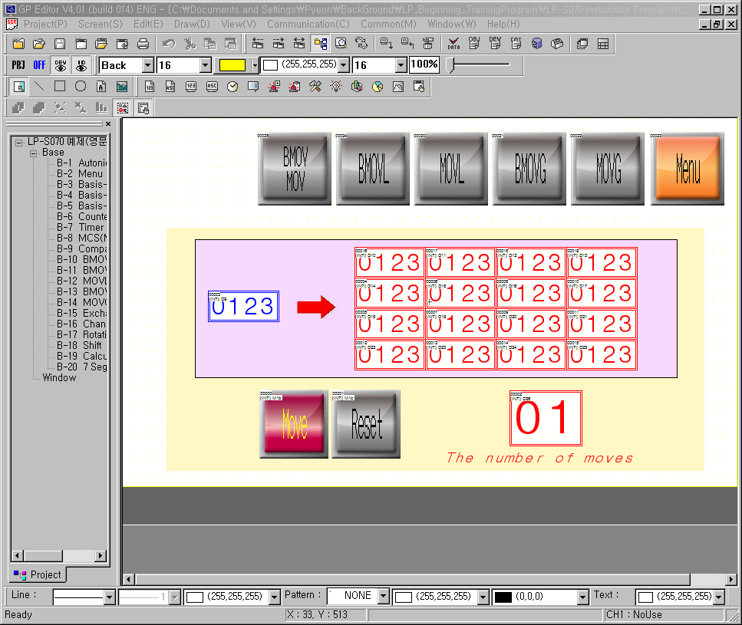

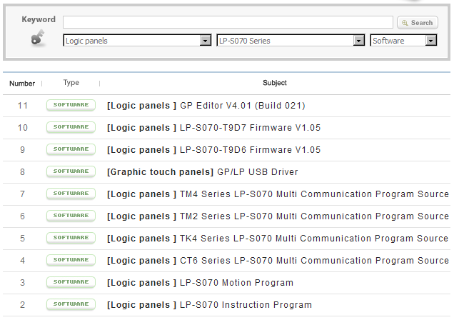
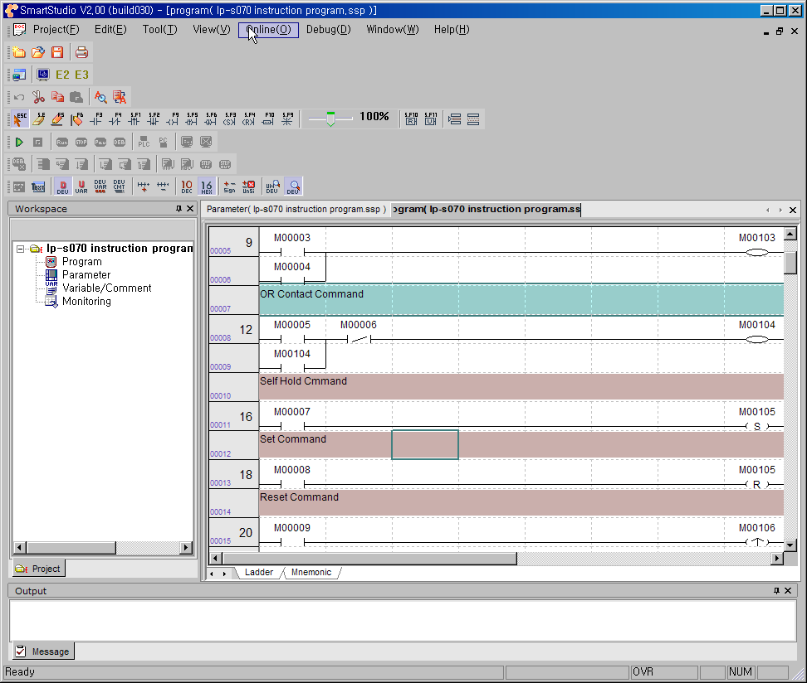
4. Program
4-1. Program download
Autonics Home page reference room(http://www.autonics.com)
Logic panel → LP-S070 → Software
Able to download program No.1 and No.11 at the lists
GP-EDITOR
SMART-STUDIO

Slide 28


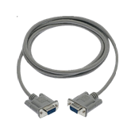
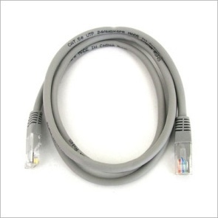
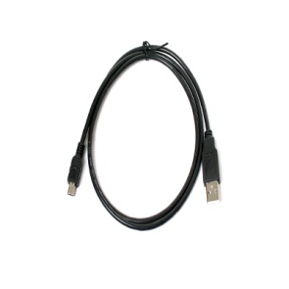

4. Program
4-2. System requirements
1. Operating system
Minimum specifications : Windows98/NT/XP
Recommended specification : Windows98/NT/XP
※ Vista, Windows7 compatibility
2. Memory
Minimum specifications : 256 MB
Recommended specification : 512 MB
3. Hard disk
Minimum specifications : 1 GB
Recommended specification : 2 GB
4. Resolution
Minimum specifications : 1024 * 768
Recommended specification : 1024 * 768
5. Other
Communication port :
RS-232C Serial port, USB Device, Ethernet
RS232C
Ethernet
USB HOST
USB
※Able to download program up/down load by various interface

Slide 29
5. Smart-Studio
5-1. Smart-Studio?
SmartStudio is the exclusive software to write program and debug for LP series.
1. Supports multi project
→ You can open up to 5 projects at the same time and write or edit programs.
2. Convenient program edit
→ Enables to edit by cell unit
→ Enables to edit with multi window
→ Supports several view functions such as viewing device name, variable name, or device name & comment, etc to edit
program easily.
→ You can edit ladder program and mnemonic program at the same time.
3. Several monitor function
→ Supports several monitor function such as monitoring variable, device, system, or time chart, etc.
4. Convenient user interface
→ Easy adaptation for SmartStudio by same basic function of Microsoft window.
5. Various message window
→ Supports various message window for edit or check program easily.
6. Real time switching ladder and mnemonic program
→ Switching ladder or mnemonic program in real time and it is available to write or edit at two editors simultaneously.

Slide 30
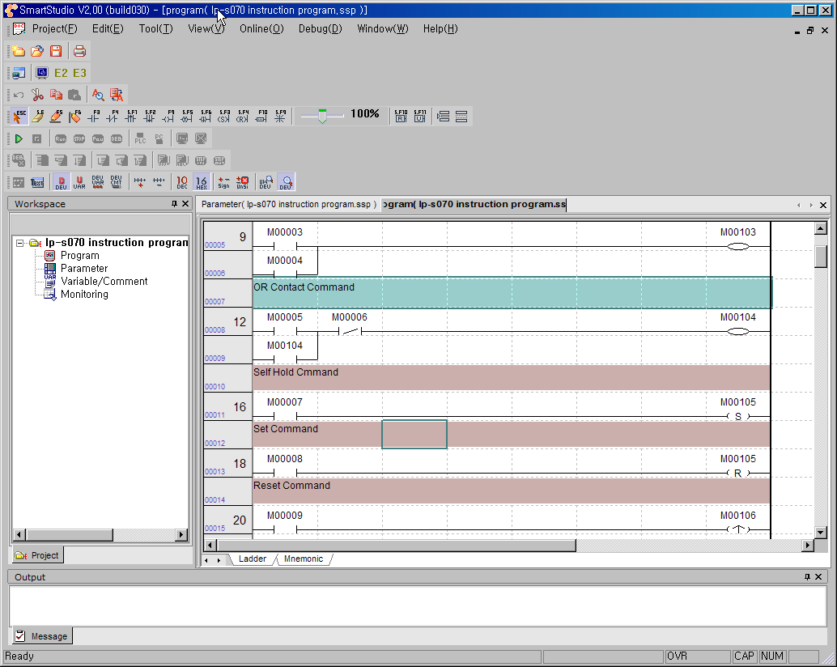
5. Smart-Studio
5-2. Screen layout

Slide 31
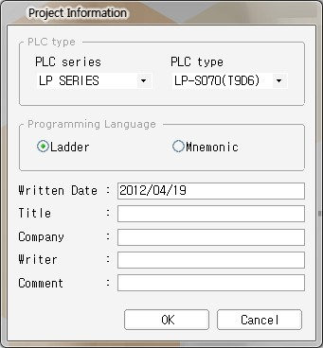
5. Smart-Studio
5-3. Project new/save/open
■ Creates a new project.
Creates a new project.
Select [Project]-[New Project] of menu, and ‘Project Information’ dialog box appears.
① Select the series of the device by pull-down menu.
② Select the type of the series by pull-down menu.
③ Select a programming language for the new project.
④ Create a new project
⑤ Cancel creating a new project.
①
②
③
④
⑤

Slide 32
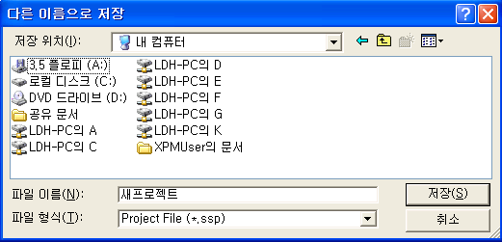

5. Smart-Studio
5-3. Project new/save/open
■ Save project
Saves the edited project.
Select [Project]-[Save Project] of menu. If the project is already saved, it is saved in the present
project file which has same file name. If the project is saved for the first time, ‘Save As’ dialog box appears.
Specify the path, enter the file name, and click ‘Save’ to save the current project.
New Project
If the project is a newly created one, or there are changes to the project since it saved last time, the project name in the workspace displays with * at the end as shown inside a red circle in the image below.

Slide 33
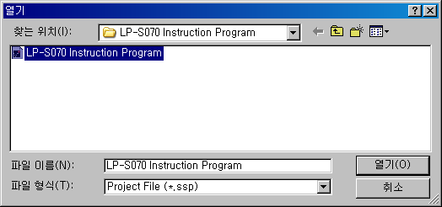
5. Smart-Studio
5-3. Project new/save/open
■ Open project
Opens a saved project.
Select [Project]-[Open Project] of menu and ‘Open’ dialog box appears.
Select SmartStudio’s the project (extension: *.ssp) file and click ‘Open’. The project file opens in SmartStudio.

Slide 34
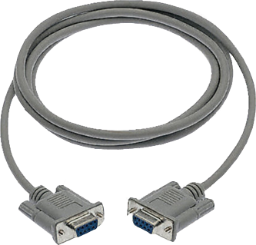
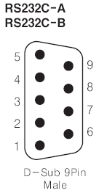


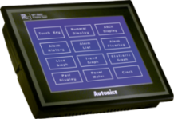
6. Program Up/Download
6-1. RS232 Interface
■ Cable information
Port | Pin No. | GP/LP-S044, GP-S057, GP/LP-S070
 | 1 | X
 | 2 | RXD
 | 3 | TXD
 | 4 | DTR
 | 5 | SG
 | 6 | DSR
 | 7 | X
 | 8 | X
 | 9 | X
RS232C Communication cable
PC
LP
2
3
4
5
6
2
3
4
5
6

Slide 35
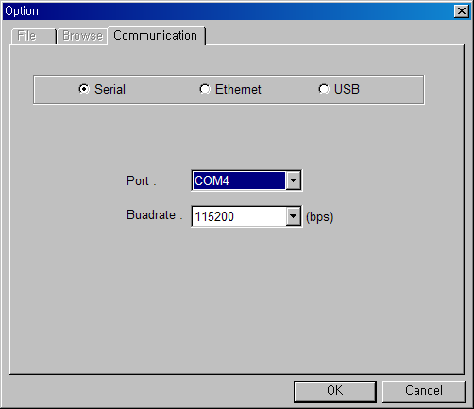
6. Program Up/Download
6-1. RS232 Interface
■ Smart-Studio Communication setting

Slide 36


6. Program Up/Download
6-1. RS232 Interface
■ LP Setting
LP-S070
before
SYSTEM SETTING
close
Monitoring
Environment
Data
Functionality
Diagnostics
USER SCREEN IS NOT FOUND
Touch left-upper point as default
To access system setting menu

Slide 37
6. Program Up/Download
6-1. RS232 Interface
■ LP Setting
LP-S070
close
before
SYSTEM SETTING
close
before
SYSTEM SETTING\ ENVIRONMENT
Monitoring
Environment
Data
Functionality
Diagnostics
Serial Communication
Language
Local Ethernet
Screen Bright
Assistance Setting
Clock
Touch Environment Setting

Slide 38
6. Program Up/Download
6-1. RS232 Interface
■ LP Setting
LP-S070
close
before
SYSTEM SETTING\ ENVIRONMENT
\ SERIAL\SET
close
before
SYSTEM SETTING\ ENVIRONMENT
Serial Communication
Language
PROTOCOL
PORT
CH1
TM2_Mod_A V2.0M
RS-422
set
Local Ethernet
Screen Bright
CH2
EDITOR
RS-232C
set
Assistance Setting
Clock
GP ST.# : 0
TOUCH ENVIRONMENT SETTING
TOUCH SERIAL SETTING

Slide 39
6. Program Up/Download
6-1. RS232 Interface
■ LP Setting
LP-S070
SYSTEM SETTING\ ENVIRONMENT
\ SERIAL\SET
close
before
close
SYSTEM SETTING\ ENVIRONMENT
\ SERIAL
before
CH2
PROTOCOL
PORT
BAUD RATE
115200
CH1
TM2_Mod_A V2.0M
RS-422
설정
DATA LENGTH
8
CH2
PARITY
EVEN
설정
EDITOR
RS-232C
STOP
1
FLOW CONTROL
XON/XOFF
GP ST.# : 0
CH1 or CH2 : set the EDITOR – RS232C
Touch set
Touch Serial set

Slide 40
6. Program Up/Download
6-1. RS232 Interface
■ LP Setting
LP-S070
before
SYSTEM SETTING\ ENVIRONMENT
\ SERIAL\SET
close
CH2
BAUD RATE
115200
DATA LENGTH
8
PARITY
EVEN
STOP
1
FLOW CONTROL
XON/XOFF
BAUD RATE : 115200bps(SAME AS GP-EDITOR)
DATA LENGTH : 8BIT
PARTY : EVEN
STOP : 1BIT
Touch set

Slide 41
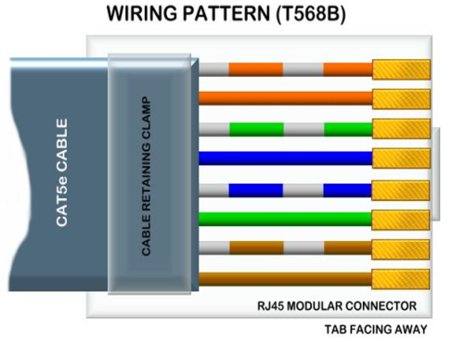
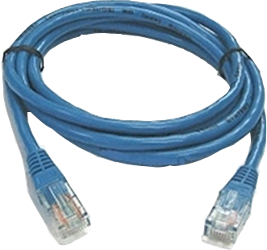
6. Program Up/Download
6-2. ETHERNET Interface
■ Cable information
 | 1 | WHITE-RED | TXD+
 | 2 | RED | TXD-
 | 3 | WHITE-GREEN | RXD+
 | 4 | BLUE | SG
 | 5 | WHITE-BLUE | SG
 | 6 | GREEN | RXD-
 | 7 | WHITE-BROWN | SG
 | 8 | BROWN | SG
Ethernet Communication cable
PC
GP
HUB: DIRECT cable compatible
PC : CROSS cable compatible

Slide 42
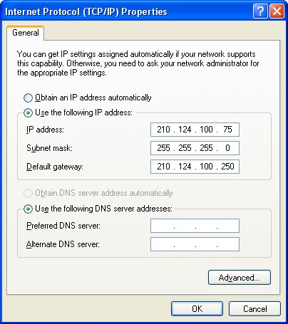
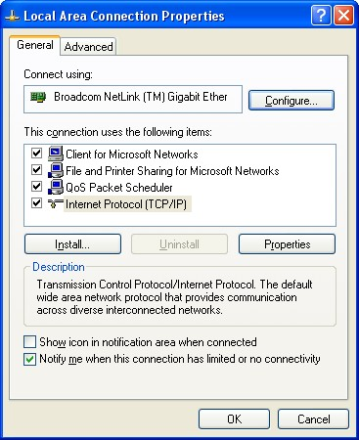


6. Program Up/Download
6-2. ETHERNET Interface
■ PC TCP/IP setting
In order to use Ethernet interface, check the IP address
Control panel → network adapters → local area protocol properties(general) →
Internet Protocol Properties(TCP/IP) → general click, than check IP address

Slide 43
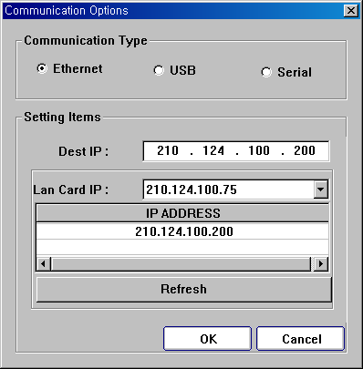


6. Program Up/Download
6-2. ETHERNET Interface
■ Smart-Studio Communication setting
Smart-Studio: [menu] → [Online] → [Communication option]
Select Ethernet, then set Target IP (Same as PC IP)
[Menu] → [Online] → [Connection] → [Download] Click

Slide 44
6. Program Up/Download
6-1 ETHERNET Interface
■ LP Setting
LP-S070
before
SYSTEM SETTING
close
Monitoring
Environment
Data
Functionality
Diagnostics
USER SCREEN IS NOT FOUND
Touch left-upper point as default
To access system setting menu

Slide 45
6. Program Up/Download
6-1. Ethernet Interface
■ LP Setting
LP-S070
close
before
SYSTEM SETTING
close
before
SYSTEM SETTING\ ENVIRONMENT
Monitoring
Environment
Data
Functionality
Diagnostics
Serial Communication
Language
Local Ethernet
Screen Bright
Assistance Setting
Clock
Touch Environment Setting

Slide 46
6. Program Up/Download
6-2. ETHERNET Interface
■ LP Setting
LP-S070
close
before
SYSTEM SETTING\ ENVIRONMENT
\ Local Ethernet
close
before
SYSTEM SETTING\ ENVIRONMENT
Serial Communication
Language
IP Address
210.124.100. 200
Local Ethernet
Screen Bright
Subnet Mask
255.255.255. 0
Gateway
210.124.100.250
Mac Address
XX – XX - XX – XX - XX – XX
Assistance Setting
Clock
Touch local ethernet
Touch environment

Slide 47
6. Program Up/Download
6-2. ETHERNET Interface
■ LP Setting
LP-S070
before
SYSTEM SETTING\ ENVIRONMENT
\ Local Ethernet
close
IP Address
210.124.100. 200
Subnet Mask
255.255.255. 0
Gateway
210.124.100.250
Mac Address
XX – XX - XX – XX - XX – XX
IP Address : Do not set equal to end of the Number of PC IP
Subnet Mask : Same as PC
Gateway : Same as PC
로컬이더넷설정 터치

Slide 48
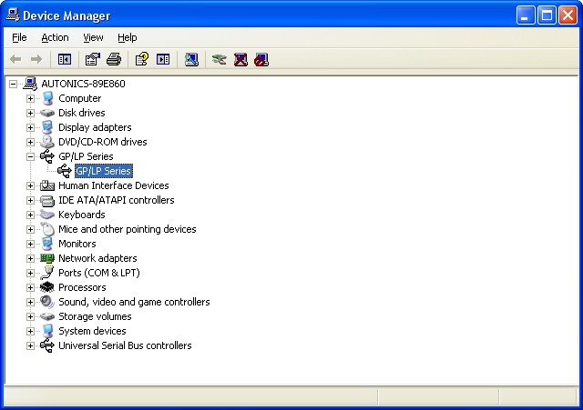
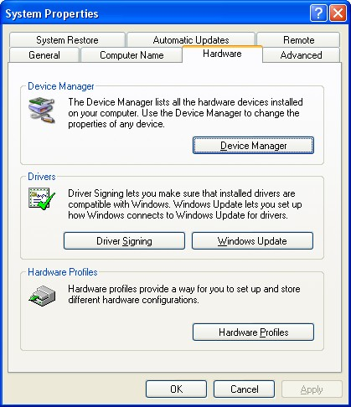

6. Program Up/Download
6-3. USB Interface
■ Check PC driver
[Control panel] → [System Properties] → [Hardware Profiles] →
[Device Manager]→ Check GP/LP Series
Visit out website (www.autonics.com) and download “USB driver”

Slide 49
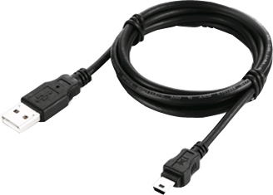
6. Program Up/Download
6-3. USB Interface
■ Cable information
USB Communication cable
PC
GP
Compatible with universal mini USB cable

Slide 50

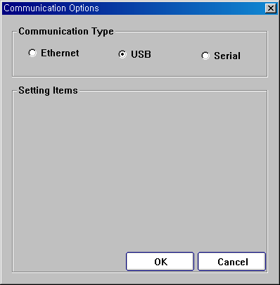
6. Program Up/Download
6-3. USB Interface
■ Smart-Studio Communication setting
Smart-Studio [Menu] →[Online] → [Communication option]
Select USB
[Menu] → [Online] → [Connection] → [Download] Click

Slide 51
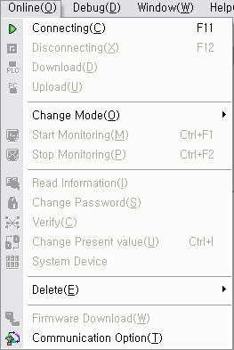
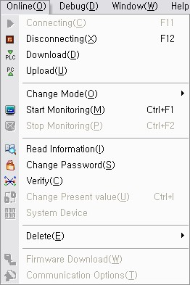
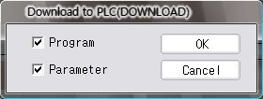
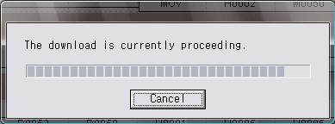
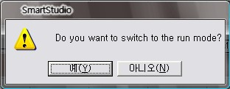


6. Program Up/Download
6-4. Smart-Studio Download

Slide 52



6. Program Up/Download
6-5. Smart-Studio Up load

Slide 53
7. LP Instruction
7-1. Download example of LP Instruction
Autonics Home page reference room(http://www.autonics.com)
Logic panel → LP-S070 → Software
Able to download program No2 at the list.
Example of commend
Drawing program
Example of commend
Ladder program

Slide 54


7. LP Instruction
7-2. Basic I/O Contact and Alternate Instruction
Format : LOAD S
OP | DATA TYPE | ① Available device ② Contents of processing ③ Range
S | BIT | ① X, Y, M, S, F, T, C, UB
 |  | ②Bit device contact
X0
Y0
Operation
Format : LOADN S
OP | DATA TYPE | ① Available device ② Contents of processing ③ Range
S | BIT | ① X, Y, M, S, F, T, C, UB
 |  | ② Bit device contact
X0
Operation
Y0

Slide 55


7. LP Instruction
7-2. Basic I/O Contact and Alternate Instruction
<Ladder Programming >
< Graphic Drawing>
Alternate

Slide 56

7. LP Instruction
7-3. AND Contact Instruction
Format : AND S
OP | DATA TYPE | ① Available device ② Contents of processing ③ Range
S | BIT | ① X, Y, M, F, C, UB
 |  | ②Bit device contact
Operation
X0
X1
Y0

Slide 57
7. LP Instruction
7-3. AND Contact Instruction
< Ladder Programming >
< Graphic Drawing >

Slide 58

7. LP Instruction
7-4. OR Contact Instruction
Format : OR S
OP | DATA TYPE | ① Available device ② Contents of processing ③ Range
S | BIT | ① X, Y, M, F, C, UB
 |  | ②Bit device contact
operation
X0
X1
Y0

Slide 59

7. LP Instruction
7-4. OR Contact Instruction
< Ladder Programming >
< Graphic Drawing >

Slide 60

7. LP Instruction
7-5. Self-locking circuit
Once X0 is switched on, Y0 will be turned on and it will keep itself as the on state until X1 is switched on.
Operation
X0
X1
Y0

Slide 61


7. LP Instruction
7-5. Self-locking circuit
<Ladder Programming >
<Graphic Drawing >

Slide 62

7. LP Instruction
7-6. Set & Reset Instruction
Format : SET D
OP | DATA TYPE | ① Available device ② Contents of processing ③ Range
S | BIT | ① X, Y, M, UB
 |  | ②Set a device
Format : RST D
OP | DATA TYPE | ① Available device ② Contents of processing ③ Range
S | BIT | ① X, Y, M, UB
 |  | ②Reset a device
Operation
X0
X1
Y0

Slide 63

7. LP Instruction
7-6. SET & RESET
<Ladder Programming >
<Graphic Drawing >

Slide 64



7. LP Instruction
7-7. Circuit Alternate Instruction
Program the ladder with considering the features of self-locking circuit and contacts
Operation
M9
M106
M107

Slide 65
7. LP Instruction
7-8. Step controller Instruction
Step device
yyy : Group No. (0~255)
xx : Step No. (0~99)
The Syyy.xx contact will turn on when the previous step of same group and the input is on.
Once Syyy.xx is switched on, it keeps on state
until the next step turns on or the step controller group is initialized(The Syyy.00 is switched on)
Even if multiple input condition turn on, only one step controller is switched on.
The Syyy.00 is initialization step and the Syyy.xx group will be initialized by switching on Syyy.00.
When the CPU is turned to Run mode , the Syyy.00 is set by default.
Format : SET Syyy.xx D
OP | DATA TYPE | ① Available device ② Contents of processing ③ Range
D | BIT | ① S
 |  | ② yyy is group No.(0~255) xx is Step No.(0~99)
X0
X1
X2
S0.0
S0.1
S0.2

Slide 66

7. LP Instruction
7-8. Step controller Instruction
<Ladder Programming >
Operation
X0
X1
X2
S0.0
S0.1
S0.2

Slide 67


7. LP Instruction
7-8. Step controller Instruction
<Ladder Programming >
<Graphic Drawing >

Slide 68

7. LP Instruction
7-8. Step controller Instruction
Format : CTUD S N
1. If the count-up pulse is applied to the input rung
when the reset signal is OFF, the the word value of
S device is increased one by one. Likewise, if the
count-down pulse is applied to the input rung, the
word value of S device is decreased one by one.
2. If the word value of S device is greater than the
setting value “N”, the corresponding counter contact
turns ON, and if the word value of S device is less
than the setting value “N”, the corresponding
counter contact turns OFF.
3. If the reset signal is ON, the word value of S
device becomes 0.
OP | DATA TYPE | ① Available device ② Contents of processing ③ Range
S | WORD | ① C, UW
 |  | ② Counter contact you want to use
 |  | ③ 0(h0000)~65535(hFFFF)
N | WORD | ① X, Y, M , S, T, C, D, Z, F, UW, integer
 |  | ② Setting value of counter
 |  | ③ 0(h0000)~65535(hFFFF)
1
2
3
4
5
6
7
8
9
0
Operation
Reset(X2)
Pulse(X0)
Pulse(X1)
Setting value
Current value
Output(C0)

Slide 69


7. LP Instruction
7-9. Counter Instruction
<Ladder Programming >
<Graphic Drawing >

Slide 70

7. LP Instruction
7-10. Counter Instruction
■ Timer Instruction (ON DELAY TIMER)
Format : TON S N
OP | DATA TYPE | ① Available device ② Contents of processing ③ Range
S | WORD | ① T
 |  | ② Timer contact number
 |  | ③ 0(h0000)~65535(hFFFF)
N | WORD | ① Constant, Z, X, Y, M, D, S, F, T, C, UW
 |  | ② Timer setting value
 |  | ③ 0(h0000)~65535(hFFFF)
1.The device value will start to increase when the
input condition turns on, It will increase by 1 at
every 0.1 or 0.01 sec until the setting value or
input condition turns off.
2. The timer contact and current value is cleared
when the input condition turns off or RST
instruction is executed.
10
0
1
2
3
4
5
6
7
8
9
1
2
3
4
5
6
7
8
Operation
9
Input Condition(X0)
Setting Value
Device Value
Output(T0)

Slide 71

7. LP Instruction
7-10. Counter Instruction
■ Timer Instruction (OFF DELAY TIMER)
Format : TOFF S N
1. When the input condition turns on, the device
value will be set as the setting value and the
timer contact will turn on.
2. When the input condition turns off, the device
value will decrease by 1 at every 0.1 or 0.01 sec
until it reaches to 0 or input condition turns off.
3. When the input condition turns off or RST
instruction is executed, the timer contact will
turn off and the current value will be cleared as 0.
OP | DATA TYPE | ① Available device ② Contents of processing ③ Range
S | WORD | ① T
 |  | ② Timer contact number
 |  | ③ 0(h0000)~65535(hFFFF)
N | WORD | ① Constant, Z, X, Y, M, D, S, F, T, C, UW
 |  | ② Timer setting value
 |  | ③ 0(h0000)~65535(hFFFF)
Operation
10
10
0
1
2
3
4
5
6
7
8
9
0
1
2
3
4
5
6
7
8
9
Input Condition (X0)
Setting Value
Device Value
Output (T0)

Slide 72


7. LP Instruction
7-10. Counter Instruction
<Ladder Programming >
<Graphic Drawing >

Slide 73

7. LP Instruction
7-11. Comparison Instruction
Format : LOAD = S1 S2
OP | DATA TYPE | ① Available device ② Contents of processing ③ Range
S1 | INT | ① integer, *, Z, X, Y, M, D, L, S, F, T, C, UW
 |  | ② Data or address to be compared with S2
 |  | ③ -32768(h8000)~32767(h7FFF)
S2 | INT | ① Constant, *, Z, X, Y, M, D, L, S, F, T, C, UW
 |  | ② Data or address to be compared with S1
 |  | ③ -32768(h8000)~32767(h7FFF)
If S1 and S2 are same, The switch is turned on.
2. If S1 and S2 are not same, The switch is turned off.
3. The comparison is executed as signed operation.
(h8000(-32768)~hFFFF(-1)<0 ~ h7FFF(32767))
Example)
Comparison result
LOAD= H0001 h3456
OFF
Comparison result
LOAD= H0001 h0001
ON.

Slide 74

7. LP Instruction
7-11. Comparison Instruction
Format : LOAD> S1 S2
OP | DATA TYPE | ① Available device ② Contents of processing ③ Range
S1 | INT | ① Constant, *, Z, X, Y, M, D, L, S, F, T, C, UW
 |  | ② Data or address to be compared with S2
 |  | ③ -32768(h8000)~32767(h7FFF)
S2 | INT | ① Constant, *, Z, X, Y, M, D, L, S, F, T, C, UW
 |  | ② Data or address to be compared with S1
 |  | ③ -32768(h8000)~32767(h7FFF)
If S1 is greater than S2, The switch is turned on.
2. If S1 is less than S2, The switch is turned off.
3. The comparison is executed as signed operation.
(h8000(-32768)~hFFFF(-1)<0 ~ h7FFF(32767))
Example)
Comparison result
LOAD> H0001 h3456
OFF
Comparison result
LOAD> H0003 h0001
ON.

Slide 75

7. LP Instruction
7-11. Comparison Instruction
Format : LOAD< S1 S2
OP | DATA TYPE | ① Available device ② Contents of processing ③ Range
S1 | INT | ① Constant, *, Z, X, Y, M, D, L, S, F, T, C, UW
 |  | ② Data or address to be compared with S2
 |  | ③ -32768(h8000)~32767(h7FFF)
S2 | INT | ① Integer, *, Z, X, Y, M, D, L, S, F, T, C, UW
 |  | ② Data or address to be compared with S1
 |  | ③ -32768(h8000)~32767(h7FFF)
If S1 is less than S2, the switch is turned off.
2. If S2 is greater than S2, the switch is turned on.
3. The comparison is executed as signed operation.
(h8000(-32768)~hFFFF(-1)<0 ~ h7FFF(32767))
Example)
LOAD< H0001 h3456
Comparison result
ON.
Comparison result
LOAD< H0001 h0007
OFF

Slide 76


7. LP Instruction
7-11. Comparison Instruction
<Ladder Programming >
<Graphic Drawing >

Slide 77

7. LP Instruction
7-12. Bit Data Transfer Instruction
Format : BMOV S D
OP | DATA TYPE | ① Available device ② Contents of processing ③ Range
S | BIT | ① Constant, X, Y, M, F, T, C, UB
 |  | ② The source device at which the data to be transferred is stored.
D | BIT | ① Y, M, F, UB
 |  | ② The device of transfer destination
1. Transfer the data of device specified
at [S] to the device specified at [D].
Example)
S bit
Dbit

Slide 78


7. LP Instruction
7-12. Bit Data Transfer Instruction
<Ladder Programming >
<Graphic Drawing >

Slide 79

7. LP Instruction
7-12. Word Data Transfer Instruction
Format : MOV S D
OP | DATA TYPE | ① Available device ② Contents of processing ③ Range
S | BIT | ① Constant, *, Z, Y, M, D, L, F, T, C, UW
 |  | ② The source device at which the word data to be transferred is stored.
 |  | ③ 0(h0000)~65535(hFFFF)
D | BIT | ① *, Z, Y, M, D, L, F, T, C, UW
 |  | ② The device of transfer destination
 |  | ③ 0(h0000)~65535(hFFFF)
Transfer the word data of device
specified at [S] to the device
specified at [D].
Example)
S word
D word

Slide 80

7. LP Instruction
7-12. Word Data Transfer Instruction
<Ladder Programming >
<Graphic Drawing >

Slide 81

7. LP Instruction
7-12. Multiple Bit Data Transfer Instruction (1:N)
Format : BMOVL S D N
OP | DATA TYPE | ① Available device ② Contents of processing ③ Range
S | BIT | ① X, Y, M, F, T, C, UB
 |  | ② The start address of source data area
D | BIT | ① Y, M, F, UB
 |  | ② The start address of destination area will store transferred data
N | WORD | ① constant, *, Z, X, Y, M, D, L, F, T, C, UW
 |  | ② The number of transferred data
 |  | ③ 0(h0000)~65535(hFFFF)
1. Transfer the bit data of device specified
at [S] to the bit device specified at [D]
as many as designated as “N”.
Example)
(S)
(D)
(D)+1
(D)+2
●
●
(D)+((N)-1)
●
●
●
●

Slide 82


7. LP Instruction
7-12. Multiple Bit Data Transfer Instruction (1:N)
<Ladder Programming >
<Graphic Drawing >

Slide 83

7. LP Instruction
7-12. Multiple Word Data Transfer Instruction (1:N)
Format : BMOVL S D N
OP | DATA TYPE | ① Available device ② Contents of processing ③ Range
S | BIT | ① Constant, *, Z, X, Y, M, D, L, F, T, C, UW
 |  | ② The start address of source data area
 |  | ③ 0(h0000)~65535(hFFFF)
D | BIT | ① Constant, *, Z, X, Y, M, D, L, F, T, C, UW
 |  | ② The start address of destination area will store transferred data
 |  | ③ 0(h0000)~65535(hFFFF)
N | WORD | ① Constant, *, Z, X, Y, M, D, L, F, T, C, UW
 |  | ② The number of transferred data
 |  | ③ Until the rest of destination device
1. Transfer the word data of device specified
at [S] to the word device specified at [D]
as many as designated as “N”.
Example)
(S)
(D)
(D)+1
(D)+2
●
●
(D)+((N)-1)
●
●
●
●

Slide 84


7. LP Instruction
7-12. Multiple Word Data Transfer Instruction (1:N)
<Ladder Programming >
<Graphic Drawing >

Slide 85

7. LP Instruction
7-12. Multiple Bit Data Transfer Instruction (N:N)
Format : BMOVG S D N
OP | DATA TYPE | ① Available device ② Contents of processing ③ Range
S | BIT | ① X, Y, M, F, C, UB
 |  | ② The start address of source data area
D | BIT | ① Y, M, F, UB
 |  | ② The start address of destination area will store transferred data
N | WORD | ① Integer, *, Z, X, Y, M, D, L, F, T, C, UW
 |  | ② Information for start bit and number of transferred bits
 |  | ③Until the rest of source device and destination device.
1. Transfer the group of bit data device specified
at [S] to the group of bit device specified at [D].
“N” = the number of bits as a group
Example)
(S)
(S)+1
(S)+2
●
●
(S)+((N)-1)
(D)
(D)+1
(D)+2
●
●
(D)+((N)-1)
●
●
●
●

Slide 86


7. LP Instruction
7-12. Multiple Bit Data Transfer Instruction (N:N)
<Ladder Programming >
<Graphic Drawing >

Slide 87

7. LP Instruction
7-12. Multiple Word Data Transfer Instruction (N:N)
Format : MOVG S D N
OP | DATA TYPE | ① Available device ② Contents of processing ③ Range
S | BIT | ① *, Z, X, Y, M, D, L, F, T, C, UW
 |  | ② The start address of source data area
 |  | ③ 0(h0000)~65535(hFFFF)
D | BIT | ① *, Z, X, Y, M, D, L, F, T, C, UW
 |  | ② The start address of destination area will store transferred data
 |  | ③ 0(h0000)~65535(hFFFF)
N | WORD | ①Constant, *, Z, X, Y, M, D, L, F, T, C, UW
 |  | ② Information for start word and number of transferred words
 |  | ③Until the rest of source device and destination device.
1. Transfer the group of word data device specified
at [S] to the group of word device specified at [D].
“N” = the number of words as a group
Example)
(S)
(S)+1
(S)+2
●
●
(S)+((N)-1)
(D)
(D)+1
(D)+2
●
●
(D)+((N)-1)
●
●
●
●

Slide 88


7. LP Instruction
7-12. Multiple Word Data Transfer Instruction (N:N)
<Ladder Programming >
<Graphic Drawing >

Slide 89

7. LP Instruction
7-13. Exchange Instruction
Format : XCH S1 S2
OP | DATA TYPE | ① Available device ② Contents of processing ③ Range
S | WORD | ① *, Z, X, Y, M, D, L, F, T, C, UW
 |  | ② The word that its content is exchanged with S2
 |  | ③ 0(h0000)~65535(hFFFF)
S | WORD | ① *, Z, X, Y, M, D, L, F, T, C, UW
 |  | ② The word that its content is exchanged with S1
 |  | ③ 0(h0000)~65535(hFFFF)
1.Exchanges word contents of two
devices specified at [ S1 ] and [ S2 ].
Example)
(S1)
(S2)

Slide 90


7. LP Instruction
7-13. Exchange Instruction
<Ladder Programming >
<Graphic Drawing >

Slide 91

7. LP Instruction
7-14. Rotation Instruction (ROR)
Format : ROR S C
OP | DATA TYPE | ① Available device ② Contents of processing ③ Range
S | WORD | ① *, Z, X, Y, M, D, L, F, T, C, UW
 |  | ② The device to be rotated right
 |  | ③ 0(h0000)~65535(hFFFF)
C | WORD | ① Constant, *, Z, X, Y, M, D, L, F, T, C, UW
 |  | ② The number of rotation to the right
 |  | ③ 0 ~ 255
Rotate the source device
in the direction of CW as many as “C”.
Example)
B15
B0
1 | 0 | 1 | 1 | 0 | 0 | 1 | 1 | 1 | 1 | 0 | 0 | 0 | 1 | 0 | 1
C
Rotate to the direction of CW as many as N.
LSB is rotated to the MSB

Slide 92

7. LP Instruction
7-14. Rotation Instruction (ROL)
Format : ROL S C
OP | DATA TYPE | ① Available device ② Contents of processing ③ Range
S | WORD | ① *, Z, X, Y, M, D, L, F, T, C, UW
 |  | ② ② The device to be rotated left
 |  | ③ 0(h0000)~65535(hFFFF)
C | WORD | ① Constant, *, Z, X, Y, M, D, L, F, T, C, UW
 |  | ② The number of rotation to the left
 |  | ③ 0 ~ 255
Rotate the source device
in the direction of CCW as many as “C”.
Example)
B15
B0
C
1 | 0 | 1 | 1 | 0 | 0 | 1 | 1 | 1 | 1 | 0 | 0 | 0 | 1 | 0 | 1
MSB is rotated to the LSB
Rotate to the direction of CCW as many as N.

Slide 93


7. LP Instruction
7-14. Rotation Instruction
<Ladder Programming >
<Graphic Drawing >

Slide 94

7. LP Instruction
7-15. Shift Instruction
Format : SFTR S N
OP | DATA TYPE | ① Available device ② Contents of processing ③ Range
S | WORD | ① *, Z, X, Y, M, D, L, F, T, C, UW
 |  | ② The device to be shifted
 |  | ③ 0(h0000)~65535(hFFFF)
N | WORD | ① Constant, *, Z, X, Y, M, D, L, F, T, C, UW
 |  | ② The number of bit to be shift in right direction
 |  | ③ 0 ~ 16
16bit of source word is shifted
to the direction of CW as many as N.
Example)
B15
B0
S word
1 | 0 | 1 | 1 | 0 | 0 | 1 | 1 | 1 | 1 | 0 | 0 | 0 | 1 | 0 | 1
Shift to the direction of CW as many as N.

Slide 95


7. LP Instruction
7-15. Shift Instruction
<Ladder Programming >
<Graphic Drawing >

Slide 96

7. LP Instruction
7-16. Arithmetic Instruction (ADD)
Format : ADD S1 S2 D
OP | DATA TYPE | ① Available device ② Contents of processing ③ Range
S1 | INT | ① Constant, *, Z, X, Y, M, D, L, F, T, C, UW
 |  | ② The device is added up S2
 |  | ③ -32768(h8000) ~ 32767(hFFFF)
S2 | INT | ① Y, M, F, UB
 |  | ② The device is added up S1
 |  | ③ -32768(h8000) ~ 32767(hFFFF)
D | INT | ① *, Z, X, Y, M, D, L, F, C, UW
 |  | ② The device at which the addition result is stored
 |  | ③ -32768(h8000) ~ 32767(hFFFF)
1. Performs the addition of source word
specified at [S1] and [S2]. The addition
result is stored at the device specified at
[D].
2. The addition is executed as signed
operation.
(h8000(-32768) ~ hFFFF(-1) < 0 ~hFFFF(32767))
3. When the addition result is over
hFFFF(32767), the carry flag is set.
4. When the addition result is h0000,
the zero flag is set.

Slide 97

7. LP Instruction
7-16. Arithmetic Instruction (SUB)
Format : SUB S1 S2 D
1. Performs the subtraction of source word
specified at [S1] and [S2]. The subtraction
result is stored at the device specified at
[D].
2. The subtraction is executed as signed
operation.
(h8000(-32768) ~ hFFFF(-1) < 0 ~hFFFF(32767))
3. When the subtraction result is less than
h8000(-32767), the borrow flag is set .
4.When the subtraction result is h0000,
the zero flag is set
OP | DATA TYPE | ① Available device ② Contents of processing ③ Range
S1 | INT | ① Constant, *, Z, X, Y, M, D, L, F, T, C, UW
 |  | ② The device is subtracted from S2
 |  | ③ -32768(h8000) ~ 32767(hFFFF)
S2 | INT | ① Y, M, F, UB
 |  | ② The device is subtracted from S1
 |  | ③ -32768(h8000) ~ 32767(hFFFF)
D | INT | ① *, Z, X, Y, M, D, L, F, C, UW
 |  | ② The device at which the subtraction result is stored
 |  | ③ -32768(h8000) ~ 32767(hFFFF)

Slide 98

7. LP Instruction
7-16. Arithmetic Instruction (MUL)
Format : MUL S1 S2 D
OP | DATA TYPE | ① Available device ② Contents of processing ③ Range
S1 | INT | ① Constant, *, Z, X, Y, M, D, L, F, T, C, UW
 |  | ② The device is multiplied by S2
 |  | ③ -32768(h8000) ~ 32767(hFFFF)
S2 | INT | ① Y, M, F, UB
 |  | ② The device is multiplied by S1
 |  | ③ -32768(h8000) ~ 32767(hFFFF)
D | DINT | ① *, Z, X, Y, M, D, L, F, C, UW
 |  | ② The device at which multiplication result is stored
 |  | ③ -32768(h8000) ~ 32767(hFFFF)
1. Performs the multiplication of source
word specified at [S1] and [S2]. The
multiplication result is stored at the
device specified at[D].
2. The multiplication is executed as signed
operation.
3.When the multiplication result is h0000,
the zero flag is set.

Slide 99

7. LP Instruction
7-16. Arithmetic Instruction (DIV)
Format : DIV S1 S2 D
OP | DATA TYPE | ① Available device ② Contents of processing ③ Range
S1 | INT | ① Constant, *, Z, X, Y, M, D, L, F, T, C, UW
 |  | ② The device is divided by S2
 |  | ③ -32768(h8000) ~ 32767(hFFFF)
S2 | INT | ① Y, M, F, UB
 |  | ② The device divides S1
 |  | ③ -32768(h8000) ~ 32767(hFFFF)
D | INT | ① *, Z, X, Y, M, D, L, F, C, UW
 |  | ② The device at which division result is stored
 |  | ③ -32768(h8000) ~ 32767(hFFFF)
1. Performs the division of source word
specified as [ S1 ] and [ S2 ], and stores
the division result into the device specified
as [ D+1, D ]. The quotient is stored at [ D ],
and the remainder is stored at [ D+1 ].
2. The division is executed as signed
operation.
3.When the division result is h0000, the zero
flag is set.

Slide 100


7. LP Instruction
7-16. Arithmetic Instruction
<Ladder Programming >
<Graphic Drawing >

Slide 101

7. LP Instruction
7-17. Master Control Instruction (MCS)
Format : MCS N
OP | DATA TYPE | ① Available device ② Contents of processing ③ Range
N | CONSTANT | ① Constant
 |  | ② MCS No. (0~7)
 |  | ③ 0~7
1. If MCS input condition is on, It is executed until MCS No.
and MCR No. are same. If MCS input condition is off, It is
not executed.
2. Each MCS instructions are followed by a number (n) that
shows the priority master control . 0 is the highest priority,
and 7 is lowest priority. The MCS instruction should be
used in order of priority level.
3. When the high priority MCS is reset, all of MCS ,which the
priority is lower, is reset too.
X0
EX) 1. X0 ON
X1 OFF
A , C program ON
2. X0 ON
X1 ON
A , B, C program ON
3. X0 OFF
X1 ON
A , B, C program OFF
4. X0 OFF
X1 OFF
A , B, C program OFF
MCS 0
A
X1
MCS 1
B
MCR 1
C
MCR 0

Slide 102
7. LP Instruction
7-17. Master Control Instruction (MCR)
Format : MCR N
OP | DATA TYPE | ① Available device ② Contents of processing ③ Range
N | CONSTANT | ① Constant
 |  | ② MCR No. (0~7)
 |  | ③ 0~7
1.Master control reset
The MCR instruction shows the end of master control.
When a MCR n instruction is executed,

Slide 103


7. LP Instruction
7-17. Master Control Instruction
<Ladder Programming >
<Graphic Drawing >

Slide 104


7. LP Instruction
7-18. Conversion Instruction (BIN2BCD)
Format : BIN2BCD S D
OP | DATA TYPE | ① Available device ② Contents of processing ③ Range
S | WORD | ① Constant, *, Z, X, Y, M, D, L, F, T, C, UW
 |  | ② The source device at which the data to be converted to BCD format is stored
 |  | ③ 0 ~ 9999 (h0000 ~ h270F)
D | WORD | ① *, Z, X, Y, M, D, L, F, T, C, UW
 |  | ②The device at which the converted result is stored
 |  | ③h0 ~ h9999
1.Converts binary data (0 to H270F) of the device
specified at [ S ] into BCD format and
transfers the result to the device specified at [ D ].
2. When the converted data is out of “0~9999”
range, Error flag is set.
B0
0 | 0 | 0 | 1 | 0 | 0 | 1 | 1 | 1 | 1 | 0 | 1 | 0 | 1 | 0 | 1
➔ 5077(10)
0 | 1 | 0 | 1 | 0 | 0 | 0 | 0 | 0 | 1 | 1 | 1 | 0 | 1 | 1 | 1
5
0
7
7

Slide 105

7. LP Instruction
7-18. Conversion Instruction (BCD2DASC)
Format : BCD2DASC S D
OP | DATA TYPE | ① Available device ② Contents of processing ③ Range
S | WORD | ① Constant, *, Z, X, Y, M, D, L, F, T, C, UW
 |  | ② The source device at which the data to be converted to ASCII format is stored
 |  | ③h0000 ~ hFFFF
D | WORD | ① *, Z, X, Y, M, D, L, F, T, C, UW
 |  | ②The device at which the converted result is stored
 |  | ③ byte per (h30~h39) available range
1.Converts BCD of the device specified at [ S ] into
ASCII format and transfers the result to the device
specified at [ D ].
2. Operating range is H0000 ~ H 9999
3. When S device is not BCD code, Error flag is set.
S word
D double word
12
BCD
h3433
High order word
High order 8 bit
Low order 8 bit
34
BCD
h3231
Low order word

Slide 106

7. LP Instruction
7-18. Conversion Instruction (DASC2BCD)
Format : DASC2BCD S D
OP | DATA TYPE | ① Available device ② Contents of processing ③ Range
S | WORD | ① Constant, *, Z, X, Y, M, D, L, F, T, C, UW
 |  | ② The source device at which the data to be converted to BCD format is stored
 |  | ③ 0 ~ 9999 (h0000 ~ h270F)
D | WORD | ① *, Z, X, Y, M, D, L, F, T, C, UW
 |  | ②The device at which the converted result is stored
 |  | ③ byte per (h30~h39) available range
1.Translate S word data to ASCII and read decimal
number, Convert the decimal number to BCD
code and stored D word.
2. It is stored unsigned, The operating range is
H0000 ~ H9999.
3. When S word ASCII is not “H30 ~ H39” ,
Error flag is set.
B15 B8 B7 B0
Code Convert
S word
h36
h34
4660
Decimal number
D word
h4660
h30
h36

Slide 107

7. LP Instruction
7-18. Conversion Instruction (BCD2BIN)
Format : BCD2BIN S D
OP | DATA TYPE | ① Available device ② Contents of processing ③ Range
S | WORD | ① Constant, *, Z, X, Y, M, D, L, F, T, C, UW
 |  | ② The source device at which the data to be converted to BIN format is stored.
 |  | ③ 0 ~ 9999 (h0000 ~ h270F)
D | WORD | ① *, Z, X, Y, M, D, L, F, T, C, UW
 |  | ②The device at which the converted result is stored
1.Converts BCD (0 to 9999) of the device
specified at [ S ] into BIN format and
transfers the result to the device specified at [ D ].
2.When S word is not BCD code,
Error flag is set.
B0
1 | 0 | 0 | 1 | 0 | 0 | 0 | 0 | 0 | 1 | 1 | 1 | 0 | 1 | 1 | 1
➔ 5077(BCD)
0 | 0 | 0 | 1 | 0 | 0 | 1 | 1 | 1 | 1 | 0 | 1 | 0 | 1 | 0 | 1
1
3
D
5

Slide 108


7. LP Instruction
7-18. Conversion Instruction
<Ladder Programming >
<Graphic Drawing >

Slide 109

7. LP Instruction
7-19. 7 Segment Instruction
Format : SEG S D N
OP | DATA TYPE | ① Available device ② Contents of processing ③ Range
S | BIT | ① X, Y, M, UB
 |  | ② The source device for the data to be decoded as 7-segment
 |  | ③ N.A.
D | BIT | ① X, Y, M, UB
 |  | ② The device at which decoded data is stored
 |  | ③ N.A
N | WORD | ① Constant, *, Z, X, Y, M, D, L, F, C, UW
 |  | ② Number of data to be decoded
 |  | ③ Up to remaining device of S, D
Decode the data of S bit into 7-segment,
as many as designated as N, and then store
the decoded data at D device in 8-bit unit.

Slide 110


7. LP Instruction
7-19. 7 Segment Instruction
<Ladder Programming >
<Graphic Drawing >

Slide 111
7. LP Instruction
7-20. Motion Instruction
Instruction | Operation | Note
MTVDM | Speed direct drive | Designate direct drive data directly and it executes speed drive
MTPDM | Position direct drive | Designate direct drive data directly and it executes position drive
MTIDM | Indirect designate drive | Operates with the number of scripted string in the specified pattern from pattern list.
MTMEC | Error remove | Removes the error when error flag occurs by error during motion drive
MTEMS | Emergency stop | Stop all motion actions by emergency stop instruction
MTCPP | Current position preset | Re-set the current position
MTFOS | Forced home setting | Sets the specified position as the set home position value
MTSRS | Normal stop | Executes normal stop instruction to the currently motion driving channel
MTOBC | Origin back | Goes back to the preset origin point
MTOVV | Speed overide | Converts the currently operating speed set (unit set) to the other speed and operates with the converted speed
MTOVP | Position override | Changes the set target position to the designated position
MTIPT | Line interpolation | Executes line interpolation drive with two axes
MTUAI | Action item drive | Operates one action of motion referring the number of action item

Slide 112


8. Other
8-1. Download example of LP Motion instruction
Autonics Home page reference room(http://www.autonics.com)
Logic panel → LP-S070 → Software
Able to download program No.3 at the list.
Motion Program
Of GP-Editor
Motion Program
Of Smart-Studio
※Training LP series intermediate

Slide 113


