Slide 1
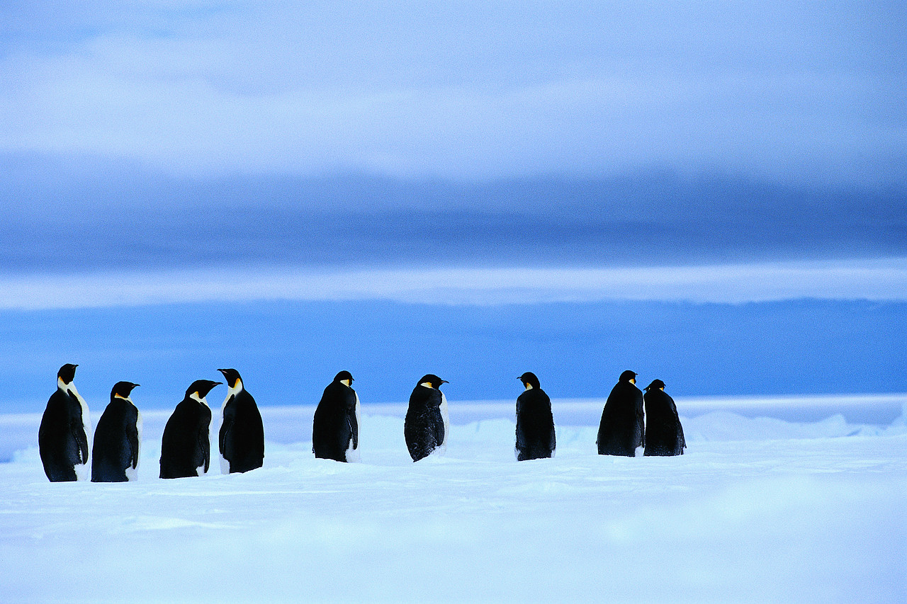
Homeostasis : The central concept in physiology
Lesson by :
Fibria

Slide 2
What is physiology?
Physiology is “the science of normal functioning and phenomena of living things”; its concerns itself how animal work.

Slide 3
Specialized cells evolved into tissues, organs, and physiological systems that serve specific functions.
Organs are made up of tissues, which are then made up of cells.
Organs consist of multiple tissues, and most have all four types.
An organ system is a group of organs that function together.

Slide 4
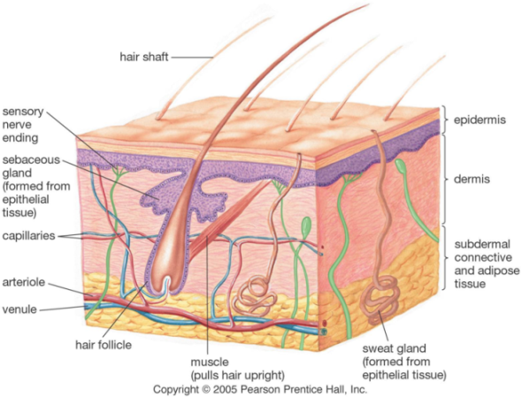
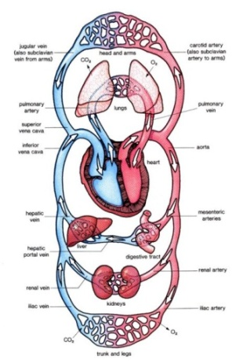
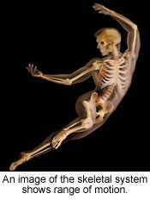
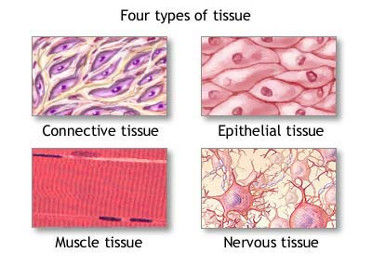
Organization in Living Things
Cells are organized into tissues.
  Tissues are organized into organs.
    Organs are organized into systems.
      Systems form an organism.

Slide 5
Four Tissue Types
Epithelial
Connective
Nervous
Muscular

Slide 6
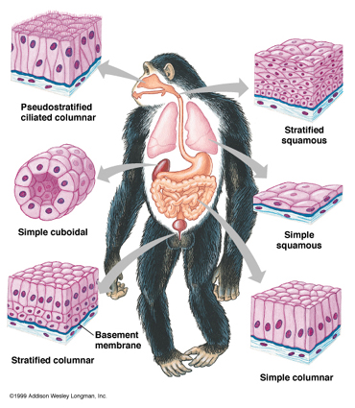
Epithelial Tissue
Epithelial cells form the outer covering, line the internal cavities, and make up the glands.
Examples: Skin, mucous membranes.

Slide 7
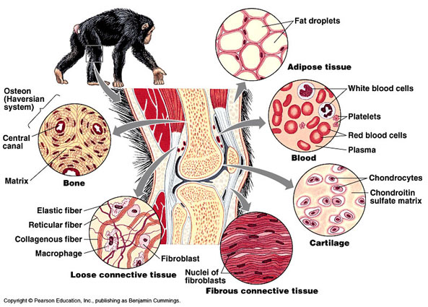
Connective Tissue
Consists of living cells in a secreted matrix.
Examples: bone, cartilage, blood.

Slide 8
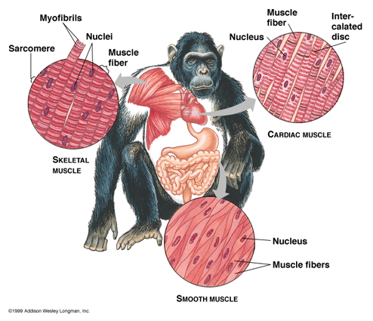
Muscular Tissue
Specialized protein fibers allow these cells to contract.
Examples: skeletal muscle, smooth muscle, cardiac muscle.

Slide 9
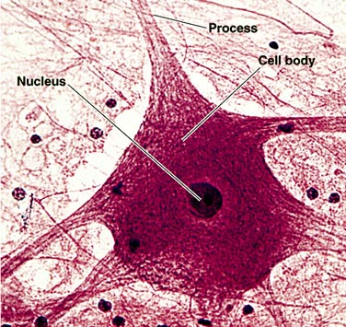
Nervous Tissue
Neurons have the ability to pass an “electrical” signal from one cell to another, or to target cells (muscles, glands, organs).

Slide 10

Tissues Form Organs
Nerves
Lymph Glands
Vessels
Lungs
Small Intestine
Skin

Slide 11
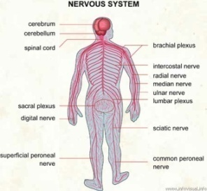
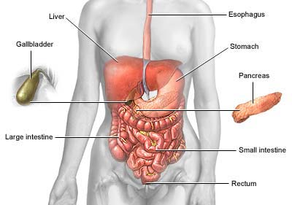
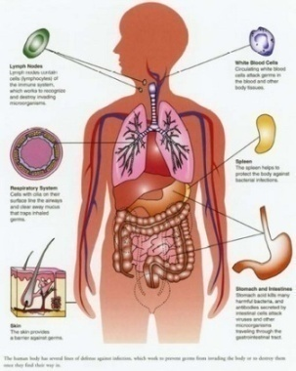
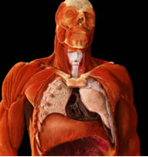
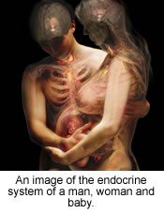

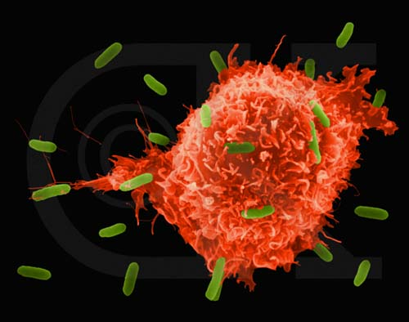
Organs To Organ Systems
Nervous System
Endocrine System
Musculo-skeletal System
Circulatory System
Respiratory System
Digestive System
Immune System

Slide 12

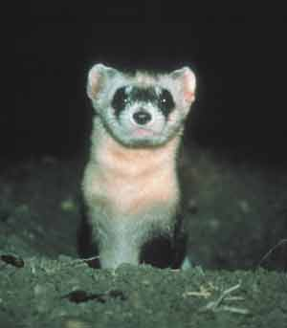

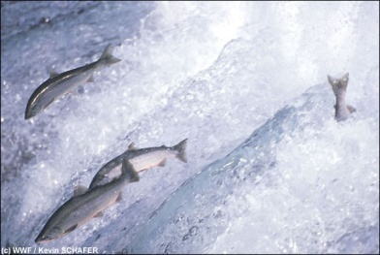
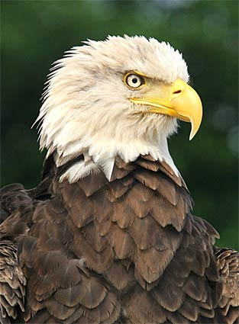
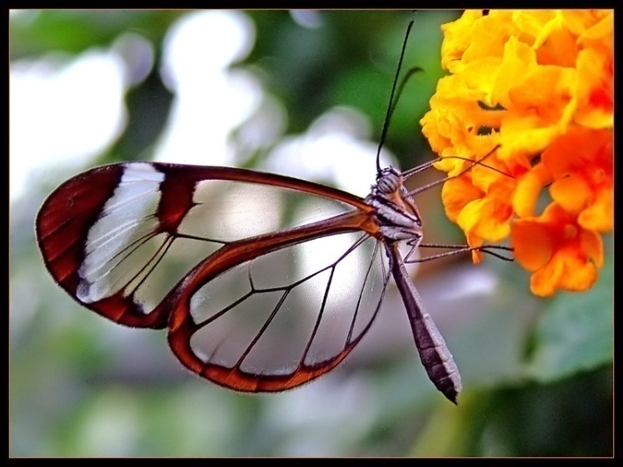
Organ Systems to Organisms
Mammals
Birds
Amphibians
Reptiles
Fish
Insects

Slide 13
Animal physiology looks at the way different animals deal with common problem, such as : how oxygen can be delivered to cells to meet their metabolic needs and how animals cope with changes in their external environment

Slide 14
External environment (terrestrial&aquatic) : rarely constat
ex : temperature, water avaibility, gas concentration, pH, etc
Biggest challenge that an animal likely to face
Changing the body fluid : extracellular fluid (ECF) and intracellular fluid (ICF)
What animal must strive to do is to maintain their body fluid?

Slide 15
Homeostasis
Homeostasis is the act of keeping the internal environment of a living organism within an acceptable range of conditions.
Homeostasis controls temperature, pH, blood volume, oxygen levels, blood sugar levels, ionic composition, dissolve gas concentration, nutrient level and other conditions.

Slide 16
French physiologist Claude Bernard in 1857
realized the importance of stability in the animal internal environment
American physiologist Walter Cannon in 1929
the term of Homeostasis was first use

Slide 17
FEEDBACK MECHANISMS
Feedback mechanisms are the general mechanism of nervous or hormonal regulation in animals.
Negative feedback is when the response diminishes the original stimulus (respon yang mengurangi stimulus).
Positive feedback is when the response enhances the original stimulus (memicu mekanisme-mekanisme yang memperbesar stimulus).

Slide 18
Stimulus
Receptors
Integrating Center
Efectors
Response
Afferent neurons
Efferent neurons

Slide 19
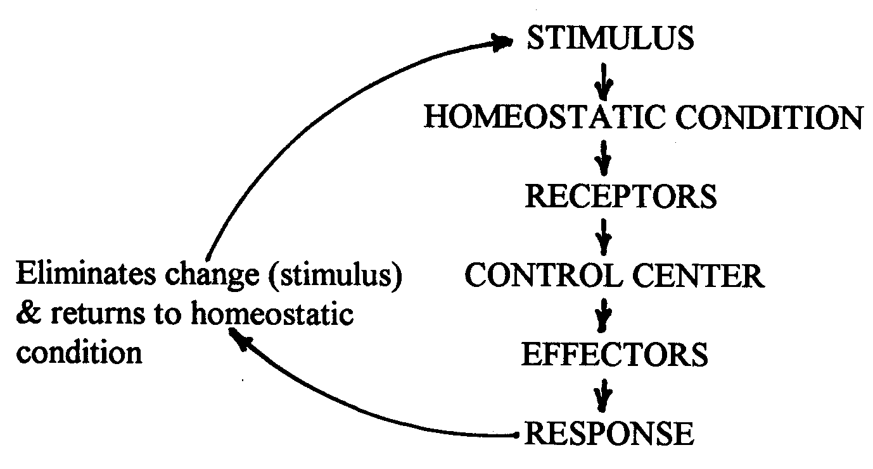
Negative Feedback

Slide 20
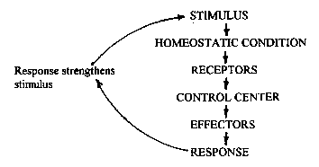
Positive Feedback

Slide 21
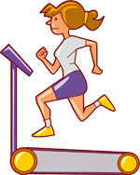
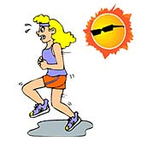
Examples of Negative Feedback
Exercise creates metabolic heat which raises the body temperature (the stimulus),
cooling mechanisms such as vasodilatation (flushed skin) and sweating begin (the response),
body temperature falls (thus decreasing the original stimulus).

Slide 22
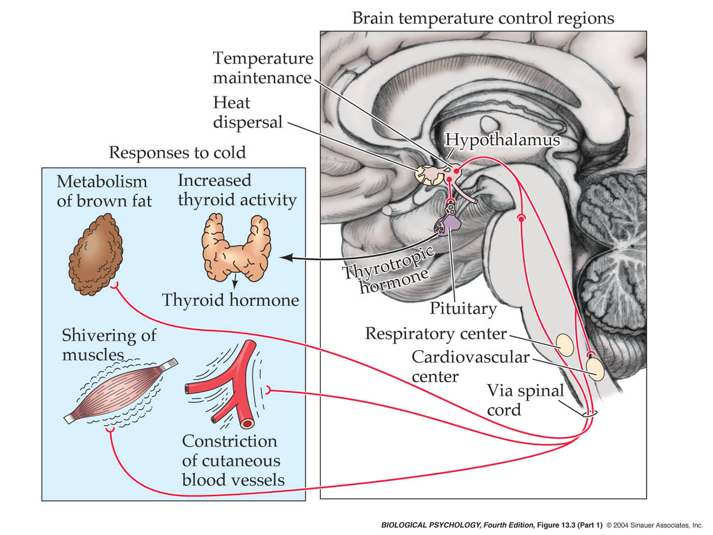
Temperature

Slide 23
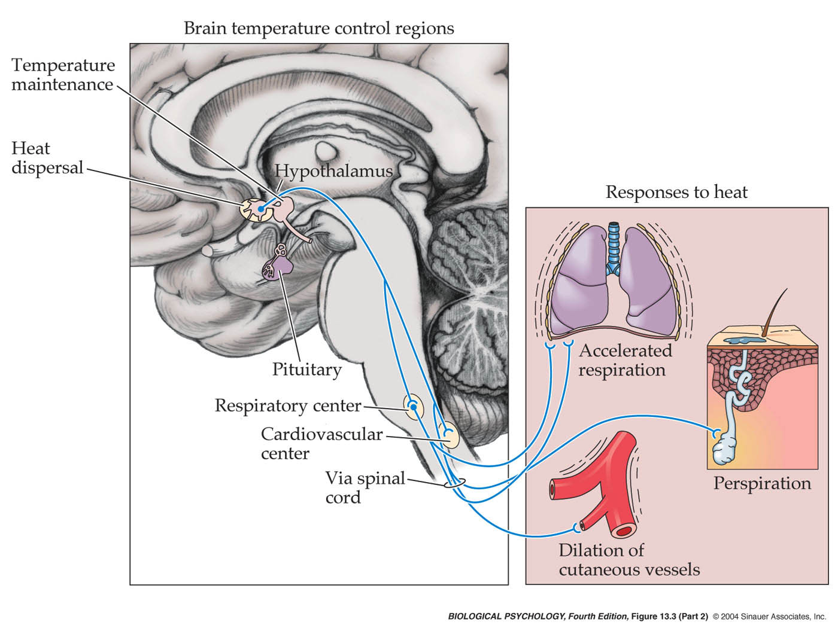

Slide 24
Text book :
Kay, Ian. 1998. Introduction to Animal Physiology. BIOS Scientific Publisher. Manchaster United Kingdom

