Slide 1
NEURON and NERVOUS SYSTEM
Lesson by : Fibria
Pendidikan Biologi
Universitas PGRI Semarang

Slide 2
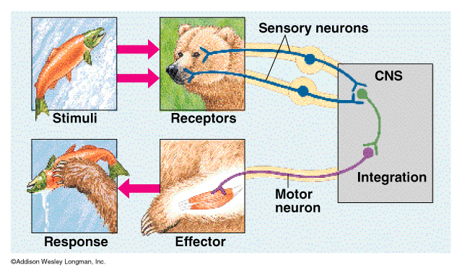

Slide 3
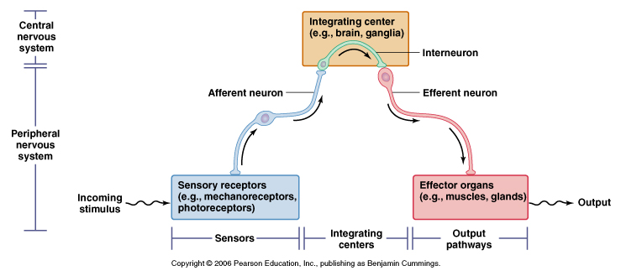

Slide 4
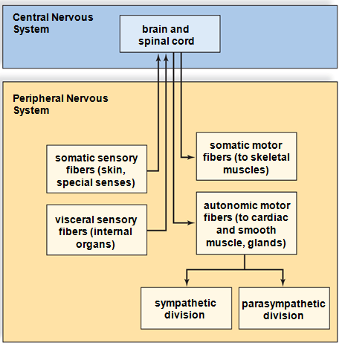

Slide 5


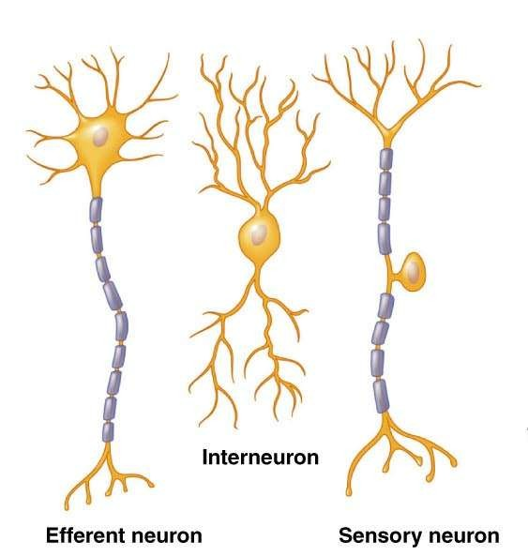
Functional Classifications

Slide 6
Fundamental Types of Neurons
Sensory (afferent) neurons
  receptors detect changes in body and external environment
  this information is transmitted into brain or spinal cord
Interneurons (association neurons)
  lie between sensory & motor pathways in CNS
  90% of our neurons are interneurons
  process, store & retrieve information
Motor (efferent) neuron
  send signals out to muscles & gland cells
  organs that carry out responses called effectors
Notes:
What do you need to percieve? We’ll talk about that in more detail later, but pressure, light, vibrations, chemical flavors, you need docking bays to receive these and change transduce those types of energy into chemical energy.

Slide 7
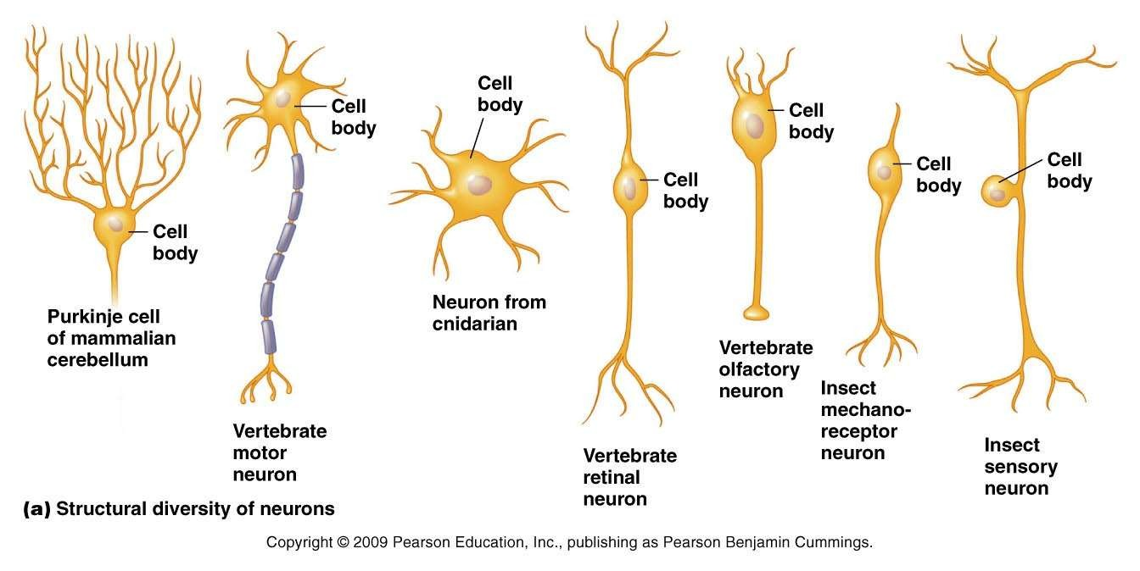
 Structure relates to the function of that particular neuron.

Slide 8

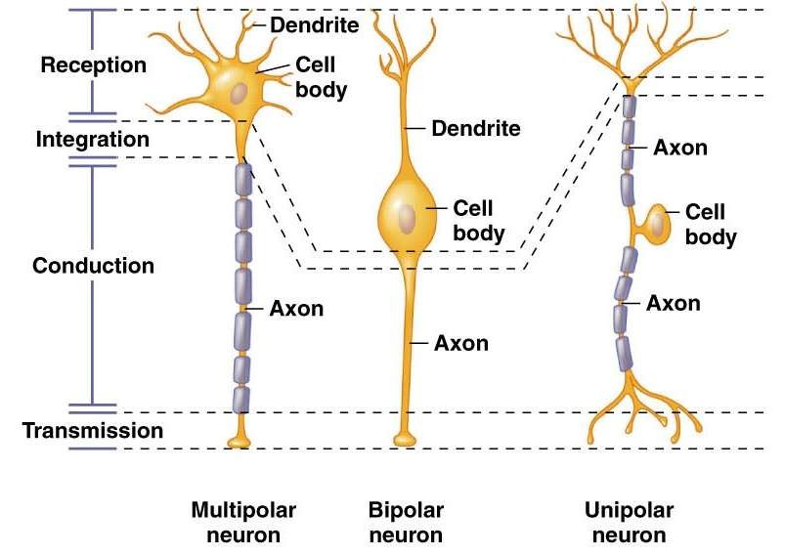
Structural Classifications

Slide 9

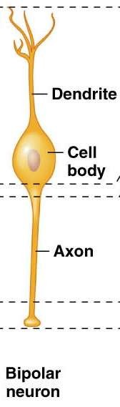
Bipolar Neurons
2 main processes extend from the cell body:
  One is highly branched and conveys signals to the cell body
  One convey signals away from the cell body.
Least common type of neurons in vertebrates

Slide 10


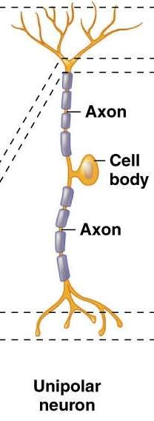
Unipolar Neurons
Has one single process away from the cell body which splits into 2 main branches:
  One branch conveys signals to the cell body
  One conveys signals away from the cell body.
More common in invertebrates:
  Invertebrate motor neurons are often unipolar rather than multipolar.

Slide 11

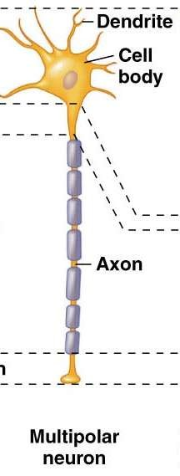
Multipolar Neurons
Many cellular extensions leading from the cell body:
  only one is an axon.
  All others are dendrites.
Most common type of neuron in vertebrates

Slide 12
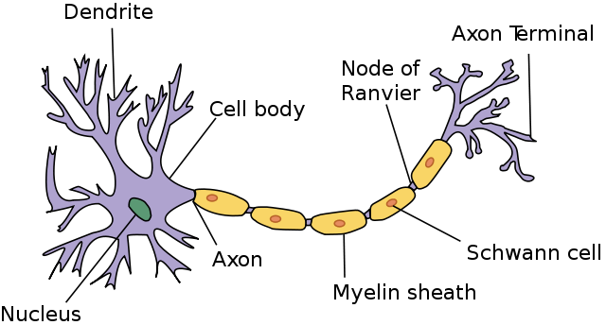
STRUCTURE of NEURON
Multipolar Neuron

Slide 13
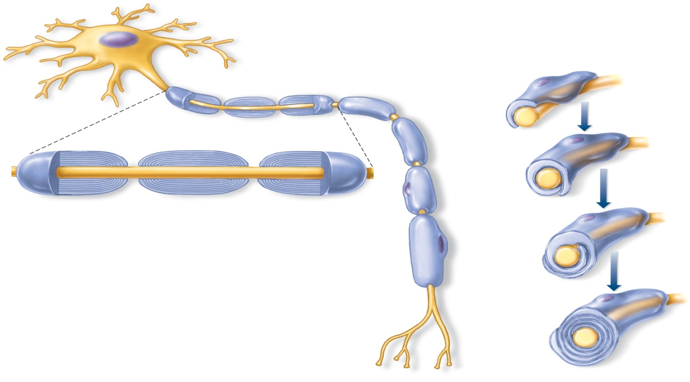
Neurons Generate Nerve Impulses
All neurons have the same basic structure: cell body, dendrites, and axon.
Cell body
Nucleus
Dendrites
Schwann
cell
Schwann
cell
Axon
Nucleus
Axon
(a)
Myelin
sheath
Node of
Ranvier
Schwann
cell
Axon
(b)
Myelin sheath

Slide 14
Fundamental Properties of Neurons
Excitability (irritability)
  ability to respond to changes in the body and external environment called stimuli
Conductivity
  produce traveling electrical signals
Secretion
  when electrical signal reaches end of nerve fiber, a chemical neurotransmitter is secreted
Notes:
They can be triggered, set off, activated, booted up.
Electricity of course coming from the greek elektra which was the greek word for Amber which caused static electricity. Then in the 1700’s Ben Franklin figured out the flow of + and – particles which your cells do with ions
Do these so they can communicate which electricity and chemicals in an aqueous environment.

Slide 15
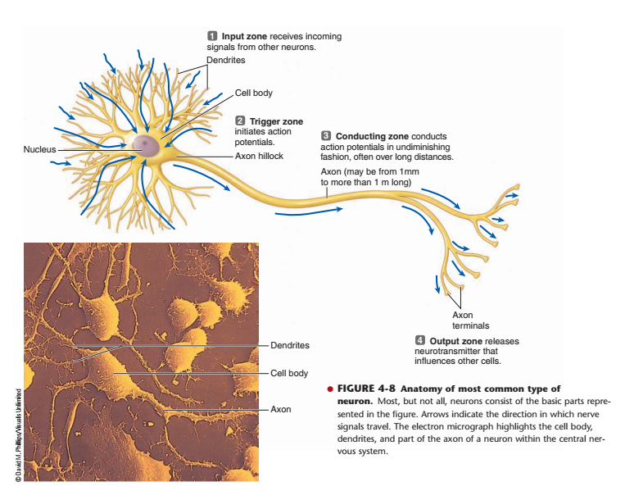

Slide 16
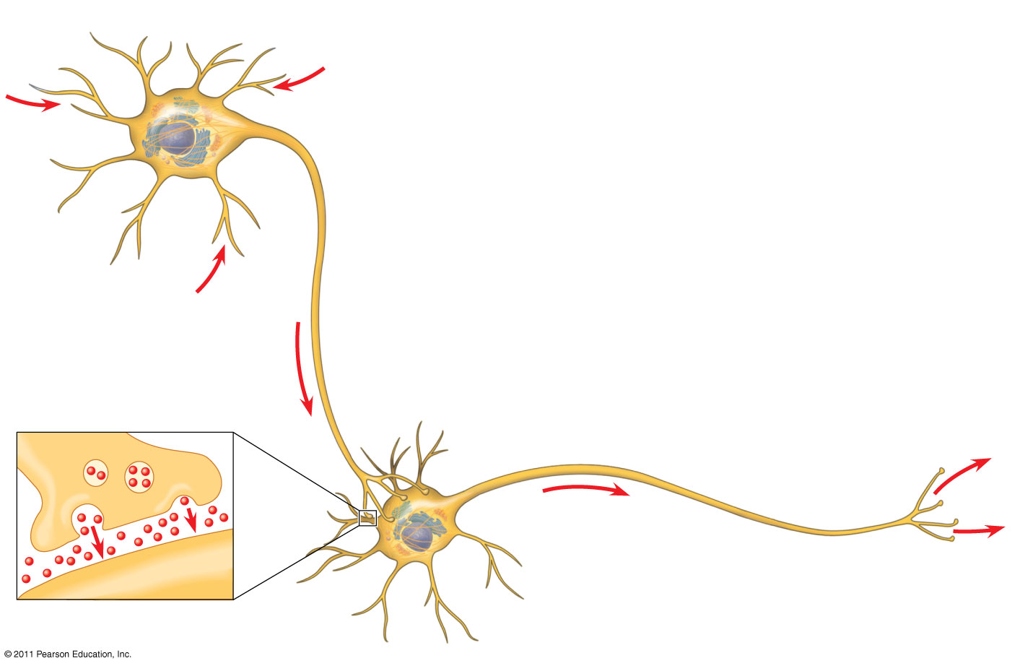
Dendrites
Stimulus
Axon hillock
Nucleus
Cell
body
Presynaptic
cell
Axon
Signal
direction
Synapse
Synaptic terminals
Synaptic
terminals
Postsynaptic cell
Neurotransmitter
Notes:
16
Figure 48.4 Neuron structure and organization.

Slide 17
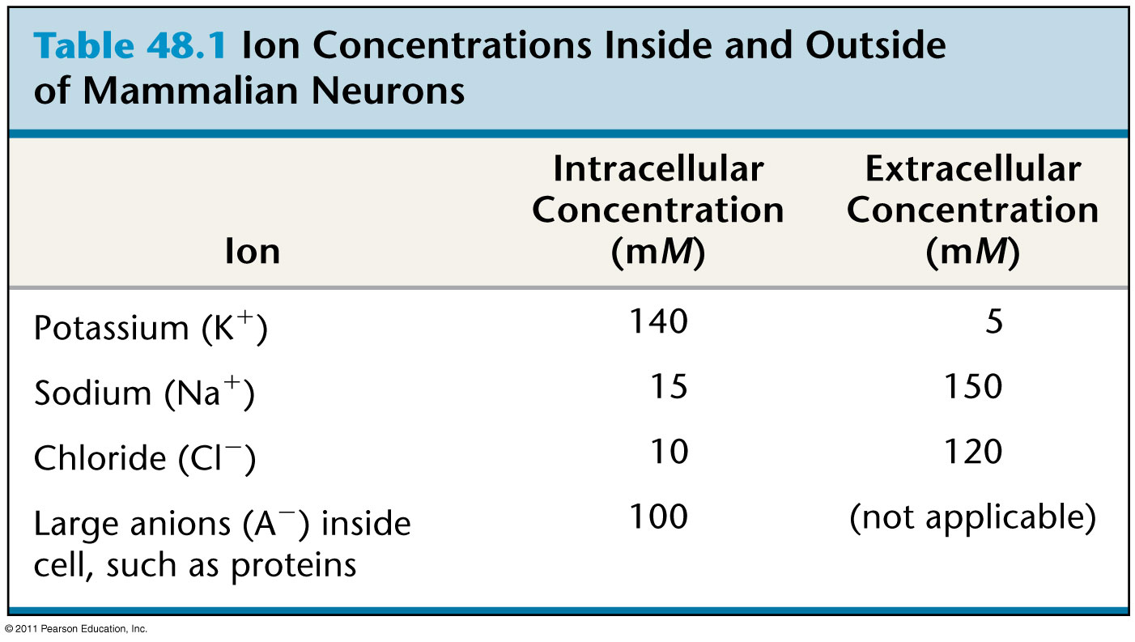
Table 48.1
Notes:
17
Table 48.1 Ion Concentrations Inside and Outside of Mammalian Neurons

Slide 18
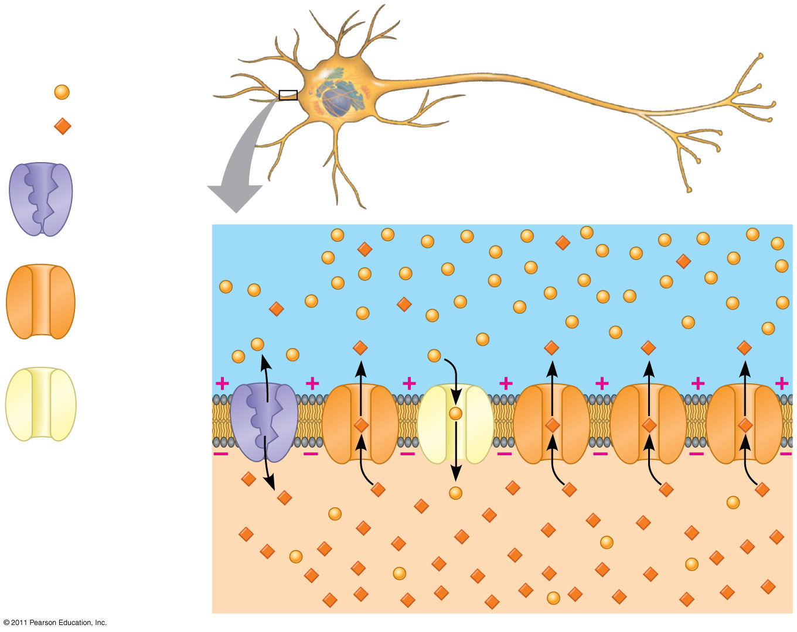
Figure 48.7
Key
Na⁺
K⁺
Sodium-
potassium
pump
OUTSIDE
OF CELL
Potassium
channel
Sodium
channel
INSIDE
OF CELL
Notes:
18
Figure 48.7 The basis of the membrane potential.

Slide 19
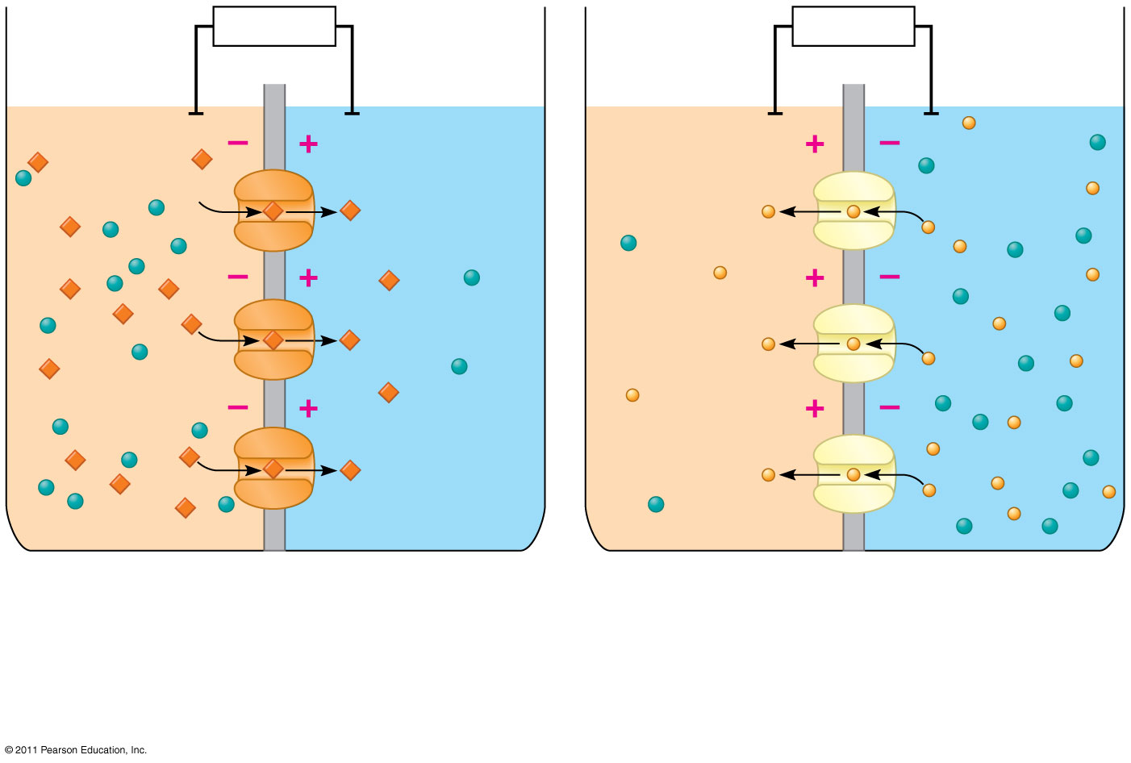
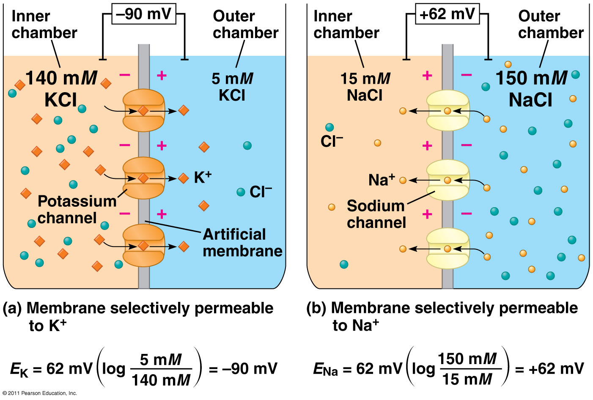
Figure 48.8
Inner
chamber
− 90 mV
Outer
chamber
Inner
chamber
+ 62 mV
Outer
chamber
140 mM
KCl
5 mM
KCl
15 mM
NaCl
150 mM
NaCl
Cl⁻
K⁺
Na⁺
Cl⁻
Potassium
channel
Sodium
channel
Artificial
membrane
(a)
Membrane selectively permeable
to K⁺
(b)
Membrane selectively permeable
to Na⁺
E_{K} = 62 mV
= −90 mV
E_{Na} = 62 mV
= +62 mV
Notes:
19
Figure 48.8 Modeling a mammalian neuron.

Slide 20
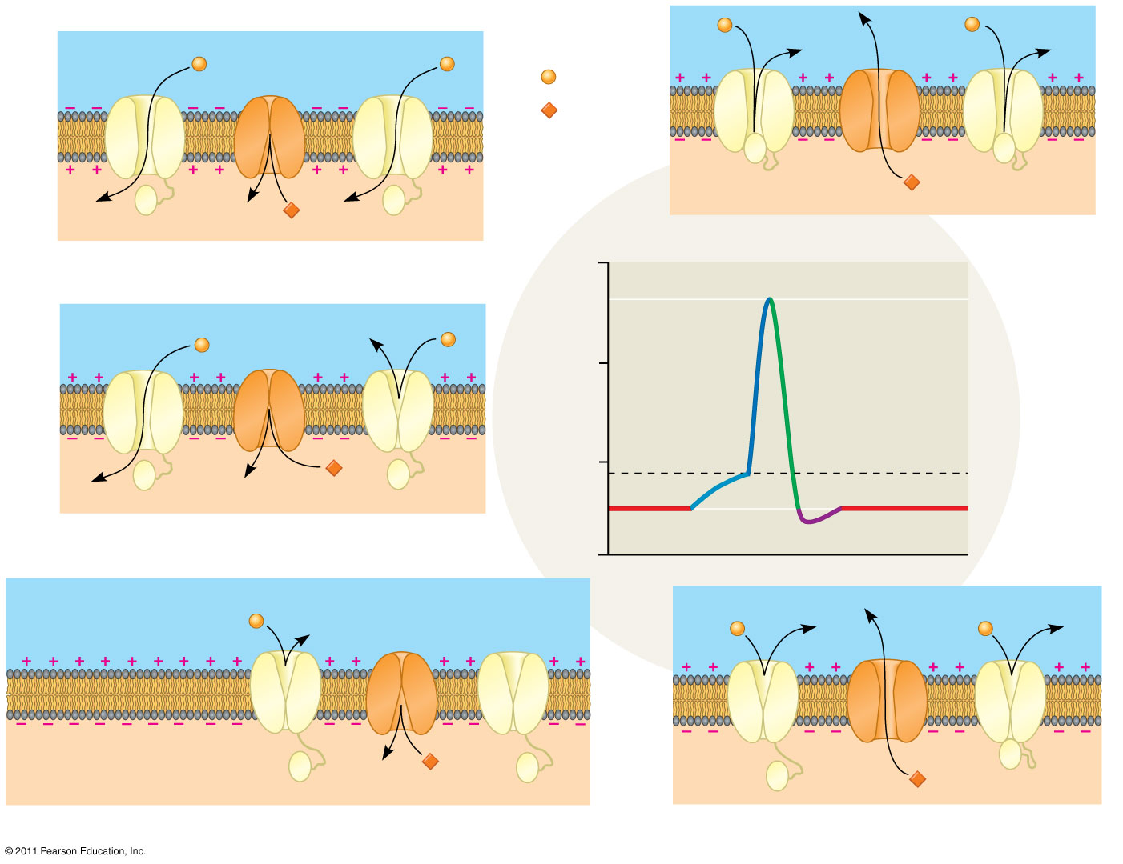
Figure 48.11-5
Key
Na⁺
K⁺
4
Falling phase of the action potential
3
Rising phase of the action potential
+50
Action
potential
0
3
Membrane potential
(mV)
Threshold
4
2
−50
1
5
1
2
Depolarization
Resting potential
−100
Time
OUTSIDE OF CELL
Sodium
channel
Potassium
channel
INSIDE OF CELL
Inactivation loop
1
Resting state
5
Undershoot
Notes:
20
Figure 48.11 The role of voltage-gated ion channels in the generation of an action potential.

Slide 21
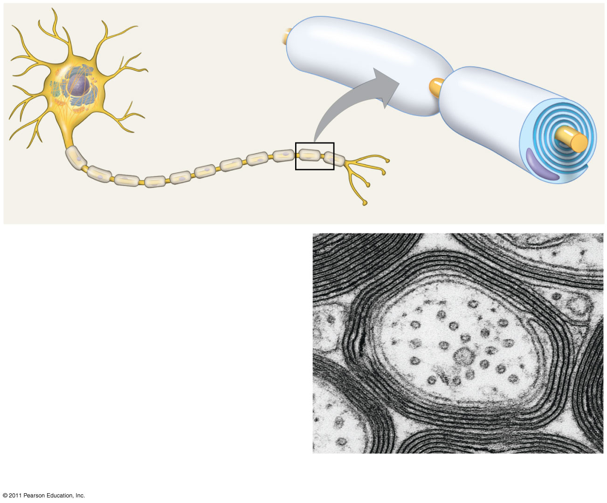
Figure 48.13
Node of Ranvier
Layers of myelin
Axon
Schwann
cell
Schwann
cell
Axon
Nodes of
Ranvier
Nucleus of
Schwann cell
Myelin sheath
0.1 μm
Notes:
21
Figure 48.13 Schwann cells and the myelin sheath.

Slide 22
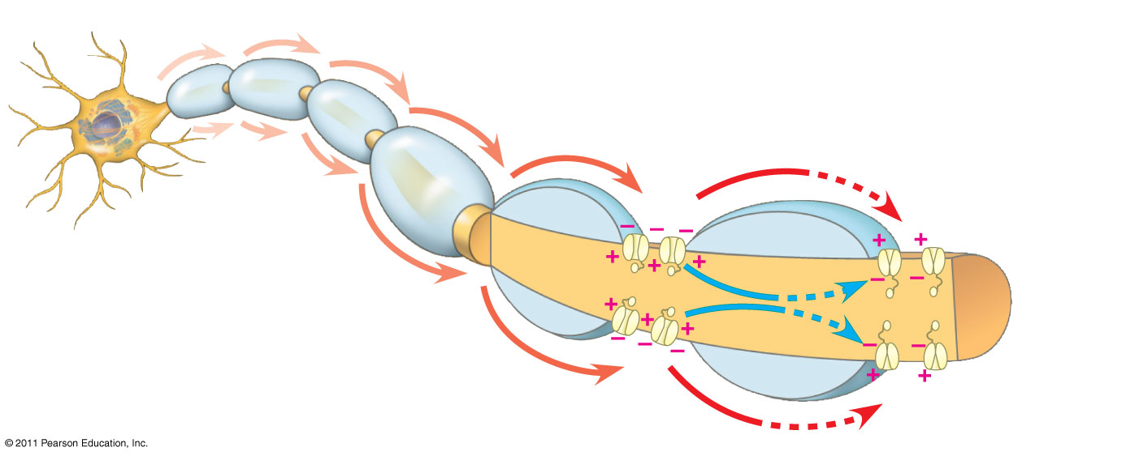
Figure 48.14
Schwann cell
Depolarized region
(node of Ranvier)
Cell body
Myelin
sheath
Axon
Notes:
22
Figure 48.14 Saltatory conduction.

Slide 23
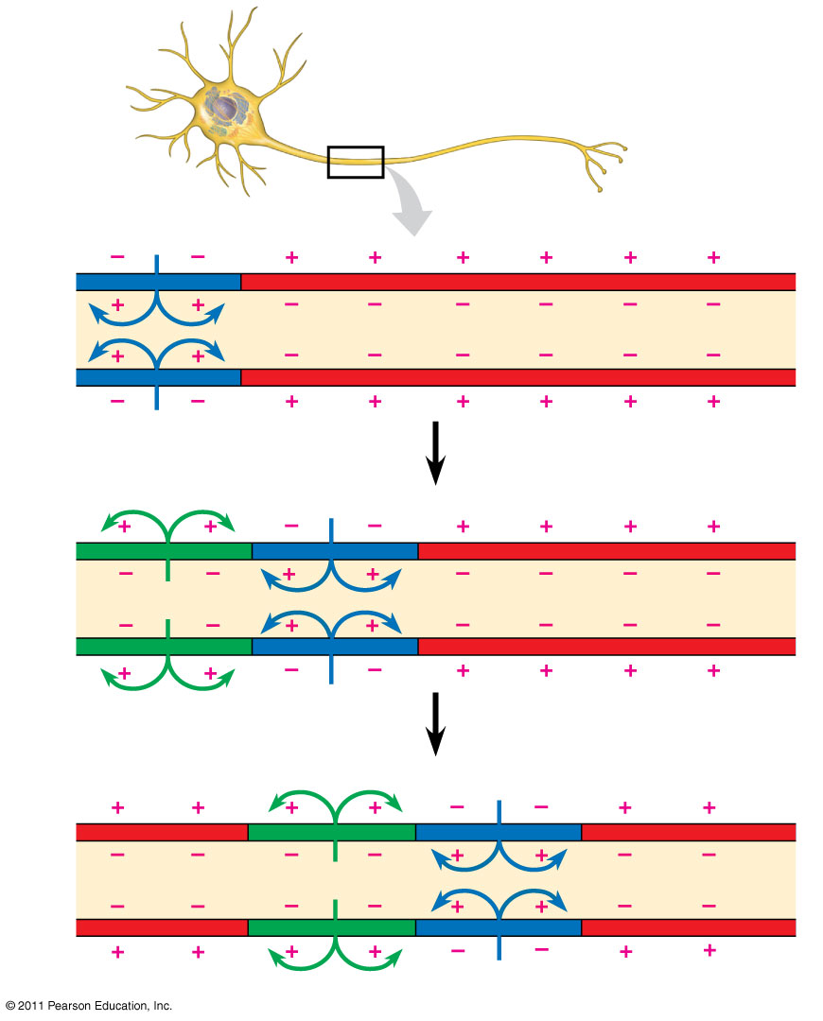
Figure 48.12-3
Axon
Action
potential
Plasma
membrane
1
Na⁺
Cytosol
Action
potential
K⁺
2
Na⁺
K⁺
Action
potential
K⁺
3
Na⁺
K⁺
Notes:
23
Figure 48.12 Conduction of an action potential.

Slide 24
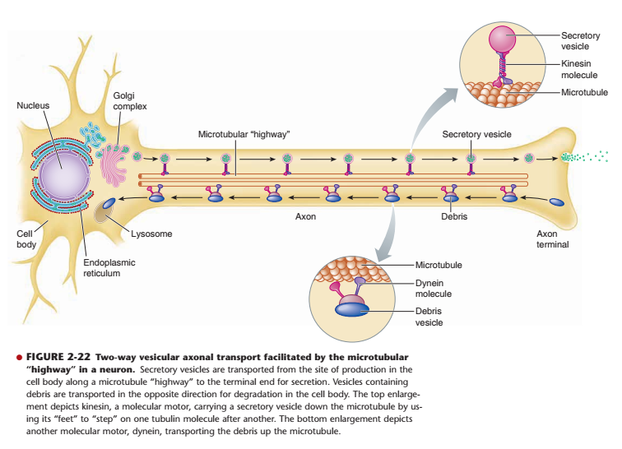

Slide 25
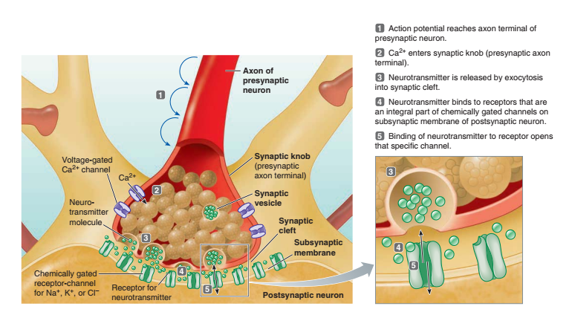

Slide 26
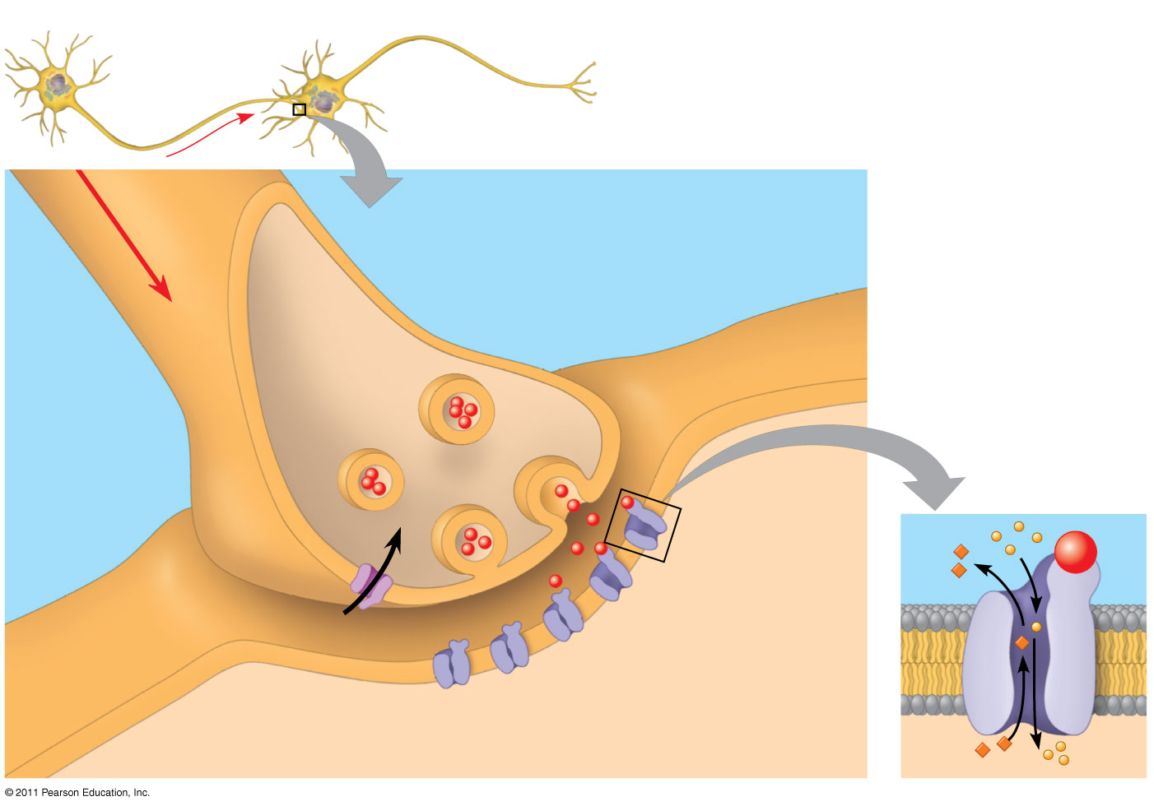
Figure 48.15
Presynaptic
cell
Postsynaptic cell
Axon
1
Synaptic vesicle
containing
neurotransmitter
Postsynaptic
membrane
Synaptic
cleft
Presynaptic
membrane
3
K⁺
Ca²⁺
2
Voltage-gated
Ca²⁺ channel
Ligand-gated
ion channels
4
Na⁺
Notes:
26
Figure 48.15 A chemical synapse.

Slide 27
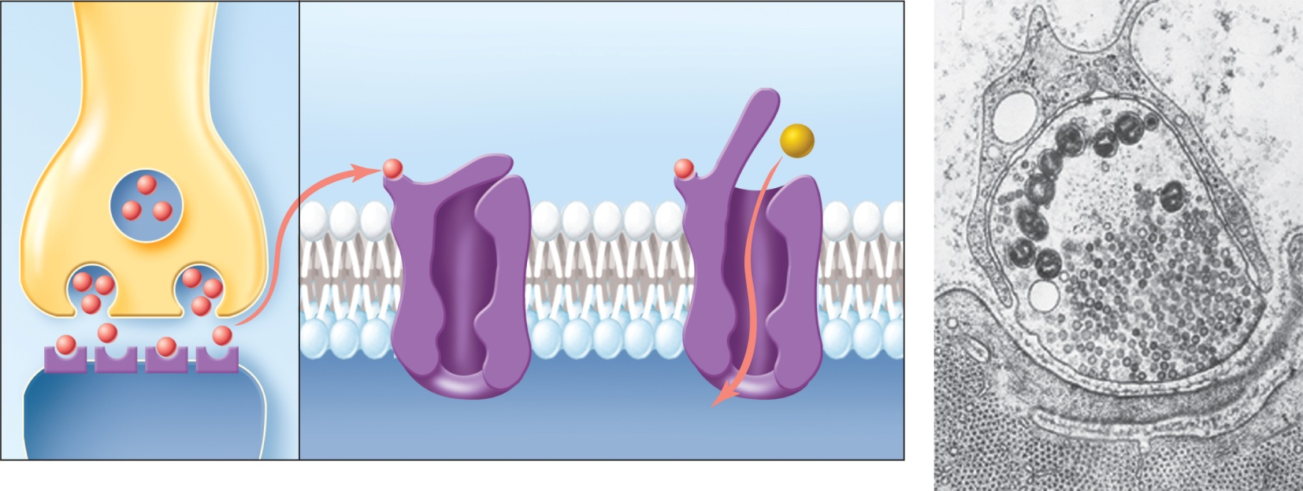
Events at the synapse
Neurotransmitter
Axon
terminal
Gate closed
Chemically-gated
ion channel
Mitochondria
Synaptic
vesicles
Synaptic
cleft
Postsynaptic
cell skeletal
muscle)
(a)
(b)

Slide 28



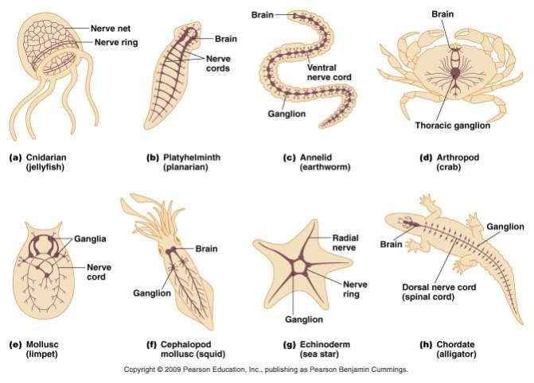
Nervous Systems:
Diversity & Functional Organization

Slide 29

Diversity of Neural Signaling
The diversity of neuron structure and function allows neurons to play many roles.
3 basic function of all neurons:
  Receive and integrate incoming signals
  Conduct these signals through the cell
  Transmit these signals to other cells

Slide 30
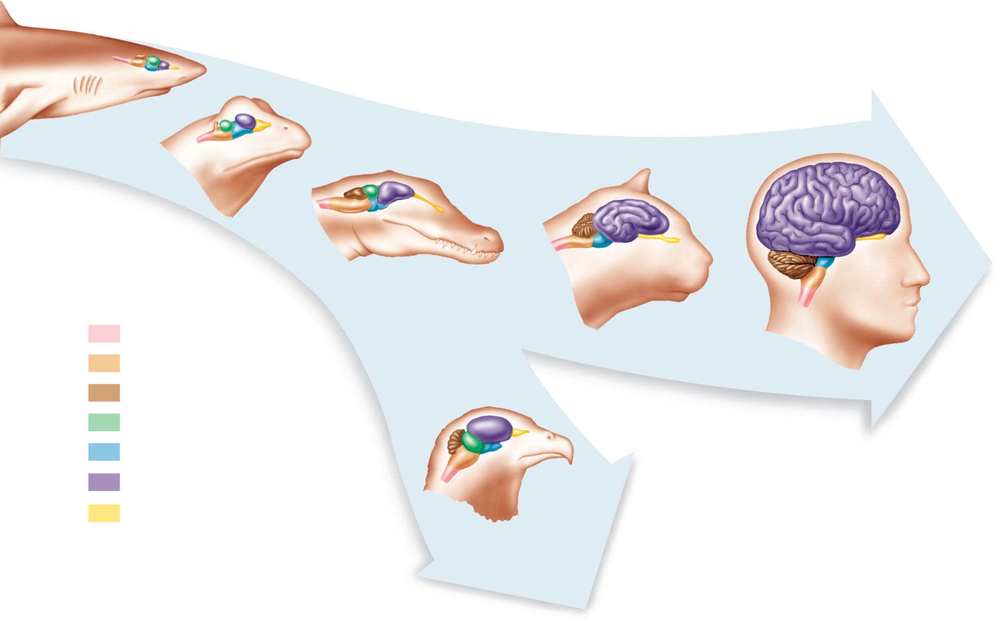
The evolution of the vertebrate brain
Shark
Frog
Crocodile
Spinal cord
Cat
Medulla oblongata
Human
Cerebellum
Optic tectum
Midbrain
Cerebrum
Olfactory tract
Bird

Slide 31
INVERTEBRATE NERVOUS
The simplest animals with nervous systems, the cnidarians, have neurons arranged in nerve nets
A nerve net is a series of interconnected nerve cells
More complex animals have nerves
Nerves are bundles that consist of the axons of multiple nerve cells
Sea stars have a nerve net in each arm connected by radial nerves to a central nerve ring
Notes:
Nervous system has three specific functions
Receiving sensory input
Performing integration
Generating motor output

Slide 32
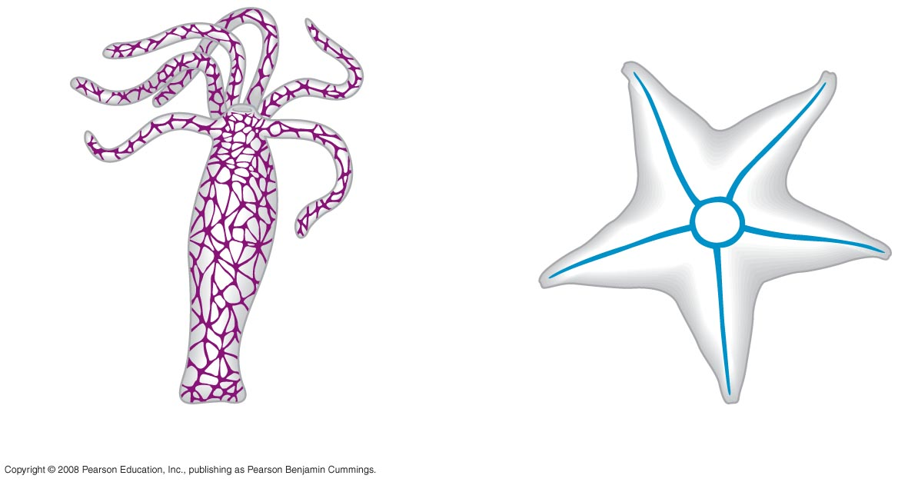
Fig. 49-2a
Radial
nerve
Nerve
ring
Nerve net
(a) Hydra (cnidarian)
(b) Sea star (echinoderm)
Notes:
Figure 49.2a, b Nervous system organization
Hydras
Nerve net composed of neurons in contact with one another
Also in contact with contractile epitheliomuscular cells
Bilaterally symmetrical animals exhibit cephalization
Cephalization is the clustering of sensory organs at the front end of the body
Relatively simple cephalized animals, such as flatworms, have a central nervous system (CNS)
The CNS consists of a brain and longitudinal nerve cords

Slide 33
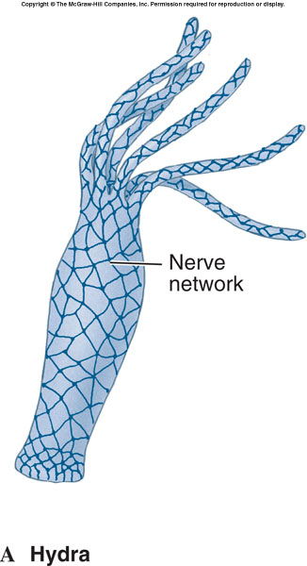
The simplest animals with nervous systems, the cnidarians, have neurons arranged in nerve nets.

Slide 34
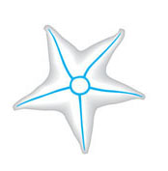
Sea stars have a nerve net in each arm connected by radial nerves to a central nerve ring.
Radial
nerve
Nerve
ring
(b) Sea star (echinoderm)

Slide 35
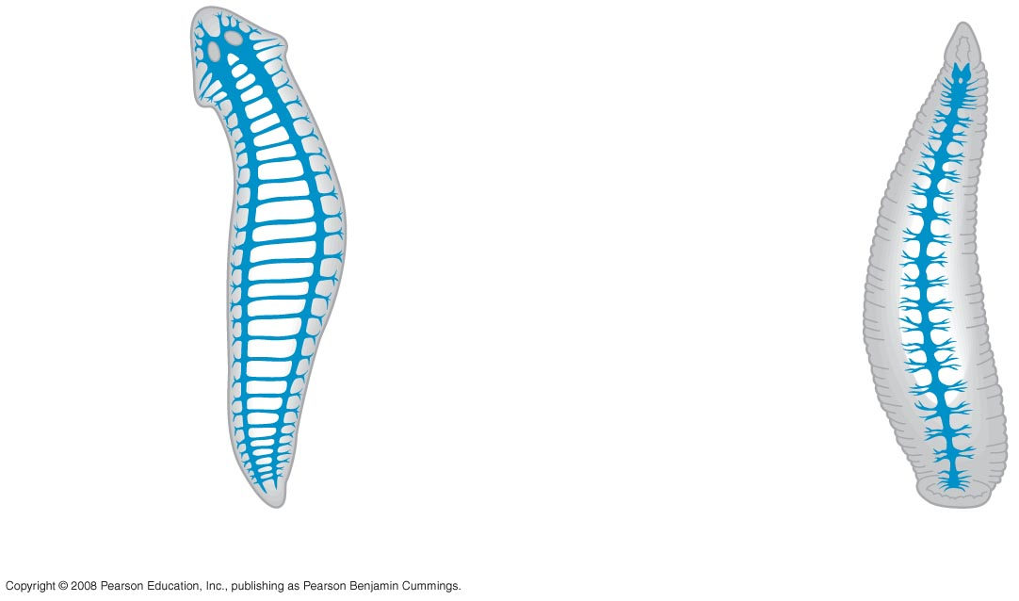
Fig. 49-2b
Eyespot
Brain
Brain
Nerve
cords
Ventral
nerve
cord
Transverse
nerve
Segmental
ganglia
(c) Planarian (flatworm)
(d) Leech (annelid)
Notes:
Figure 49.2c,d Nervous system organization
Annelids and arthropods have segmentally arranged clusters of neurons called ganglia

Slide 36
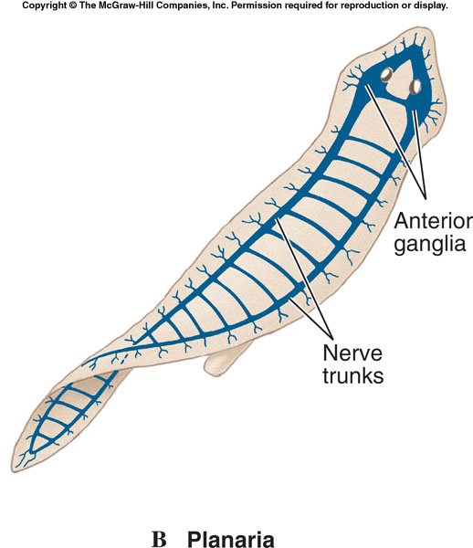
In relatively simple cephalized animals, such as flatworms, a central nervous system (CNS) is evident.

Slide 37
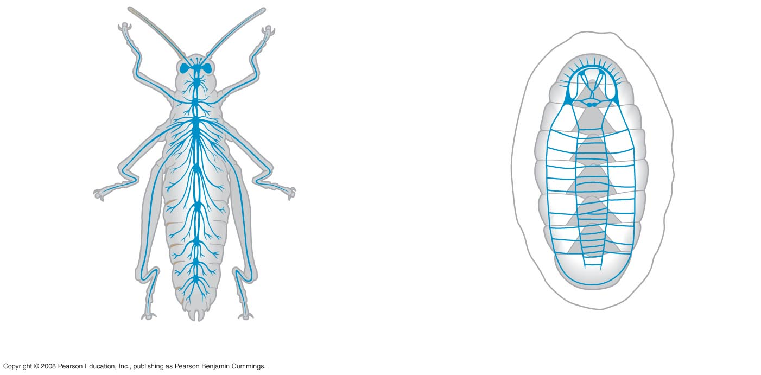
Fig. 49-2c
Brain
Ganglia
Ventral
nerve cord
Anterior
nerve ring
Longitudinal
nerve cords
Segmental
ganglia
(e) Insect (arthropod)
(f) Chiton (mollusc)
Notes:
Figure 49.2e, f Nervous system organization
Nervous system organization usually correlates with lifestyle
Sessile molluscs (e.g., clams and chitons) have simple systems, whereas more complex molluscs (e.g., octopuses and squids) have more sophisticated systems -True nervous systems

Slide 38
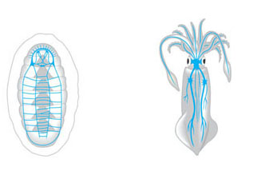
Molluscs generally have three pairs of well-defined ganglia.
In cephalopods, these ganglia have developed into complex nervous centers with highly developed sense organs.

Slide 39
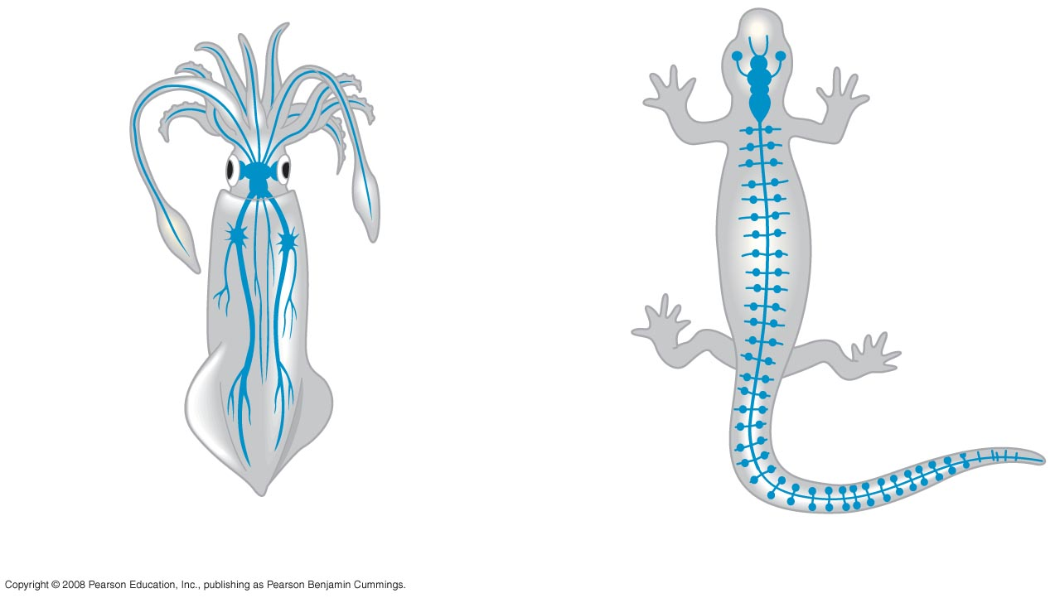
Fig. 49-2d
Brain
Brain
Spinal
cord
(dorsal
nerve
cord)
Sensory
ganglia
Ganglia
(g) Squid (mollusc)
(h) Salamander (vertebrate)
Notes:
Figure 49.2g, h Nervous system organization

Slide 40
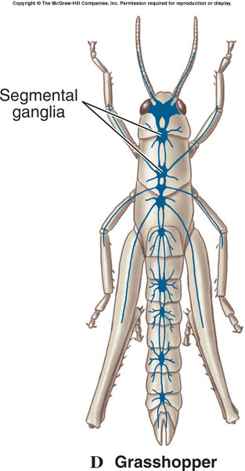
The arthropod plan resembles that of annelids, but ganglia are larger and sense organs are better developed.
  Often elaborate social behavior.

Slide 41
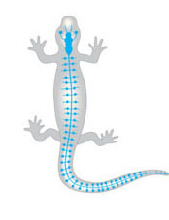
In vertebrates, the central nervous system consists of a brain and dorsal spinal cord.
  The PNS connects to the CNS.
Brain
Sensory
ganglion
Spinal
cord
(dorsal
nerve
cord)
(h) Salamander (chordate)

Slide 42
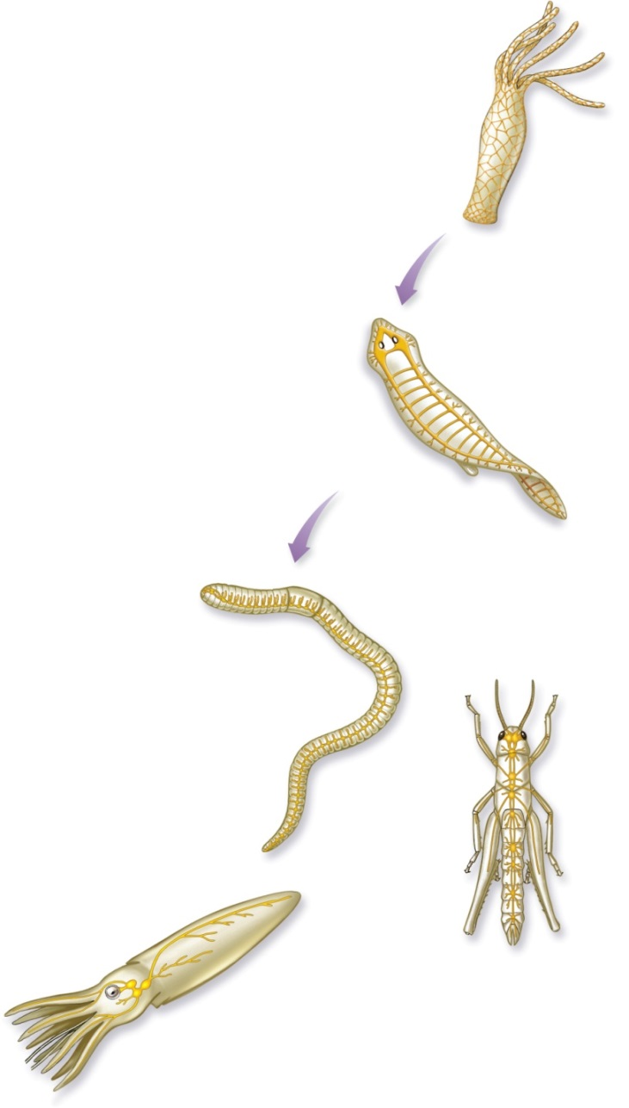
Evolution of the Animal Nervous System
A series of evolutionary changes lead from the flatworms to the vertebrate nervous system:
  More sophisticated sensory mechanisms.
  Differentiation into central and peripheral nervous systems.
  Differentiation of sensory and motor areas.
  Increased complexity of association.
  Elaboration of the brain.
Nerve
net
1
Cnidarian
Associative
neurons
Nerve
cords
2
Flatworm
Central nervous
system
Brain
Peripheral
nerves
3
Earthworm
Ventral
nerve
cords
Giant
axon
Brain
5
Arthropod
4
Mollusk

