Slide 1
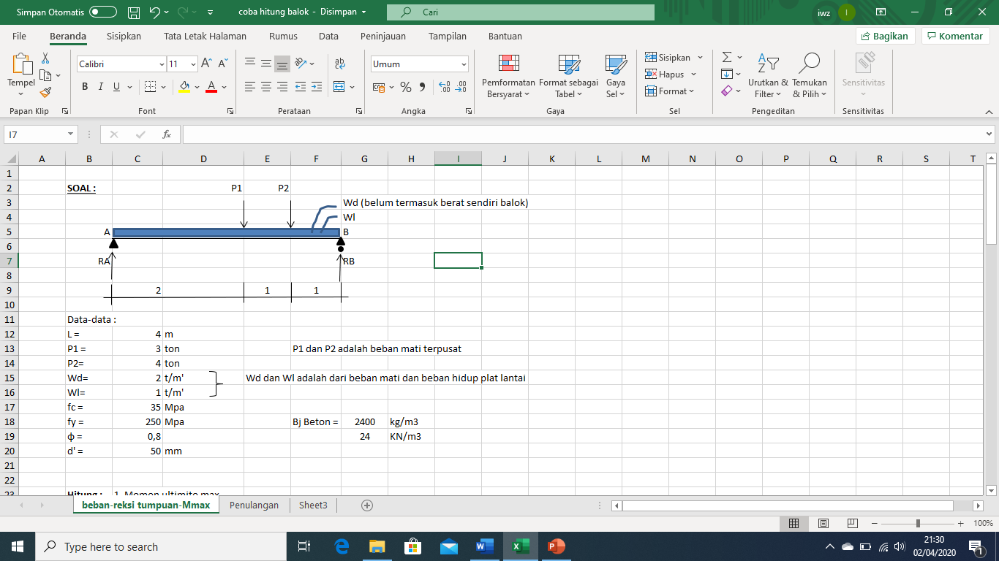
PERHITUNGAN BALOK
DENGAN BEBAN MERATA DAN TERPUSAT
Hitung : | 1. Momen ultimite max
 | 2. Dimensi dan Penulangan balok
 | 3. Gambar penulangan

Slide 2
Penyelesaian
1. Dimensi Balok
h = | (1/8 s.d 1/16) L |  |  |  |  | b = | ( 1/2 s.d 2/3 ) h
h = | 1/9 x 4,00 | =˜ 0,45 m | =˜ 0,45 m |  |  | b = | ½ x 0,45 | =˜ 0,20 m
h = | 450 | mm | mm |  |  | b = | 200 | mm
berat sendiri balok = |  | b x h x Bj beton | b x h x Bj beton
Wbs balok = 0,2x0,45 |  | 216 | X 2400= 216 |  | kg/m'
 |  | 0,216 | 0,216 |  | ton/m'
2. Pembebanan Balok ( Wu )
 | Wu = | 1,2 Wd + 1,6 Wl + 1,2 Wbs |  |  |  |  | Wu = | 4,26 | ton/m
 | Pu1= | 1,2 P1 |  |  |  |  | Pu1 = | 3,60 | ton
 | Pu2= | 1,2 P2 |  |  |  |  | Pu2 = | 4,80 | ton

Slide 3
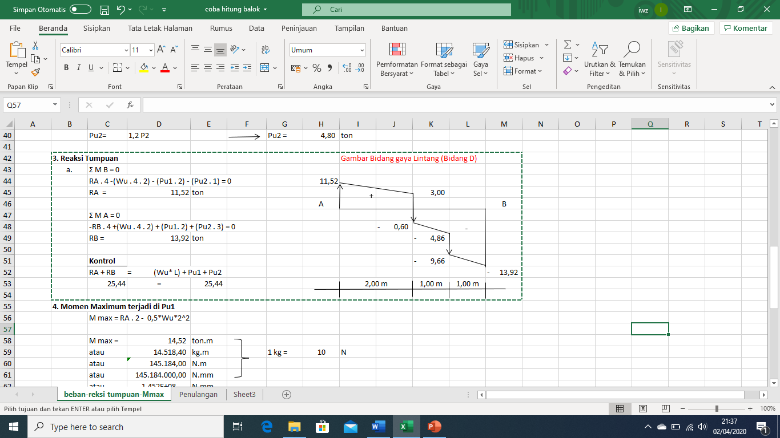
audio
Pu1
Pu2
Wu = | 4,26 | ton/m
Pu1 = | 3,60 | ton
Pu2 = | 4,80 | ton
Wu
3. Reaksi Tumpuan
a. | Σ M B = 0
 | RA . 4 -(Wu . 4 . 2) - (Pu1 . 2) - (Pu2 . 1) = 0
 | RA = | 11,52 | ton
 | Σ M A = 0
 | -RB . 4 +(Wu . 4 . 2) + (Pu1. 2) + (Pu2 . 3) = 0
 | RB = | 13,92 | ton
 | Kontrol
 | RA + RB = (Wu* L) + Pu1 + Pu2
 | 25,44 | = | 25,44 | (oke)
11,52-(Wux2,00)

Slide 4
4. Momen Maximum terjadi di Pu1
 | M max = RA . 2 - 0,5*Wu*2^2
 | M max = | 14,52 | ton.m
 | atau | 14.518,40 | kg.m |  |  | 1 kg = | 10 | N
 | atau | 145.184,00 | N.m
 | atau | 145.184.000,00 | N.mm
 | atau | 1,452E+08 | N.mm
Q=wu.2

Slide 5
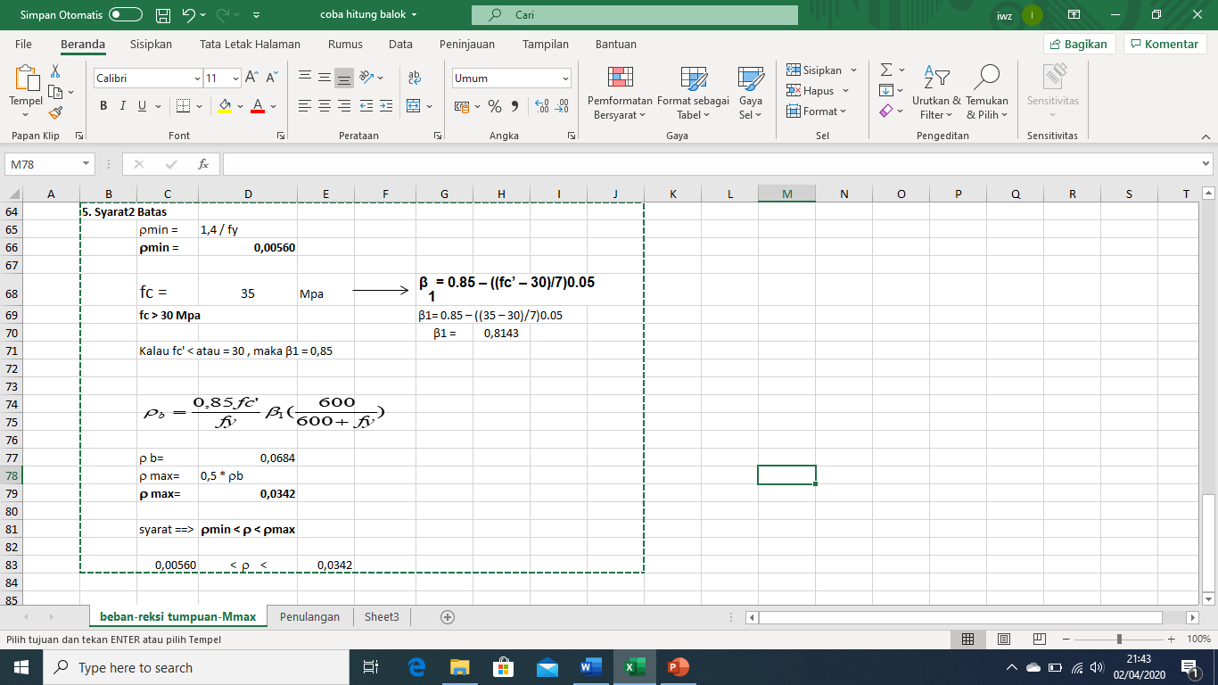

= 1,4/250
Bila ρ < ρmin maka dipakai nilai ρmin
Bila ρ > ρmax maka dimensi balok harus diperbesar

Slide 6
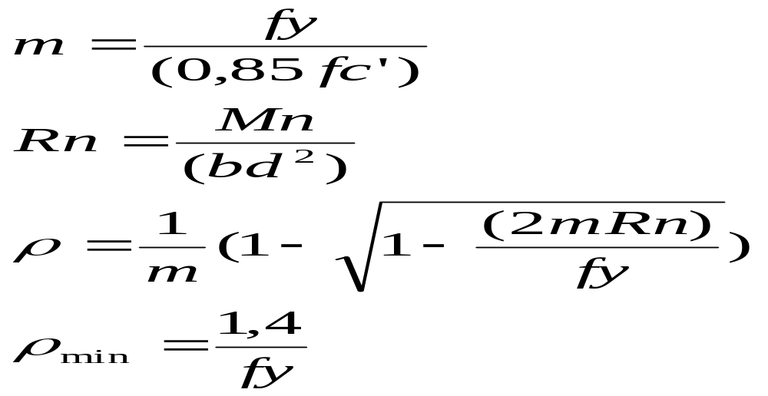
ANALISA PENULANGAN BALOK
Data :
h = | 450 | mm
b = | 200 | mm
d' = | 50 | mm
d = h-d'= | 400 | mm
Ф= | 0,8
fc = | 35 | MPa
fy= | 250 | Mpa
ρmin = | 0,0056
ρmax= | 0,0342
p = | 25 | mm (selimut beton)
Ф sengkang= | 8 | Mm
s= ( b - (2p+2 Фskg + n ФTP))/(n-1)
Syarat : | ρmin < ρ < ρ max
ρmin < | ρ | < ρmax
0,0056 | 0,02539 | 0,0342
Jarak sisi luar antar tulangan pokok min 25 mm
Momen Maximum =
145.184.000 | N.mm
1,452E+08 | N.mm

Slide 7
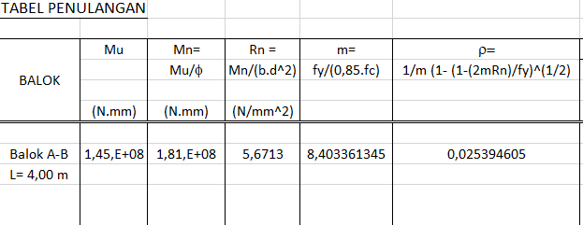
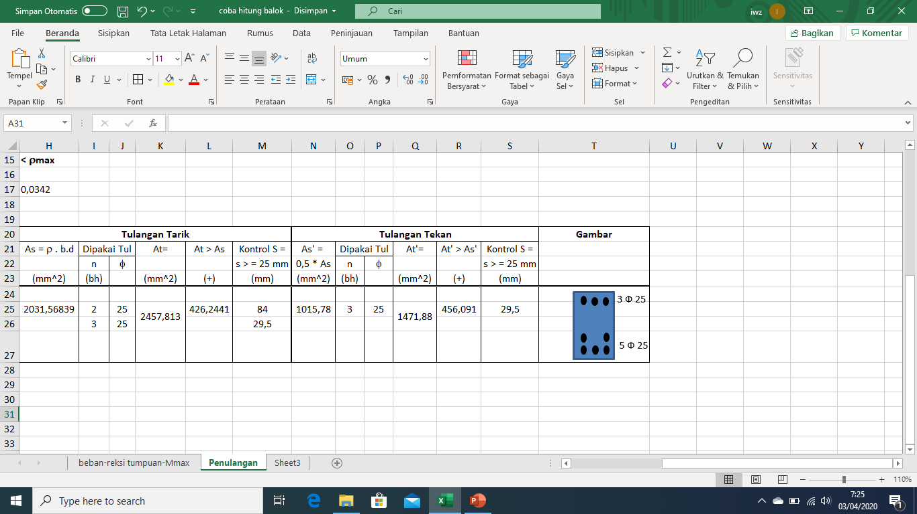

Slide 8
P= 25 mm
s= ( b - (2p+2 Фskg + n ФTP))/(n-1)
Syarat : | ρmin < ρ < ρ max
ρmin < | ρ | < ρmax
0,0056 | 0,02539 | 0,0342
d = 400 mm
h=450 mm
s =( 200 – (2. 25 + 2. 8 + 3. 25))/(3-1)
S = (200 – (50 +16 +75)) /2
S = (200- 141)/2
S = 29,5 mm > syarat 25 mm (oke)
s
s
s
d’=50 mm
s =( 200 – (2. 25 + 2. 8 + 4. 25))/(4-1)
S = (200 – (50 +16 +100)) /3
S = (200- 166)/3
S = 11,33 mm < syarat 25 mm (tidak oke)
b=200 mm

Slide 9
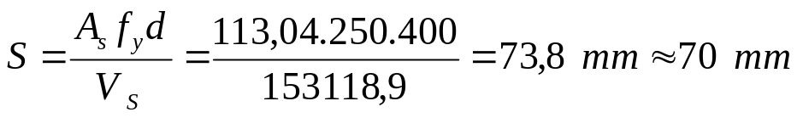
Perhitungan Tulangan Geser :
VU > Ø Vc → perlu tul. Geser sengkang
Vu < Ø Vc → tidak perlu perhitungan tul. Geser sengkang cukup memakai tul geser praktis- Φ 8 – 200 mm)
V_{C} = 1/6 x (√f_{c}’) xb_{W}x d
= 1/6(√35). 200 mm . 400 mm =78881,06 N
Ø VC = 0,6 . 78881,06 = 47328,64 N
VU > Ø VC → perlu perhitungan tul. Geser sengkang
13,92.10^4 N > 47328,64 N
Analisa Perhitungan tulangan Geser:
V_{S perlu} = V_{U}/Ø – V_{C}= (13,92.10^4 /0,60) – 78881,06
= 153118,9 N
Bila menggunakan sengkang Ø 12 maka As = 113,04 mm2
Data2 :
Av = Vu = 13,92 ton
= 13,92.10^4 N
= 139200 N
fc = 35 Mpa
fy = 250 MPa
b = 200 mm
h = 450 mm
d’ = 50 mm
d= h-d’ = 450 – 50 = 400 mm
1 kg = 10 N
N/mm^2 = MPa
As= 0,25 x π x D^2
= 0,25. 3,14 . 12^2
= 113,04 mm^2
Jadi besi sengkang yang dipakai :
Ø 12 – 70 mm untuk daerah tumpuan
Ø 12 – 100 mm untuk daerah lapangan

Slide 10
Sekian dan terima kasih

