Slide 1
Unit Operations in Food Processing
Ag Processing Technology

Slide 2
Food Processing
Series of physical processes that can be broken down into simple operations
These operations can stand alone

Slide 3

Unit Operations
Material Handling
Cleaning
Separating
Size reduction
Fluid Flow
Mixing
Heat transfer
Concentration
Drying
Forming
Packaging
Controlling

Slide 4
Materials Handling
Includes
  Harvesting, refrigerated trucking of perishable produce, transportation of live animals, conveying a product from truck or rail car to storage
During these operations
  Sanitary conditions must be maintained
  Losses minimized
  Quality maintained
  Bacterial growth minimized
Transfers and deliveries must be on time while keeping time to a minimum for efficiency and quality
Trucks, trailers, harvesting equipment, railcars , a variety of conveyors, forklifts, storage bins, & pneumatic lift systems are all part of the process

Slide 5
Cleaning
Ranges from dirt removal to the removal of bacteria from liquids
Uses
  Brushes
  High-velocity air
  Steam
  Water
  Vacuums
  Magnets
  Microfiltration
  Mechanical separation
Method used depends on the food surface
Equipment and floors and walls of the facility also require frequent, thorough cleanings to maintain product quality

Slide 6
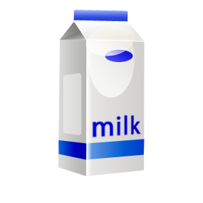
Separating
Achieved on the basis of density or size and shape
Density based separations include
  Cream from milk
  Solids from suspension
  Removal of bacteria from fluid

Slide 7
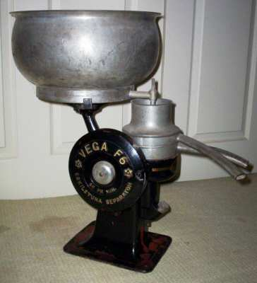
Cream Separator
Disc type centrifuge
Separates the milk into low and high density fluid streams, permitting the separate collection of cream and skim milk

Slide 8

Clarification
Done with a clarifier-a disc type centrifuge that applies forces of 5,000-10,000 times gravity and forces denser materials to the outside
Used to remove sediment and microorganisms
Allows solids to be removed
Used to recover yeast cells from spent fermentation broths and to continuously concentrate bakers cheese from whey

Slide 9
Membrane Processes
Uses membranes with varying pore sizes to separate on the basis of size and shape
Reverse osmosis
  Uses membranes with the smallest pore and is used to separate water from other solutes
  Requires a high pressure pump
Ultra filtration
  Uses membranes with larger pores and will retain proteins, lipids and colloidal salts while allowing smaller molecules to pass through to the permeate phase
  Requires a low pressure pump
Microfiltration
  Pores less than 0.1 microns are used to separate fat from proteins and to reduce microorganisms from fluid food systems
  Requires a low pressure pump

Slide 10
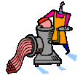
Size Reduction
Uses high-shear forces, grater, cutters, slicers, homogenizers, ball mill grinders
Size reducers used for meat include
  Grinders, Bacon slicers, sausage stuffers, & vertical choppers
Better thought of as size adjustment because size can be reduced or it can be increased by aggregation, agglomeration or gelation

Slide 11
Pumping (Fluid Flow)
Achieved by either gravity flow or through the use of pumps
Gravity flow
  Flow is laminar and is transferred from the fluid to the wall between the adjacent layers
  Adjacent molecules don’t mix
Pumps
  Centrifugal pump uses a rotating impeller to create a centrifugal force within the pump cavity. The flow is controlled by the choice of the impeller diameter and rotary speed of the pump drive. The capacity of a centrifugal pump is dependent upon the speed, impeller length and the inlet and outlet diameters
  Positive Pumps consist of a reciprocating or rotating cavity between two lobes or gears and a rotor. Fluid enters by gravity or a difference in pressure, and the fluid forms the seals between the rotating parts. The rotating movement of the rotor produces the pressure to cause the fluid to flow.

Slide 12
Mixing
Two major purposes
  Heat transfer
  Ingredient incorporation
Different mixer configurations are used to achieve different purposes
Efficiency depends on
  Design of impeller
  Diameter of impeller
  Speed
  baffles

Slide 13
Heat Exchange
Used for either heating or cooling
Used to
  Destroy microorganisms, produce a healthful food, prolong shelf-life through destruction of enzymes and to promote products with acceptable taste, odor and appearance

Slide 14
5 Factors that Influence Heat Transfer
Heat Exchanger Design
Heat Transfer properties of the product
  Specific heat
  Thermal conductivity
  Latent heat
Density
Method of Heat Transfer
  Conduction
  Radiation
  Convection
Viscosity

Slide 15
Types of Heat Exchanges Used In the Food Industry
Plate
  Pass fluid over a plate where heating or cooling medium is being passed up and down on the other side of the plate
  Most efficient method of heating fluids with low viscosity
Tubular
  Composed of a tube within a tube in which product and heating or cooling medium are flowing in opposite directions.
  Low cost
  Used for fluids of higher viscosities
Swept Surface
  Have blades that scrape the surface of the heat exchanger and bring new product continuously to the heat or cooling surface
  Used for fluids of very high viscosity
  Example: Ice Cream Freezer

Slide 16
Common Unit Processes that Include Heat Transfer as a Unit Operation
Pasteurization (heat)
Sterilization (heat)
Drying (heat)
Evaporation (heat)
Refrigeration (cold)
Freezing (cold)

Slide 17
Concentration
Achieved through evaporation and reverse osmosis
Often used a pre-step to drying to reduce costs

Slide 18

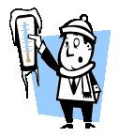
Drying
3 methods
  Sun or tray
  Spray
  freeze

Slide 19

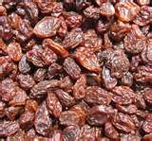
Sun or Tray Drying
Least expensive
Used with products that are already solid like fruits and vegetables
Drying is achieved through exposure to the sun or a current of warm or hot air
Used to make grapes into raisins

Slide 20
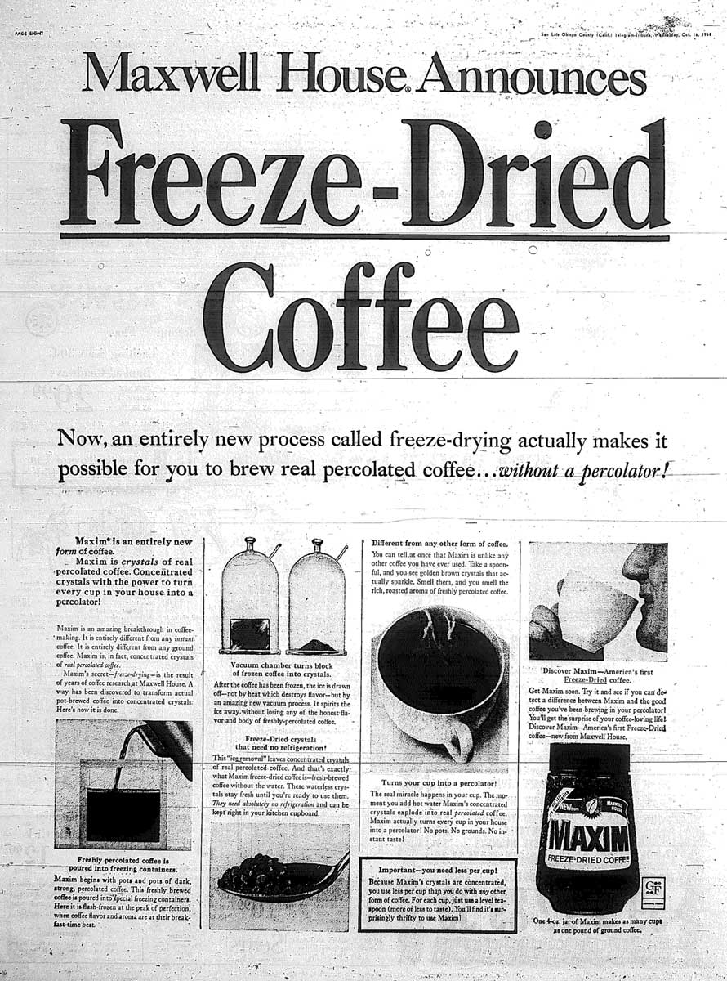
Freeze Drying
Used with heat sensitive products
Moisture is removed without a phase change
Commercially only instant coffee is widely freeze dried

Slide 21
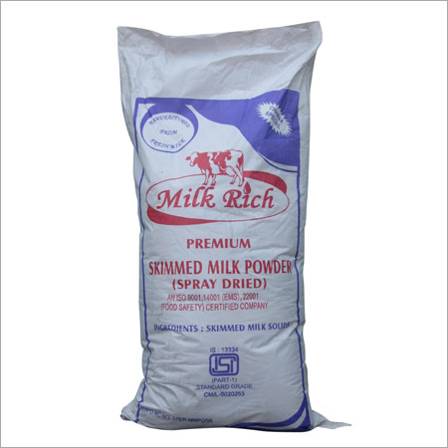
Spray Drying
Most common
Used for fluid products

Slide 22
Forming
Processes
  Compacting
  Pressure
  Extrusion
  Molds
  Powders & binding agents
  Heat and pressure
  Extrusion cooking
Used for
  Hamburger patties, chocolates
  Jellies, tablets, butter, sausages,
  Variety breads, margarine bars,
  cheeses

Slide 23
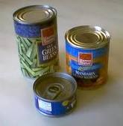
Packaging
Machines operate at high speeds and automatically package food products in a step-wise and automated fashion from forming the container, filling the container, sealing the container, labeling and stacking it
Use a variety of materials

Slide 24
Controlling
Tools include
  Valves
  Thermometers
  Scales
  Thermostats
  Other instruments to control pressure, temperature, fluid flow, acidity, weight, viscosity, humidity, time and specific gravity
All automated

Slide 25
Conserving Energy
Energy intensive
Energy represents a significant share of the costs of the final product
Food processors are always looking for new ways to optimize energy use
Energy requirements are monitored and new and more efficient ways are continually looked for
Examples:
  Heat that is used or removed is captured and used somewhere else in the process

Slide 26
New Processes
Major goal of food scientist and food processing engineers
Always looking to improve quality and/or increase efficiency

Slide 27
Summary
Material handling, cleaning, separating, size reduction, fluid flow, mixing, heat transfer, concentration, drying, forming, packaging and controlling are the units that make up food processing
Most processing involves a combination or overlap of these units of operation
When they do overlap complex controls ensure the proper function or each operation

