Slide 1
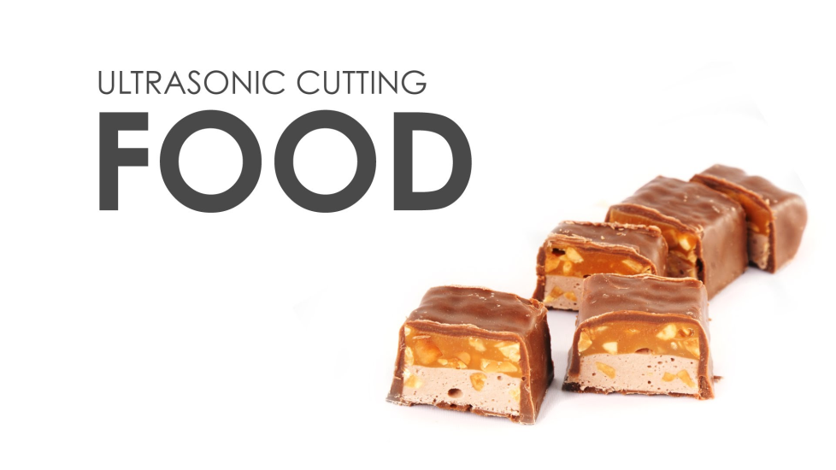
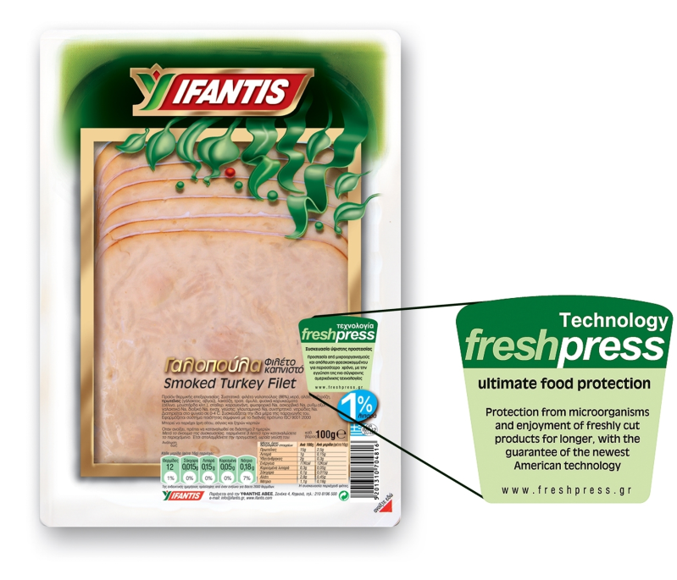

Slide 2
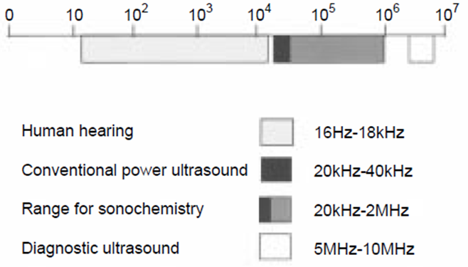
ALTERNATIVE METHODS FOR FOOD TREATMENT
1
Ultrasound treatment - sonication
Sound frequency ranges

Slide 3
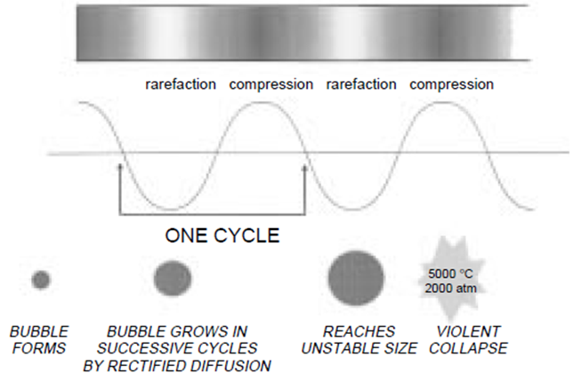
!
ALTERNATIVE METHODS FOR FOOD TREATMENT
2
Ultrasound treatment (sonication) - principle
Sound propagation in a liquid showing cavitation bubble formation and collapse

Slide 4
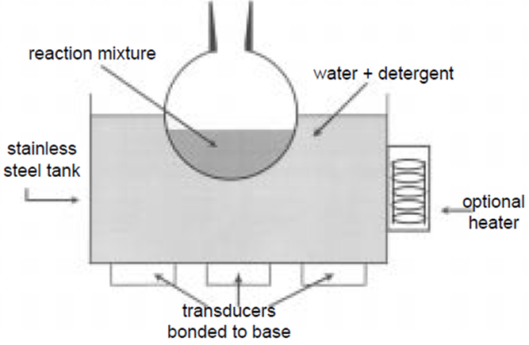
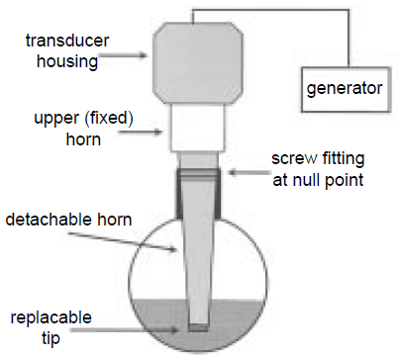
ALTERNATIVE METHODS FOR FOOD TREATMENT
3
Ultrasound treatment (sonication) - equipment
Simplest – ultrasonic baths
Ultrasonic probe system

Slide 5
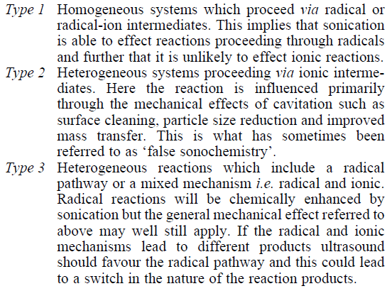
ALTERNATIVE METHODS FOR FOOD TREATMENT
4
Ultrasound treatment (sonication) - mechanism

Slide 6
!
ALTERNATIVE METHODS FOR FOOD TREATMENT
5
Ultrasound treatment (sonication) – food applications
Ultrasound in the food industry
The food industry as well as the pharmaceutical industry offer manifold possibilities for the use of sonication. Ultrasonic processors are used in food manufacturing for:
disintegration of cells
extracting (extract intracellular components or obtain cell-free bacterial enzyme)
activation (acceleration) of an enzyme reaction in liquid foods
acceleration of fermentation
mixing and homogenizing
dispersion of a dry powder in a liquid
emulsifying of oil/fat in a liquid stream
spraying
degassing
inspection, e.g. in the beverage industry
deactivation of enzymes
microbial inactivation (preservation)
crystallization
meat processing
stimulation of living cells
enhanced oxidation

Slide 7
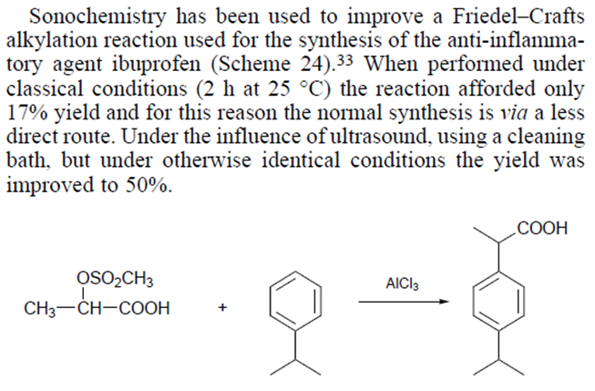
ALTERNATIVE METHODS FOR FOOD TREATMENT
6
Ultrasound treatment (sonication) – non-food applications

