Slide 1

Biaya Transportasi

Slide 2
Pengertian Biaya Transportasi
►Biaya Transportasi adalah biaya yang harus
dikeluarkan untuk melakukan proses
transportasi
►Biaya
tersebut berupa :
Biaya Penyediaan Prasarana
Biaya Penyediaan Sarana
Biaya oprasional Transpor

Slide 3
Pihak Yang menanggung biaya
► Pengguna (Penumpang/penyewa)
Ongkos/ biaya tiket / biaya sewa dan Biaya Waktu
► Pemilik sistem (Operator)
Biaya operasional dan pemeliharaan
► Pemerintah
Biaya infrastruktur dan subsidi
► Daerah
Biaya tidak lansung berupa Land Use, biaya sosial
► Non Pemakai
Biaya perubahan nilai tanah, produktifitas dan biaya
sosial lainnya

Slide 4
Biaya dan tarif Jasa Transportasi
►Biaya transportasi adalah sebagai dasar
penentuan tarif jasa transportasi
►Tingkat tarif ditentukan berdasarkan pada
biaya :
Biaya lansung
Biaya tak lansung
Keuntungan

Slide 5
► Biaya
Lansung
Adalah jumlah biaya yang diperhitungkan dalam
proses produksi yang harus dibayarkan lansung
► Gaji
► BBM
Awak
► Biaya
Di terminal
► Biaya
Tak lansung
Adalah biaya lain dalam menunjang proses produksi
► Biaya
pemeliharaan
► Biaya umum/kantor
► Biaya bunga/nilai uang
► Pajak

Slide 6
Biaya Operasional Kendaraan (BOK)
►Biaya Operasi Kendaraan (BOK) merupakan
penjumlahan dari biaya gerak (running cost)
dan biaya tetap (standing cost)

Slide 7
Biaya Gerak
Konsumsi bahan bakar
Konsumsi olie mesin
Pemakaian ban
Biaya perawatan, onderdil kendaraan dan
pekerjaannya
Biaya awak (untuk kendaraan umum)
depresiasi kendaraan

Slide 8
Biaya Tetap
Biaya akibat bunga
Biaya asuransi
Overhead cost

Slide 9
►BOK untuk jalan dihitung dengan
menggunakan Persamaan yang
dikembangkan PT. PCI (Pacific Consultant
International)
►Kendaraan
golongan
Dikelompokkan menjadi 3
golongan I meliputi kendaraan penumpang,
golongan II A sejenis bus besar dan
golongan II B meliputi jenis truk besar.

Slide 10
Konsumsi Bahan Bakar
(Lt/1000 km)
Jalan TOL
► Kendaraan Gol. I
► Kendaraan Gol IIA
► Kendaraan Gol IIB
: Y = 0,04376 V2 – 4,94076 V + 207,04840
: Y = 0,14461V2 – 16,10285 V + 636,50343
: Y = 0,13485 V2 – 15,12463 V + 592,60931
Jalan Arteri
► Kendaraan Gol. I : Y = 0,05693 V2 – 6,42593 V + 269,18567
► Kendaraan Gol II A : Y = 0,21692V2 – 24,15490 V + 954,78624
► Kendaraan Gol II B : Y = 0,21557 V2 – 24,17699 V + 947,80862

Slide 11
Konsumsi Olie (Lt/ 1000 km)
Jalan TOL
► Kendaraan Gol. I : Y = 0.00029 V2 – 0.03134 V + 1.69613
► Kendaraan Gol II A : Y = 0.00131 V2 – 0.15257 V + 8.30869
► Kendaraan Gol II B : Y = 0.00118 V2 – 0.13770 V + 7.54073
Jalan Arteri
► Kendaraan Gol. I : Y = 0.00037 V2 – 0.04070 V + 2.20403
► Kendaraan Gol. II A : Y = 0.00209 V2 – 0.24413 V + 13.29445
► Kendaraan Gol. II B : Y = 0.00186 V2 – 0.22035 V + 12.06486

Slide 12
Pemakaian Ban /1000 km
►
Kendaraan Gol. I
Kendaraan Gol. II A
Kendaraan Gol. II B
: Y = 0.0008848 V – 0.0045333
: Y = 0.0012356 V – 0.0065667
: Y = 0.0015553 V – 0.0059333
►
►
Suku Cadang / 1000 km
Kendaraan Gol I
: Y = 0.0000064 V + 0.0005567
Kendaraan Gol II A : Y = 0.0000332 V + 0.0020891
Kendaraan Gol II B : Y = 0.0000191 V + 0.0015400

Slide 13
Montir / 1000 km
Kendaraan Gol I
Kendaraan Gol II A :
Kendaraan Gol II B :
Depresiasi / 1000 km
Kendaraan Gol. I
Kendaraan Gol II A
Kendaraan Gol II B
:
Y = 0.00362 V + 0.36267
Y = 0.02311 V + 1.97733
Y = 0.01511 V + 1.21200
: Y = 1/(2.5 V + 125)
: Y = 1/(9.0 V + 450)
: Y = 1/(6.0 V + 300)

Slide 14
Biaya Bunga / 1000 km
►
Kendaraan Gol I
: Y = (0.15 * 1000) / (500 V)
► Kendaraan Gol II A : Y = (0.15 * 1000) / (2571.42857 V)
► Kendaraan Gol II B : Y = (0.15 * 1000) / (1714.28571 V)
Biaya Asuransi / 1000 km
►
Kendaraan Gol I
: Y = 38 / (500 V)
► Kendaraan Gol II A : Y = 60 / (2571.42857 V)
► Kendaraan Gol II B : Y = 61 / (1714.28571V)

Slide 15

Estimating Fuel Consumption in Traffic models
Presented by
Paul Emmerson
Head of Transport modelling
To CONTRAM USER GROUP 2007
30 November 2007

Slide 16
First a disclaimer!
This presentation is based on personal experiences of trying to relate the different demand of emission models and traffic models over the past year
The view given are not necessarily those of the CONTRAM Development team, TRL of the DfT.

Slide 17
Fuel consumption modelling in the early eighties
Fuel consumption relationships were developed that took account of the detailed traffic output from the more sophisticated traffic models of the time not simply a function of speed
For instance -

Slide 18
CONTRAM 5- RR249 Appendix F
Includes the effect of speed fluctuations and queuing and allowed the fuel consumed during queuing to calculated separately
and

Slide 19
TRANSYT
Again uses estimates of idle emissions and number of stop starts
F = O.1*L+1.5D + 0.008S
  where, in a specified period of time:
  F is the total fuel consumed in litres
  L is the total distance travelled in vehicle-kilometres
  D is the total delay in vehicle hours, and
  S is the total number of stop/starts
(LR 934 – validated by running a car around Glasgow City centre)
Notes:
Similar model for SATURN again to updating since first developed in the early eighties

Slide 20
However…
These sophisticated traffic–based fuel models from the early 80’s have all but disappeared and the coefficients in them are hard to keep updated (apart from simple constant factoring)
Instead the emphasis has been on variations between vehicles rather than on traffic conditions
For example:-

Slide 21
CONTRAM – MODEM formulae.
‘simple speed effect i.e.
  y = a₀ + a₋₁/V + a₂V²
But a large number of vehicle types – vehicle type, Euro class, engine size
Various names for the runs – current ones can be found in the National Atmospheric Emmisions Inventory (http://www.naei.org.uk/datachunk.php?f_datachunk_id=8).
TRL is current upgrading these values both for fuel consumption and emissions.
The emphasis now is on standardisation so each vehicle is ‘run’ over the same drive cycle – now usually on a dynamometer
The number of drive cycles tested is very limited
Notes:
Main thrust from emissions modelling

Slide 22
Current methodology
Still need for estimating fuel consumption in traffic models
  Most models use externally derived relationship or Government values – in UK (WebTAG 3.5.6)
  Either internally within the traffic model or externally as part of appraisal i.e TUBA
Gives fuel in the form of CO₂ by vehicle class is a function as follows:-
EF(g CO2/km) = (a + b.v + c.v^2 + d.v^e + f.ln(v) + g.v^3 + h/v + i/v^2 + j/v^3).x But most relationships do not use all the possible parameters but virtually all involve at least a simple inverse function.

Slide 23
Developing fuel consumption equations for COBA/WEBTAG
Fuel consumption values from say 20 kms/hr to 120 kms/hr are estimated from the above relationships
A weighted value for each speed value is estimated by taking into account the proportions of vehicle types with a vehicle class.
These new values are then used to estimate the fuel consumption for each of the major vehicle classes (petrol, diesel cars, LGV, HGVs etc)

Slide 24
Current relationships
L = a + b.v + c.v² + d.v³
Where:
L = consumption, expressed in litres per kilometre;
v = average speed in kilometres per hour; and
a, b, c, d are parameters defined for each vehicle category.

Slide 25
Issues arising
Currently the emission modelling is dictating the data on which the fuel consumption equations are based
  Health warning are put on the values for speeds lower than say 10kms/hr by emissions modellers since this is outside the range of the ‘average ‘ speeds for any drive cycle but these are speeds commonly found in congested conditions.
Is the dynamometer data good enough for the type of relationship traffic modellers want
Is the form of the relationship correct for traffic modelling

Slide 26
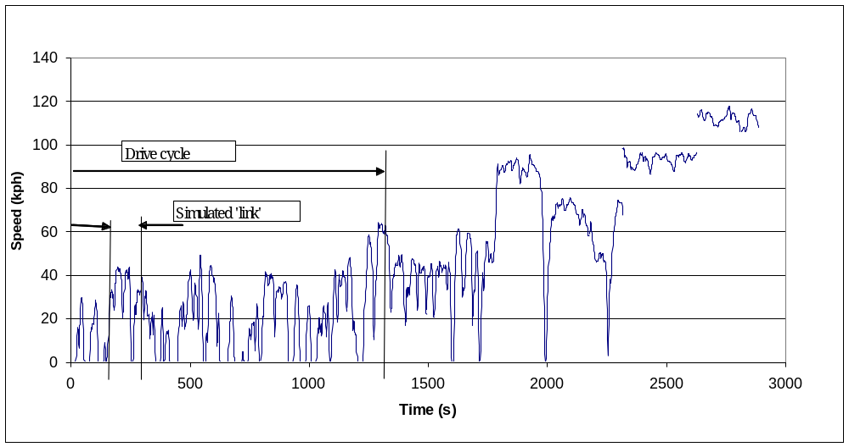
Example of Drive-cycle data
Notes:
CO2 emissions data were obtained from measurements on a single Euro III gasoline car driven over 5 cycles. These cycles were based on real driving patterns developed by TRL, based on the road routes previously used by Warren Spring Laboratory around Stevenage and Hitchin. These are the urban, suburban, rural, Motorway 90km/h and Motorway 113km/h cycles. The rural cycle was split to obtain an extra point to complete a more balanced speed curve giving 6 drive cycles. An example of a full drive cycle is shown in Figure 1 which shows all the test cycles together.

Slide 27
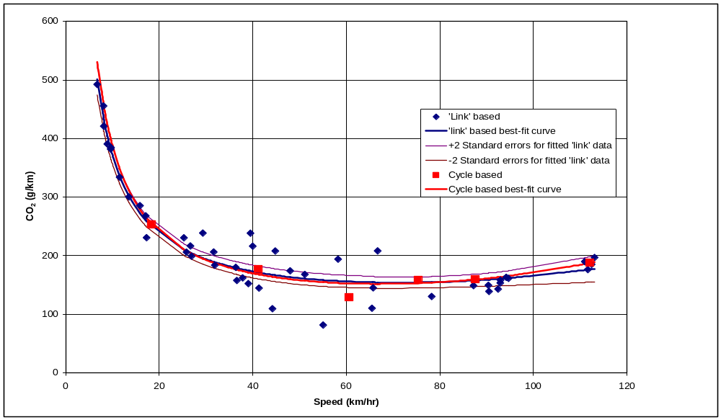
Plotting curves based on ‘link’ data
Euro III car
Notes:
Fitted data of CO2 emissions v average speed for Euro III car using disaggregated drive cycle data simulating links and the original drive cycle data
Best fit form = Form of Equation: a+b/v+cv3

Slide 28
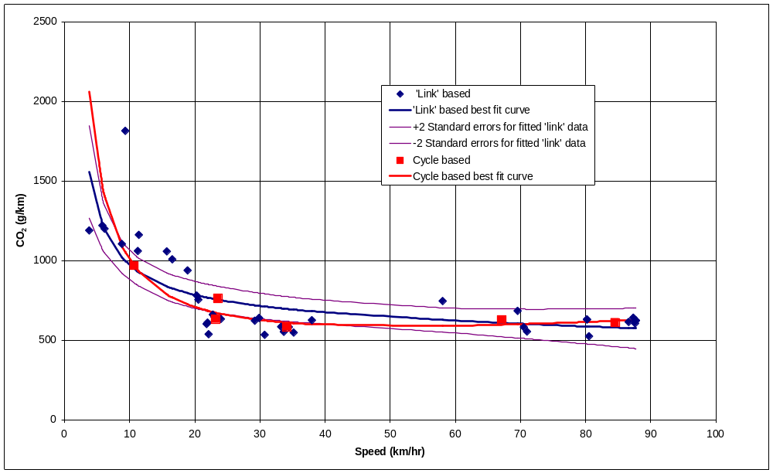
Euro III 17 tonne truck
Notes:
Euro III 17 tonne truck using disaggregated drive-cycle data simulating links and the original drive-cycle data

Slide 29
Tentative conclusions
For the car data the fact that the speed range of the drive cycle data is less than ideal for traffic modelling purposes is not serious
For the lorry data the differences are greater but they do not invalidate the use of estimates of fuel consumption for speed values less than 10km/hr

Slide 30
Is the form of the relationship correct for traffic modelling?
What was obvious from the previous work was that all the individual vehicle types in included an inverse function of speed when related to litres/co2 per kms.
But
The current WebTAG (3.5.6) guidance is a simple cubic equation.
Examples:-

Slide 31
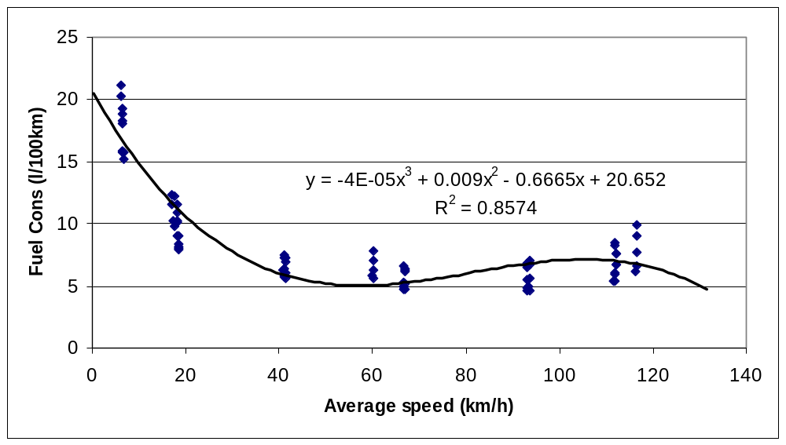
Cubic form
Notes:
Cubic (3rd order polynomial) curve fitted to l/100km data
Poor predictions at extrapolated extremities

Slide 32
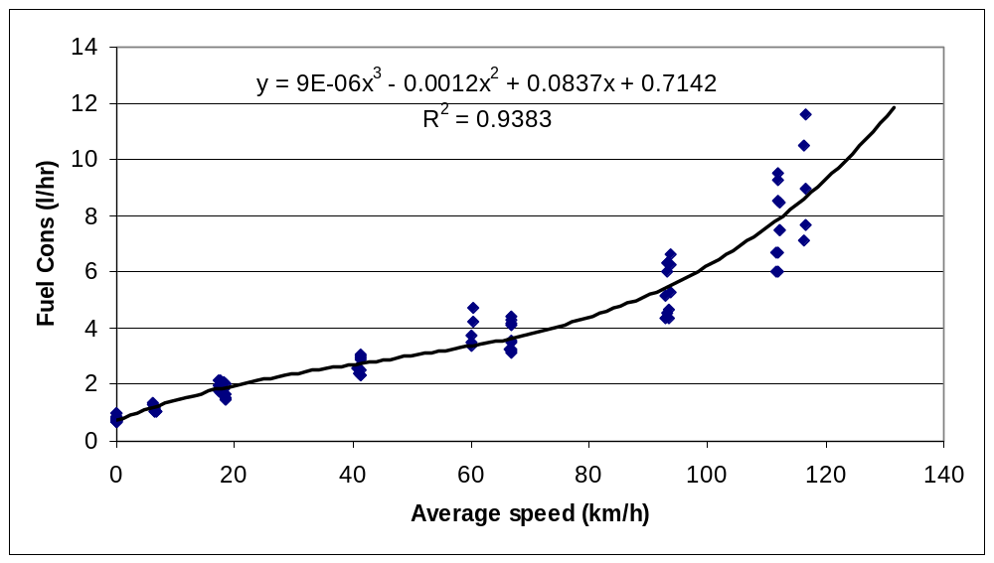
Inverse form fitted as litre/hr
Notes:
Cubic (3rd order polynomial) curve fitted to l/hr data
Idle data can be included
Good predictions at extremities
Currently being used to up date fuel consumption equations

Slide 33
Conclusions
There has been changes in the ‘best-practice’ fuel consumption modelling as the importance of the emissions modelling work has dominated research
There are potential problems with using this data for estimating fuel consumption within traffic models but
  The limited research suggests that the lack of data over low speeds may not as serious as first thought.
  Care must be taken with the from of equation used so that the relevant end constraints are met. – infinite consumption per km at zero speed.

