Slide 1
Food Fermentation

Slide 2
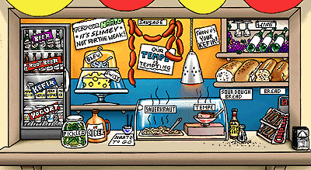
Snack Bar

Slide 3
What are fermented foods?
Foods or food ingredients that rely on microbial growth as part of their processing or production

Slide 4
Food Fermentation
Metabolic activities occur during fermentation that:
  Extend shelf life by producing acids
  Change flavor and texture by producing certain compounds such as alcohol
  Improve the nutritive value of the product by:
    Microorganisms can synthesize vitamins
    Breakdown indigestible materials to release nutrients, i.e., bound nutrients

Slide 5
Fermented Foods
Foods fermented by yeast
  Malt→Beer
  Fruit (grapes) → Wine
  Rice → Saki
  Bread dough → Bread
Foods fermented by mold
  Soybeans → Soy sauce
  Cheese → Swiss cheese
Foods fermented by bacteria
  Cucumbers → Dill pickles
  Cabbage → Sauerkraut
  Cream → Sour cream
  Milk → Yogurt

Slide 6
Food Fermentations – Definitions
Anaerobic breakdown of an organic substrate by an enzyme system in which the final hydrogen acceptor is an organic compound
  Example:
  NADH₂ NAD
  Pyruvic acid Lactic acid
  (CH₃-CO-COOH) (CH₃-CHOH-COOH)
Biological processes that occur in the dark and that do not involve respiratory chains with oxygen or nitrate as electron acceptors

Slide 7
Food Fermentations – Biochemistry
Sugars … Acids … Alcohols, Aldehydes
Proteins … Amino acids … Alcohols, Aldehydes
Lipids … Free fatty acids … Ketones

Slide 8
Respiration vs. fermentation
Refer to how cells generate energy from carbohydrates
RESPIRATION:
Glycolysis + TCA (Kreb’s) Cycle + Electron Transport
O₂ is final electron acceptor
Glucose is completely oxidized to CO₂
C₆H₁₂O₆ + 6 O₂ 6 CO₂ + 6 H₂O + 38 ATP
(Glucose)
Notes:
“Fermentation” is used broadly – describe where the use of the word comes from.
ATP=main chemical energy in a cell.

Slide 9
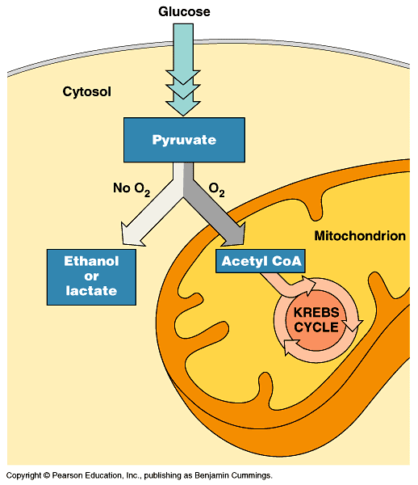
Some organisms (facultative anaerobes), including yeast and many bacteria, can survive using either fermentation or respiration.
For facultative anaerobes,
pyruvate is a fork in the
metabolic road that leads
to two alternative routes.
Fig. 9.18
Copyright © 2002 Pearson Education, Inc., publishing as Benjamin Cummings

Slide 10
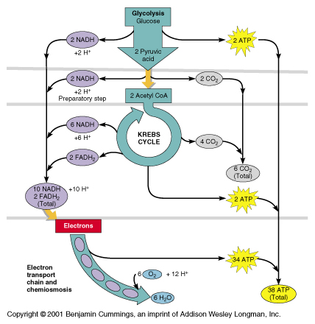

Slide 11
Respiration vs. fermentation
FERMENTATION:
An organic compound is the final electron acceptor
Glucose is converted to one or more 1-3 carbon
compounds
Examples:
C₆H₁₂O₆ 2 CH₃-CH₂OH + 2CO₂ + 2 ATP
(Glucose)
(ethanol)
C₆H₁₂O₆ 2 CH₃-CHOH-COOH + 2 ATP
(lactic acid)
C₆H₁₂O₆ CH₃-CHOH-COOH +
CH₃-CH₂OH + CO₂ + 1 ATP
Notes:
In this class, we will deal mostly with m/o that are generating energy by fermentation.
Why would a cell ferment vs. respire (since less energy is produced)? Can’t respire, can, but no oxygen present.
Produces less energy than respiration, but no oxygen required.
From food standpoint, byproducts are important.

Slide 12
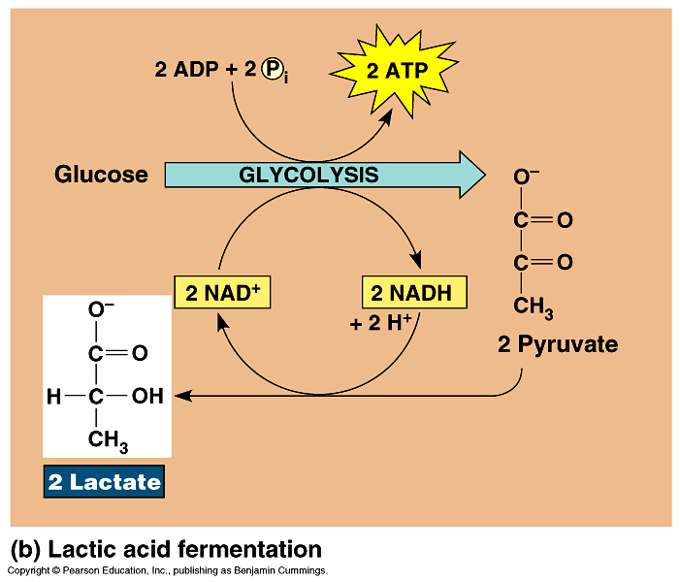
During lactic acid fermentation, pyruvate is reduced directly by NADH to form lactate (ionized form of lactic acid).
  Lactic acid fermentation by some fungi and bacteria is used to make cheese and yogurt.
Copyright © 2002 Pearson Education, Inc., publishing as Benjamin Cummings

Slide 13
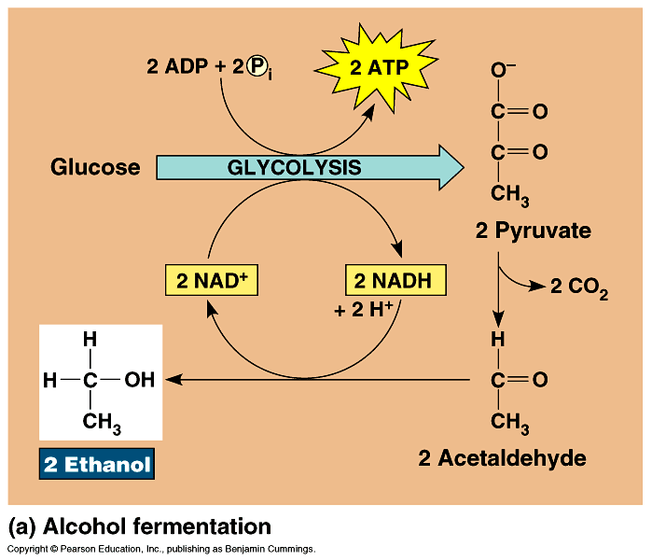
In alcohol fermentation, pyruvate is converted to ethanol in two steps.
  First, pyruvate is converted to a two-carbon compound, acetaldehyde by the removal of CO₂.
  Second, acetaldehyde is reduced by NADH to ethanol.
  Alcohol fermentation
  by yeast is used in
  brewing and
  winemaking.
Fig. 9.17a
Copyright © 2002 Pearson Education, Inc., publishing as Benjamin Cummings

Slide 14
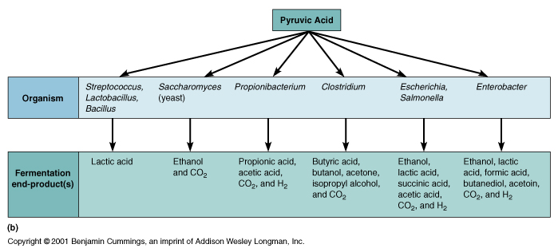

Slide 15
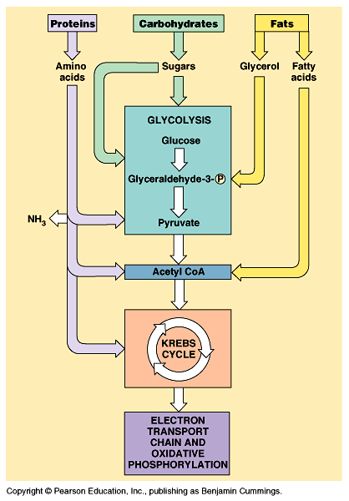
Carbohydrates, fats, and proteins can all be catabolized through the same pathways.
Fig. 9.19
Copyright © 2002 Pearson Education, Inc., publishing as Benjamin Cummings

Slide 16
Respiration vs. fermentation
Some cells can respire and ferment sugars for energy. The cell will do one or the other depending on the conditions.
Example: Saccharomyces cerevisiae (baker’s, ale and wine yeast).
Some cells can only respire or only ferment sugars for energy.
Example: Lactic acid bacteria produce energy by fermentation.
Notes:
In this class, we will deal mostly with m/o that are generating energy by fermentation.
Why would a cell ferment vs. respire (since less energy is produced)? Can’t respire, can, but no oxygen present.
Produces less energy than respiration, but no oxygen required.
From food standpoint, byproducts are important.

Slide 17
Important organisms
lactic acid bacteria
Lactobacillus | Carnobacterium
Leuconostoc | Enterococcus
Pediococcus | Lactococcus
Streptococcus | Vagococcus
yeasts
Saccharomyces sp. (esp. S. cerevisiae) | Zygosaccharomyces | Candida
molds
Aspergillus | Penicillium | Geotrichum | Rhizopus

Slide 18
Typical fermentation process
substrate disappears as cell mass increases
sugar, then other small molecules, then polymers used
primary metabolic products (acids) accumulate during growth
pH drops if acids produced
growth and product formation stop as substrate is depleted
microbial succession depends on substrate and acid levels

Slide 19
Food Fermentations
In food fermentations, we exploit microorganisms’ metabolism for food production and preservation.
Where do the microorganisms come from to initiate the food fermentation?
Two ways to initiate a food fermentation….
...traditional & controlled fermentations
Notes:
Fermentative energy pathways that we are expoiting

Slide 20
Controlled vs. Natural Fermentation
Natural fermentation
  Create conditions to inhibit undesirable fermentation yet allow desirable fermentation
  Examples:
    Vegetable fermentations
      Vegetables + salt

Slide 21
Controlled vs. Natural Fermentation
Controlled fermentation
  Deliberately add microorganisms to ensure desired fermentation
    Example: fermented dairy products
      Lactose … Lactic acid
      Starter culture
        Lactics or Lactic starter or Lactic acid bacteria (LAB)

Slide 22
Traditional Fermentation
Incubation
under specific
conditions
Raw material with indigenous microflora
Final product
= desirable m/o’s
= undesirable (pathogen or spoilage) m/o’s
Disadvantage: Process and product are unpredictable depending on source of raw material, season, cleanliness of facility, etc.
Advantage: Some flavors unique to a region or product may only be attained this way.
Notes:
Relies on m/o naturally found in the raw material.
Have been going on for thousands of years. Long before we knew what bacteria and fungi are.
Conditions adjusted so that desirable microorganisms grow.

Slide 23
Controlled Fermentation
Add starter culture
Raw material
Incubation
under specific
conditions
Final product
Advantage: – uniformity, efficient, more control of process and product
Disadvantage: Isolating the right strain(s) to inoculate is not always easy. Complexity of flavors may decrease.
Notes:
Large numbers of desirable m/o’s are added to the raw material.
This is a starter culture.
It helps if raw material is sterile or has reduced natural microflora, so that the added m/o’s dominate quickly.
Conditions adjusted so that desirable (starter culture) m/o’s grow.

Slide 24
Controlled Fermentations: Starter cultures
Two main starter culture types are used to inoculate the raw material:
Pure microbial cultures prepared specifically for a particular food fermentation. (More details on these later.)
“Backslop” method = Using some of the product from a previous successful fermentation to inoculate the next batch of raw material.

Slide 25
Controlled Fermentation: pure cultures
Add pure microbial culture
Raw material
Incubation
under specific
conditions
Pure culture
Final product
Notes:
Provides most control
First used in the 1890s.

Slide 26
Controlled Fermentation: “backslop” method
Add product (or byproduct) from a recent successful fermentation
Raw material
Incubation
under specific
conditions
Final product from a previous fermentation (traditional or controlled)
Final product
Mainly used in home applications in the U.S. – home production of yogurt and sourdough
Notes:
Can pass on undesirable organisms too.
Balance of live organisms may change in final product.
Used in the old days. Not common now on an industrial scale because of the risk of contamination.

Slide 27
Summary
Why we ferment foods
Microbial energy metabolism: respiration vs. fermentation
Traditional fermentations – indigenous microflora
Controlled fermentations – starter culture added

Slide 29
Food products
from milk:
  cheese, yogurt, sour cream, buttermilk
  lactic acid bacteria (lactobacilli, streptococci)
meats:
  fermented sausages, hams, fish (Asia)
  lactic acid bacteria (lactobacilli, pediococci), molds

Slide 30
beverages:
beer (yeasts make ethanol)
wines (ethanol fermentation from grapes, other fruits)
vinegar (ethanol oxidized to acetic acid)
breads:
sourdough (yeast + lactobacilli)
crackers, raised breads (yeasts)

Slide 31
single cell protein:
how cheaply and efficiently can cells be grown?
  waste materials as substrate (bacteria, yeast, molds)
  sunlight and CO2 (algae)
uses in animal feeds (frequently) or human foods
prefer protein to whole cells
  high nucleic acids --> kidney stones,

Slide 32

Organic acids
Primary Metabolites
Organic acids are. (primary products of metabolism).
During the log phase of growth the products produced are essential to the growth of the cells.
Secondary metabolites:
(Secondary products of metabolism)
During the stationary phase some microbial cultures
synthesize compounds which are not produced during
the trophophase* and do not appear to have any
obvious function in cell metabolism.(idiophase*)

