Slide 1
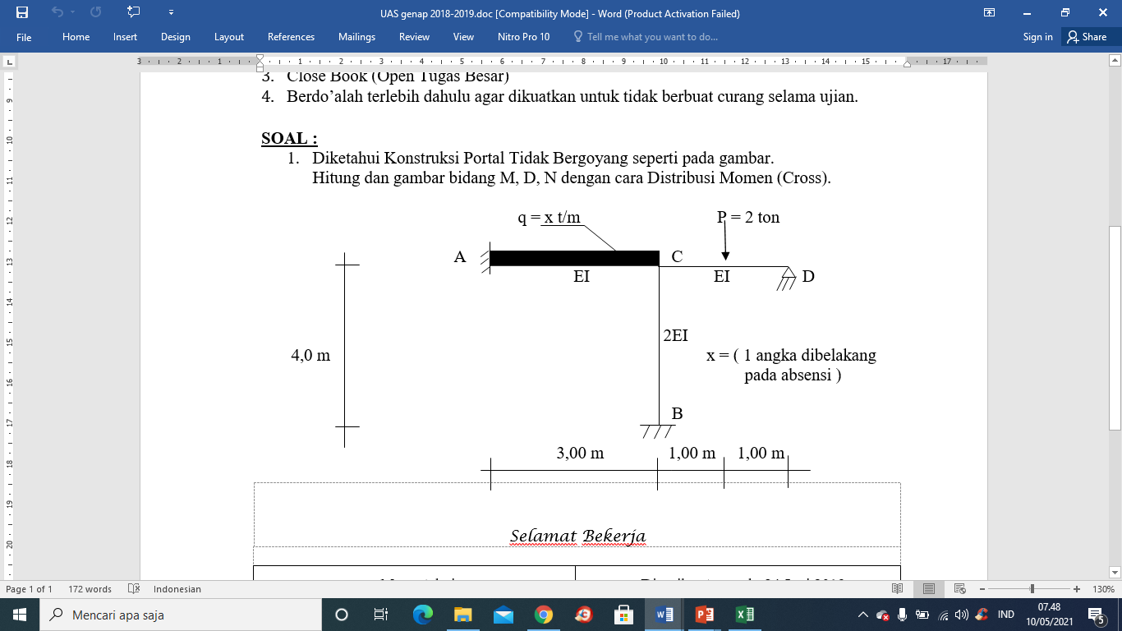
3
JAWABAN TUGAS 2
PORTAL TIDAK BERGOYANG

Slide 2
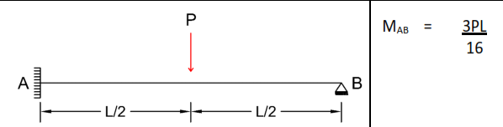
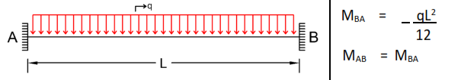
Momen Primer
MCD = - 3. 2 . 2 / 16 = - 0,75 t.m
MAC = -3. 3^2/12 = - 2,25 t.m
MCA = + 2,25 t.m
C
Angka kekakuan batang:
Titik C
K ca = 4EI/L = 4. EI/3 = 1,33 EI
K CD = 3 EI/L = 3.EI/2 = 1,5 EI
K CB = 4EI/L = 4.(2EI)/4 = 2EI
Sigma K c = 4,83 EI
Faktor Distribusi:
Titik A
FD AC = 0 (ujung jepit)
Titik C
FD CA = kca/∑kC = 1,33 EI/4,83 EI = 0,28
FD CD = 0,31
FD CB = 0,41
FD titik B
FD BC = 0 (ujung Jepit)
Titik D
FD DC = 1 (ujung sendi)
∑FD c = 1

Slide 3
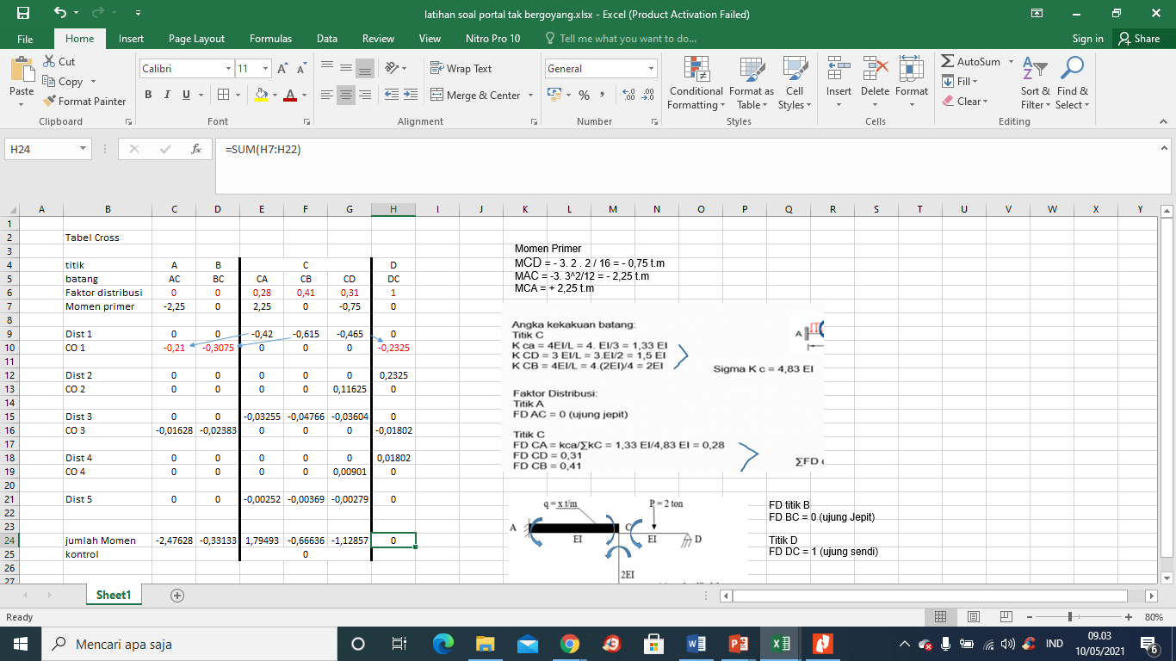

Slide 4
1,795
-2,476
-1,129
-0,666
-0,331

Slide 5
3,00 m
1,00 m
1,00 m
Mencari Reaksi Tumpuan :
3 t/m
1,795
-2,476
-1,129
2/2 = 1 t
3x3/2 = 4,5 t
1,129/2 = 0,5645 t
2,476/3 = 0,825 t
1,795/3 = 0,598 t
0,249 t
1,5645 t
0,4355 t
-0,666
4,727 t
4,273 t
Kontrol :
P – 1,5645 – 0,4355 = 0
0,666/4 = 0,1665
0,331/4 = 0,08275
4,00 m
Kontrol :
(3 x 3) - 4,727 – 4,273 = 0
-0,331
0,249 t

Slide 6
Free Body Diagram
1,795
0,249 t
0,249 t
5,8375 t
-2,476
-1,129
4,273 t
0,4355 t
-0,666
1,5645 t
4,727 t
0,249 t
-0,331
0,249 t
4,273+1,5645 = 5,8375 t

Slide 7
Bidang Gaya Lintang (D)
4,727 t
1,5645 t
x
4,273 t
0,4355 t
0,249 t

