Slide 1
PORTAL 3 SENDI TIDAK SIMETRIS STATIS TERTENTU

Slide 2
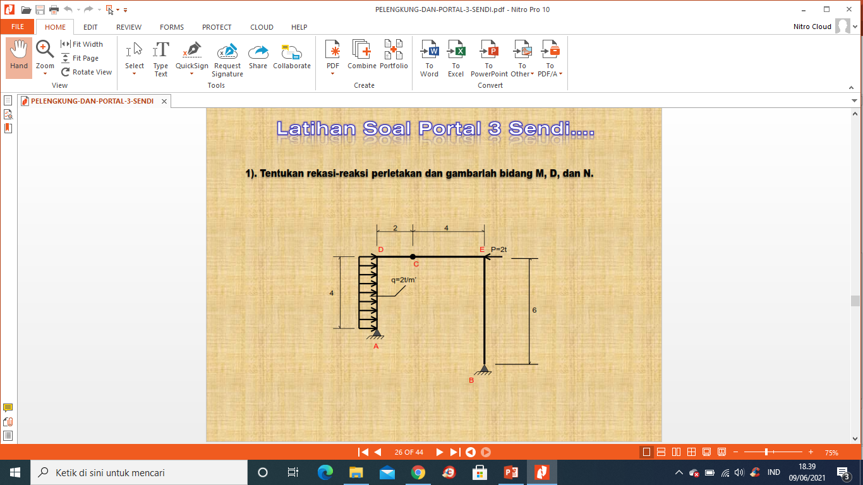
Ha
Hb
Va
Vb

Slide 3
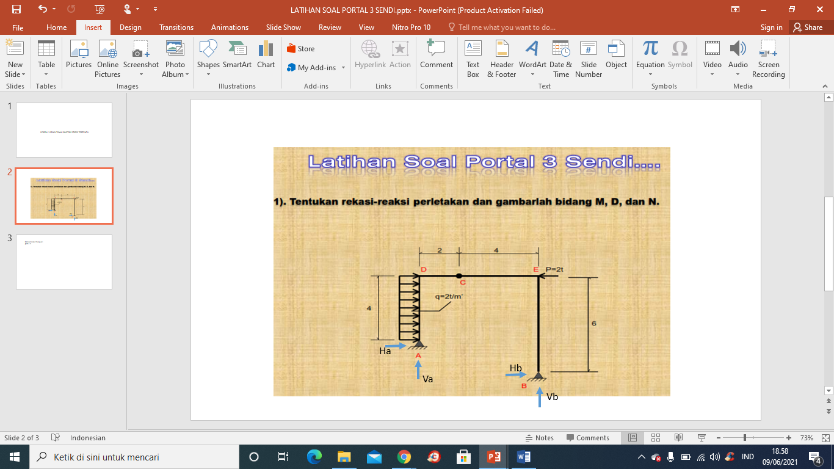
Mencari reaksi Tumpuan:
∑MA = 0
Vb. 6 – Hb.2 – P.4 + (q.4) . 2 =0
6Vb – 2Hb – 8 + 16 = 0
6 Vb + 2 Hb = 8
3 Vb + Hb = 4 ......................(1)
∑MB = 0
Va.6 + Ha.2 +(q.4) . 4 – P.6 = 0
3Va + Ha + 16 – 6 =0
3Va +Ha = - 10 ................(2)
∑MC = 0 (kiri)
Va. 2 – Ha. 4 –(q.4). 2 = 0
Va- 2Ha = 8 ..................... (3)
∑MC = 0 (kanan)
-vb . 4 –Hb.6 = 0
2Vb + 3Hb = 0 ......................(4)
(1) X 3 → 9 Vb + 3 Hb = 12
2 Vb + 3 Hb = 0
7 Vb = 12
Vb = 1,71 ton
---→ 3. 1,71 + Hb = 4
Hb = - 1,13 ton
Atau Hb = 1,13 ton
(2) → 3Va +Ha = - 10
(3)x3 → 3 Va – 6 Ha = 24
7 Ha = - 34
Ha = - 4,86 ton
Atau Ha = 4,86 t
→ 3Va + (- 4,86 ) = - 10
Va = -5,14/3 = -1,71 ton
-
-

Slide 4
Kontrol :
∑H = 0
(q.4) – P – Ha – Hb = 0
8 – 2 – 4,86 – 1,13 = 0
0 = 0
Mc= - Va.2 +Ha.4 – (q.4).2
= - 3,42 + 19,44 -16
= 0
Me = - Hb.6 = - 6,78 t.m
Mencari Momen :
Ma = 0
Mb = 0
Batang A-D
Mx = Ha. X – (q.x). x/2
X= 0 M0= 0
X= 1m M1= 3,86 t.m
X=2m M2= 5,72 t.m
X=3m M3= 5,58 tm
X=4m M4= 3,44 t.m
x
Ha= 4,86 t
Hb= 1,13 t
Va= 1,71 t
Vb= 1,71 t

Slide 5
1,71 t
3,14 t
1,13 t
Me = - 6,78 t.m
(8-4,86)=3,14 t
1,71 t
M D = 3,44 t.m
1,71 t
1,71 t
1,13 t
8 t
Hb= 1,13 t
Va= 1,71 t
Ha= 4,86 t
Vb= 1,71 t

