Slide 1



FEBRIAN MD

Slide 2

2D Animation with Flash
Macromedia was acquired by Adobe Systems in 2005, and the entire Macromedia product line including Flash, Dreamweaver, Director/Shockwave and Authorware is now handled by Adobe.
In 2007, Adobe released Adobe Flash CS3 Professional, the first version released under Adobe, and the ninth major version of Flash. It introduced the ActionScript 3.0 programming language, which supported modern programming practices and enabled business applications to be developed with Flash. Adobe Flex Builder (built on Eclipse) targeted the enterprise application
development market, and was also released the same year. Flex Builder included the Flex SDK, a set
of components that included charting, advanced UI, and data services (Flex Data Services).
In 2008, Adobe released the historic tenth version of Flash, Adobe Flash CS4. Flash 10 improved animation capabilities within the Flash editor, adding a motion editor panel (similar to Adobe After Effects), inverse kinematics (bones), basic 3D object animation, object-based animation, and other advanced text and graphics features. Flash Player 10 included the first in-built 3D engine (without GPU acceleration), that allowed basic object transformations in 3D space (position, rotation, scaling).

Slide 3
Also in 2008, Adobe released the first version of Adobe Integrated Runtime (later re-branded as Adobe AIR), a runtime engine that replaced Flash Player, and provided additional capabilities to the ActionScript 3.0 language to build desktop and mobile applications. With AIR, developers could access the file system (files & folders), and connected devices (joystick, gamepad, sensors) for the first time.
In 2011, Adobe Flash Player 11 was released, and with it the first version of Stage3D, allowing for GPU-accelerated 3D rendering for Flash applications and games, on desktop platforms such as Microsoft Windows and Mac OS X.^{[27]} Adobe further improved 3D capabilities from 2011 to 2013, adding support for 3D rendering on Android and iOS platforms, alpha- channels, compressed textures, texture atlases, and other features.^{[28][29]} Adobe AIR was upgraded to support 64-bit computers, and developers could now add additional functionality to the AIR runtime using AIR Native Extensions (ANE).
In 2014, Adobe AIR reached a milestone when over 100,000 unique applications were built on AIR, and over 1 billion installations of the same were logged from users across the world (May 2014).^{[30][31]} Adobe AIR was voted as the Best Mobile Application Development product at the Consumer Electronics Show for two consecutive years (CES 2014 and CES
_{2015).}[32][33]
In 2016, Adobe changed Flash's name to Adobe Animate. This was because the Flash Player had a bad reputation, and they wanted to seperate it from that.

Slide 4


Slide 5












Slide 6



Slide 7
Types of animation in flash
Motion tweens . Use motion tweens to set properties for an object, such as position and alpha transparency in one frame and again in another frame. Flash then interpolates the property values of the frames in between. Motion tweens are useful for animation that consists of continuousmotion or transformation of an object. Motion tweens appear in the Timeline as a contiguous span of frames that can be selected as a single object by default. Motion tweens are powerful and simple to create.
Classic tweens are like motion tweens, but are more complex to create. Classic tweens allow for some specific animated effectsnot possible with span-based tweens.
Inverse kinematic poses allow you to stretch and bend shape objects and link groups of symbol instances to make them move together in naturalistic ways. Once you have added bones to a shape or a group of symbols, you can change the position of the bonesor symbols in different keyframes. Flash interpolates the positions in the in-between frames.
In shape tweening, you draw a shape at one specific frame in the Timeline, and change that shape or draw another shape atanother specific frame. Flash Pro then interpolates the intermediate shapes for the frames in between, creating the animation of one shapemorphing into another.
Frame by frame . This animation technique lets you specify different art for each frame in the Timeline. Use this technique to create an effect that is like the frames of a film being played in rapid succession. This technique is useful for complex animation where the graphic elements of each frame must be different.

Slide 8
frame rate
The frame rate, the speed the animation is played at, is measured in number of frames per second (fps). A frame rate that’s too slow makes the animation appear to stop and start; a frame rate that’s too fast blurs the details of the animation.
A frame rate of 24 fps is the default for new Flash documents and usually gives the best results on the web. The standard motion-picture rate is also 24 fps.
The complexity of the animation and the speed of the computer playing the animation affect the smoothness of the playback.
To determineoptimum frame rates, test your animations on a variety of
computers.
Because you specify only one frame rate for the entire Flash Pro document, set this rate before you begin creating animation.

Slide 9
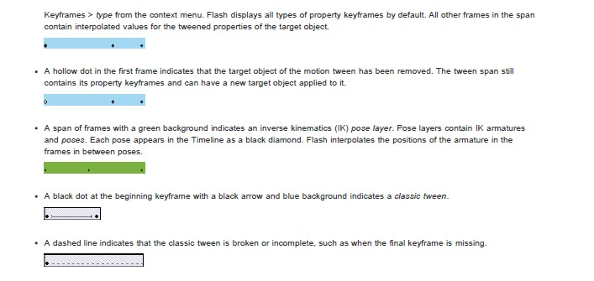

Slide 10
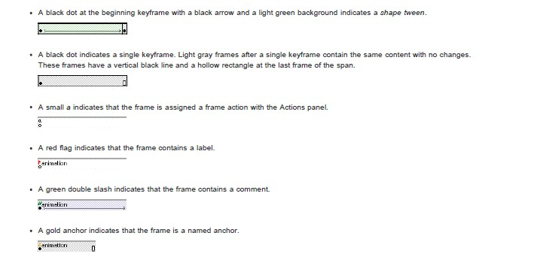

Slide 11
Praktikum 1
User Interface Adobe Flash CS 6
Gambar dan animasi sederhana

