Slide 1
mengenal
INFRASTRUKTUR KOTA #2
infra
structure
urban
mata kuliah perencanaan kota lanjut
dosen pengampu :
ratri septina saraswati

Slide 2
Moda Darat (jalan raya)
Teknologi terkait:
  Sistem Informasi dan Komputasi
  Material
  Energi Alternatif
  Struktur Bangunan
  Navigasi
Teknologi Hybrid
A hybrid vehicle (HV) is a vehicle that uses two or more distinct power sources to propel the vehicle such as:
An on-board rechargeable energy storage system (RESS) and a fueled power source (internal combustion engine) for vehicle propulsion
Air and internal combustion engines; it is also called a bi-energy vehicle.
Human powered bicycle with battery assist.
The term most commonly refers to Hybrid-electric vehicle (HEV) which includes internal combustion engines and electric motors (generally powered by electric batteries, other rechargeable energy storage system -RESS- or overhead wires).

Slide 3



Prinsip dan bagian ke-Ilmu-an terkait:
  Mekanika fluida
    motor bakar
  Energi Alternatif
  Mekanika teknik
  Mekanika bahan
Teknologi terkait:
  Sistem Informasi dan Komputasi
  Material:
    Super-konduktor → MAGLEV
  Struktur Bangunan
  Sinyal dan telekomunikasi

Slide 4
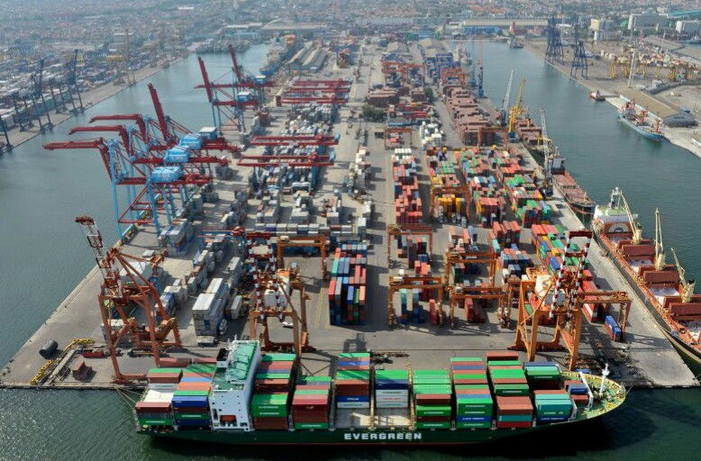
Transportasi Air
Sarana:
Kapal laut, tongkang, perahu
Masih tergantung sumber daya bahan bakar fosil
Efisiensi penggunaan energi tinggi karena daya angkut besar
Mobilitas rendah
Prasarana:
  Pelabuhan dan jalur pelayanan (imajiner)
  Penyesuaian terhadap karakteristik moda dan alur pelayaran pada sistem pelabuhan laut

Slide 5
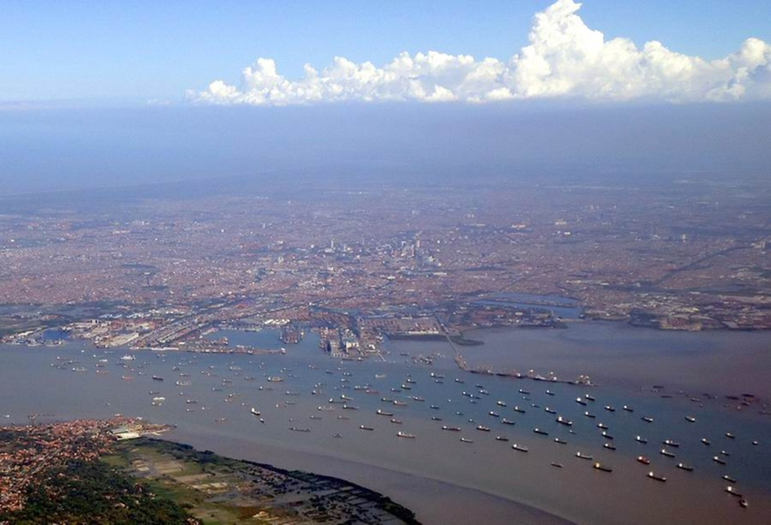

Slide 6
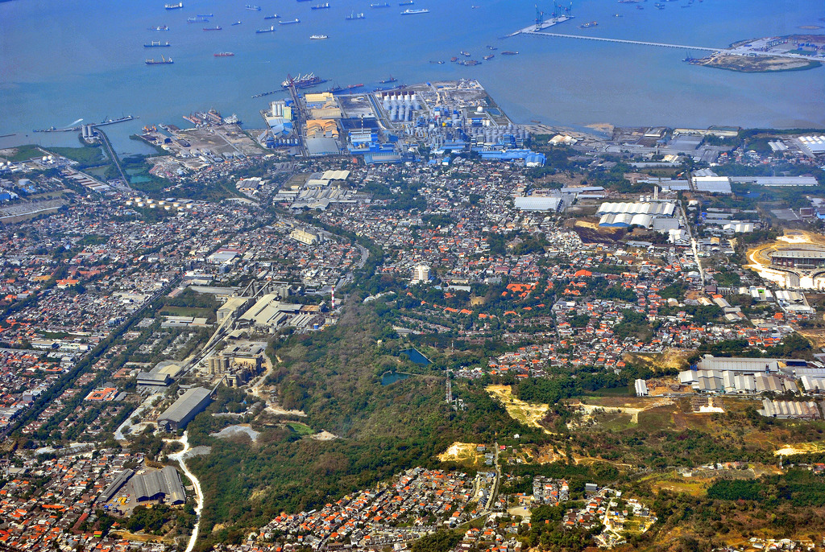

Slide 7
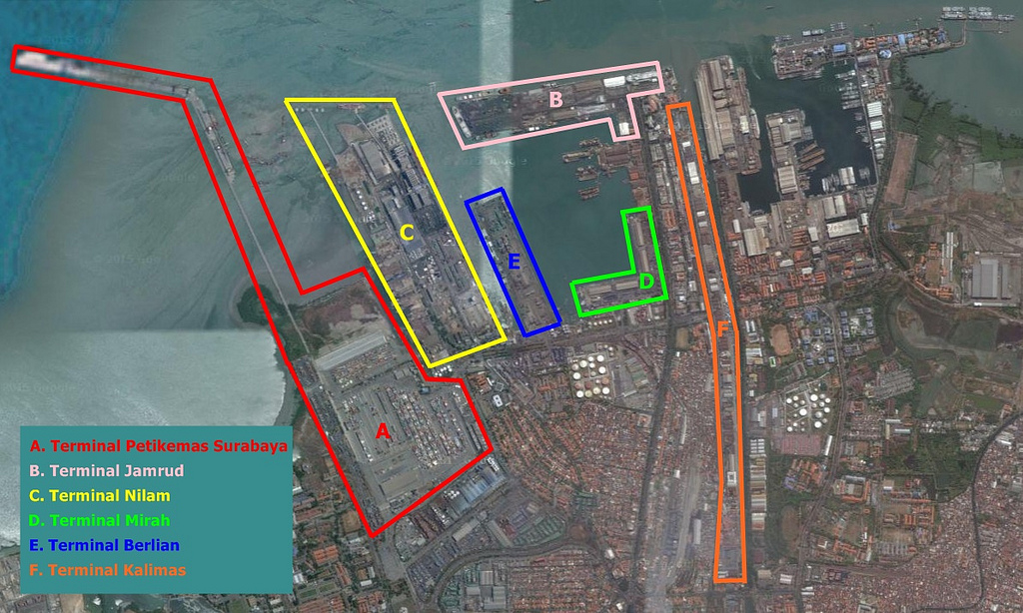
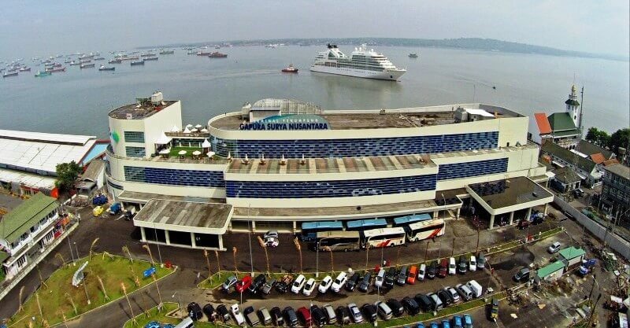

Slide 8
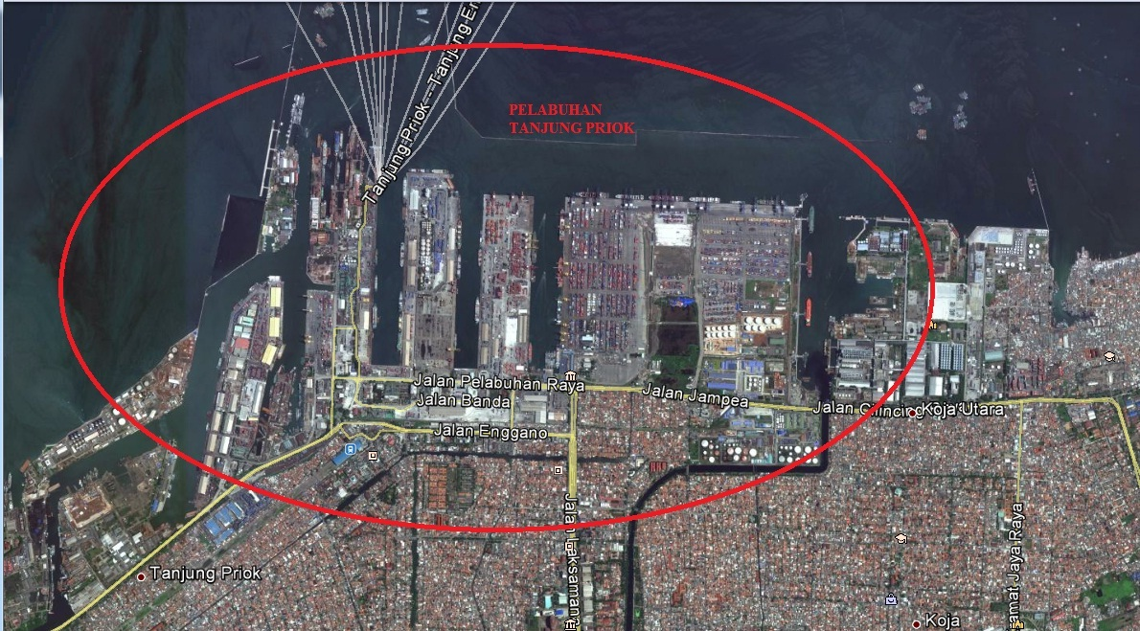

Slide 10
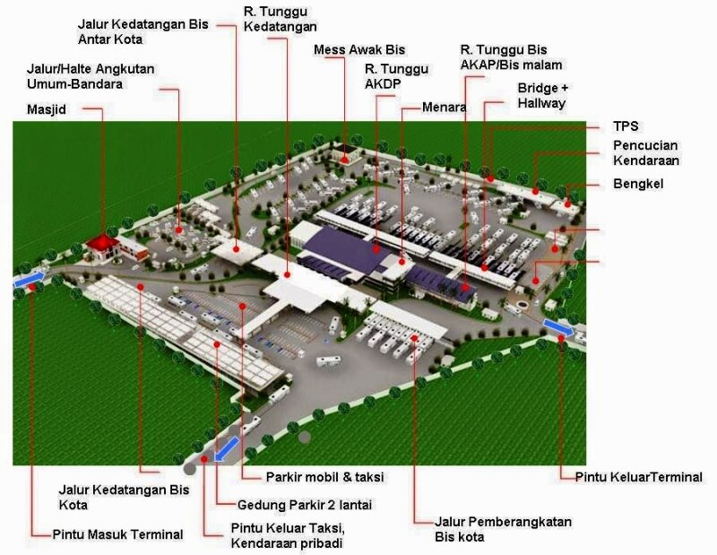

Slide 11


