Slide 1
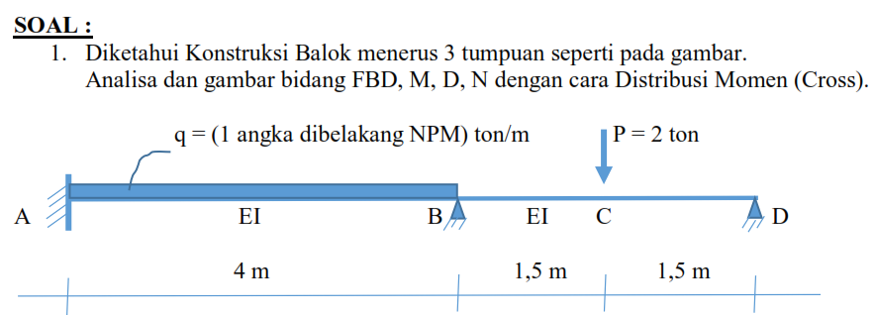
JAWABAN UTS ANALISA STRUKTUR LANJUTAN
BALOK 3 TUMPUAN METODE CROSS

Slide 2
JAWABAN:
MAB
MBA
q = 6 t/m
Kekakuan Batang
Titik B
Batang BA → kAB = kBA = 4 EI/L (jepit-jepit)
= 4EI/4 = EI
Batang BD → kBD = kDB = 3EI/L (jepit-sendi)
= 3EI/3 = EI
A
B
EI
4 m
∑kB = 2 EI
MBD
P=2ton
D
2. Koefisien Distribusi (DF)
Titik A → μAB = 0 (ujung jepit)
Titik B → μBA = kBA/∑kB = EI/(2EI) = 0,5
μBD = kBD/∑kB = EI/(2EI) = 0,5
Titik D → μDB = 1 (ujung sendi)
B
EI
C
1,5m
1,5m
∑μB = 1
3. Momen Primer
Batang AB → MAB = 1/12 . q.L^2 = 8 t.m
MBA = -1/12. q.L^2 = -8 t.m
MBD = 3/16 . P.L = 1,125 t.m
MDB = 0

Slide 3
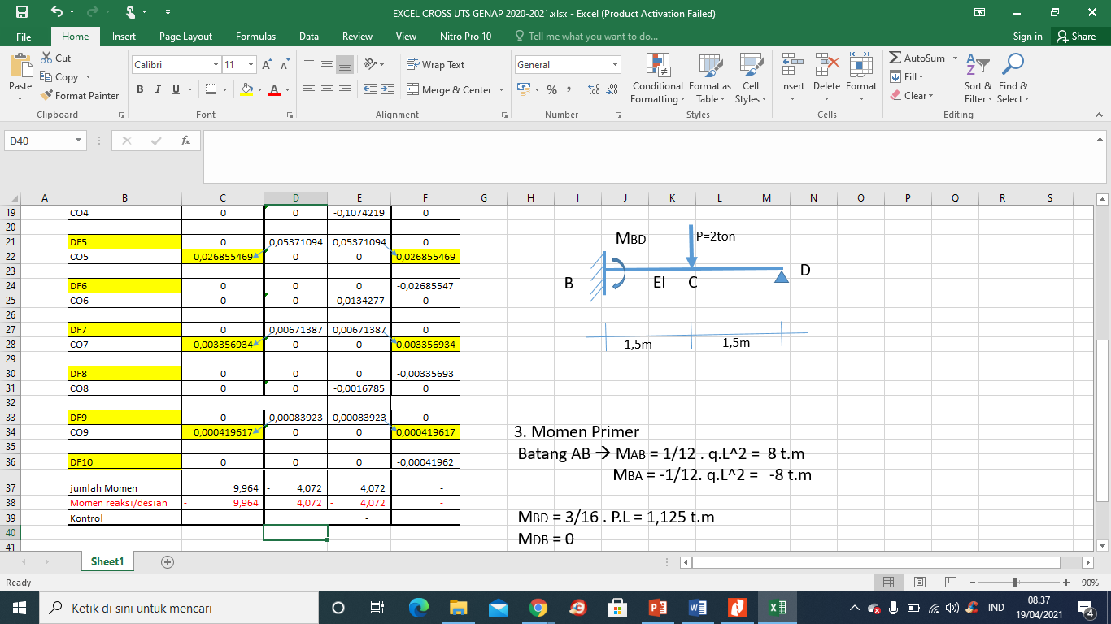
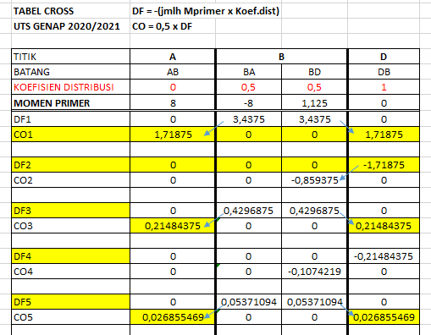

Slide 4
FBD
MAB=-9,964
MBA= 4,072
MBD=-4,072
P=2ton
q = 6 t/m
A
B
D
EI
B
EI
C
4 m
1,5m
1,5m
0,5*(q.4)=12
12
P/2=1
2,491
MAB/L=2,491
MBD/3=1,357
MBA/L= 1,018
1,018
2,357
0,357
10,527
13,473
2
24

Slide 5
GAYA LINTANG/ BIDANG D
MAB=-9,964
MBA= 4,072
MBD=-4,072
P=2ton
q = 6 t/m
A
B
D
EI
B
EI
C
4 m
1,5m
1,5m
13,473
10,527
0,357
2,357
13,473
2,357
+
B
+
C
0,357
X/13,473 = (4-X)/10,527
X = 2,2 m
A
(4-X)
-
D
X
10,527

Slide 6
BIDANG MOMEN
MAB=-9,964
MBA= 4,072
MBD=-4,072
P=2ton
q = 6 t/m
A
B
D
EI
B
EI
C
MC= -0,357. 1,5
= - 0,5355 t.m
4 m
1,5m
1,5m
Av =13,473
10,527
0,357
2,357
X/13,473 = (4-X)/10,527
X = 2,2 m terjadi Mmax.
-9,964
B
-4,072
Mx= Av . X - 9,964 – (q.x).0,5.x
x=0 → MAB = -9,964 t.m
X= 1 m → M1 =
X=2m → M2 =
X= 2,2m → Mmax =
X=3 m → M3=
X=4 m → M 4= MBA= 4,072 t.m
-0,5355
-
-
C
A
+
D
X=2,2m
Mmax
1,5m
1,5m

