Slide 1
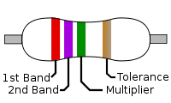
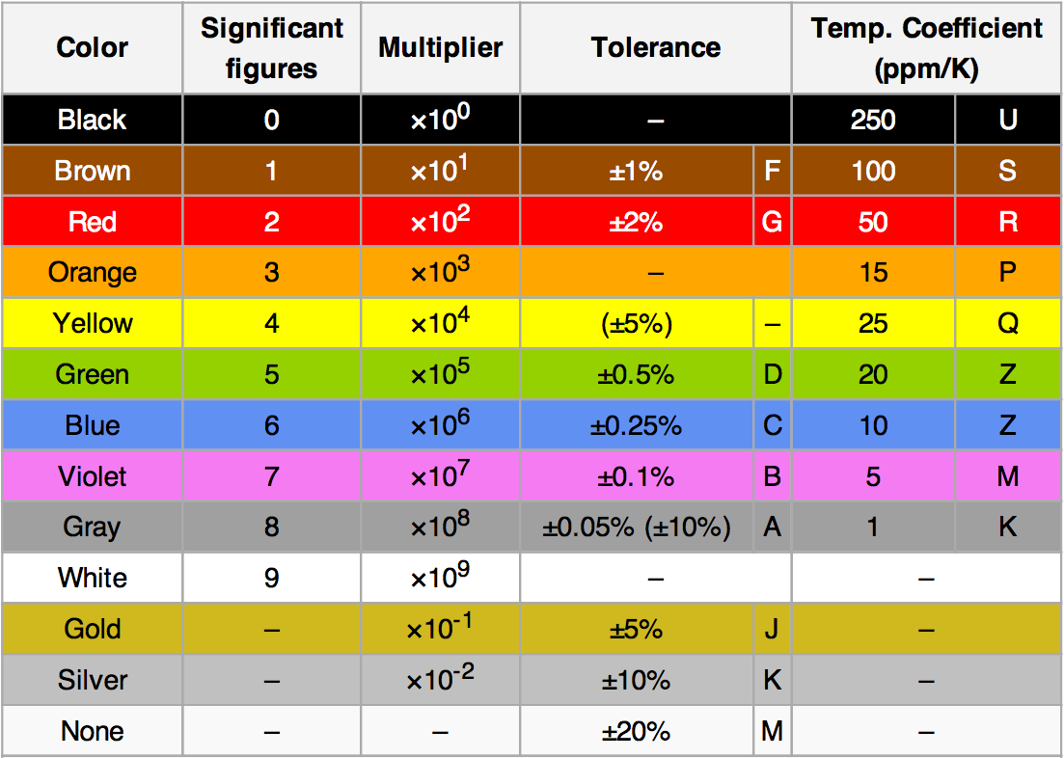
<Blink> LED
Robotiika
Resistor:
For example, a resistor with
bands of yellow, violet, red,
and gold will have
first digit (yellow),
second digit (violet),
followed by (red)
result : 4,700 ohms.
Gold signifies that the
tolerance is ±5%, so the
real resistance could lie
anywhere between 4,465
and 4,935 ohms.

Slide 2
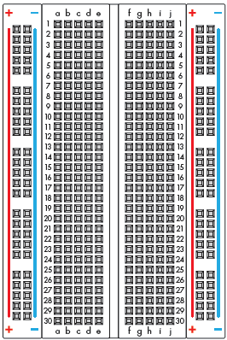
<Blink> LED
Robotiika
Breadboard:

Slide 3
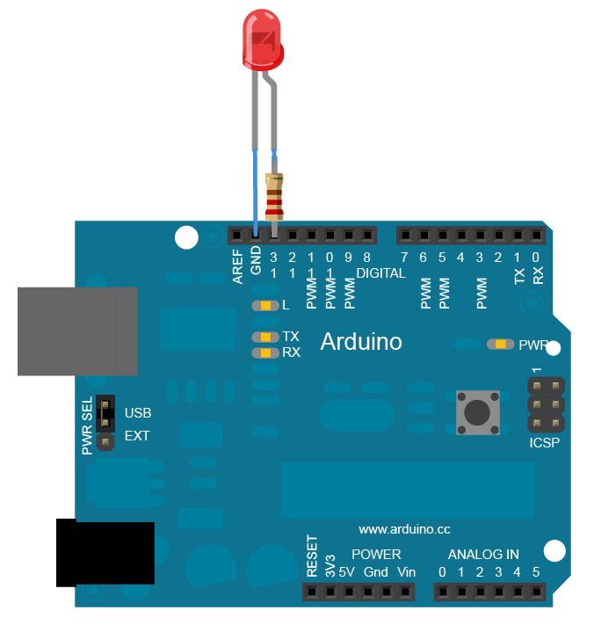
1)Persiapan Hardware
Robotika
Circuits:
Dalam Praktik #2 komponen elektronika yang perlu dipersiapkan adalah :
Arduino Uno
LED
Resistor 330 ohm
Bread Board
Kabel Jumper

Slide 4
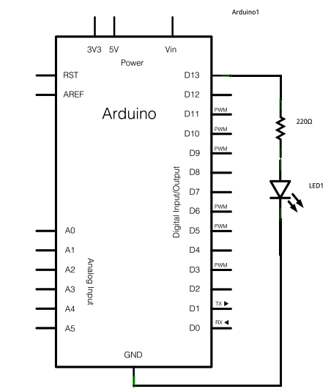
1)Persiapan Hardware
Robotika
Schematic:
Circuit ditampilkan dalam bentuk schematik dengan penggunaan simbol

Slide 5
2)Programming
Robotika
Coding:
// tekan tombol RESET terlebih dahulu pada board
void setup() {
// initialize digital pin LED_BUILTIN as an output.
pinMode(LED_BUILTIN, OUTPUT);
}
// fungsi perulangan
void loop() {
digitalWrite(LED_BUILTIN, HIGH); // menyalakan LED (HIGH sbg perintah ON)
delay(1000); // kondisi delay
digitalWrite(LED_BUILTIN, LOW); // mematikan LED (LOW sbg perintah OFF)
delay(1000); // kondisi delay
}

Slide 6
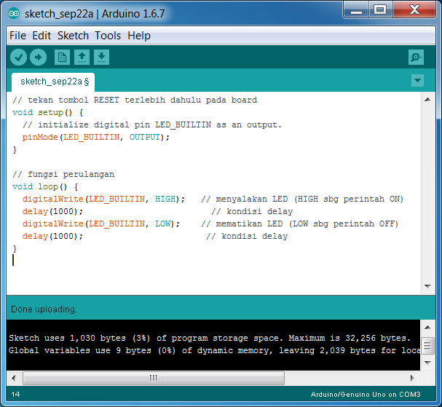
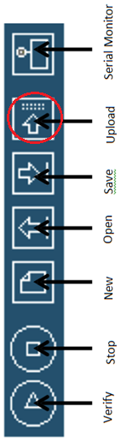
2)Programming
Robotika
Arduino IDE:

Slide 7
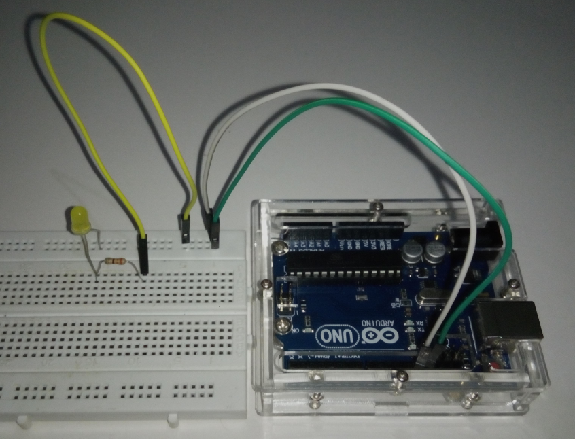
2)Programming
Robotika
Assembly Result:

Slide 8
2)Custom Program
Robotika
Coding:
// tekan tombol RESET terlebih dahulu pada board
void setup() {
// initialize digital pin LED_BUILTIN as an output.
pinMode(8, OUTPUT);
pinMode(10, OUTPUT);
}
// fungsi perulangan
void loop() {
digitalWrite(8, HIGH); // menyalakan LED (HIGH sbg perintah ON) PIN 8
digitalWrite(10, HIGH); // menyalakan LED (HIGH sbg perintah ON) PIN 10
delay(500); // kondisi delay
digitalWrite(10, LOW); // mematikan LED (LOW sbg perintah OFF) PIN 10
delay(500); // kondisi delay
digitalWrite(8, LOW); // mematikan LED (LOW sbg perintah OFF) PIN 8
delay(500); // kondisi delay
}

Slide 9
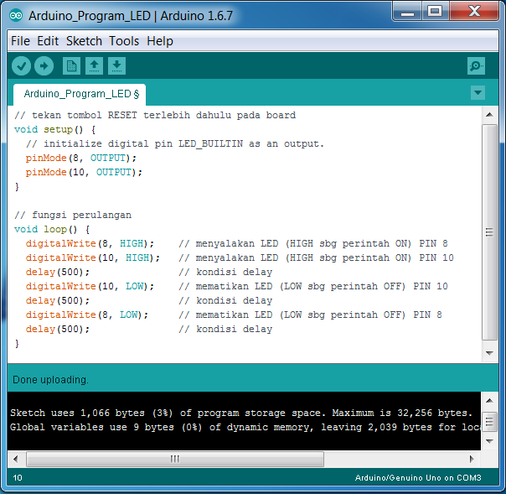
2)Custom Program
Robotika
Arduino IDE:

Slide 10
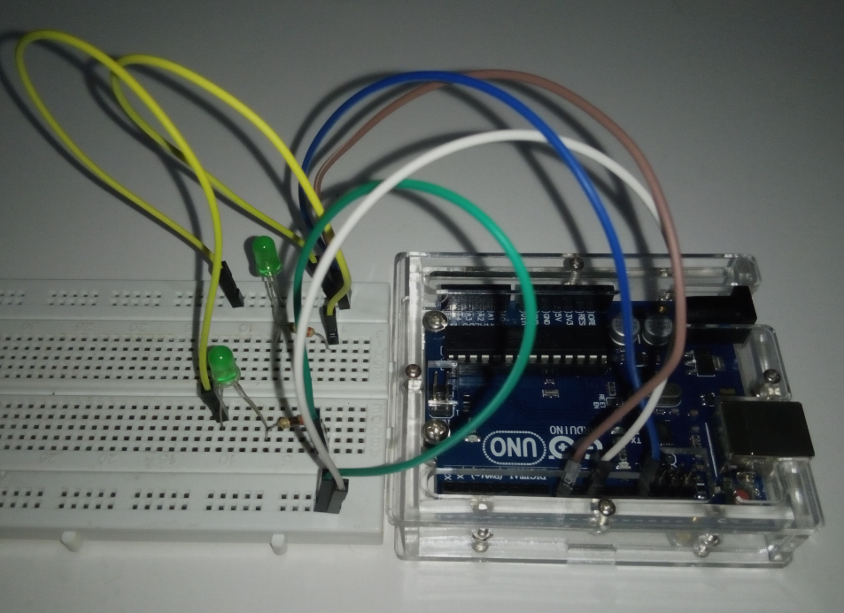
2)Custom Program
Robotika
Assembly Result:

Slide 11

Akhirul kalam
Robotika
“Sekian dan Terima Kasih”
Arif Wibisono
arif@upgris.ac.id
0821.374.28.349

