Slide 1
PERHITUNGAN BALOK
DENGAN BEBAN MERATA DAN TERPUSAT Jepit-sendi
MAB
P = 200 kg
MAB = 200 . 1 ( 4^2 – 1^2)/ (2. 4^2) = 93,75 kg.m (Akibat P)
MAB = 400. 4^2/16 = 400 kg.m ( akibat q)
MAB total = 493,75 kg.m
q = 400 kg/m’
B
A
x
Kontrol :
P+(q.L) = 973,5 +826,5
1800 = 1800 ok
x/973,5 = (3-x)/226,5
226,5.x = 2920,5 – 973,5.x
1200.X = 2920,5
X = 2,4 m
3,00 m
1,00 m
973,5
P.1 /4= 50 kg
P.3 /4=150 kg
+
3-x
x
q.L/2 = 400 x 4/2 = 800 kg
226,5
-
426,5
Mab/L = 493,75/4 = 123,5 kg
Mx = 973,5 . X – Mab –(q.x.0,5.x)
= 690,65 kg.m
826,5
973,5 kg
826,5 kg
147

Slide 2
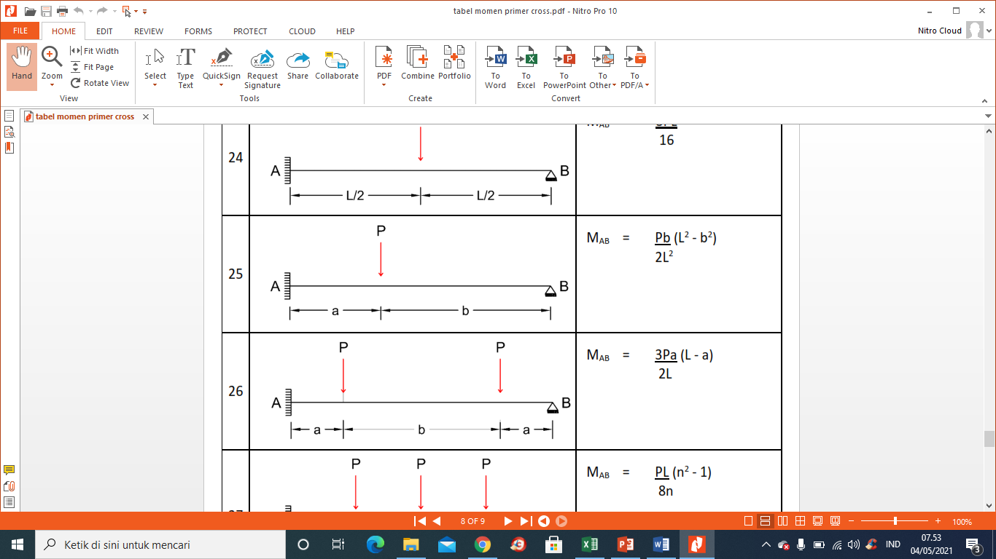
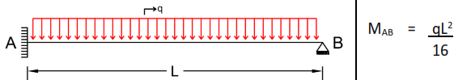
Ambil dari tabel momen primer

