Slide 1
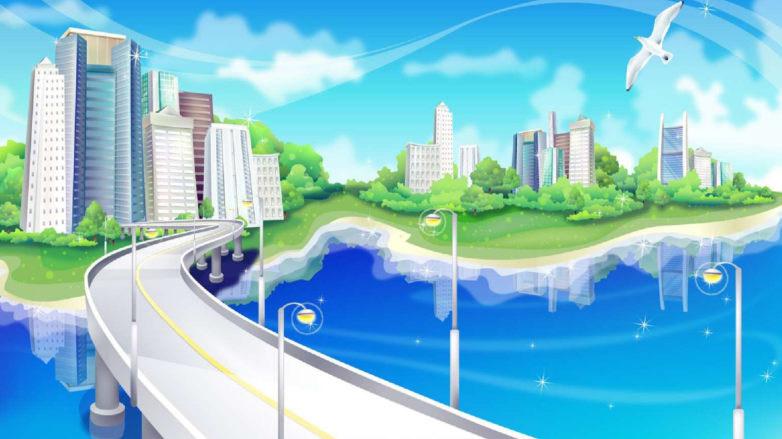
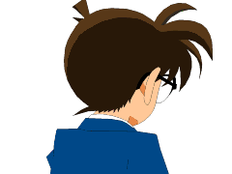


TEKNOLOGI ANIMASI
3 SKS ( 2 teori 1 praktik)
Febrian M. Dewanto
Rahmat Robi Waliyansyah

Slide 2


Mahasiswa dapat menjelaskan tentang konsep animasi baik animasi teks, dan animasi gambar serta animasi dua dimensi (2D) dan tiga dimensi (3D)
Mahasiswa dapat mengimplementasikan dan mengaplikasikan penggunaan software animasi 2D dan 3D

Slide 3

Konsep animasi | Konsep animasi 3D
Perbedaan dan macam-macam animasi | Animasi teks 3D
Teks dan Gambar | Animasi gambar 3D
Animasi Teks 2D | Presentasi animasi 3D
Animasi Gambar 2D | Game 3D
Presentasi animasi 2D | Film 3D
SILABUS DAN RPS

Slide 4



Harian dan Tugas 30%
UTS 30%
UAS 40%
14 Pertemuan
Minimal kehadiran 75%

Slide 5






Konsep Animasi
Pengertian Animasi
Metode pembuatan film yang menghasilkan gerakan-gerakan dengan proyeksi serangkaian urutan gambar
(kamus istilah periklanan Indonesia.1996)
Teknik dalam membuat karya audio visual agar menghasilkan urutan
gambar yang membentuk suatu adegan.

Slide 6
FUNGSI ANIMASI
Film
Website Presentasi Company Profile Iklan
Edukasi Desain produk dll

Slide 7
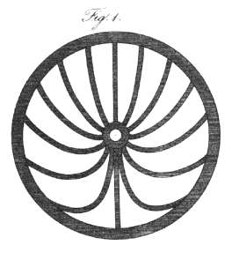
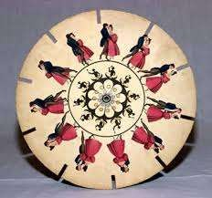

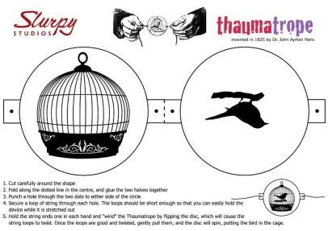
SEJARAH ANIMASI

Slide 8
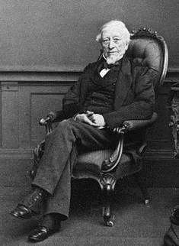
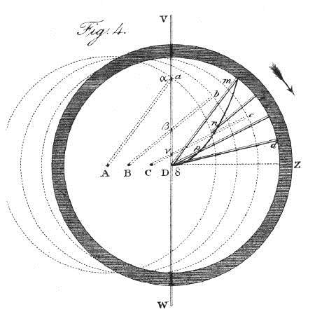
PETER MARK ROGET (1824)
Explanation of an optical deception in the appearance of the spokes of a wheel when seen through vertical apertures

Slide 9


SIR JOHN HERSCHEL DAN DR. JOHN A. PARIS (1825)

Slide 10
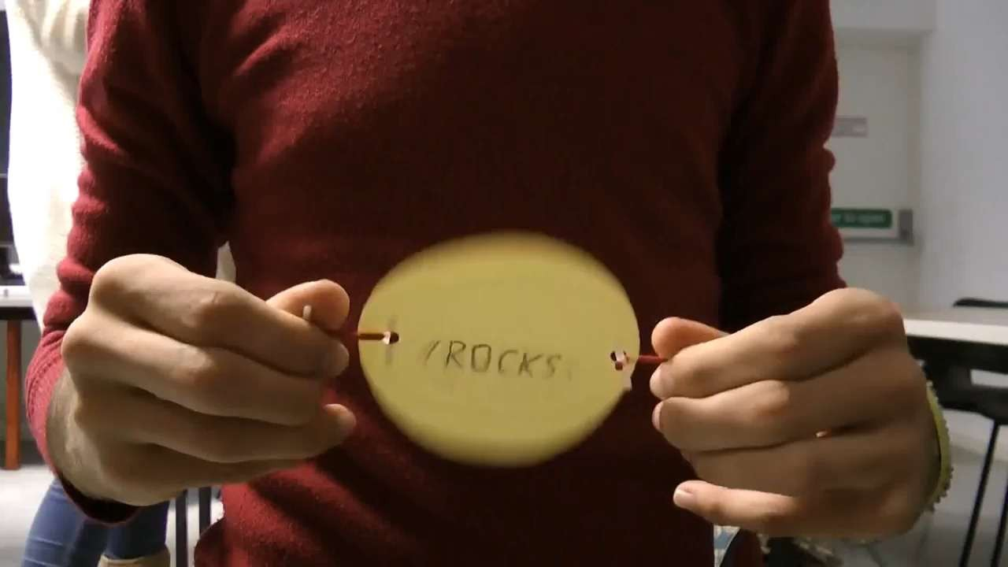
https://www.youtube.com/watch?v=yOLE2OzoIYw

Slide 11
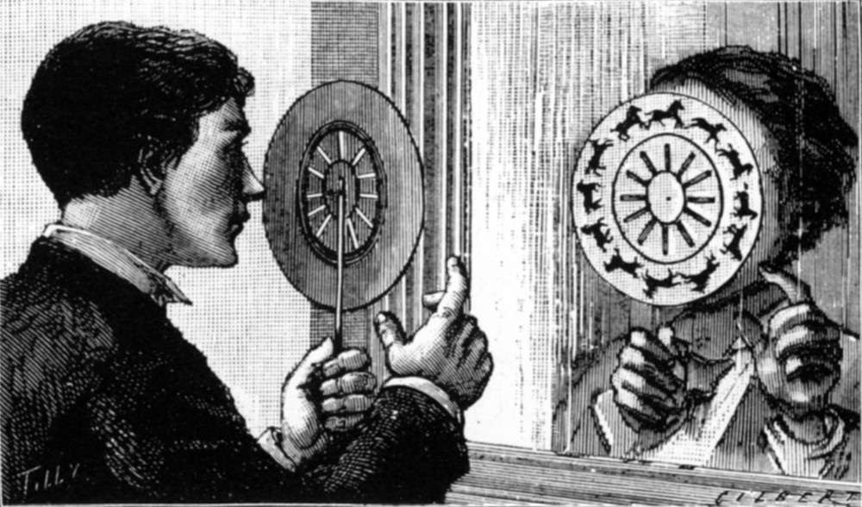
phenakistoscope
DR.PLATEAU DAN DR.RITTER (1831)

Slide 12


phenakistoscope
https://www.youtube.com/watch?v=2rzwdRqsuVM

Slide 13
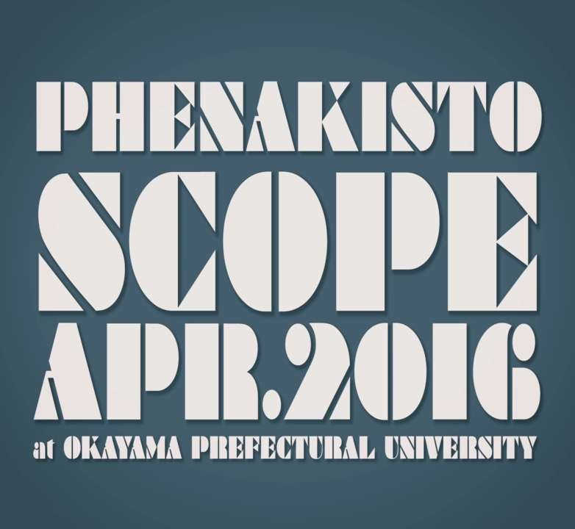
youtube.com / Kazuhiro Goshima

Slide 14
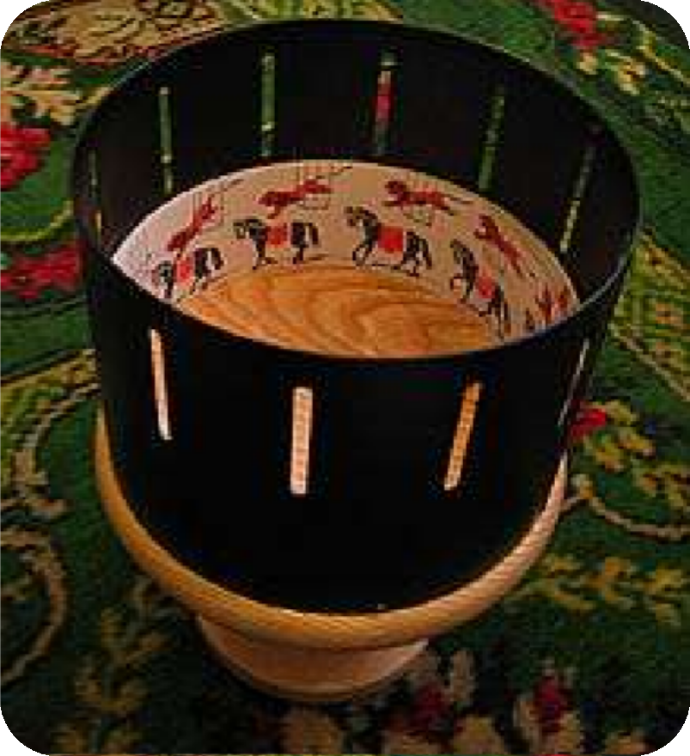

William George Horner (1834)
zoetrope

Slide 15

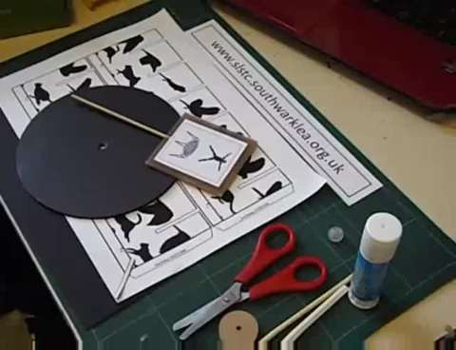
https://www.youtube.com/watch?v=lfAzr0GWknU

Slide 16
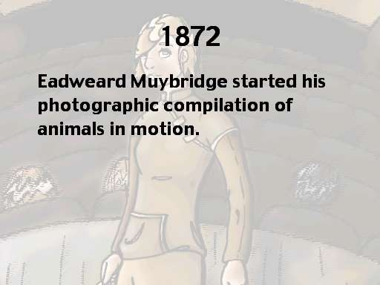

Slide 17
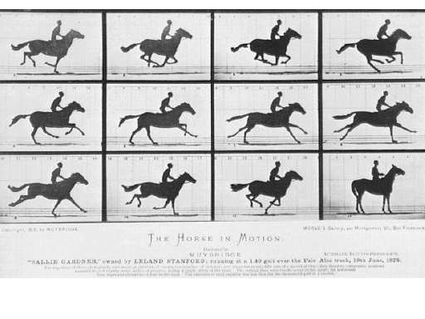

Slide 18
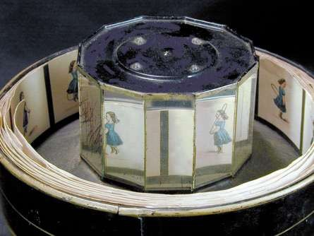
⯈The Praxinoscope was developed by in Paris.
⯈It is like the Zoetrope except the images were viewed on mirrors instead of through slits like the Phenakistoscope and the Zoetrope
EMILE REYNAUD (1877)

Slide 19
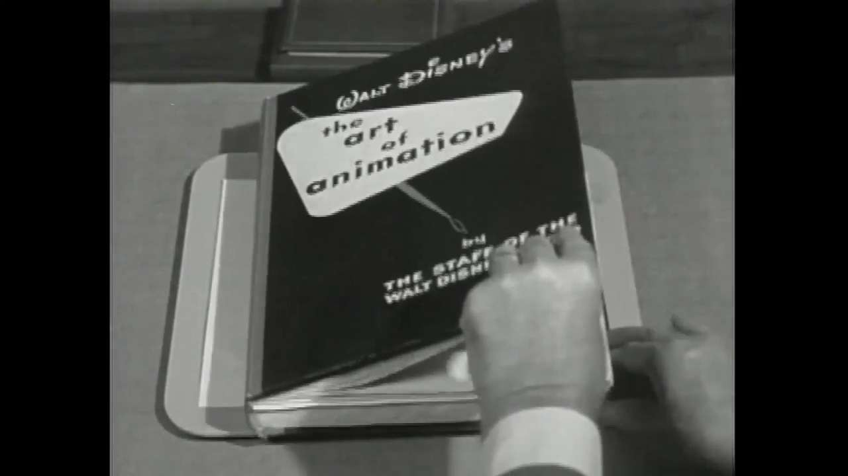
ART OF ANIMATION THAUMATROPE PHENAKISTOSCOPE ZOETROPE PRAXINOSCOPE VIDEO WALT DISNEY

Slide 20
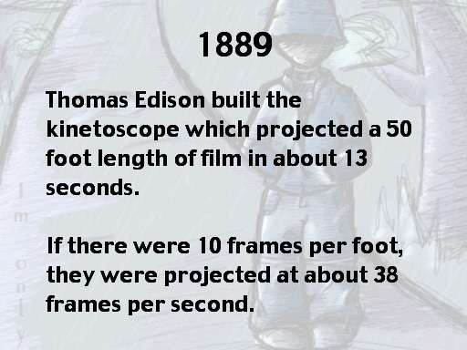
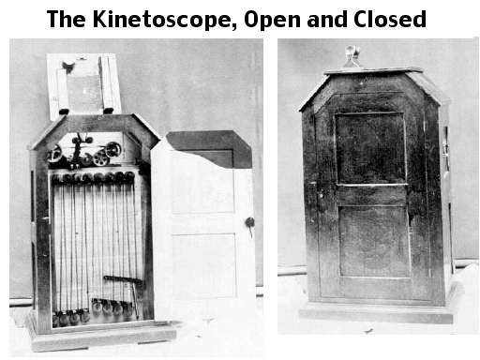

Slide 21
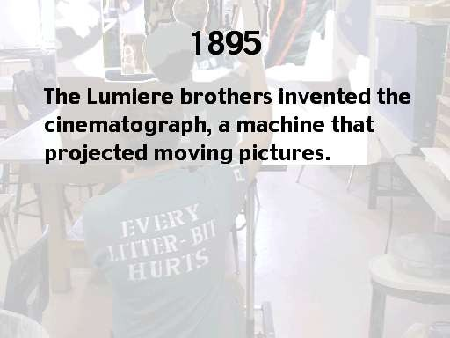

Slide 22
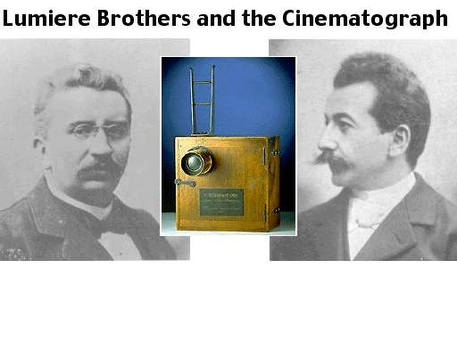

Slide 23
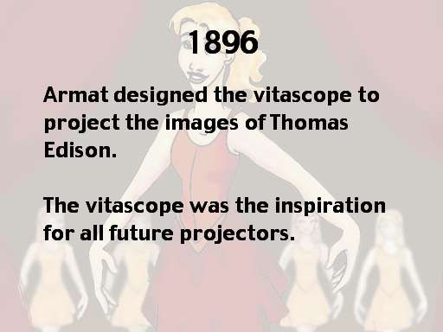

Slide 24
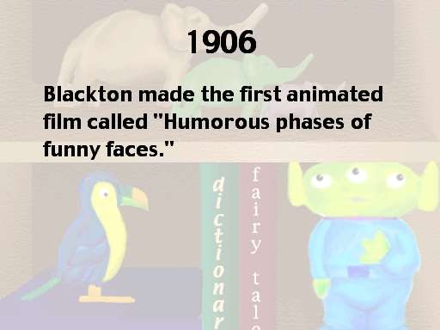
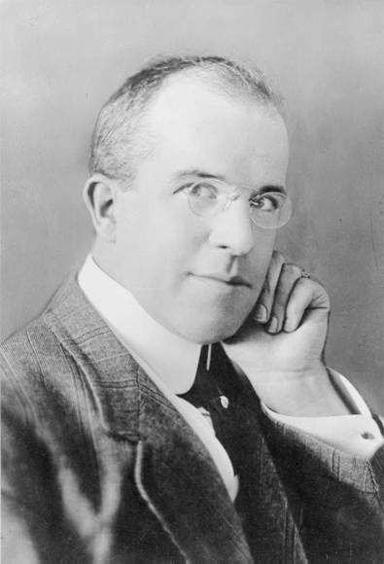

Slide 25
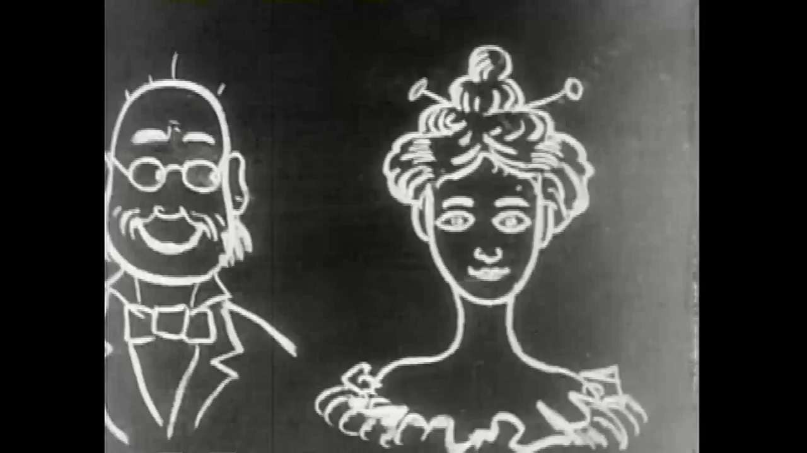

Slide 26
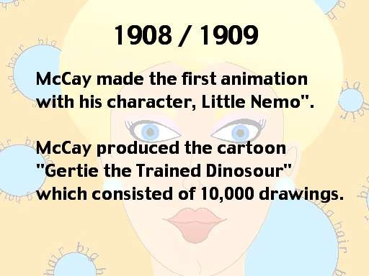

Slide 27
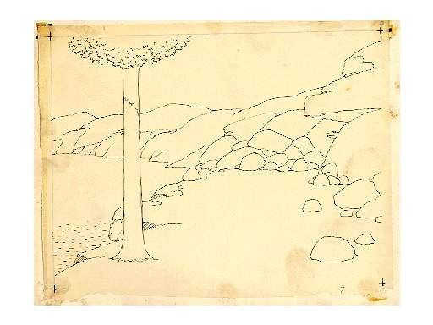

Slide 28
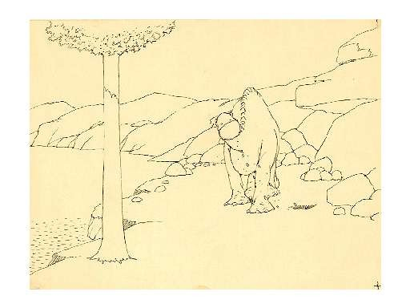

Slide 29
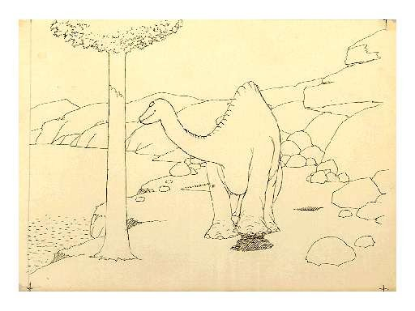

Slide 30
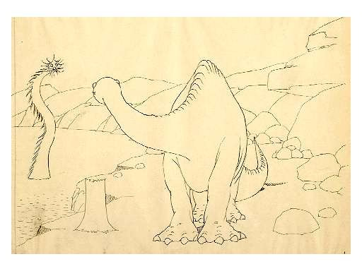

Slide 31
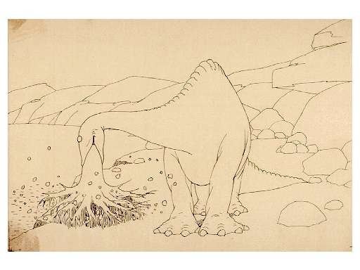

Slide 32
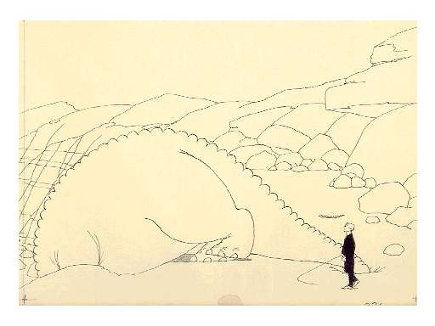

Slide 33
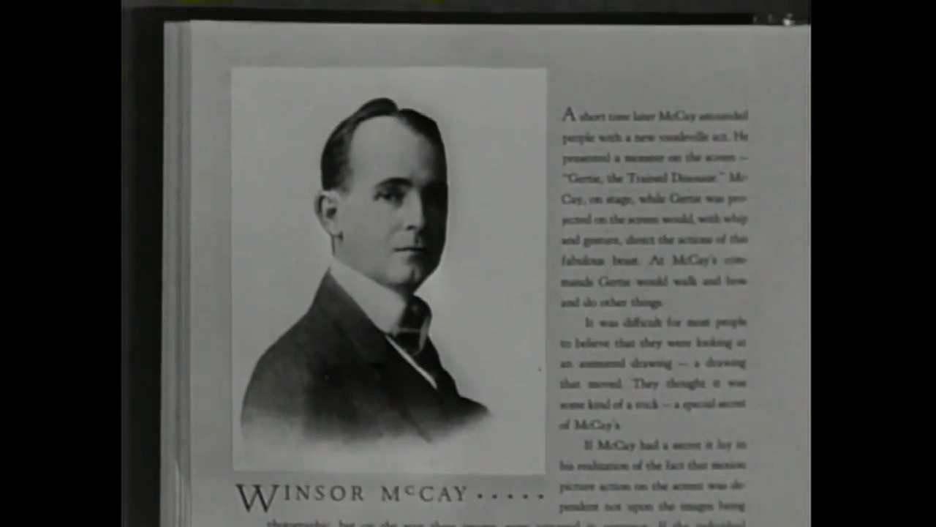

Slide 34
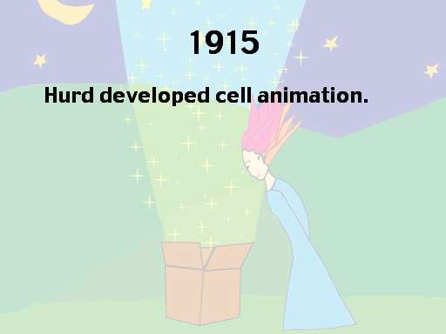

Slide 35
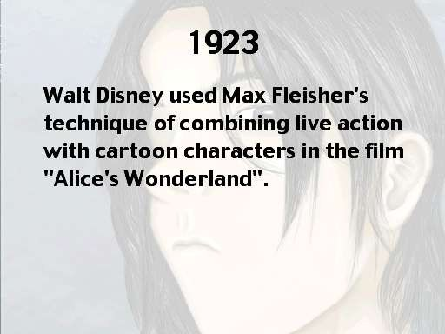
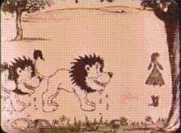

Slide 36
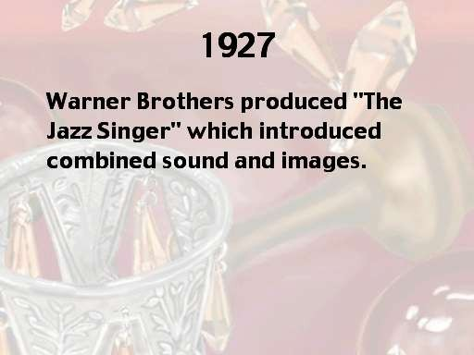

Slide 37
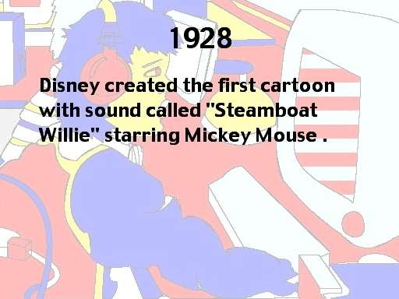
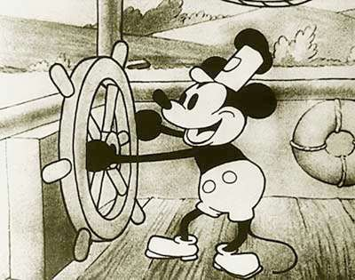

Slide 38
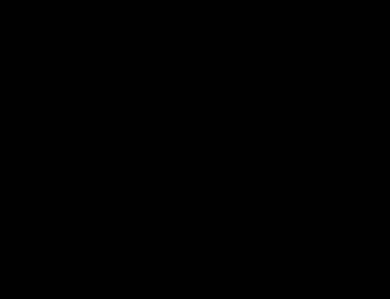

Slide 39
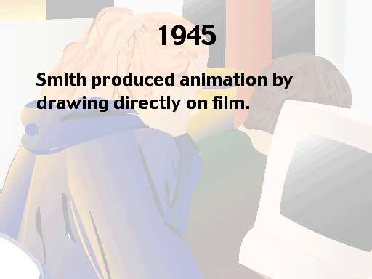

Slide 40
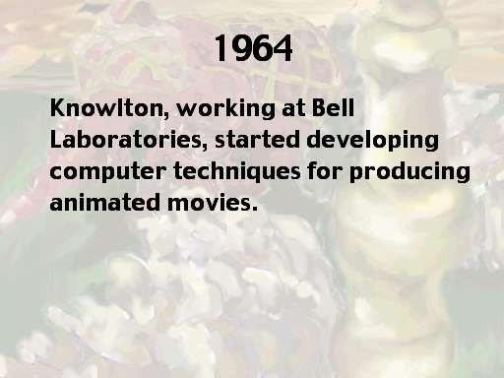

Slide 41

TYPE OF ANIMATION

Slide 42
JENIS ANIMASI
TRADISONAL ANIMASI (DRAWING)
2D ANIMATION (VECTOR BASED ANIMATION) (FLASH DAN AFTER EFFECT)
3D ANIMATION (MAYA,3Ds MAX, BLENDER) MOTION GRAPHICS (COMMERCIAL,INTRO) STOP MOTION (CLAYMATION)

Slide 43
History of Animation http://www.youtube.com/watch?v=rx2FRezidcs&feature=related http://www.privatelessons.net/2d/sample/m01.html http://courses.ncssm.edu/gallery/collections/toys/html/exhibit06.htm http://www.privatelessons.net/2d/sample/m01_03.html http://courses.ncssm.edu/gallery/collections/toys/opticaltoys.htm Thaumatrope http://education.eastmanhouse.org/discover/kits/files/3/thaumatrope.php http://www.vam.ac.uk/moc/images/image/26813-popup.html http://courses.ncssm.edu/gallery/collections/toys/animations/thaumatrope s/flowers300.htm
http://en.wikipedia.org/wiki/Thaumatrope Phenakistascope http://brightbytes.com/collection/phena.html http://brightbytes.com/collection/flipbooks.html Zoetrope http://brightbytes.com/collection/thaum.html http://brightbytes.com/collection/zoetrope.html http://brightbytes.com/collection/praxi.html

