Slide 1
INTELLIGENT
&
ACTIVE
PACKAGING

Slide 2

FOOD PACKAGING : FUNCTIONS
1. Protection
2. Communication
3. Convenience
4. Containment

Slide 3
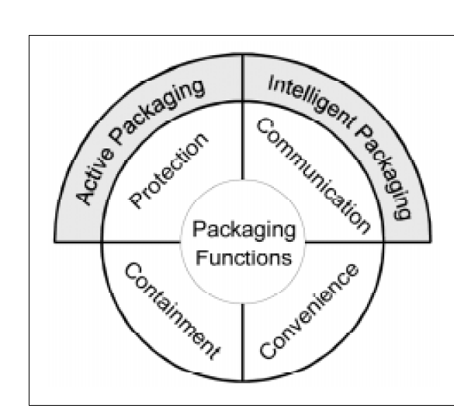
Intelligent packaging vs
Active packaging

Slide 4
INTELLIGENT PACKAGING
A packaging system that is capable of carrying out intelligent functions like
Detecting
Sensing
Recording
Tracing
Communicating, and
Applying scientific logic

Slide 5
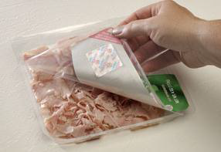
To facilitate decision-making
To extend shelf life
Enhance safety
Improve quality
Provide information and
Warn about possible problems

Slide 6
INTELLIGENT PACKAGING SYSTEMS
1.Indicators
2.Radio Frequency Identification Tags (RFID)
3.Sensors

Slide 7
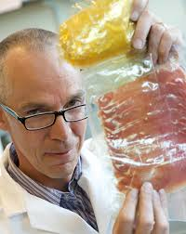
INDICATORS
Substances that indicate the presence or absence of another substance or the degree of reaction between two or more substances by means of a characteristic change, especially in colour

Slide 8
Time-temperature indicator
Gives information on temperature
Shows the variation and history in temperature
Visualised as a colour movement or colour change.

Slide 9
Reaction mechanisms
Diffusion
Polymerisation
Enzyme reaction
Types
Partial history indicators
Full history indicators
Use
Foods stored under chilled and frozen conditions

Slide 10
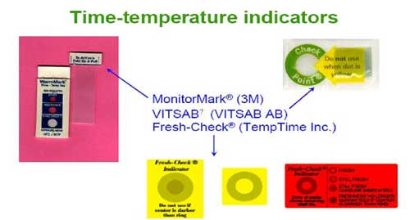
CURRENT COMMERCIAL TTI
 PRODUCTS

Slide 11
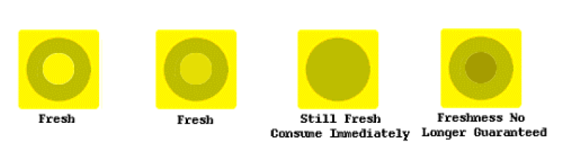
Fresh-Check®
Full history indicator
Polymerisation
Notes:
full history indicator. It consists of a small circle of polymer surrounded by a printed ring for color reference.
Price ranges from US $0.025 –0.035 each.This device is self-activated, i.e., it is
produced in an active form. Therefore, it is supplied and requires storage under deep
frozen conditions, typically –20ºC Based polymerisation reactions in which diacetylene crystals polymerise via 1,4 addition polymerisation to a highly coloured polymer

Slide 12


Slide 13
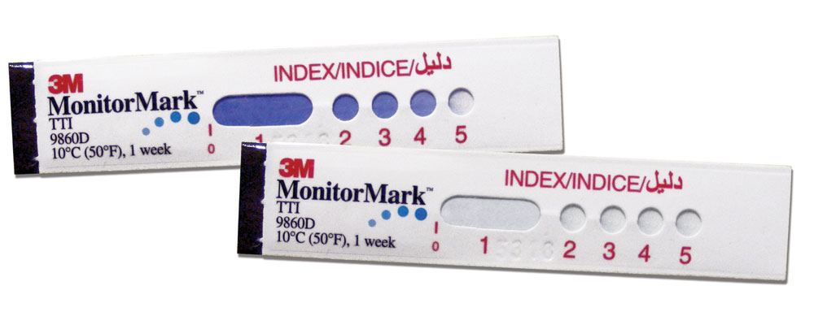
3M MONITOR MARK
Partial-history indicator
Diffusion
Notes:
contains a porous wick indicator track strip, one end of which is positioned over a reservoir pad containing a blue dyed chemical with a desired melt point.

Slide 14
Check point
Full history indicator
Two separate compartments
Enzyme solution,lipase plus a pH indicating dye compound
Substrate

Slide 15
pH change results in a color change

Slide 16
OnVuTM
The heart of the OnVu label becomes paler as the ambient temperature accumulates
This indicates gradual decay

Slide 17
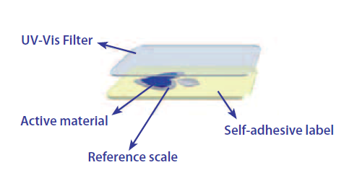

Slide 18
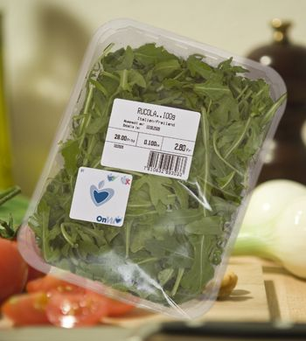
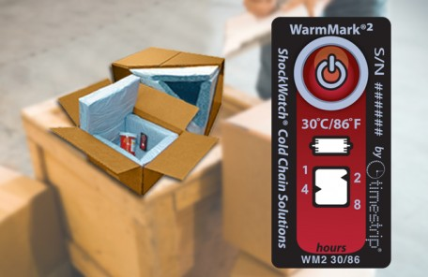
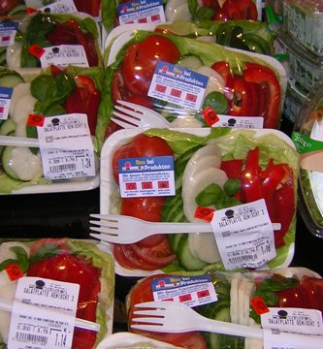

Slide 19
2.Oxygen indicator
Gives information on leakage
usage area - controlled or modified atmosphere food packaging
Ageless-eye
Vitalon
Samso-Checker

Slide 20
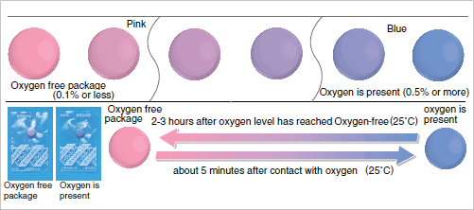
Ageless-eye
O₂ indicator tablet
  O₂ concentration in atmosphere ≤ 0.1 % → indicator is pink
  O₂ concentration in atmosphere ≥ 0.5 % → indicator is blue

Slide 21
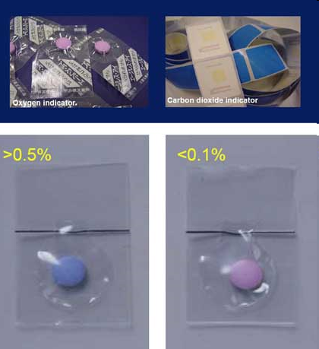

Slide 22
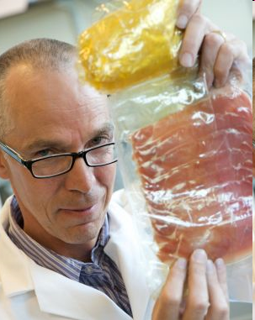
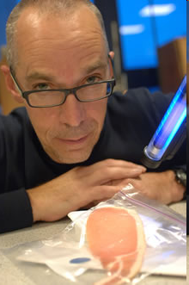
Professor Andrew Mills with food packaging incorporating the intelligent plastic indicator.
The yellow part is the indicator and it has changed colour to show that the food it contains has spoiled.
Professor Andrew Mills lights the way: a small blue colour-changing disc can be seen near the bacon
Notes:
Image: Strathclyde University

Slide 23
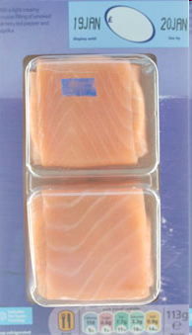
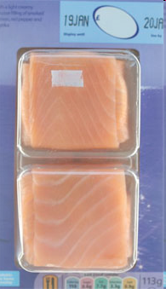
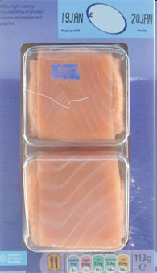
Photographs of oxygen indicator ink printed on a MAPed food package.
Left: Before UV activation. Middle: After UV activation. Right: On opening the package.

Slide 24
3. Carbon dioxide indicator
Gives information on concentration of carbon dioxide
Usage area-controlled or modified atmosphere packaging

Slide 25
4. Pathogen indicator
Gives information on microbiological status
Meat ,fish or poultry packaging
Reagents are various chemicals reacting with toxins

Slide 26
5. Freshness indicators
Indicate the microbial quality of the product by reacting to the metabolites produced in the growth of microorganisms
FreshTags®
Timestrip®
RipeSense®
SensorQTM

Slide 27

WORKING
Colour indicating tags attached as a small adhesive label to the outside of packaging film can be used to monitor the freshness of perishable food products such as seafood.

Slide 28

Fresh Tag®
  Indicator sensitive to volatile nitrogen compounds.
  packaging of fish
  Colour change in response to the release of volatile amines

Slide 29

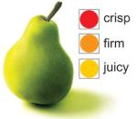
RipeSense®
- RipeSense® indicates the ripening of fruits.
-This sensor changes color when it reacts with aromatic compounds
Notes:
responsible for the odor that fruit gives off while ripening

Slide 30

SensorQTM
Beef and poultry
Sulfide gas, by microbial growth

Slide 32
Definition of Active Packaging
Active packaging is the incorporation of certain additives into packaging film or within packaging containers with the aim of maintaining and extending product shelf life.
Packaging may be termed active when it performs some desired role in food preservation other than providing an inert barrier to external conditions.
Packaging systems that are capable of scavenging oxygen; absorbing carbon dioxide/ releasing carbon dioxide, moisture, ethylene and maintaining temperature control and/or compensating for temperature changes”.

Slide 33
ACTIVE PACKAGING SYSTEM
Absorber System (Scavenger):
Example: oxygen absorber, CO₂ absorber, ethylene absorbent, moisture absorbent, absorbent of adverse flavor, UV rays absorber, lactose eliminating system, cholesterol absorption system.
Releasing System:
Example: the release of CO₂, ethanol release, release of antimicrobial substances, the release of sulfur dioxide, antioxidants release, release of desired flavors, and release of pesticides
Other Systems
Example: insulation materials, heating spontaneously (self heating), cooling spontaneously (self-cooling), control of heating in the microwave oven, the temperature sensitive film

Slide 34
Selected examples of active packaging systems
Active packaging | System mechanisms food | Applications
Oxygen scavengers | Iron based, Metal/acid Nylon MXD6, Metal (e.g. platinum) catalyst Ascorbate/metallic salts Enzyme based | Bread, cakes, cooked rice, biscuits, pizza, pasta, cheese, cured meats and fish, coffee, snack foods, dried foods and beverages
Carbon dioxide scavengers/emitters | Iron oxide/calcium hydroxide Ferrous carbonate/metal halide Calcium oxide/activated charcoal Ascorbate/sodium bicarbonate | Coffee, fresh meats and fish, nuts and other snack food products and sponge cakes
Ethylene scavengers | Potassium permanganate Activated carbon Activated clays/zeolites | Fruit, vegetables and other horticultural products
Preservative releasers | Organic acids Silver zeolite Spice and herb extracts BHA/BHT antioxidants Vitamin E antioxidant Chlorine dioxide/sulphur dioxide | Cereals, meats, fish, bread, cheese, snack foods, fruit and vegetables

Slide 35
Cont..
Ethanol emitters | Encapsulated ethanol | Pizza crusts, cakes, bread, biscuits, fish and bakery products
Moisture absorbers | PVA blanket Activated clays and minerals Silica gel | Fish, meats, poultry, snack foods, cereals, dried foods, sandwiches, fruit and vegetables
Flavour/odour absorbers | Cellulose triacetate, Acetylated paper Citric acid, Ferrous salt/ascorbate Activated carbon/clays/zeolites | Fruit juices, fried snack foods, fish, cereals, poultry, dairy products and fruit
Temperature control packaging | Non-woven plastics, Double-walled containers, Hydrofluorocarbon gas Quicklime/water, Ammonium nitrate/water, Calcium chloride/water Super corroding alloys/salt water Potassium permanganate/glycerine | Ready meals, meats, fish, poultry and beverages

Slide 36
Oxygen scavengers
A scavenger in chemistry is a chemical substance added to a mixture in order to remove or inactivate impurities or unwanted reaction products
Oxygen scavengers (also referred to as oxygen absorbers) -- food product quality by decreasing food metabolism, reducing oxidative rancidity, inhibiting undesirable oxidation of labile pigments and vitamins, controlling enzymic discoloration and inhibiting the growth of aerobic microorganisms.
Small sachets or self adhesive labels that are placed inside modified atmosphere packs to help extend product life (notably cooked meats) and help improve product appearance.
The reduction of oxygen inhibits aerobic organisms, especially mold, and prevents oxidative rancidity.
Maria, Portugal

Slide 37
THE BENEFIT OF OXYGEN SCAVENGING SYSTEM
Prevent pathogenic aerobic activity
Eliminates the need for food additives such as BHA, BHT, SO₂, sorbic acid, Na-benzoate
Maintaining flavor
Maintaining color
Reduce the risk of corrosion of the package
Extend shelf-life→ memperluas distribusi
Increase production capacity
Reduce production and distribution costs

Slide 38
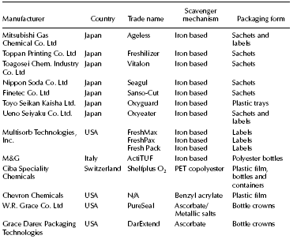
Table : Selected oxygen scavenger systems

Slide 40
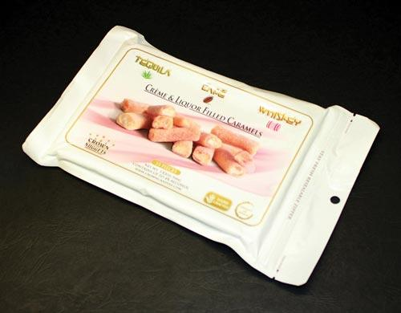
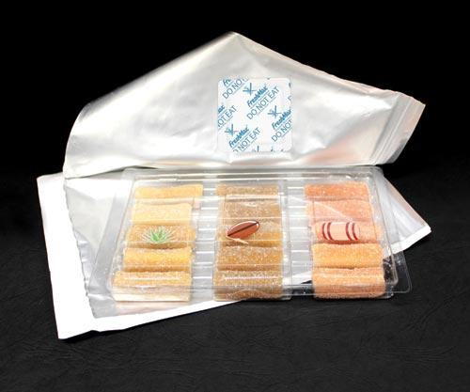

Slide 41
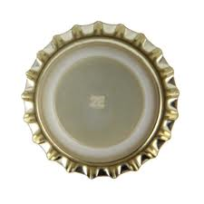
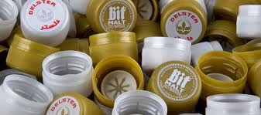
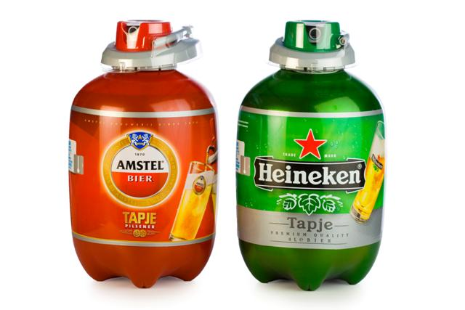
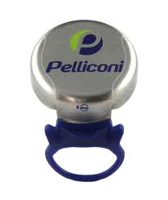
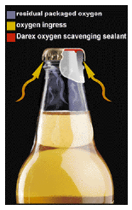
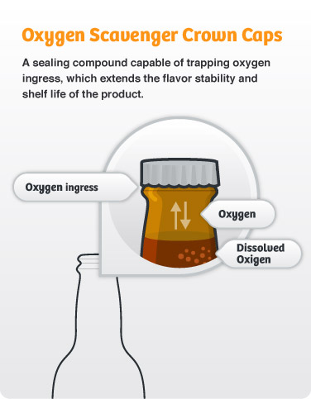
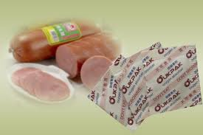
Figure. Crown oxygen scavenger from Darex (W.R.Grace).

Slide 42
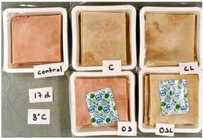
Carbon dioxide Scavenger
Carbon dioxide generators --- packaging for fresh produce where an increased concentration of CO₂, combined with decreased O₂ concentration, reduces the respiration rate thus increasing the product shelf-life
-- Emitters is in the packaging of meat products where a high level of CO₂ may inhibit microbial growth.
--Commercial solutions commonly used are the incorporation of a one-way valve and more recently, the inclusion of a CO₂ absorbing sachet.

Slide 43
CO₂ scavenger/emitter (2)
Two solutions :
Use packaging with patented one-way valves that will allow excess carbon dioxide to escape
Use a carbon dioxide scavenger or a dual-action oxygen and carbon dioxide scavenger system
Dual-action sachets typically contain:
Iron powder scavenging oxygen
Calcium hydroxide scavenges carbon dioxide when it is converted to calcium carbonate under sufficiently high humidity conditions

Slide 44
Ethylene scavengers
Principles
Ethylene is a plant hormone that accelerates the respiration rate and subsequent senescence of horticultural products such as fruit, vegetables and flowers.
Ethylene is a very reactive compound that can be altered in many ways, such as chemical cleavage and modification, adsorption, etc. This creates a diversity of opportunities for commercial applications for the removal of ethylene

Slide 45
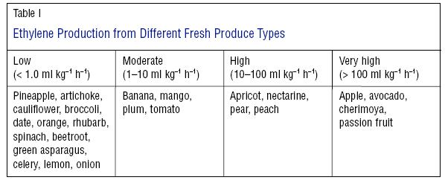

Slide 46
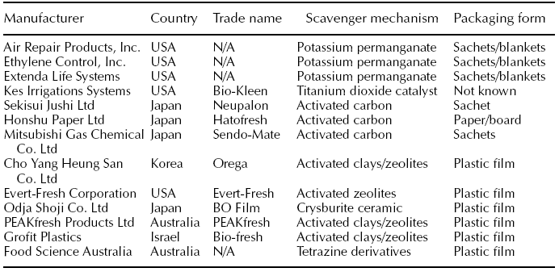
Table : Selected ethylene scavenger systems

Slide 47
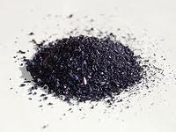
Commercial examples
Potassium permanganate-based scavengers:-
KMnO₄ are available in sachets for packages or blankets for storage chambers--- not incorporated into food
Immobilized in-- inert substrate such as alumina or silica gel-- 4 – 6%.
The performance and useful life of the scavengers depend on the substrate surface area and the content in permanganate.
Potassium permanganate oxidises ethylene to acetate and ethanol and in the process changes colour from purple to brown, and hence indicates its remaining ethylene scavenging capacity

Slide 50
Temperature Control Packaging
Temperature control active packaging includes :
Innovative insulating materials to guard against undue temperature abuse during storage and distribution of chilled foods increase the thermal mass of the food package so that it is capable of withstanding temperature rises
Self-heating cans and containers. Self-heating aluminium and steel cans and containers for sake,coffee, tea and ready meals are heated by an exothermic reaction which occurs when lime (calcium hydroxide) and water positioned in the base are mixed
Self-cooling cans. Endothermic dissolution of ammonium nitrate and chloride in water is used to cool the product

Slide 51
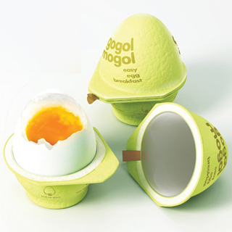
Cooking Package (1)

Slide 52
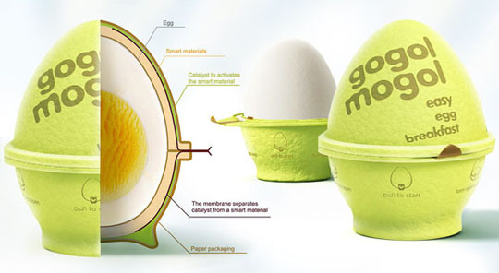
Cooking Package (2)

Slide 53
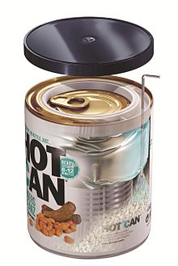
Example of Active Packaging
(Self heating)

Slide 54


Slide 55


