Slide 1


Slide 2
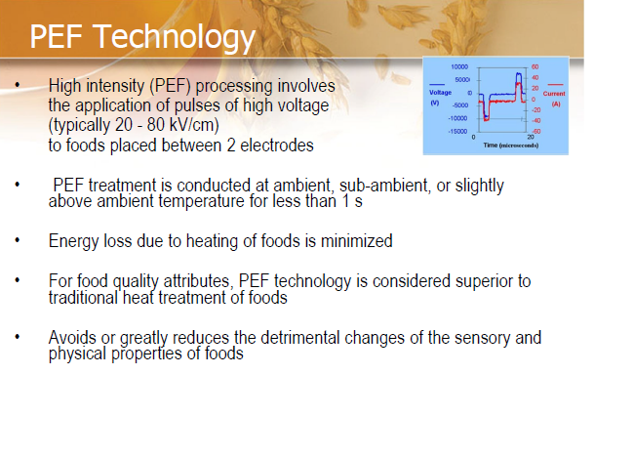

Slide 3
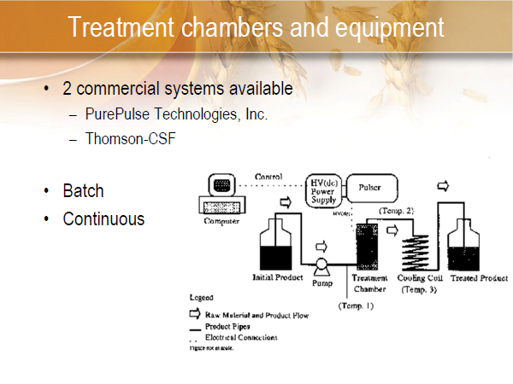

Slide 4
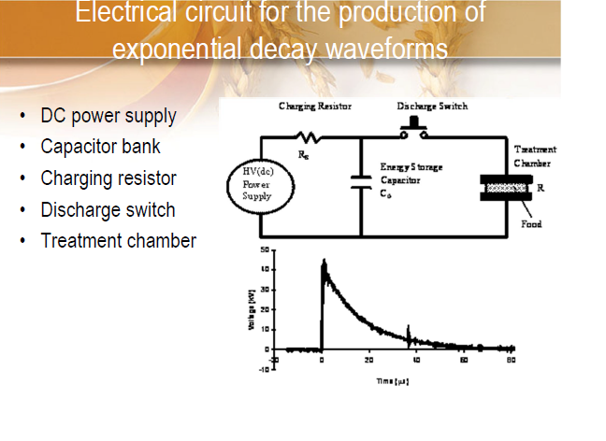

Slide 5
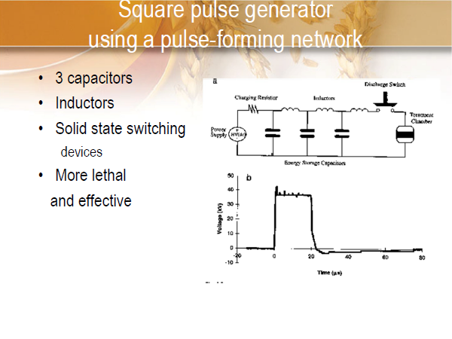

Slide 6
PROCESS FACTORS:
Electric Field – Increase in microbial inactivation with increase in intensity of electric field
Temperature- With constant electric field strength, inactivation increases with an increase in temperature (35–50°C )
Pressure. Pressure is applied to inhibit the formation of air bubbles.
Time of Exposure- Treatment time is defined as the product of the number pulses and the pulse duration. An increase in any of these variables increases microbial inactivation.
Pulse Wave Shape- may be applied in the form of exponential decaying, square-wave, oscillatory, bipolar, or instant reverse charges.

Slide 7
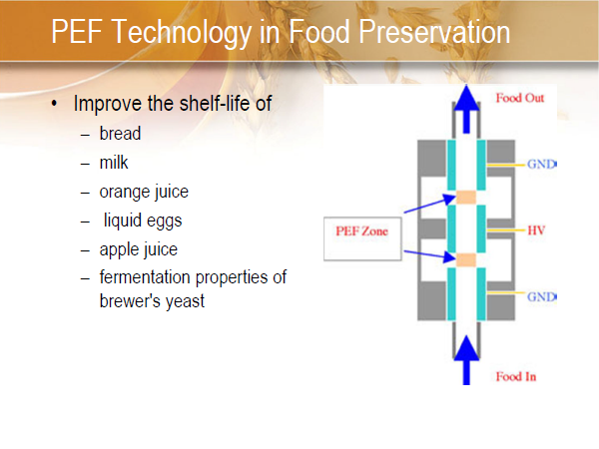

Slide 8
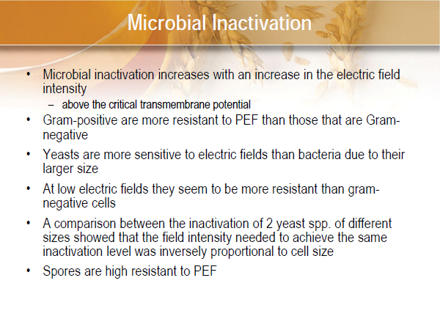

Slide 9
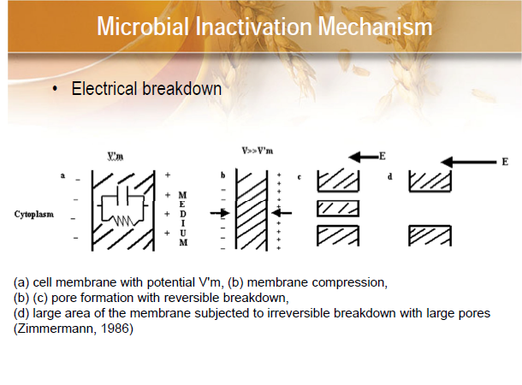

Slide 10
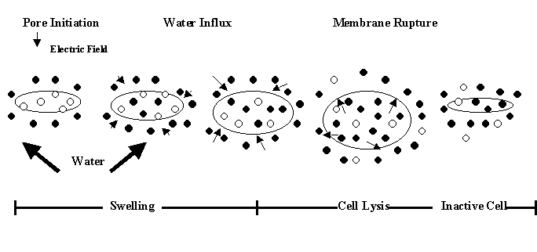
Electroporation
cell exposed to high voltage electric field pulses temporarily destabilizes the lipid bi-layer and proteins of cell membranes. Plasma membrane become permeable and causes cell death

Slide 11
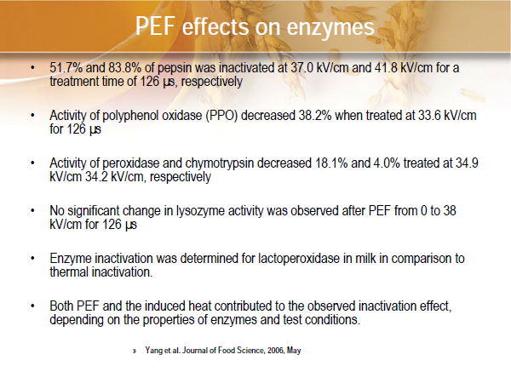

Slide 12
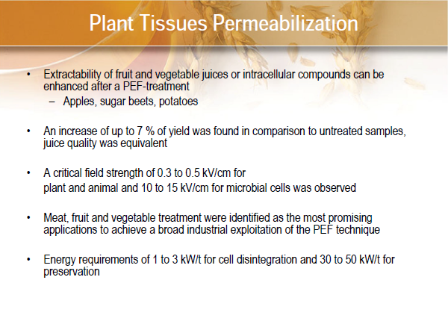

Slide 13
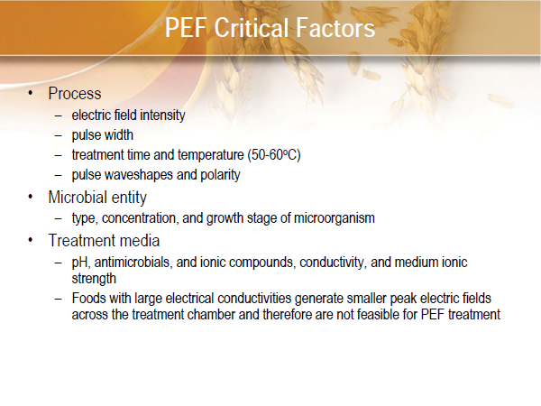

Slide 14
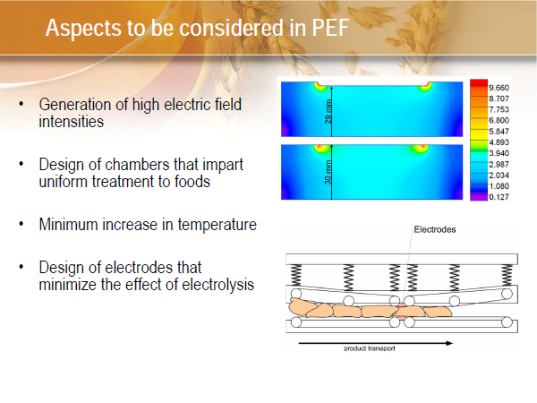

Slide 15
Thank You

