Slide 1
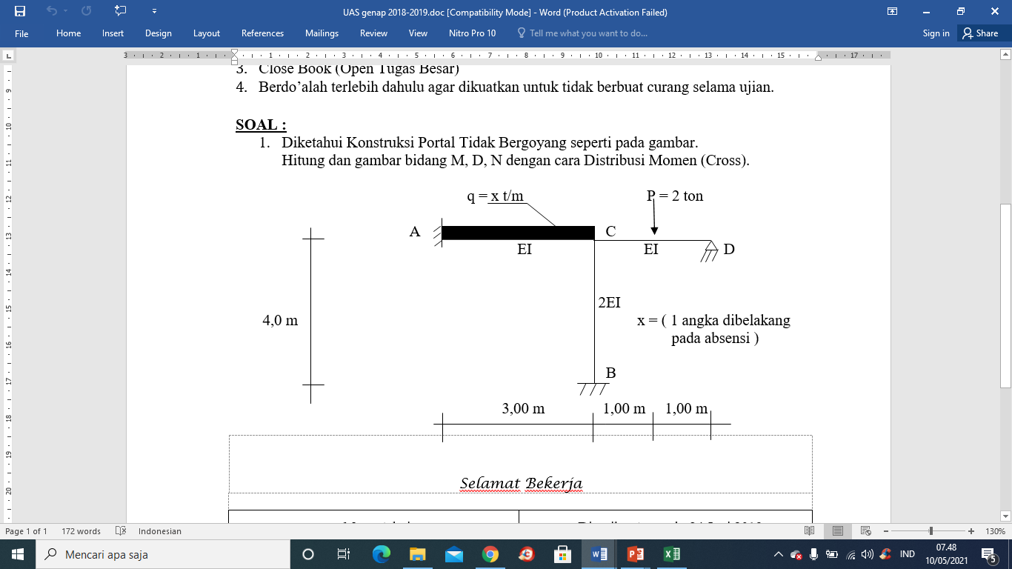
3
3 m
2EI
JAWABAN TUGAS 2
PORTAL TIDAK BERGOYANG
E

Slide 2
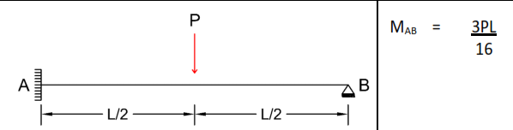
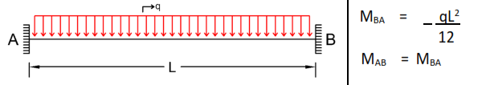
Momen Primer
MCD = - 3. 2 . 2 / 16 = - 0,75 t.m
MAC = -3. 3^2/12 = - 2,25 t.m
MCA = + 2,25 t.m
Angka kekakuan batang:
Titik C
K ca = 4EI/L = 4. EI/3 = 1,33 EI
K CD = 3 EI/L = 3.EI/2 = 1,5 EI
K CB = 4EI/L = 4.(2EI)/4 = 2EI
Titik A
kAE = 4EI/L = 4(2EI)/3 = 2,67
kAC = 4EI/L = 4EI/3 = 1,33
Sigma K c = 4,83 EI
C
Sigma K A = 4 EI
Faktor Distribusi:
Titik A
FD AC = kac/∑kA = 1,33 EI/ 4EI = 0,3325
FD AE = kae/∑kA = 2,67 EI/ 4EI = 0,6675
Titik C
FD CA = kca/∑kC = 1,33 EI/4,83 EI = 0,28
FD CD = 0,31
FD CB = 0,41
Titik B
FD BC = 0 (ujung Jepit)
Titik E
FD EA = 0 (ujung jepit)
Titik D
FD DC = 1 (ujung sendi)
∑FD A = 1
∑FD c = 1

Slide 3
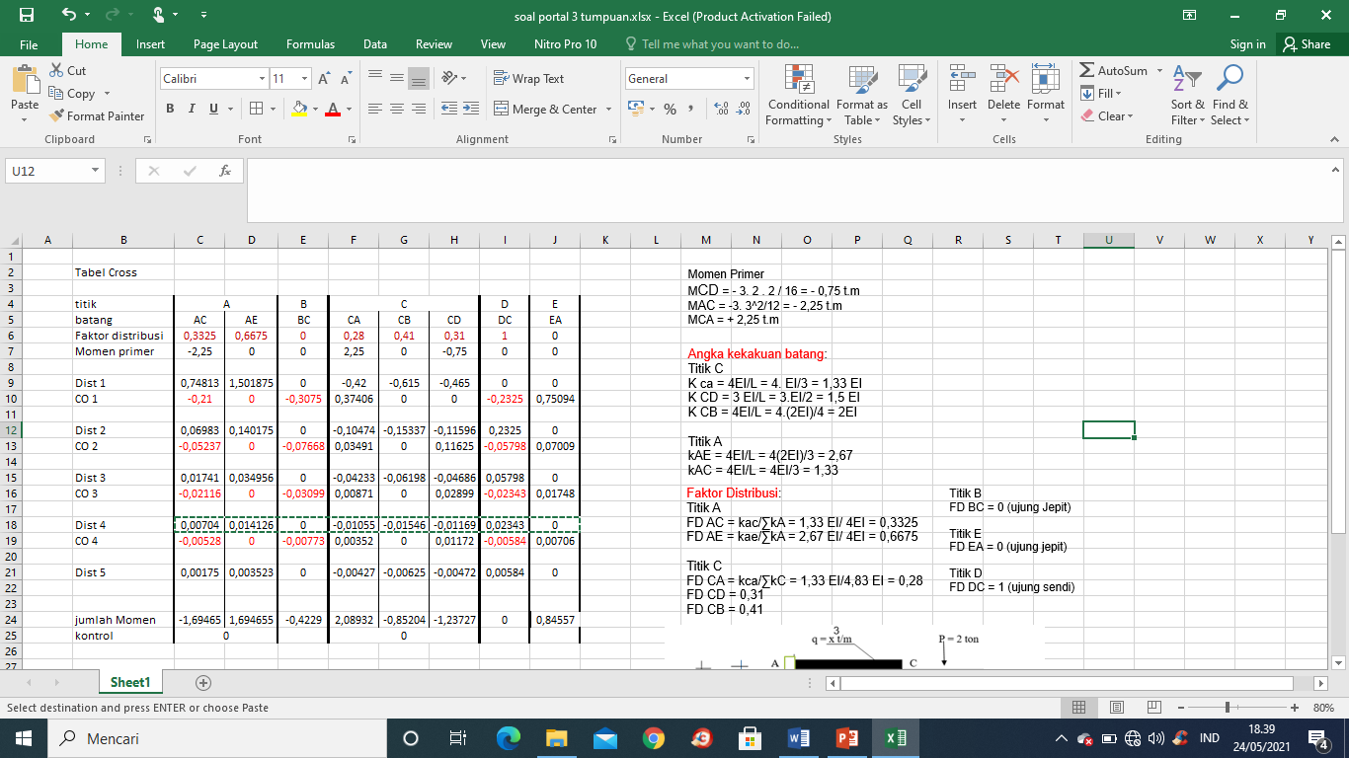

Slide 4
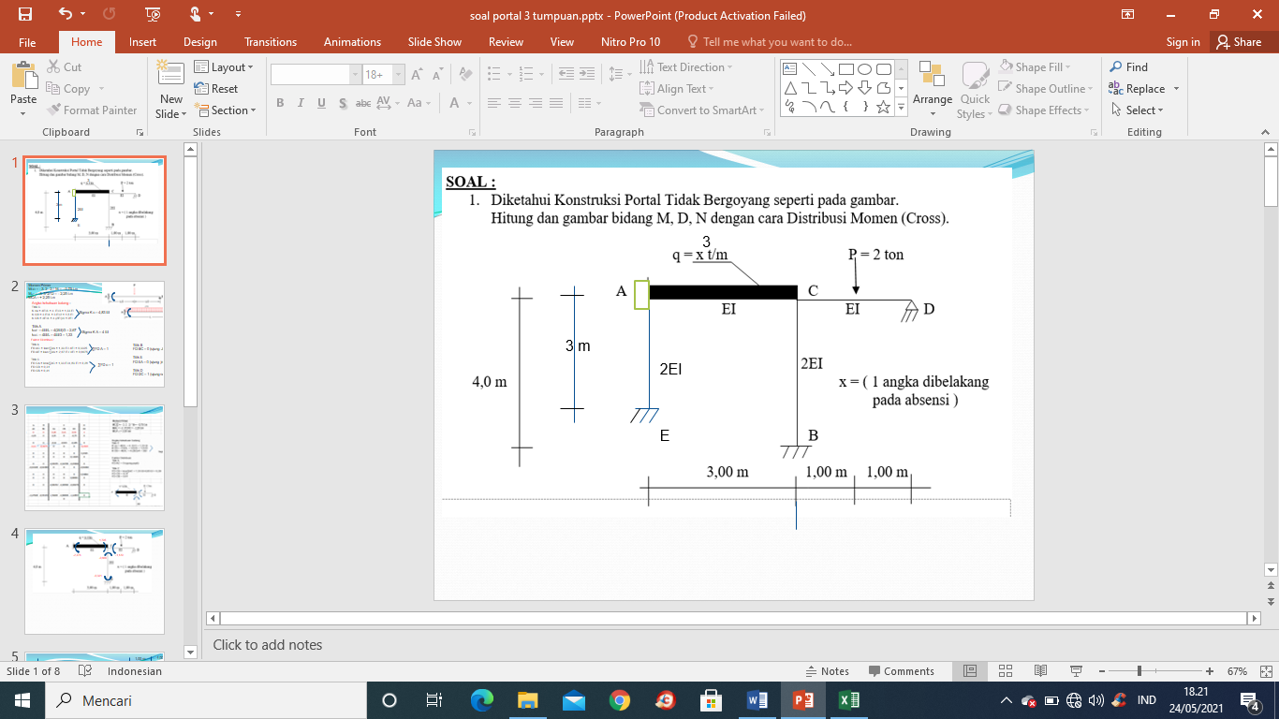
MAC = -1,695 tm
MCA = 2,089 tm
MCD = -1,237 tm
MAE = 1,695 tm
MCB = -0,852 tm
MEA = 0,846 tm
MBC = -0,4229 tm

Slide 5
3,00 m
1,00 m
1,00 m
Mencari Reaksi Tumpuan :
3 t/m
MCA = 2,089 tm
MAE = 1,695 tm
MAC = -1,695 tm
0,847 t
MCD = -1,237 tm
0,565 t
4,5 t
0,282 t
1 t
MEA = 0,846 tm
0,655 t
0,619 t
0,847 t
0,696 t
1,619 t
0,381 t
0,319 t
MCB = -0,852 tm
4,541 t
0,106 t
0,213 t
4,459 t
4,00 m
0,319 t
MBC = -0,4229 tm

Slide 6
Free Body Diagram
0,847 t
0,319 t
0,847 t
0,847 t
0,528 t
0,528 t
6,16 t
MAC = -1,695 tm
MCA = 2,089 tm
MCD = -1,237 tm
4,541 t
1,619 t
4,459 t
4,459 t
0,381 t
0,319 t
MCB = -0,852 tm
0,847 t
MAE = 1,695 tm
MBC = -0,4229 tm
MEA = 0,846 tm
0,319 t
0,847 t
E
6,16 t
4,459 t

