Slide 1
FORTIFICATION OF REFINED OIL-
IS CONSUMER BENEFITTED?
Department of Food Techn.
2018

Slide 2
Poor diet is the 4th biggest
global risk factor for disease
Rapid developmental transition and urbanization affect both consumption patterns and energy expenditure.
Simplification and no diversification of
foods

Slide 3
Why fortify with micronutrients ?
Outreach
Low cost high impact technology

Slide 4
Fortification best global investment
“Providing micronutrients”
Ranked as the best global welfare investment
World Bank Report and 2004/2008/2012
Copenhagen Consensus

Slide 5
Addition of one or more essential nutrients to a food, whether or not it is
normally contained in the food, for the
purpose of preventing or correcting a
Food fortification
demonstrated deficiency of one or more nutrients in the population or specific population groups
(FAO/WHO 1994).

Slide 6
National status of micronutrient deficiency
Nation wide data
Iodine Iron Vitamin A
Very limited Vitamin C Thiamine
Vitamin E
Emerging Zinc
Calcium Vitamin D Folic acid Vitamin B12
Riboflavin (B2) Pyridoxine(B6)

Slide 7
Identified vehicles
Salt
Wheat flour
Rice
Vegetable oils for fat soluble vitamins
Milk for vitamins A& D

Slide 8
History of oil fortification
In India, a hydrogenated oil (Vanaspati) that replaces ghee has been fortified with vitamin A since 1953.
Oil fortification is less common (in Morocco).
The technology for adding the vitamin to oil is simple and inexpensive.
Oils are used widely, so there is a potential for more oil to be fortified with this vitamin.
  Traditionally cultivated oilseeds
Groundnut, mustard/rapeseed,
sunflower
Non-conventional oils Rice bran oil, coconut oil
sesame, safflower, linseed, soybean and

Slide 9
Criteria for fortification
Fortified food consumed in adequate amounts by
target population
Fortificants that are stable and well absorbed, but
do not affect sensory properties of foods
Preferably, centrally processed food vehicles
Government and food industry partnership

Slide 10
Intake of visible fat in adult male (NNMB/ RDA 2010)
450
400
350
300
250
200
150
100
50
0
g/d
Cereals
Milk&milk products
Fats& oils
calculated actual

Slide 11
Usage of oil in households is an important consideration in determining the choice of oil as a vehicle for vitamin fortification
120.0
beverages, refreshments, processed food
sugar, salt and spices
100.0
14.9
21.1
fruits
Percentage
80.0
10.1
5.4
8.4
vegetables
12.6
8.0
60.0
10.9
egg, fish & meat
9.0
7.0
8.6
40.0
6.2
Edible oil
15.2
16.4
milk & milk products
20.0
5.6
4.8
20.4
15.6
pulses & their products
0.0
cereals & cereal substitutes
Rural Urban
Mean Per Capita Expenditure by food items

Slide 12
Factors to consider for stability and retention of vitamins in fortified oil
Oxidative Stability of oil: saturated, unsaturated
Exposure to oxygen: volume/surface ratio
Exposure to light: dark, semi dark, UV light
Temperatures during storage: cold, hot
Temperatures during cooking: low, medium, high
heat
Duration of cooking: short & long duration
Methods of cooking: boiling, pressure cooking,
baking, shallow fry, deep try, repeated fry
Storage time: weeks to months

Slide 13
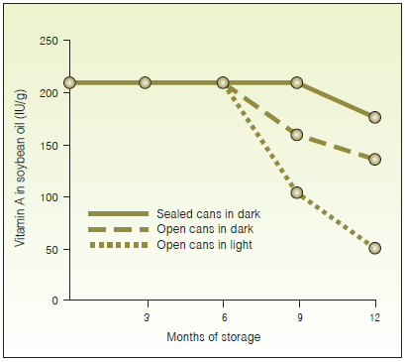
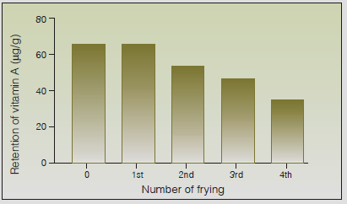
Stability of Vitamin A Fortified Soybean Oil During Storage at room temperature 23°C Under Different Conditions
Stability of Vitamin A in Fortified Soybean Oil After Repeated Frying of Potatoes at 117-170°C.
Favaro et al J. Food Comp. Anal. 1991; 4: 237-244

Slide 14
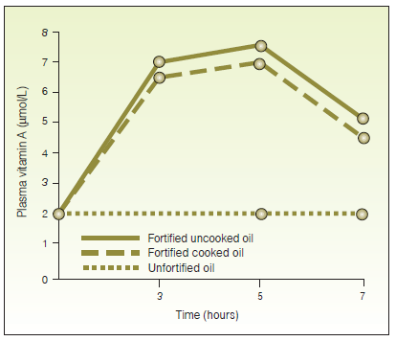
Serum Retinol levels in Humans After Ingestion of Cooked and Uncooked Fortified Oil with
Vitamin A
Dutra de Oliveira Int. J. Food Sci. Nutr. 1994; 45: 203-207

Slide 15
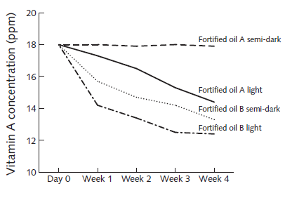
Fortified oil A (PV :0.4 mEq/kg)
Fortified oil B (PV: 5.8 mEq/kg)
Vitamin A decay under different household conditions after 4 weeks of storage 30 ± 5°C
Stability of vitamin A under different household conditions after 4 weeks of storage at 30 ± 5°C
Laillou et al Food Nutr Bull 2012; 33(3): 186-193

Slide 16
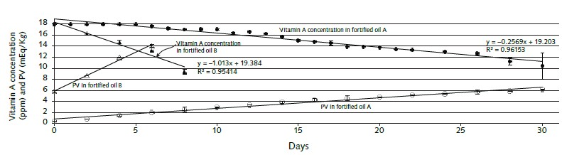
Stability of vitamin A and peroxide value (PV) in fortified oils A and B during 1 month of accelerated storage
Fortified oil A (PV :0.4 mEq/kg)
Fortified oil B (PV: 5.8 mEq/kg)
Laillou et al Food Nutr Bull 2012; 33(3): 186-193

Slide 17
Concluisons
The major nutrient proposed for oil fortification across the globe is vitamin A.
Ritu & Gupta Nutrients 2014, 6, 3601-3623

Slide 18
Vitamin D
Lack of literature data on vitamin D fortification in oil and its stability
during different cooking applications
Frying salmon resulted in degradation of 50% of the vitamin D content in the fish, while baking did not result in a significant loss of vitamin D
Lu et al J. Steroid. Biochem. Mol. Biol. 2007, 103, 642–644.
Refined oils- low specific heat and high smoke points (>180 °C).
↑ smoke points – better choice for frying Repeated frying- ↑ oxidation
Ritu & Gupta Nutrients 2014, 6, 3601-3623

Slide 19
Conclusions
Refined vegetable oil may not be suitable vehicles for vitamin D fortification.

Slide 20

Thank you

