Slide 1

LISTRIK MAGNET 1
UPGRIS
P. Fisika
ANALISIS VEKTOR

Slide 2
Pengampu
UPGRIS
P. Fisika
Nama : Drs. Harto Nuroso, M.Pd.
NPP : 936701097
Alamat : Jl. Pucang Argo Utara No. 17 – 18
Hp : sms / WA = 08122817407 (simpati)

Slide 3
ALJABAR VEKTOR
UPGRIS
P. Fisika
B
A
(B+A)
(A+B)
A
A + B = B + A
B
- B
(A-B)
A
A - B = A + (-B)

Slide 4
Perkalian dengan skalar
UPGRIS
P. Fisika
α (A + B) =αA + αB
Dot Product
A • B = A B cos θ
Cross Product
A ✕ B = A B sin θ

Slide 5
Example
UPGRIS
P. Fisika
Let C = A – B, and calculate the dot product of C with itself
C
A
θ
B
Solution:
C•C = (A – B)•(A – B) = A•A - A•B - B•A + B•B
C² = A² + B² – 2 A B cos θ ➔ law of cosinus

Slide 6
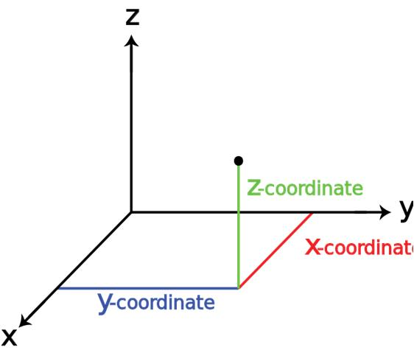
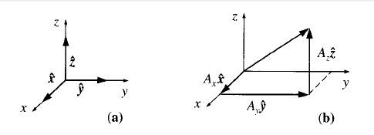
Aljabar vektor 3 dimensi
UPGRIS
P. Fisika
Misalkan : A = A_{x}i + A_{y}j + A_{z}k dan B = B_{x}i + B_{y}j + B_{z}k
A + B = (A_{x}i + A_{y}j + A_{z}k ) + (B_{x}i + B_{y}j + B_{z}k)
= (A_{x} + B_{x}) i + (A_{y} + B_{y}) j + (A_{z} + B_{z}) k
Rule (1) To add vectors, add like components

Slide 7
UPGRIS
P. Fisika
α A = (α A_{x}) i + (α A_{y}) j + (α A_{z}) k
Rule (2) To multiply by a scalar, multiply each component
Rule (3) To calculate the dot product, multiply like component, and add
A • B = (A_{x}i + A_{y}j + A_{z}k ) • (B_{x}i + B_{y}j + B_{z}k)
= A_{x}B_{x} + A_{y}B_{y} + A_{z}B_{z}

Slide 8
UPGRIS
P. Fisika
A x B = (A_{x}i + A_{y}j + A_{z}k ) x (B_{x}i + B_{y}j + B_{z}k)
= (A_{y}B_{z}–A_{z}B_{y})i+(A_{z}B_{x}-A_{x}B_{z})j+(A_{x}B_{y}–A_{y}B_{x})k
Rule (4) To calculate the cross product, form the determinant whose first row is i, j, k whose second row is A (in component form), and whose third row is B

