Slide 1
INFLECTIONAL AND DERIVATIONAL AFFIXES
(for 2C)
Entika Fani Prastikawati, S.Pd.,M.Pd.

Slide 2
English Affixes
Prefixes
Suffixes
There are two kinds of affixes in English : inflectional and derivational.

Slide 3
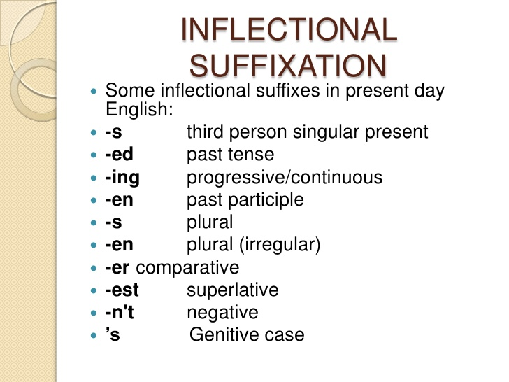
Inflectional suffixes

Slide 4
Inflectional affixes are always suffixes since they are always attached to the base.
For instance: the –s or –es ending on verbs with subject he, she, or it; the –ing ending on the continuous verb forms; the –ed of the past tense of verbs; the –s that makes nouns plural; the –er and -est that makes adjectives comparative; and so forth.
These suffixes do not change a word from one word class to another (They never turn nouns into verbs, for instance). No other suffix can follow them. The construction is called a closed construction.

Slide 5
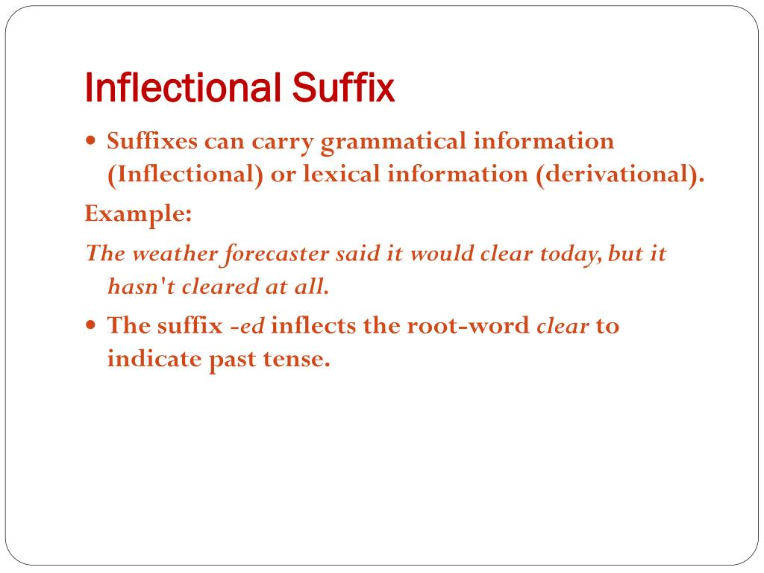

Slide 6
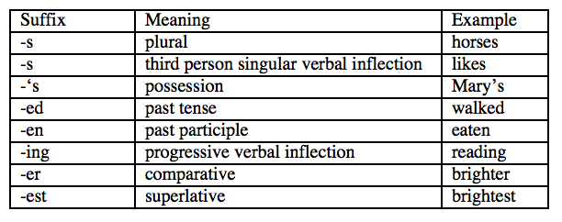

Slide 7
Derivational Suffixes
Derivational suffixes, on the other hand, change the meaning of the base in some important way, or change it into a different word class.
They turn nouns into adjectives, adjectives into verb, nouns of one type into nouns of another type, and so on.
They add new meanings to the base. They are readily followed by inflectional suffixes, and in many cases more than one derivational suffix can be found in the same word.

Slide 8
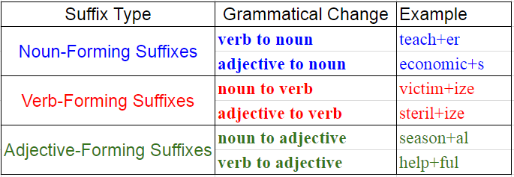

Slide 9
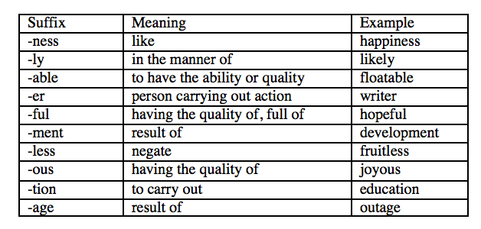
Examples

Slide 10


