Slide 1
Pencemaran Lingkungan
by : Fibria
Pendidikan Biologi
Universitas PGRI Semarang

Slide 2
Where do Pollutants Come From, and What are They Harmfull Effects? Threats to Health and Survival
Pollutant are chemicals found at the high enough levels in the environment to cause harm to people or other organisms
Pollution is the presence of substances at high enough levels in the air, water, soil, or food to threaten the health, survival, or activities of humans or other organisms
Pollutants can enter environment : naturally (ex : from volcanic eruptions) or through human anthropogenic activities ( ex : from burning coal)

Slide 3
Pengertian Pencemaran Lingkungan
Pencemaran lingkungan hidup adalah masuk atau dimasukkannya makhluk hidup, zat, energi, dan/atau komponen lain ke dalam lingkungan hidup oleh kegiatan manusia sehingga melampaui baku mutu lingkungan hidup yang telah ditetapkan.
Pencemaran air adalah masuknya atau dimasukkannya makhluk hidup, zat, energi dan atau komponen lain ke dalam air oleh kegiatan manusia, sehingga kualitas air turun sampai ke tingkat tertentu yang menyebabkan air tidak dapat berfungsi sesuai dengan peruntukannya;
Pencemaran udara adalah masuknya atau dimasukkannya zat, energi, dan/atau komponen lain ke dalam udara ambien oleh kegiatan manusia, sehingga mutu udara ambien turun sampai ke tingkat tertentu yang menyebabkan udara ambien tidak dapat memenuhi fungsinya;
Pencemaran tanah adalah keadaan di mana bahan kimia (buatan manusia) masuk dan merubah lingkungan tanah alami

Slide 4
Pollutants can have 3 types of effects :
They can disrupt or degrade life-support systems for human or other species
They can damage wildlife, human health, and property
They can be nuisances, such as : noise and unpleasant smells, tastes and sights

Slide 5
The Pollutants we produce come from two types of sources :
Point Sources of Pollutants are single, identifiable of sources. Ex : the smokestack of coal burning power plant, the drainpipe of a factory, and the exhaust pipe of an automobile.
Non-Point Sources of pollutants are dispersed and often difficult to identify. Ex : pesticides are sprayed into the air or blown by the wind into the atmosphere and runoff of fertilizers and pesticides from farmlands, and suburban lawns and gardens into streams and lakes.

Slide 6
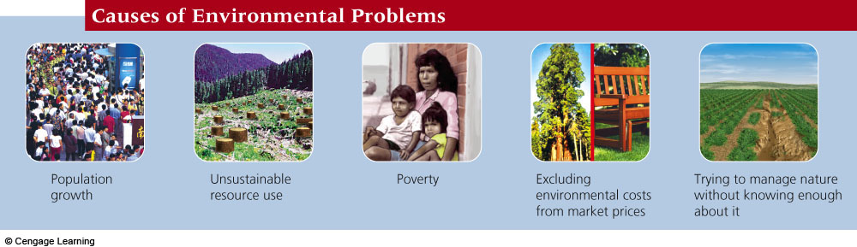

Slide 7
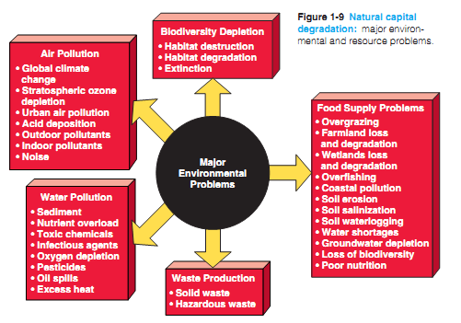

Slide 8
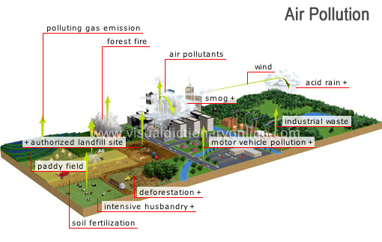

Slide 9
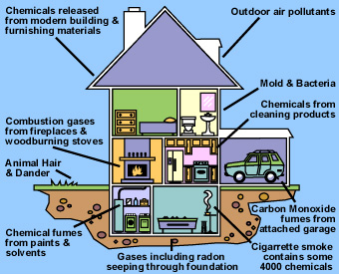
Indoor Air Pollution

Slide 10
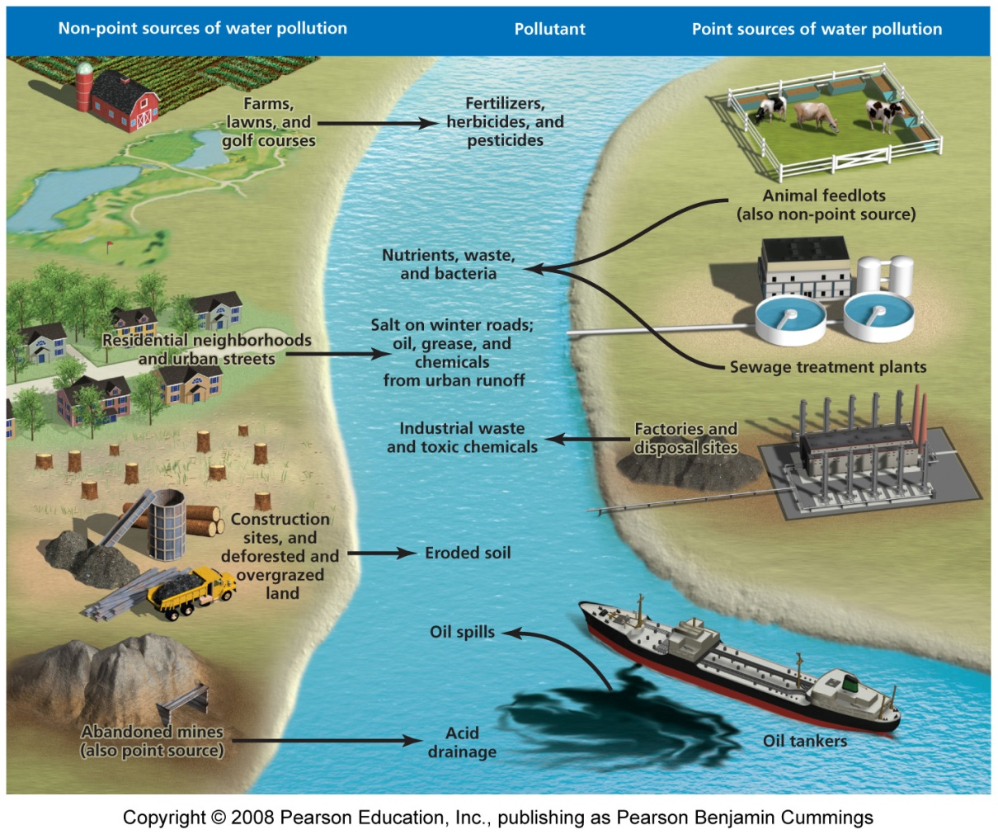
Water pollution
Non-point and Point sources

