Slide 1
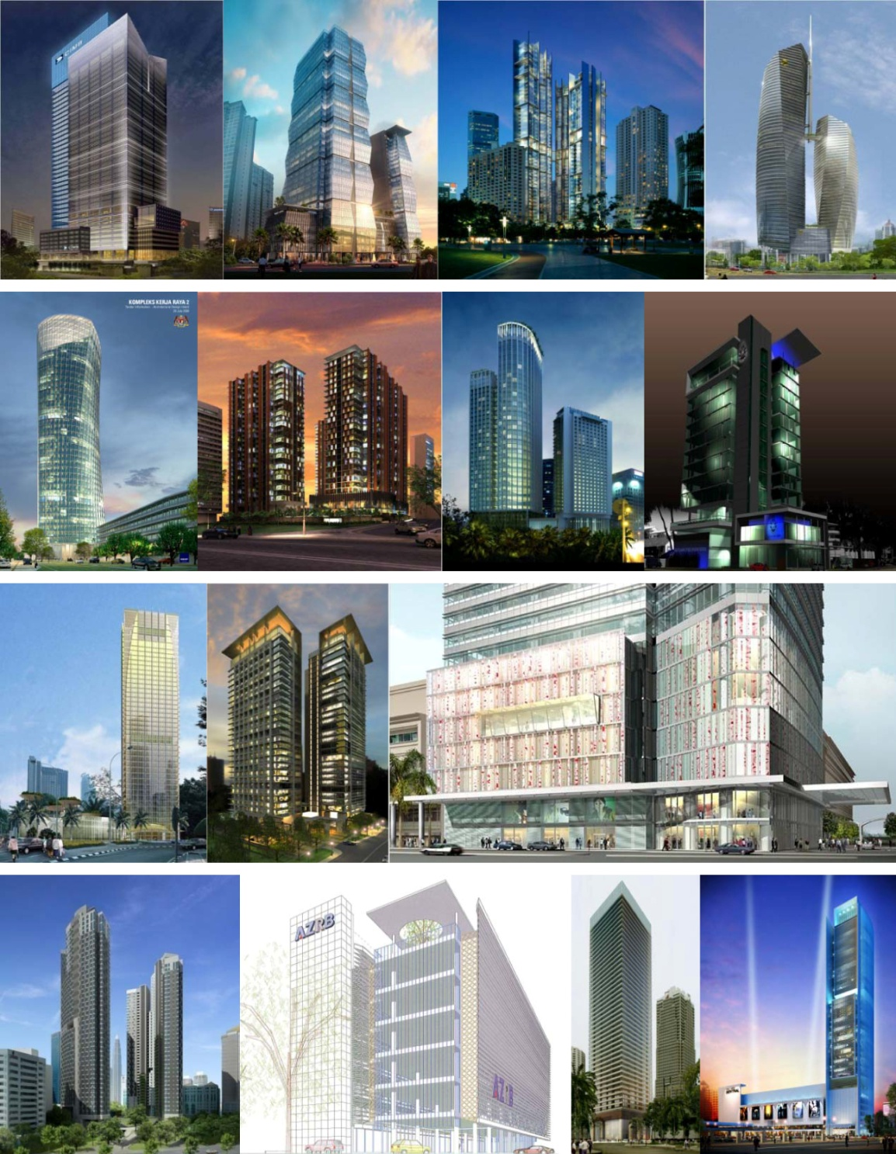
Dampak FAÇADES pada Efisiensi Energi Bangunan

Slide 2
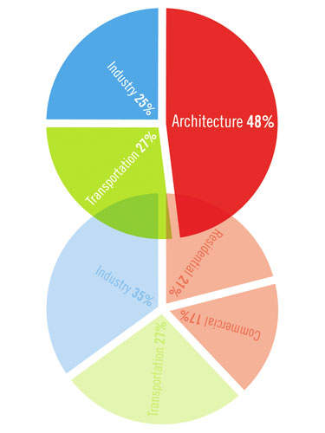
architecture is the hidden polluter
Konsumsi Energi A.S. menurut Sektor. Reorganisasi data yang ada menggabungkan energi yang dibutuhkan untuk menjalankan bangunan perumahan, komersial, dan industri bersama dengan energi yang terkandung dari bahan-bahan yang dihasilkan industri seperti karpet, ubin, dan perangkat keras - memaparkan arsitektur sebagai pencemar tersembunyi
Source : Architecture 2030

Slide 3
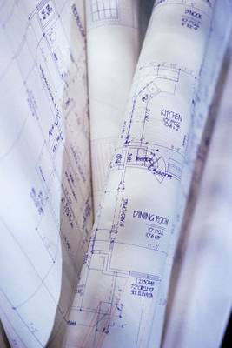
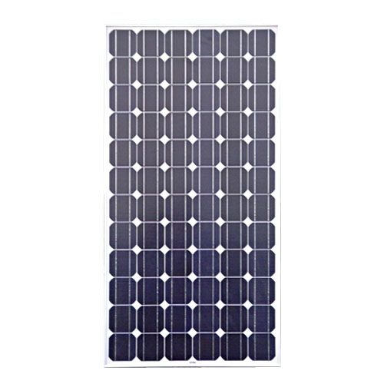
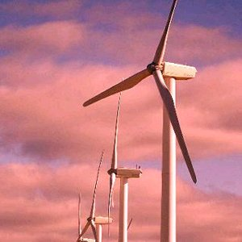
What shall we do?
DESIGN STRATEGIES
TECHNOLOGIES AND SYSTEMS
OFF-SITE RENEWABLE ENERGY

Slide 4
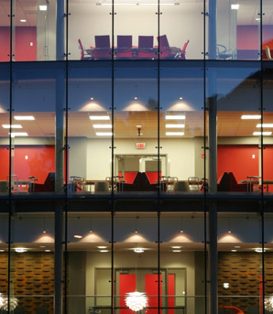
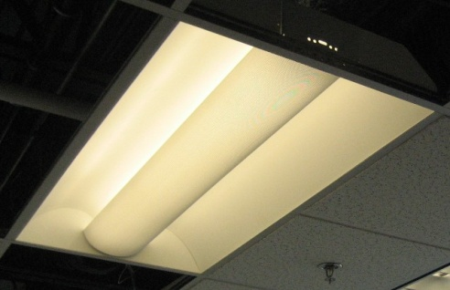



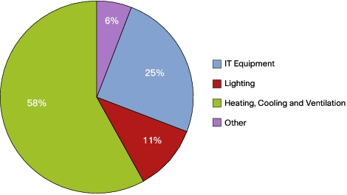
ENERGY USE IN OFFICES
Source : UK Energy Efficiency Best Practice Program Energy Consumption Guide 19: Energy Use in Offices

Slide 5
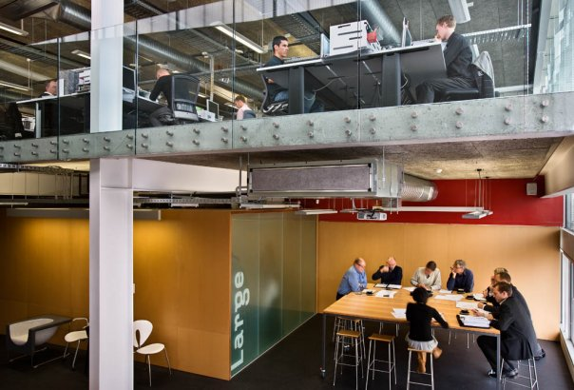
Beban AC disebabkan oleh pencahayaan, peralatan, orang-orang dan panas yang diperoleh melalui fasad

Slide 6
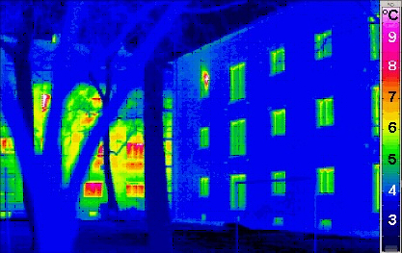
Seberapa efisien façade Anda?

Slide 7
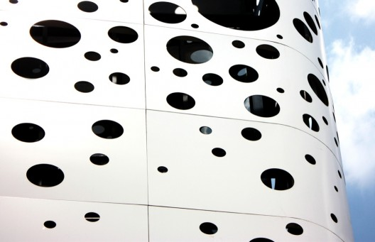
OTTV
Overall Thermal Transfer Value
WATTS PER M²

Slide 8
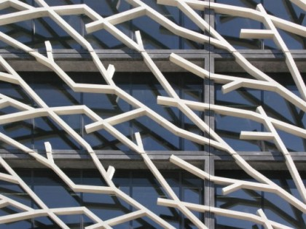
HEAT W =
OTTV x skin area
W / m2 x m2

Slide 9
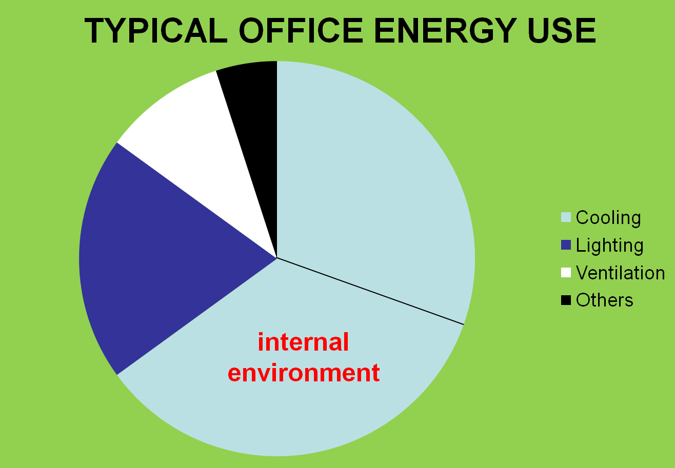
external
environment

Slide 10
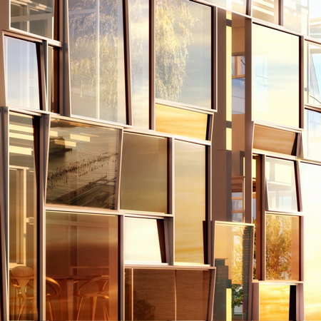
OTTV
T_{deq}
D_{T}
SF
CF
x (1-WWR) x U_{w} + x WWR x U_{f} + x x WWR x
SC
SOLAR FACTOR
SOLAR CORRECTION FACTOR
TEMPERATURE DIFFERENCE
SHADING COEFFICIENT
DIFFERENTIAL TEMPERATURE EQUIVALENT

Slide 11
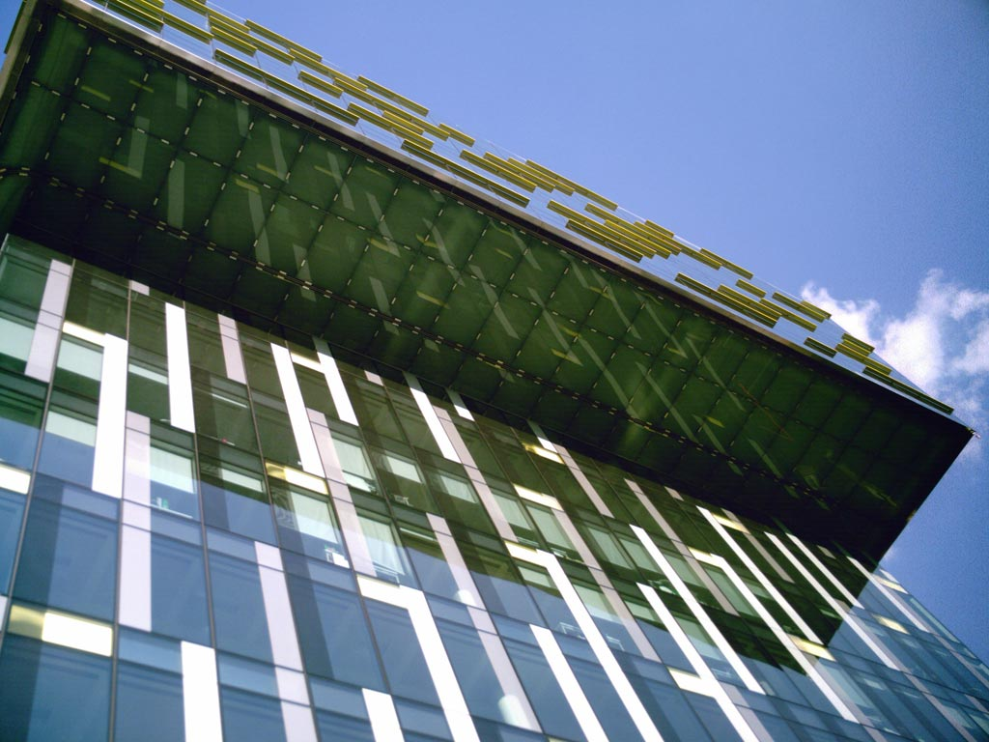
15
6
α (1 −WWR)Uw + (WWR)Uf + ( x CF x WWR x SC)
194
OTTV Simplified Formula

Slide 12

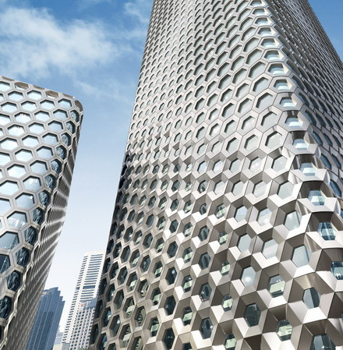
Q_{gc}
glass conduction
Q_{gs}
glass
solar
Q_{wc}
wall conduction

Slide 13
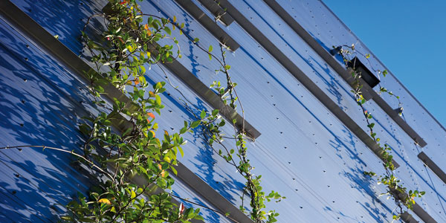
OTTV
15
6
α (1 −WWR)Uw + (WWR)Uf + ( x CF x WWR x SC)
194
WALL HEAT
SOLAR THROUGH GLASS
WINDOW HEAT

Slide 14
Q_{gc}
glass conduction
Q_{gs}
glass
solar
10% - 20%
80%
Q_{wc}
wall conduction
5%

Slide 15
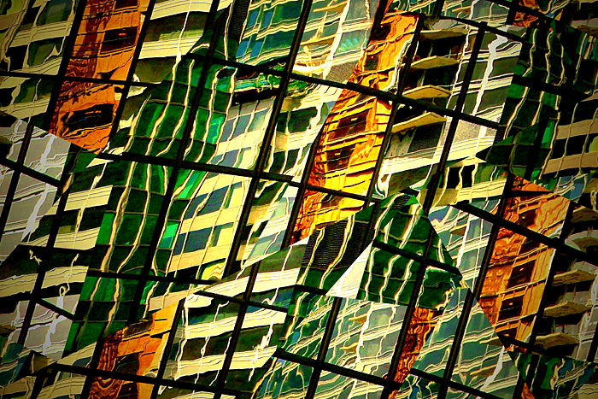
OTTV
Simplified Formula
α
Uw Uf
SC
15 (1 −WWR) + 6(WWR) + (194 x x WWR x )
CF
SOLAR ABSORPTION FACTOR
U VALUE
BLACK | 0.9 – 1.0
WHITE | 0.15 – 0.3
SILVER / ALUMINIUM | 0.1

Slide 16
OTTV
α
Uw Uf
SC
15 (1 −WWR) + 6(WWR) + (194 x x WWR x )
CF
SOLAR CORRECTION FACTOR

Slide 17
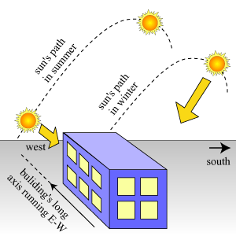
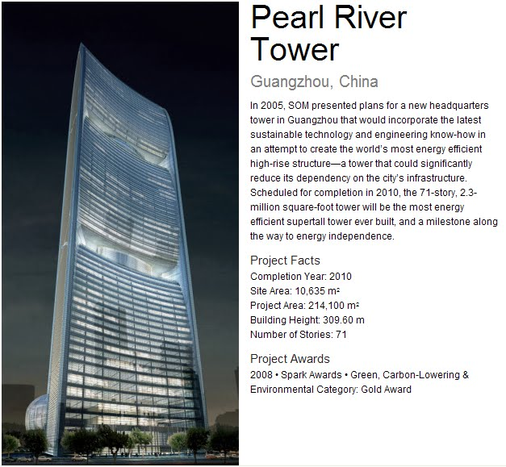
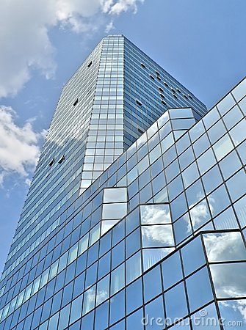
Orientation of Buildings

Slide 18
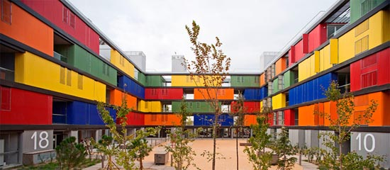
α
Uw Uf
SC
15 (1 −WWR) + 6(WWR) + (194 x x WWR x )
CF
SHADING COEFFICIENT
OTTV

Slide 19
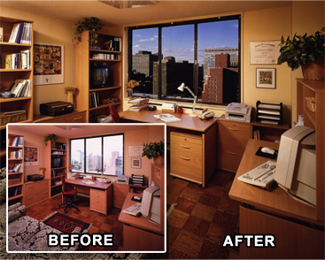
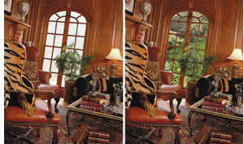
The lower the SC, the darker the interior

Slide 20
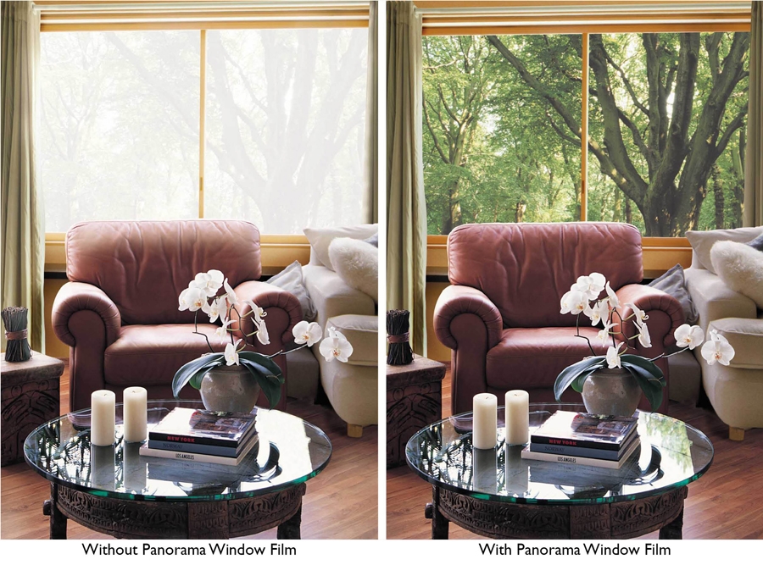
The higher the VLT, the lighter the interior,
but beware of GLARE

Slide 21
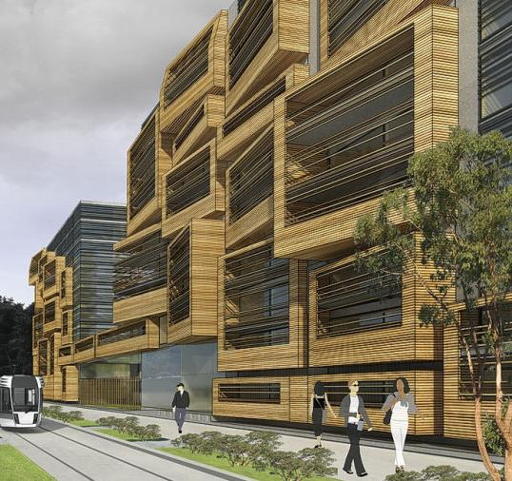
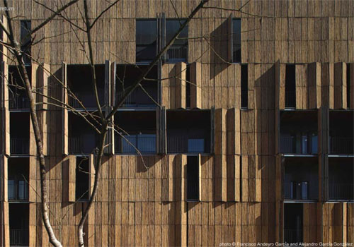
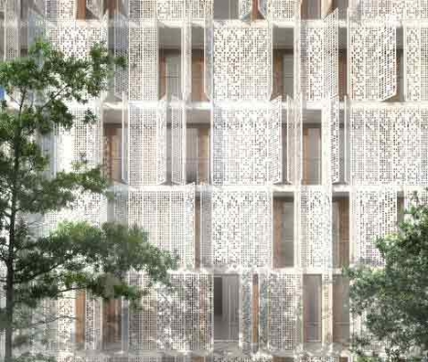
SC
SHADING
COEFFICIENT
SC = SC₁ x SC₂

Slide 22
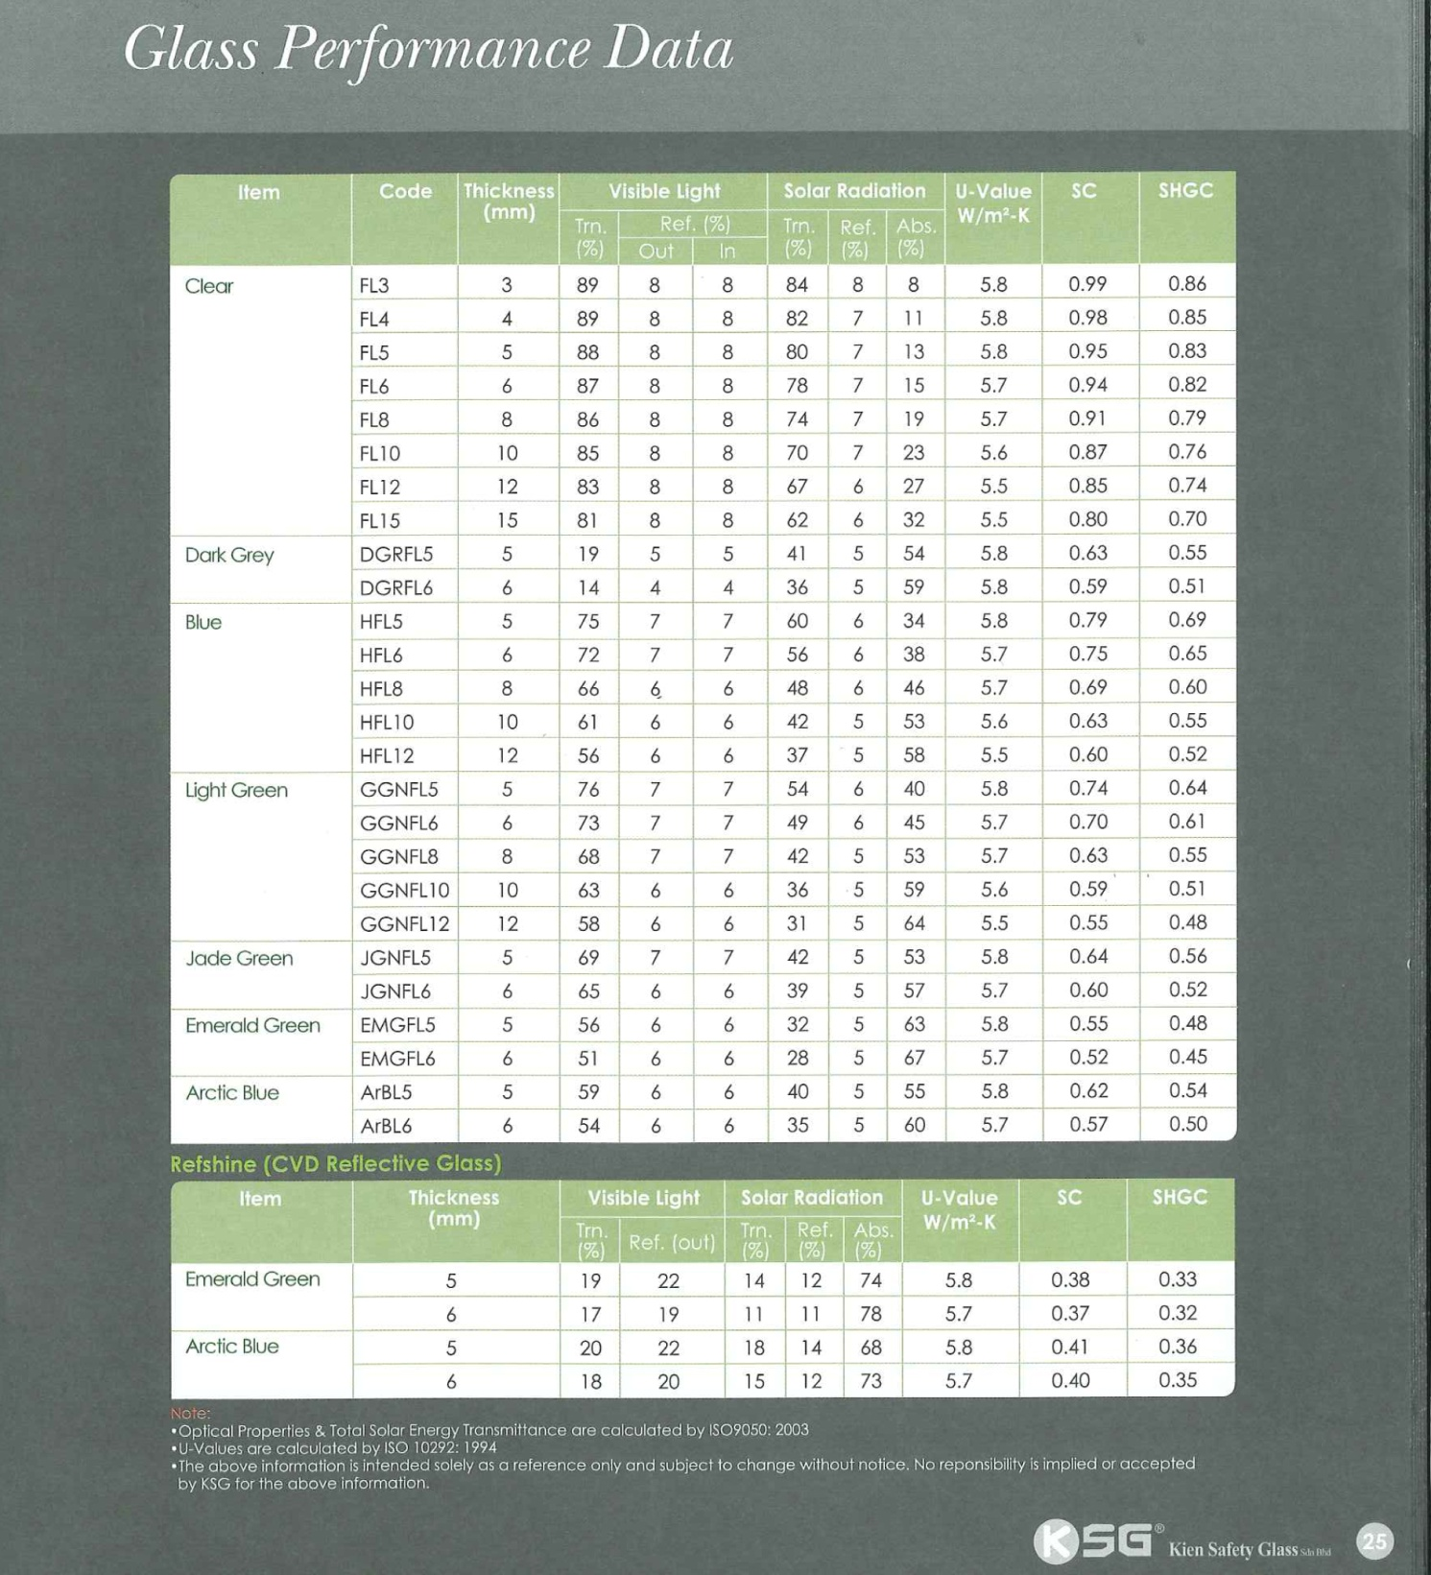

Slide 23
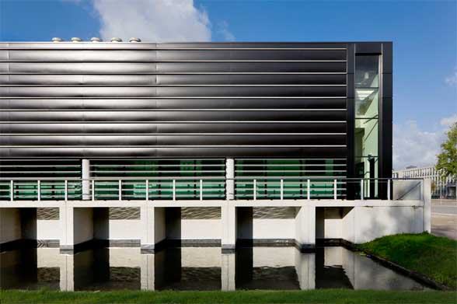
15 (1 − ) + 6( ) + (194 x x x )
Uw Uf
SC
WWR WWR WWR
α
CF
Window Wall Ratio
OTTV

Slide 24
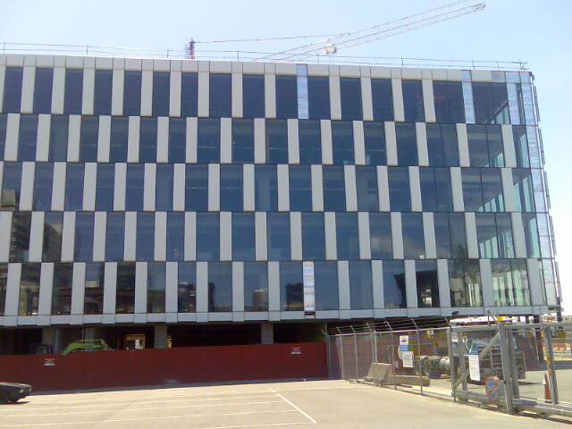
The Window Wall Ratio

Slide 25
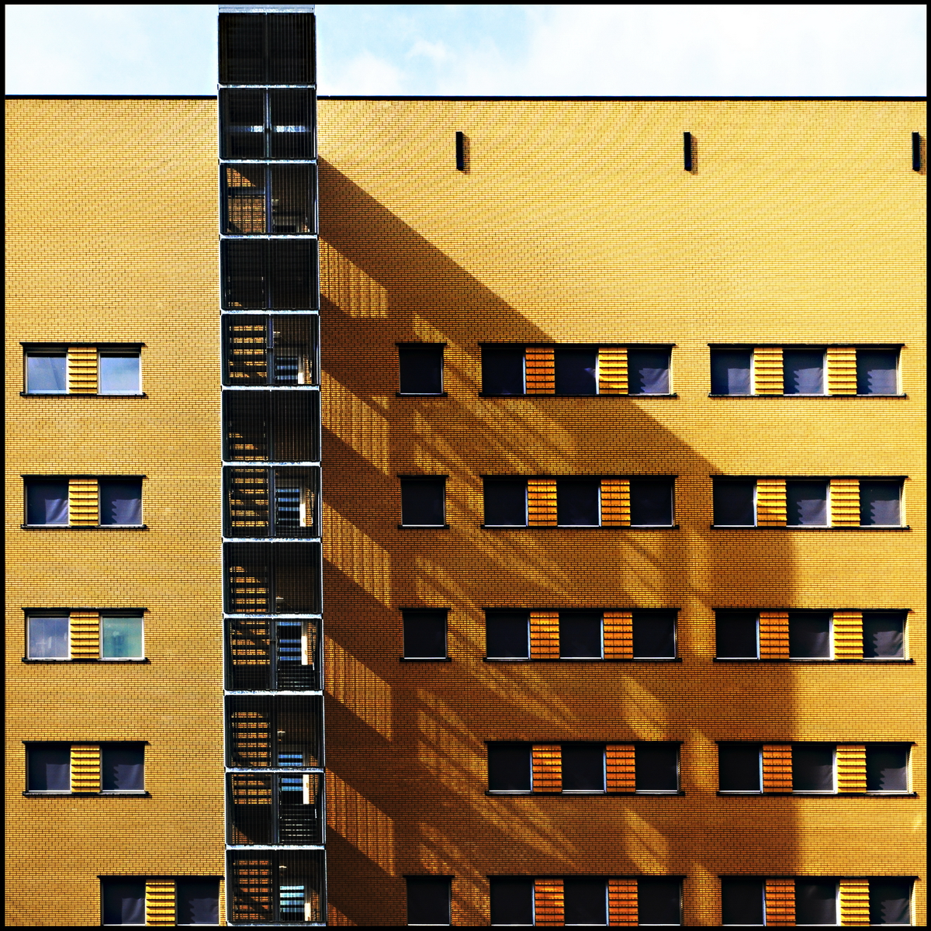
Window Wall
Ratio

Slide 26
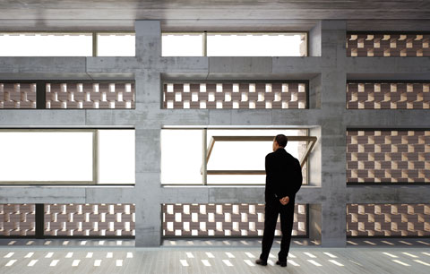
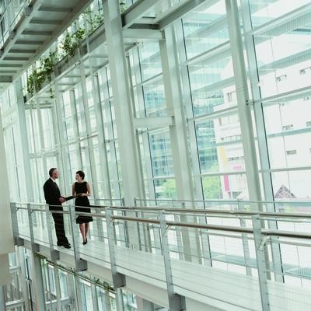
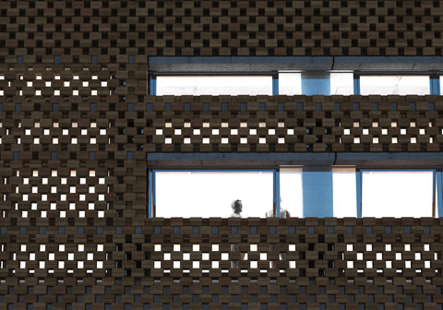
 | WWR - Window / Wall Ratio (%)
 | 11 | 13 | 15 | 17 | 19 | 21 | 23 | 25 | 27 | 29
OTTV | 36 | 39 | 44 | 47 | 51 | 55 | 59 | 63 | 67 | 71

Slide 28
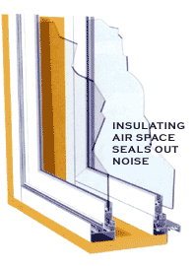
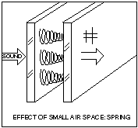
DGU
double glazed unit
Sound insulation does not work when the air gap is small, say 6 mm
Increase air gap = 20 - 100 mm

Slide 29
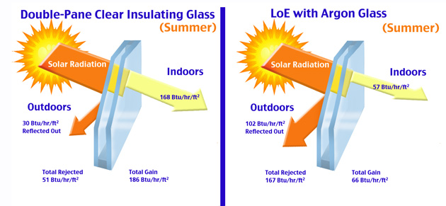
Type of Glass | R Value
Single Pane regular glass | 0.85
Clear Insulated Glass 7/8 inch overall thickness | 2.08
Hard Coat Low-E insulated glass | 2.45
Hard Coat Low-E insulated glass with argon | 2.75
Soft Coat Low-E insulated Glass | 3.50
Soft Coat Low-E insulated glass with argon | 4.35
Low-Emissivity Glass

Slide 30
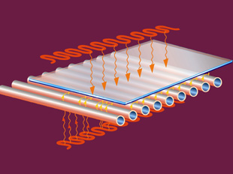
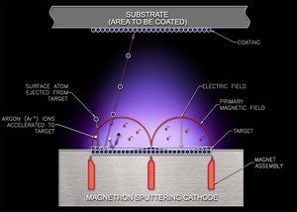
Hard Coat Low-E glass
Molten tin is heat welded to the glass. Coating is very strong and difficult to scratch or remove
Soft Coat Low-E glass
Silver, zinc, or tin are sputtered onto the surface of the glass where they stick. Coating is not strong and easily scratched

Slide 31
THANK YOU
Fenestra Malaysia Sdn Bhd
J-5-12 Solaris Mont Kiara
2 Jalan Solaris
50480 Kuala Lumpur
T +603 6205 1288
F +603 6205 1289
E info@fenestra.com.my

