Slide 1



Tingkat
Kerawanan Geologis terhadap
Kondisi Kebencanaan di Indonesia: “Jalur
Sesar Aktif dan Antisipasi
Bahaya
nya”
PusGeN
(Pusat Studi Gempa Nasional)
Lembaga Ilmu Pengetahuan Indonesia (LIPI)
Head of Geology Working Group - National Center for Earthquake Study (PuSGeN)

Slide 2
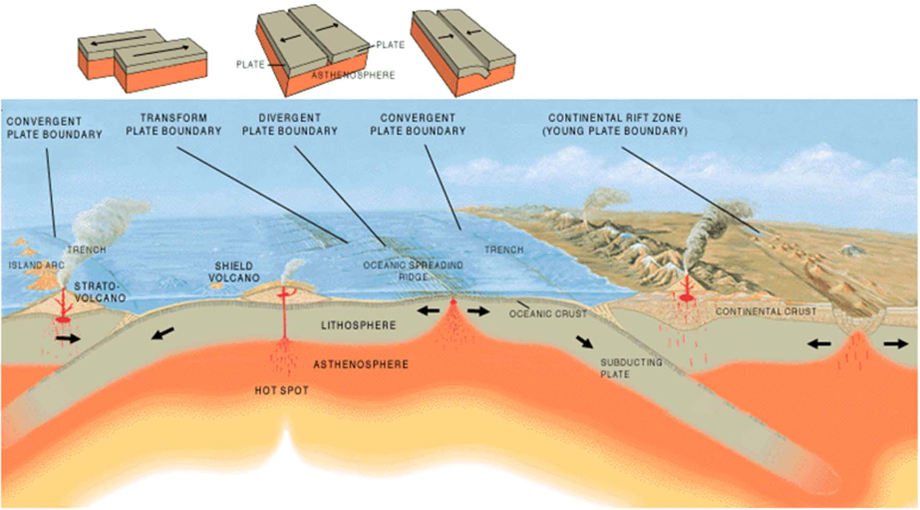
The
Earth
is
always
moving
Volcanoes
1. Spreading
center
2. Transform
fault
solid
3. Subduction
zone
Hot
liquid
From Continental Drift [Wagener, 1912] to Plate Tectonics Theory (1960)

Slide 3
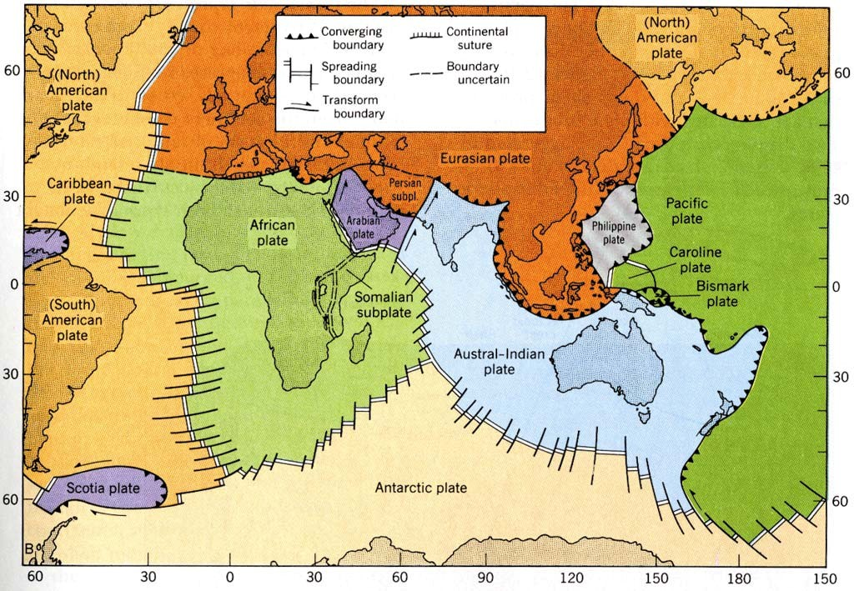
1. Spreading center
2. Transform fault
3. SUBDUCTION ZONE

Slide 4
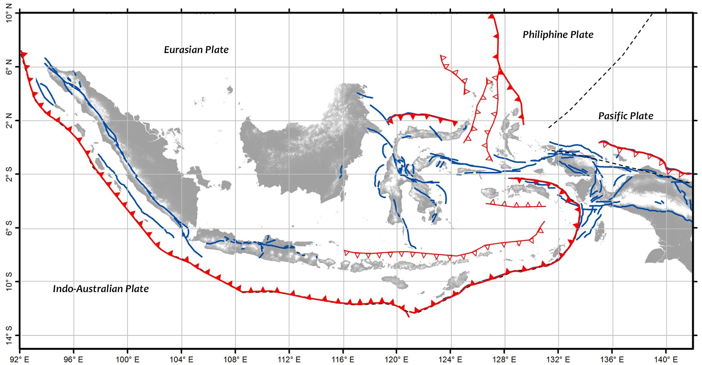
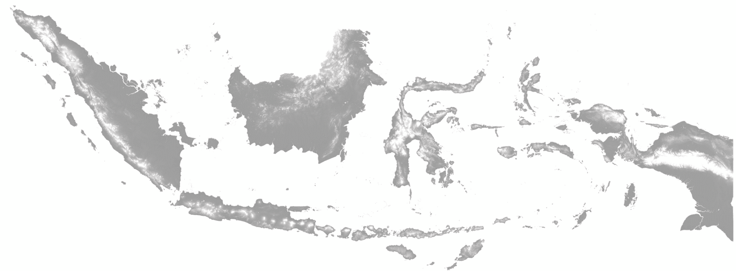
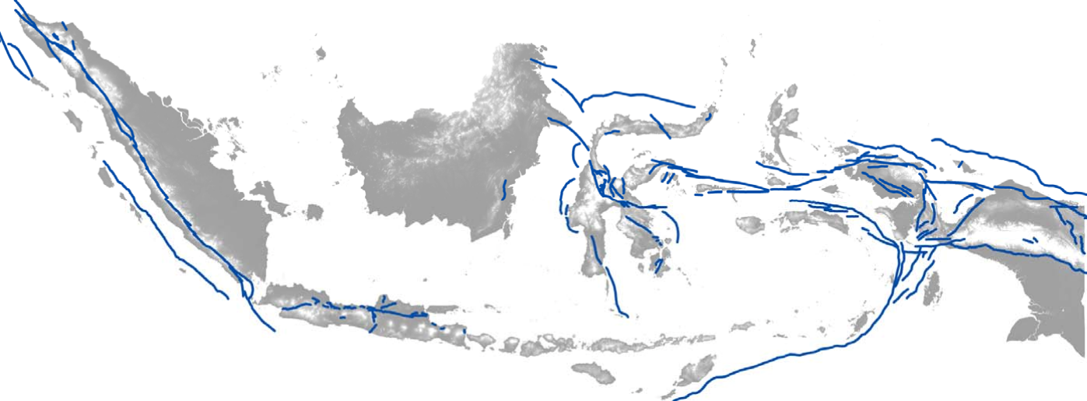
EARTHQUAKE
SOURCES
OF
INDONESIA
Philiphine Plate
Eurasian Plate
Pasific Plate
Indo Australian Plate
12
cm/yr
Active Faults
7
‐
7 cm/yr
Subduction

Slide 5

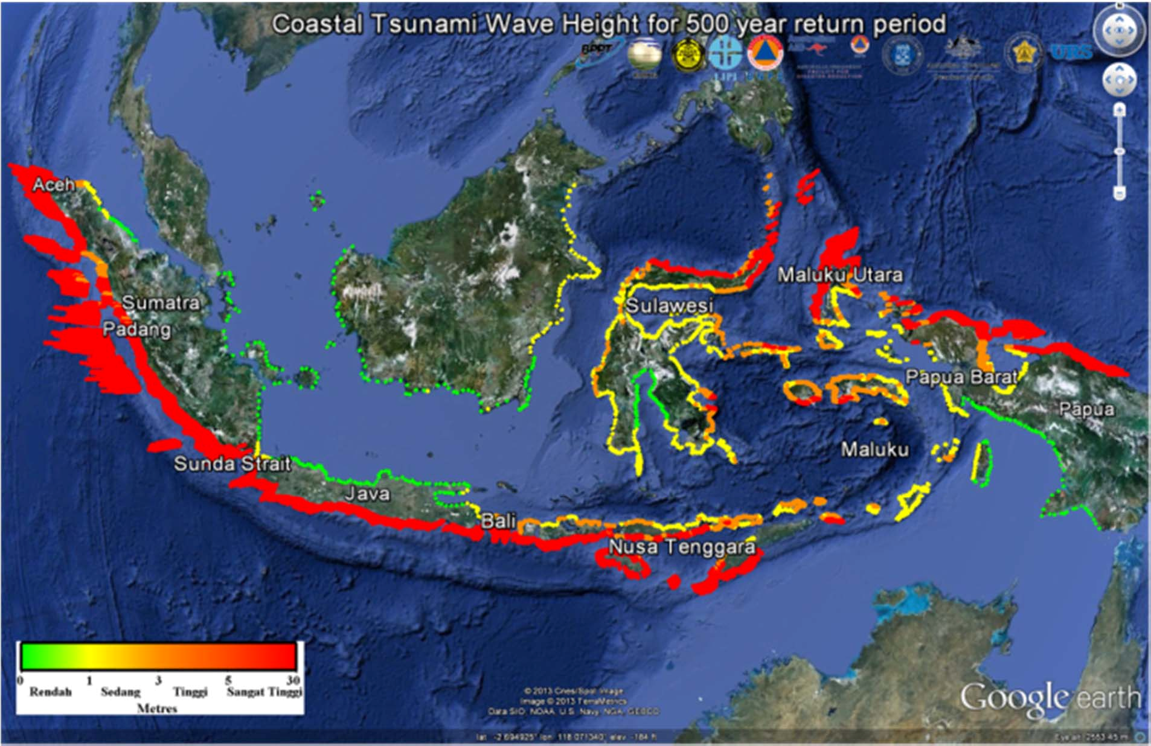
PROBABILITY OF TSUNAMI HAZARDS IN INDONESIA
For 500 Years Return Period (tsunami heights along the coast)
0
3
30 (meters)
Source: N. Horspool, I. Pranantyo, J. Griffin, H. Latief, D.H. Natawidjaja, W.
Kongko, A. Cipta, Bustaman, S.D. Anugrah, and H.K. Thio. A Probabilistic Tsunami
Hazard Assessment for Indonesia.

Slide 6
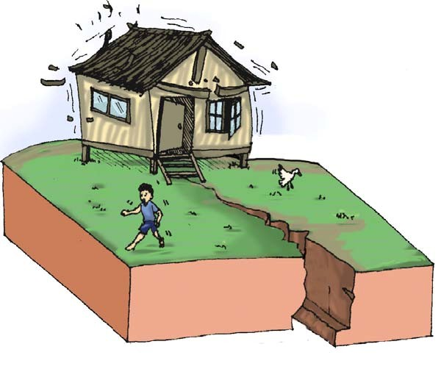
TASK
#1
Mapping Active Fault,
Measuring Sliprate
&
Earthquake Surface Ruptures

Slide 7
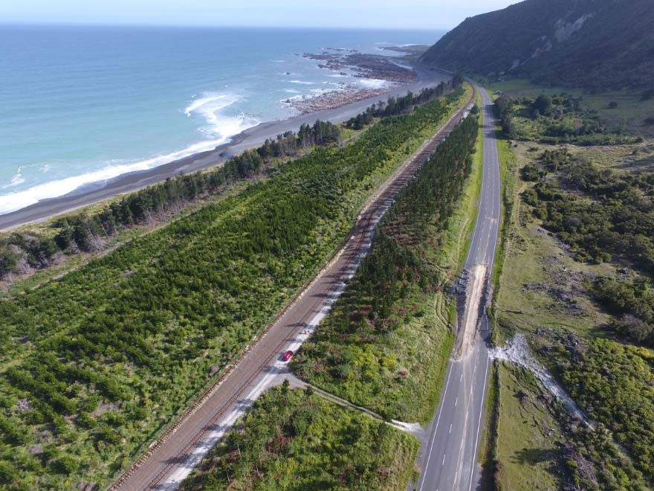
https://www.earthmagazine.org/article/complex-
kaikoura-earthquake-forces-rethink-multifault-ruptures

Slide 8
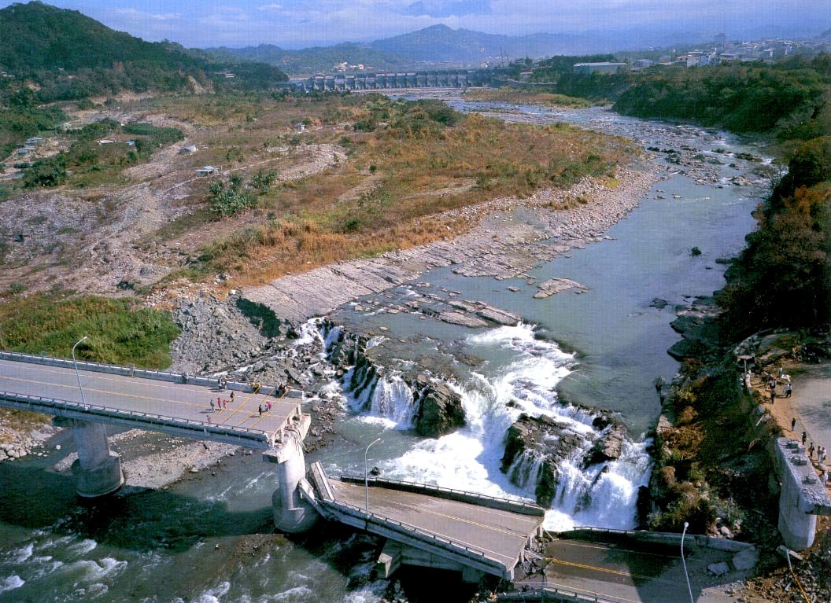
Fault Surface Rupture Hazards
UP
Chi-chi Fault 1999 (Taiwan)

Slide 9
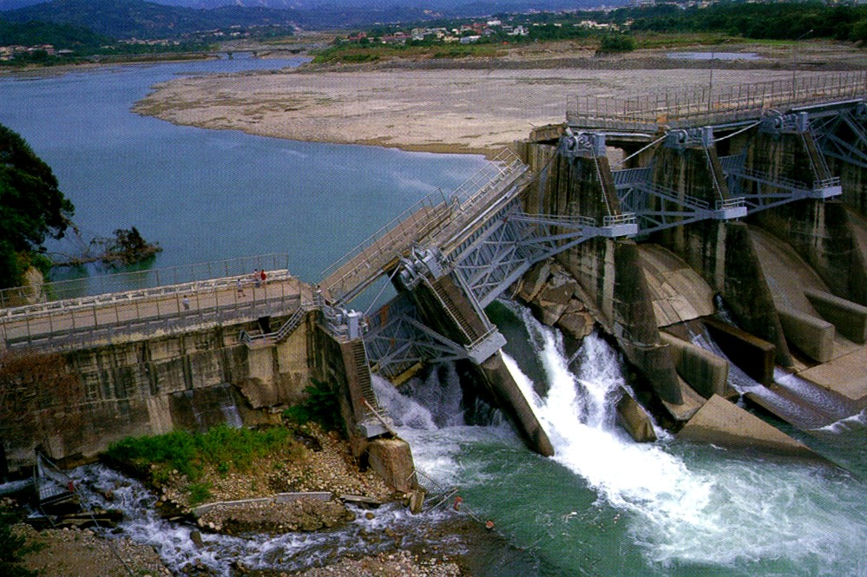
Active
UP
Faut
crossing
Dam
site
Chi-Chi 1999 earthquake
in Taiwan

Slide 10
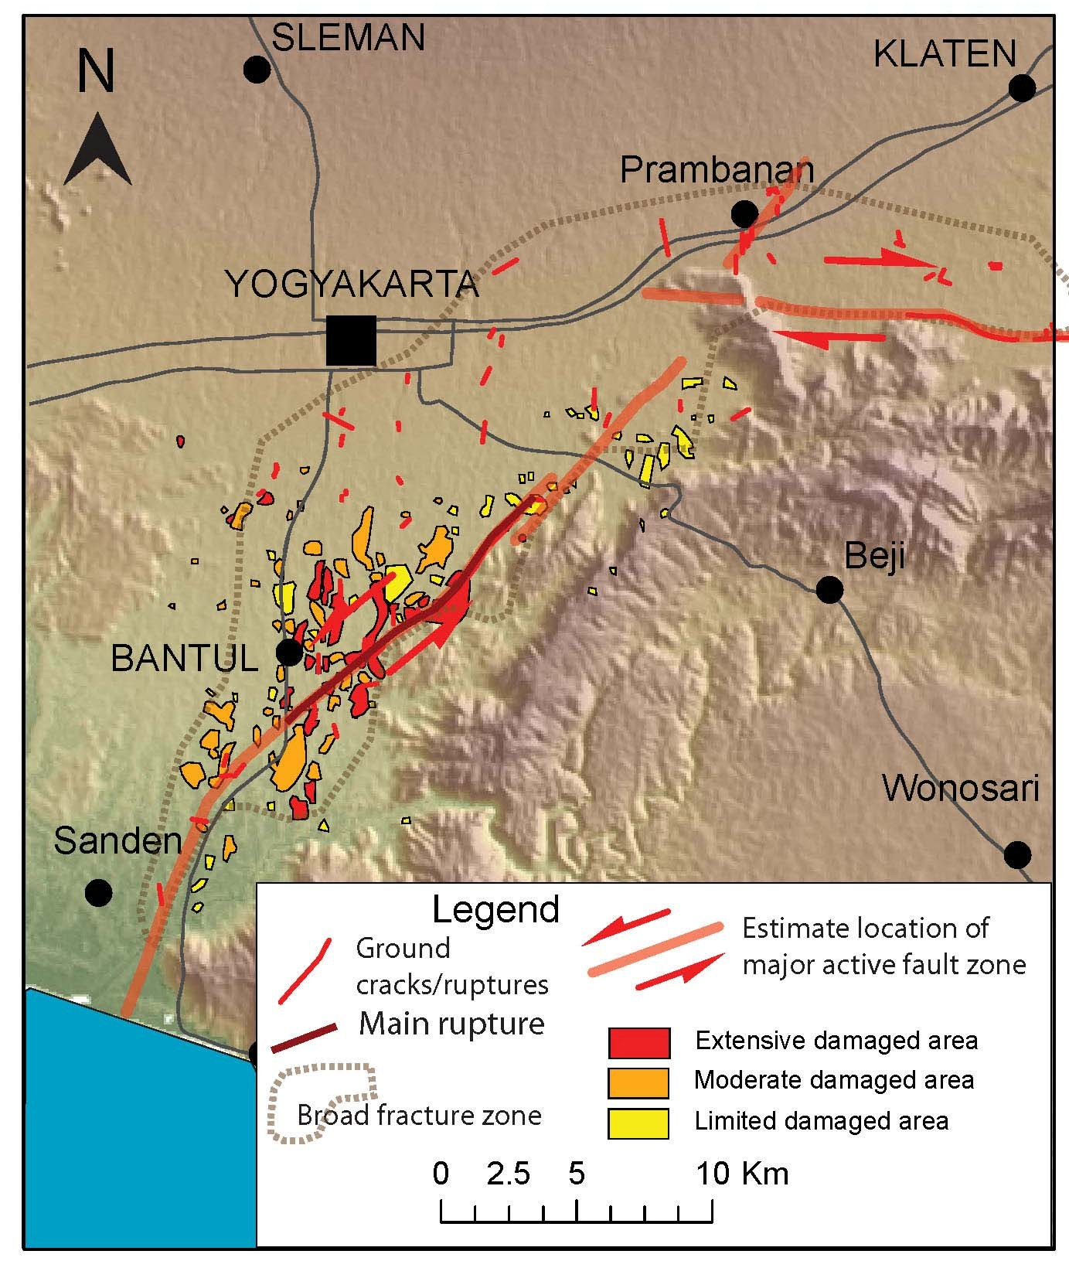
Bantul
Earthquake
May 2006
• damage zones are close fault ruptures + soft- sediment-basin effects
(Mw 6.3)
5,000 death

Slide 11
TASK #2
PALEOSEISMOLOGY

Slide 12
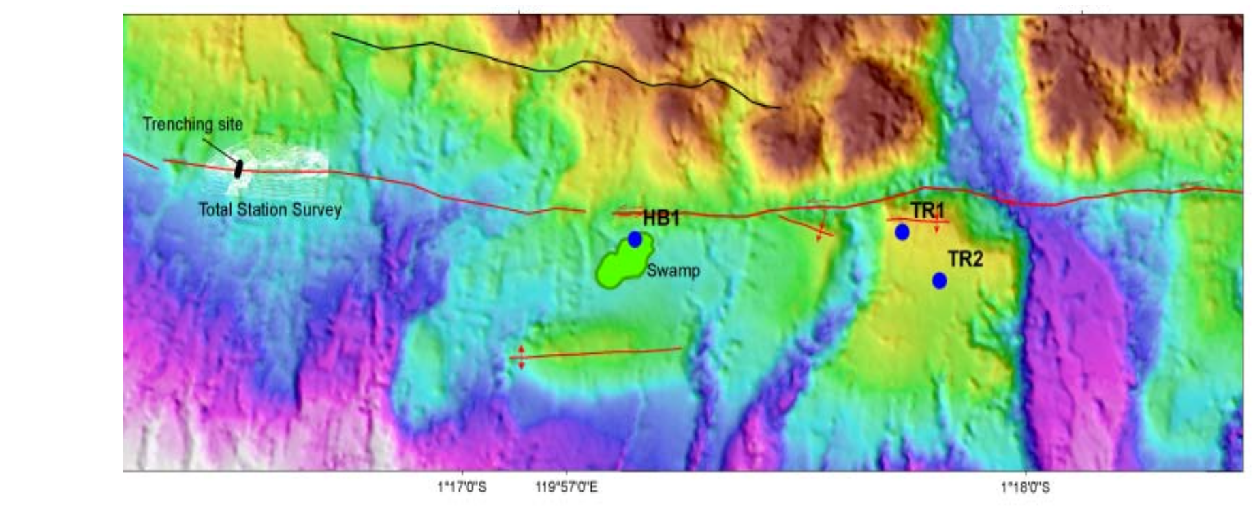
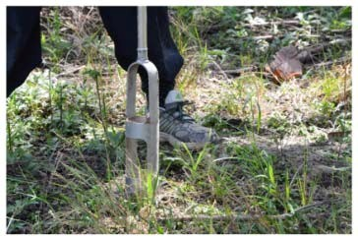
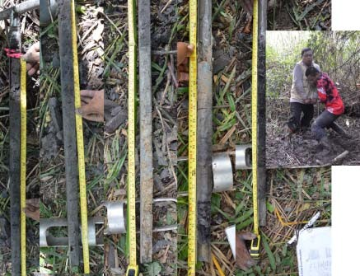
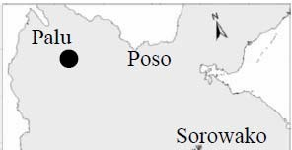
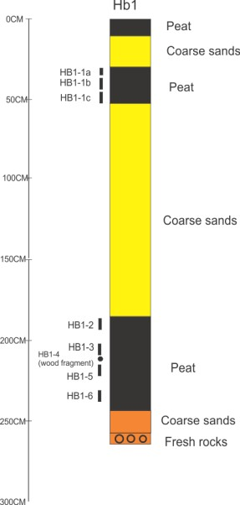
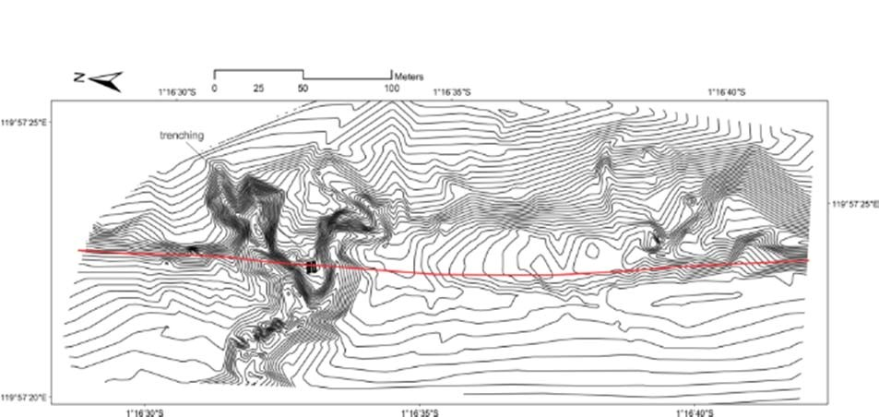
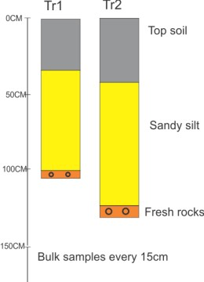
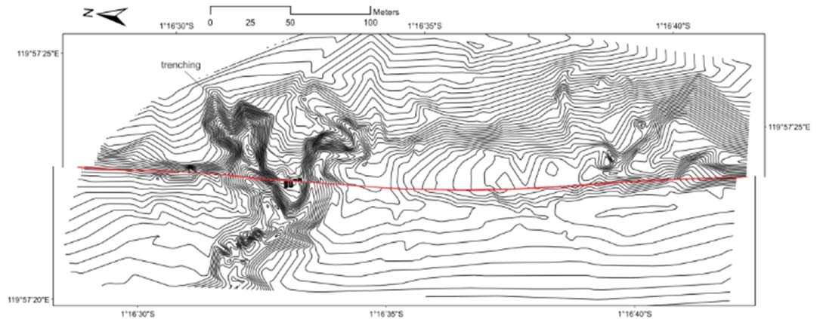
PALEOSEISMOLOGY ON SALUKI SEGMENT
Mw7
5.5±1.5m
7780 – 7770 (BC)
7790 – 7605 (BC)
Mudrik R Daryono ,et.al. (inprog
Slip
rate
Palu-Koro Fault
must
lower than 58 mm/yr

