Slide 1
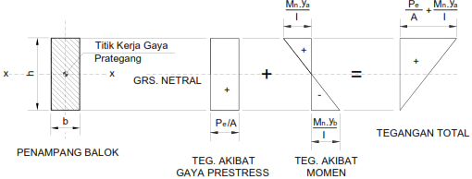
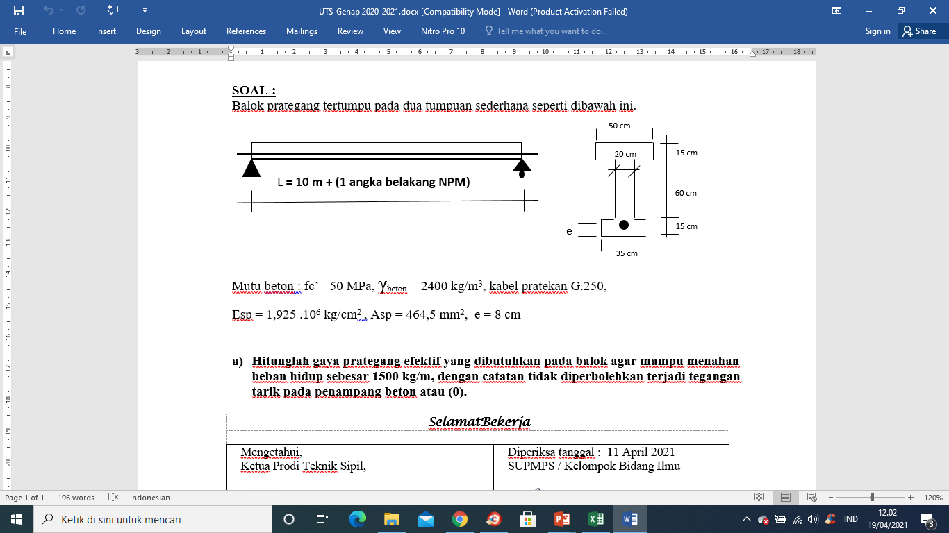
JAWABAN SOAL UTS SMSTR GENAP 2020-2021

Slide 2
JAWABAN SOAL UTS SMSTR GENAP 2020-2021

Slide 3
Mencari Titik Berat Penampang
A1 = 50 x 15 = 750 cm2
A2 = 20 x 60 = 1200 cm2
A3 = 35 x 15 = 525 cm2
Atot = 2475 cm2
Y1 = (7,5+ 75) = 82,5 cm
Y2 = (30 + 15) = 45 cm
Y3 = 7,5 cm
Y = (A1.y1 +A2.y2 +A3.y3)/Atot
= (56812,5 + 54000 + 393,75)/2475
= 48,41 cm
1
Ya =(90-48,41)=41,59
2
Y = yb= 48,41
3
2. Momen Inersia Ix
Ix = ∑(Ix⁰n + An.yn^2)
Ix1 = (14062,5 + (750. 34,09^2) = 8,8 . 10^5 cm^4
Ix2 = (360000 + (1200 . 3,41^2) = 3,7 . 10^5 cm^4
Ix3 = (9843,75 + (525 . 40,91^2) = 8,9 .10^5 cm^4
Ix total = 21,4.10^5 cm^4
Ix1⁰ = 1/12 b1.h1^3 = 14062,5 cm4
Ix2⁰ = 1/12 b2.h2^3 = 360000 cm4
Ix3⁰ = 1/12 b3.h3^3 = 9843,75 cm4
Y1 = (41,59 -7,5) = 34,09 cm
Y2= (48,41-45) = 3,41 cm
Y3= (48,41 -7,5) = 40,91 cm

Slide 4
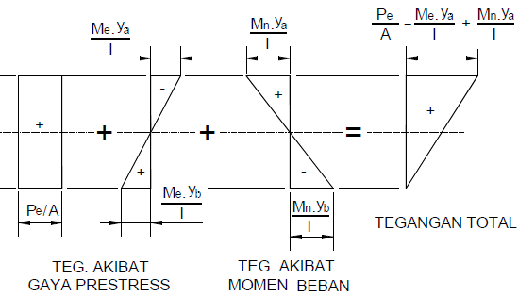
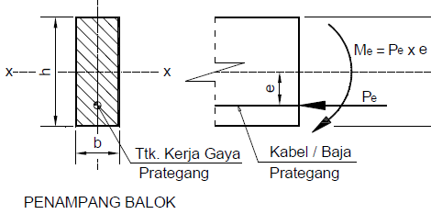
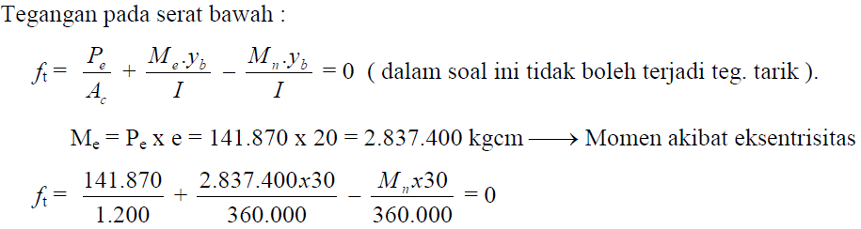
1
Ya =41,59
40,41 cm
2
Yb = 48,41
3

Slide 5
Mencari Momen akibat beban (Mu)
Mdu = (1/8 . wD. L^2)
=
Mlu = 1/8 WL. L^2
Mu = 1,2. Mdu + 1,6.Mlu
=
Beban mati :
WD = Atot . Bj beton = 2475 . 10^-4 m^2 . 2400 kg/m3 = 594 kg/m’
WL = 2000 kg/m’
Wu = 1,2.WD + 1,6.WL = 3912,8 kg/m’
L bentangan = 16 m (missal NPM 6)
Mu = 1/8. Wu.L^2 = 125209,6 kg.m
Mn= Mu/Φ = 125209,6/0,65 = 192630,15 kg.m = 1,926.10^7 kg.cm
Me = Pe. 40,41 (kg.cm)
Serat bawah = 0
Pe/(2475) + (40,41.Pe). 48,41 / 21,4.10^5 - 1,926.10^ 7 . 48,41/ 21,4.10^5 = 0
Pe/(2475 ) + 9,14.10^-4 Pe = 435,69
(4,04. 10^-4 + 9,14.10^-4 ). Pe = 435,69
13,18 . 10^-4. Pe = 435,69
Pe = 330569,04 kg atau 330,57 ton
Me= 40,41.Pe
= 1,336. 10^7 kg. cm

Slide 6
Serat atas tegangan yang terjadi =
Pe/Ac = (330569,04 / 2475) = 133,56 kg/cm^2
Me.ya/Ix = 1,336. 10^7 . 41,59/ 21,4.10^5 = 259,646 kg/cm^2
Mn.ya/Ix = 1,926.10^7 . 41,59/ 21,4.10^5 = 374,31 kg/cm^2
fca’ = Pe/Ac – Me.ya/Ix + Mn.ya/Ix
= 248,224 kg/cm^2
1 kg = 10 N
Mutu beton fc’ = 50 Mpa = 50 N/mm^2
= 50/10 kg/mm^2
= 5 kg/mm^2
= 5 kg/10^-2 cm^2
= 5.100 kg/cm^2
= 500 kg/cm^2
fcu’ = 0,60 x 500 kg/cm^2 = 300 kg/cm^2
Kontrol :
fca’ < fcu’ → 248,224 kg/cm^2 < 300 kg/cm^2 (oke)
Kesimpulan :
Jadi Gaya prategang efektif yang harus diberikan agar mampu menahan beban hidup WL = 2000 kg/m’ sebesar
Pe = 330569,04 kg atau 330,57 ton dengan mutu beton 50 MPa

