Slide 1
Bamboo as Construction Materials

Slide 2
Bamboo is one of the most common materials in construction. It is really easy and fast to grow. They are capable of growing 60 cm or more per day
Bamboo is a renewable and versatile resource, characterized by high strength and low weight, and is easily worked using simple tools

Slide 3
ADVANTAGES
Low-cost and environment friendly.
Light weight compared to steel.
Shock absorbing and thus earthquake resistant.
It uses less fossil fuel to manufacture.
Bamboo can prevent pollution by absorbing large amounts of nitrogen from waste water and reducing the amount of carbon dioxide in the air.
Its abundance in tropical and subtropical regions makes it an economically advantageous material.

Slide 4
DISADVANTAGES
It is not that uniform, i.e., large varieties of bamboo are found having different tensile strength.
It has tendency to absorb water and also to release water on drying.
Bamboo is easily infected by wood-boring insects and attracts living organisms, such as, fungi and insects because of its high content of nutrients unless treated with wood preservatives or kept very dry.
Need some treatment for presevation
Less durability than steel
It is susceptible to catch fire as compared to steel.

Slide 5
BASIC PROPERTIES OF BAMBOO
TENSILE STRENGTH
COMPRESSIVE STRENGTH
ELASTIC MODULUS
ANISOTROPIC PROPERTIES
SHRINKAGE
FIRE RESISTANCE

Slide 6
TENSIL STRESS AND UNIT WEIGHT
The common tensile stress in steel reinforcement is 160 N/mm² and in bamboo 370 N/mm².
The mass per volume of steel is 7850 kg/m³ and of bamboo is about 400-600 kg/m³.
Evidently bamboo will be cheaper because the price of bamboo per weight will be less than half that of steel.

Slide 7
MODULUS OF ELASTICITY
The cellulose fibers in bamboo act as reinforcement similar to reinforcing steel bars in concrete. The distribution of these fibers increases from the inside to the outside.
The E-modulus for bamboo is about 70 000 N/mm² – 100 000 N/mm² and about 50% of the cross-section of the fiber is cellulose; the E of the fiber is 35 000 N/mm².
In most bamboos, fibers constitute about 60% on the outside and 10% on the inside.

Slide 8
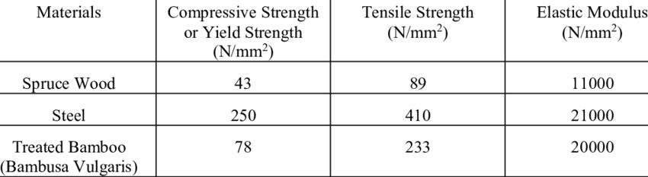

Slide 9
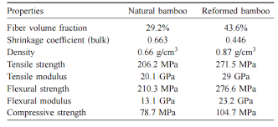

Slide 10
DURABILTY
Bamboo with low humidity is less prone to mould attacks especially when humidity content is less than 15%.
Physical and mechanical properties of bamboo increase with a decrease in its humidity content.
Bamboo to be treated with a preservative needs to be dry to facilitate penetration. Bamboo can be dried in air, green house, and oven or by fire

Slide 11
PRESERVATION OF BAMBOO
NON CHEMICAL METHODS OR TRADITIONAL METHOD
CHEMICAL METHODS

Slide 12
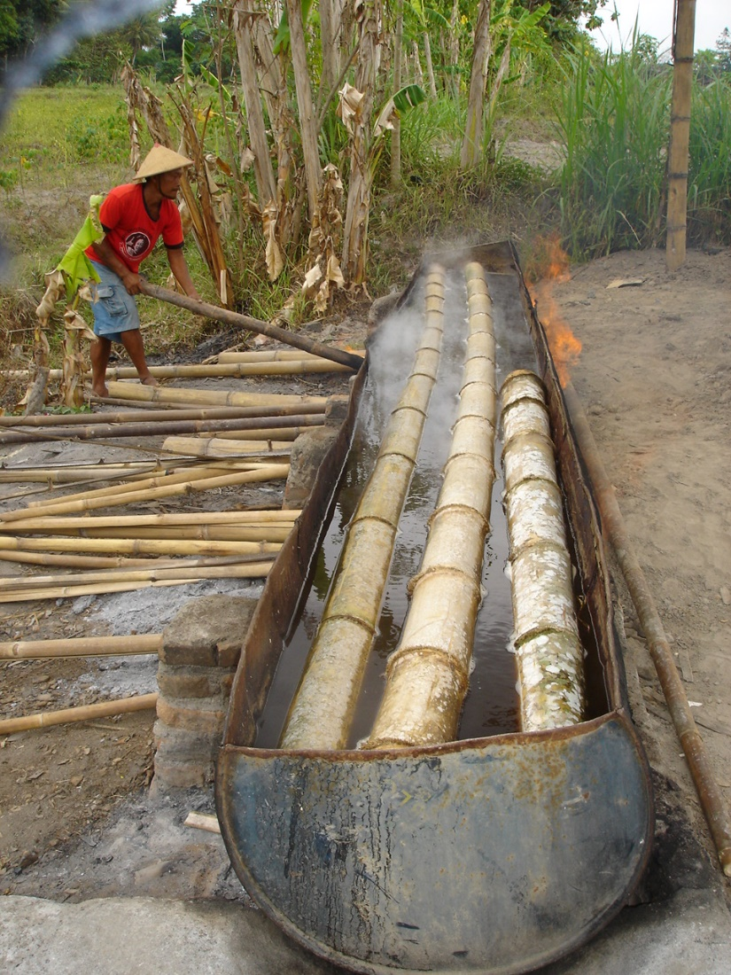
Traditional preservation
Various ways of preserving bamboo include:
Cutting time control.
the timing of bamboo cutting
Bamboo soaking.
Bamboo that has been cut down is soaked for months or even years so that it is resistant to weathering and pest attacks. Immersion is done either in ponds, rice fields, ditches, rivers or in the sea. The disadvantage of this system is that bamboo that is soaked for a long time, when removed will emit mud and an unpleasant odor, it will take a long time after soaking to dry until the odor is reduced and can be used as building material.

Slide 13
Bamboo fumigation.
Traditionally, bamboo is also sometimes smoked to increase its durability. Traditionally bamboo is placed in a smoky place (kitchen or other burning place), gradually reducing the humidity of bamboo so that biological damage can be avoided.
Dyeing with lime.
Bamboo in the form of splits or wedges is dipped in a solution of lime (CaOH2) which then turns into calcium carbonate which can block water absorption so that the bamboo is protected from fungal attacks.
Grilling/burning/heating.
Usually for bamboo with a small diameter such as the "cendani" type. Heating can increase the resistance of bamboo and make it more aesthetically pleasing, the color of bamboo becomes more yellow and shiny. In large diameter bamboo, heating is usually done to straighten bent bamboo or vice versa. The process of heating bamboo can damage the sugar structure in bamboo, thus forming carbon, as a result, bamboo that has been heated or burned is not liked by beetles or fungi and avoids damage.

Slide 14
Chemical Preservatives Recommended
Coal Tar Creosote
Copper – chrome - arsenic compositions
Acid- cupric – chromate composition
Copper – chrome- born composition
Copper zinc – napthanate Abietates

Slide 15
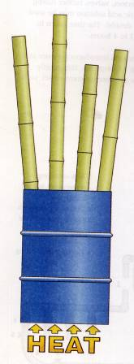
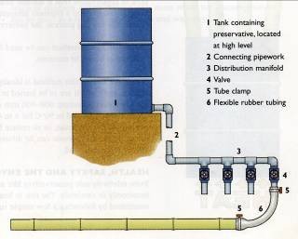
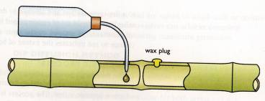
Process of Preservation
IS 401:2001 Code of Practice for Preservation of Timber
1. Surface application ( brushing, dipping)
3. Boucheire Process
5. Inter Nodal Injection
4. Diffusion Process
2. Hot & Cold Method

Slide 16
Bamboo Application for Building

Slide 17
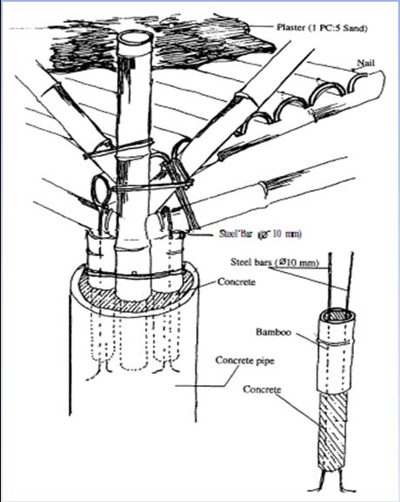
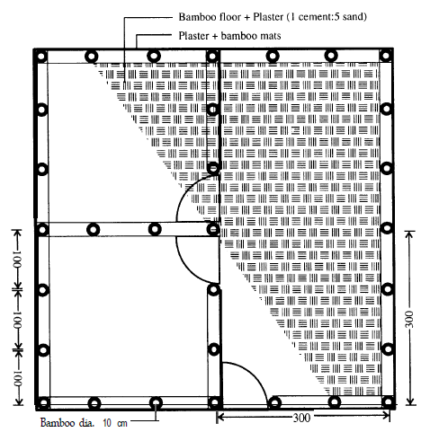
Bamboo can be used to make all building components, both structural and non-structural.
a) Bamboo Foundation
b) Bambu as Slab reinforcement

Slide 18
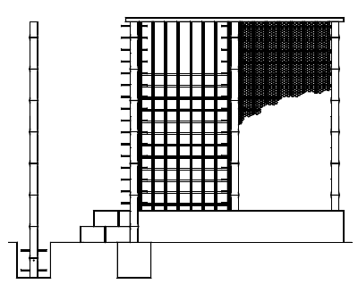
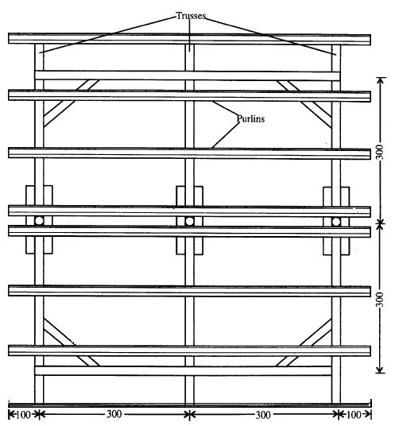
c) Bamboo as wall reinforcement
d) Bamboo as roof structure

Slide 19
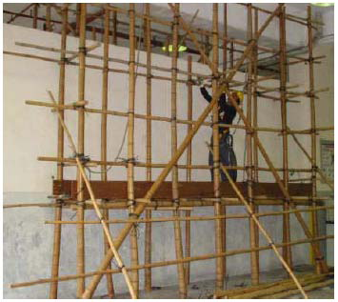
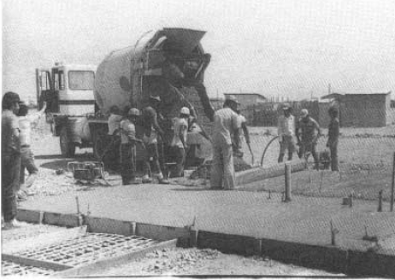
c) Scaffolding
d) Bamboo reinforcement

Slide 20
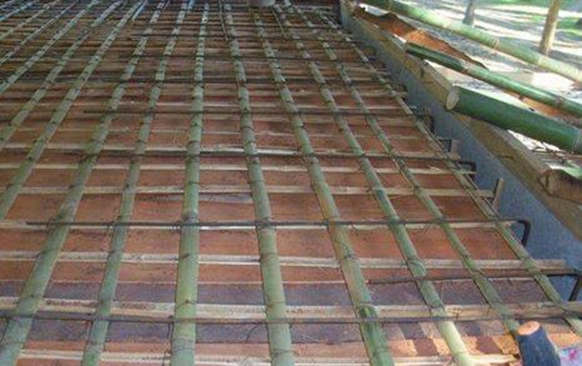
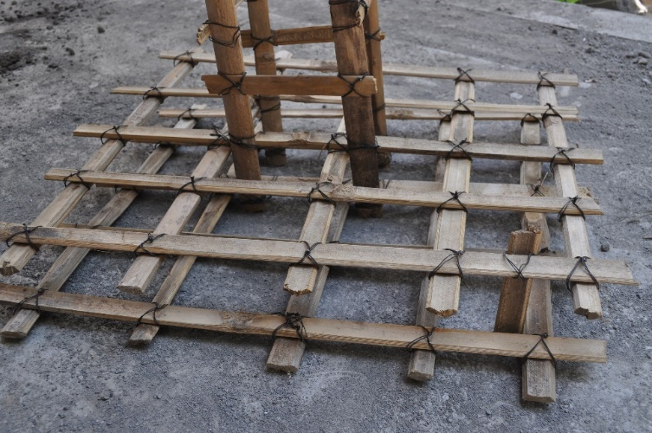
Bamboo reinforcement

Slide 21
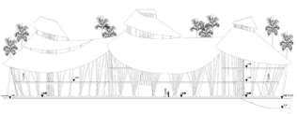
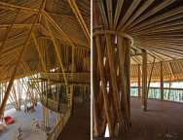
GREEN SCHOOL BUILDING
Heart of Green School,
interior designed radially with column center,

Slide 22
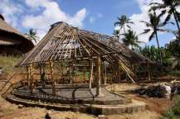
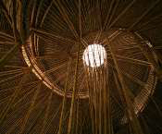
Struktur atap spiral membuat cahaya siang hari mudah masuk,

Slide 23
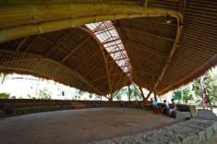
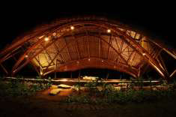
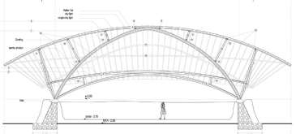
Gambar Mepantigan Hall
Gambar Konstruksi Mepantigan

Slide 24
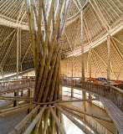
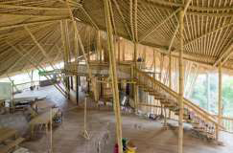
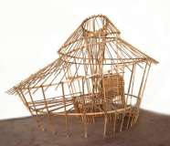
Gambar Keunikan
Struktur Heart of Green
School

Slide 25
Ground improvement

Slide 26
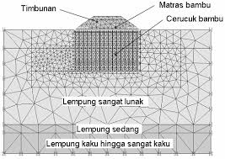
For:
Embankment with limited height
Embankment in submerge area
Embankment with tolerable settlement
Embankment in remote area

Slide 27
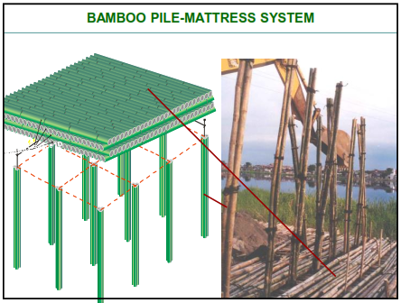
Durability?
Bamboo is durable
as long as it is always saturated
Appropriate for embankment in
coastal and swampy area where
it is always saturated

Slide 28
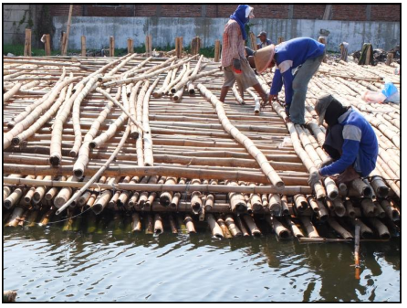
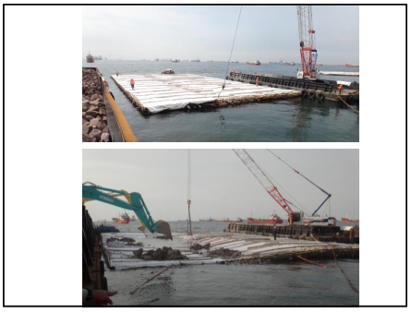

Slide 29
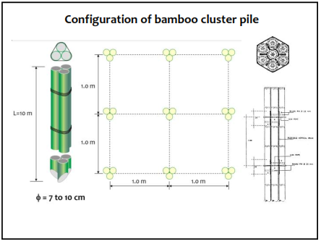
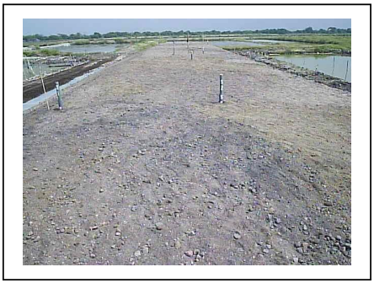

Slide 30
SEKIAN
DAN
TERIMAKASIH

