Slide 1

Perencanaan Dalam Pesan Bisnis

Slide 2
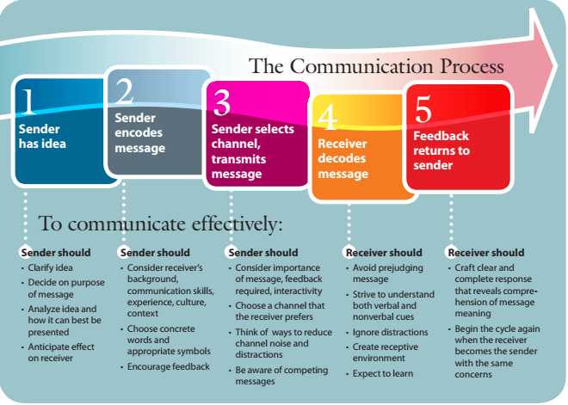
The Communication Process

Slide 3
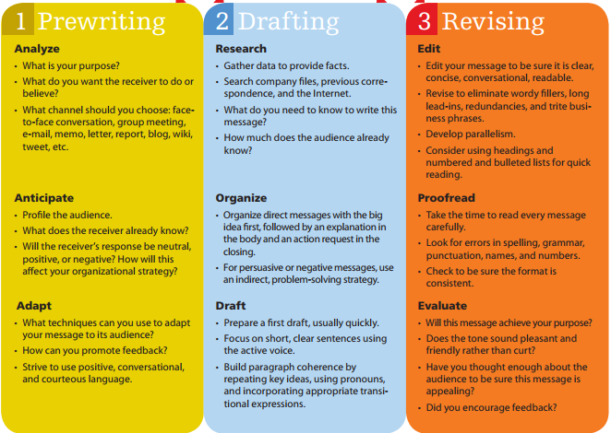
Using the 3-x-3 Writing Process as a Guide

Slide 4
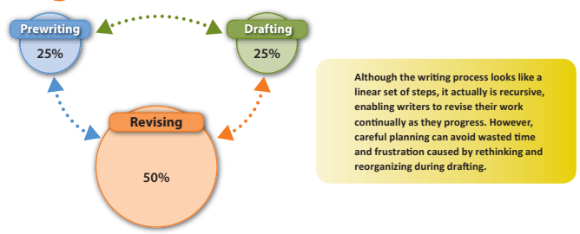
Scheduling the Writing Process

Slide 5
Analyzing and Anticipating the Audience
Analyze the purpose of a message, anticipate its audience, and select the best communication channel.

Slide 6

Determining Your Purpose

Slide 7

Anticipating and Profling the Audience

Slide 8
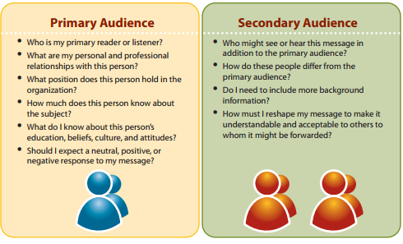
Asking the Right Questions to Profile Your Audience

Slide 9
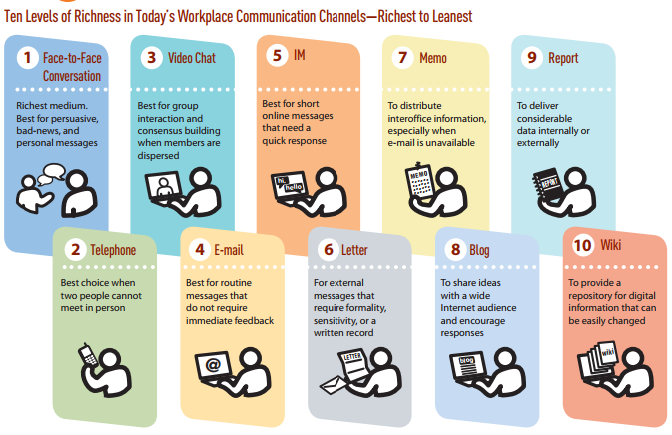
Comparing Rich and Lean Communication Channels

Slide 10
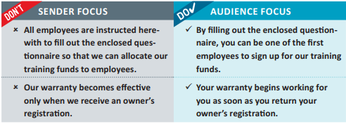
Using Expert Writing Techniques to Adapt to
Your Audience

Slide 11
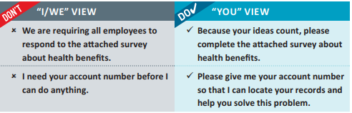
Developing the “You” View

Slide 12
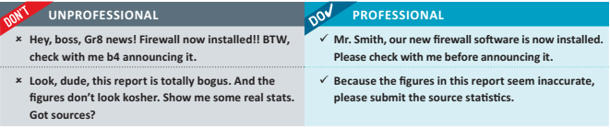

Slide 13
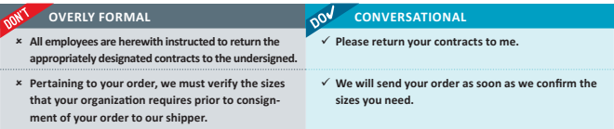

Slide 14
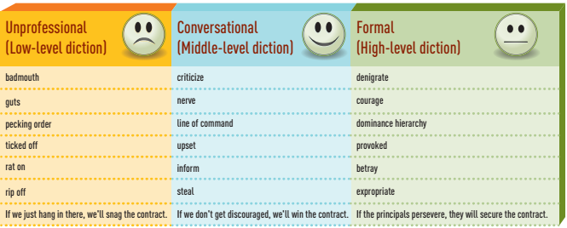
Levels of Diction

Slide 15
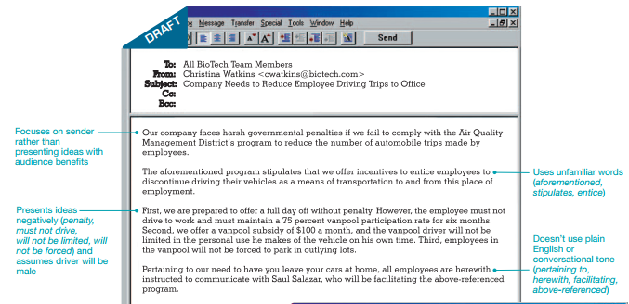
Applying Expert Writing Techniques to Improve an E-Mail Message

Slide 16
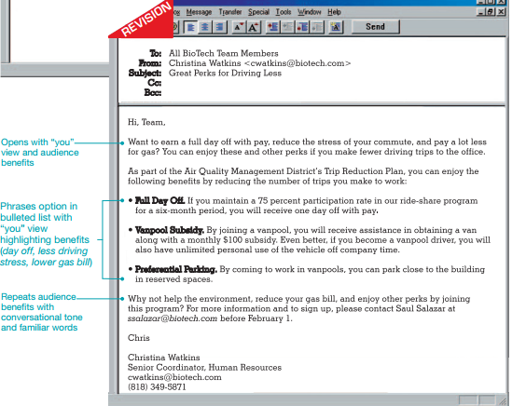

Slide 17
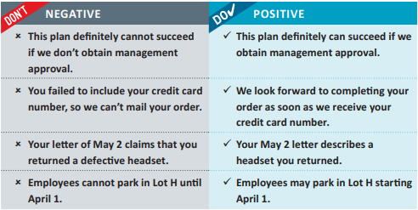

Slide 18
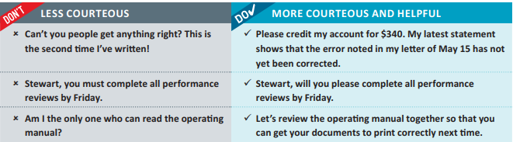
expressing Courtesy

Slide 19
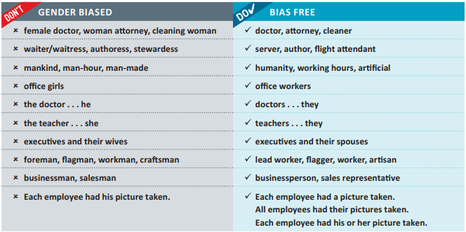
employing Bias-free language

Slide 20
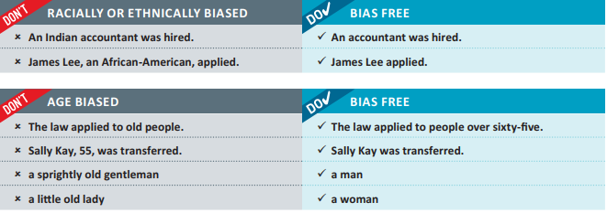

Slide 21


Slide 22
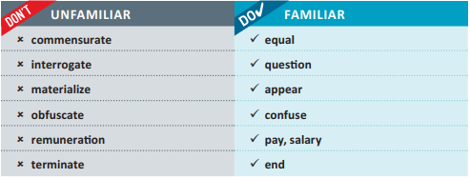
Preferring Plain language and familiar Words

Slide 24
REFLEKSI
Informasi penting hari ini
Manfaat penting dari informasi penting hari ini
Tindak lanjut yang dapat saudara lakukan

Slide 25
That’s all. Thank you! ☺
Any Questions?

