Slide 1
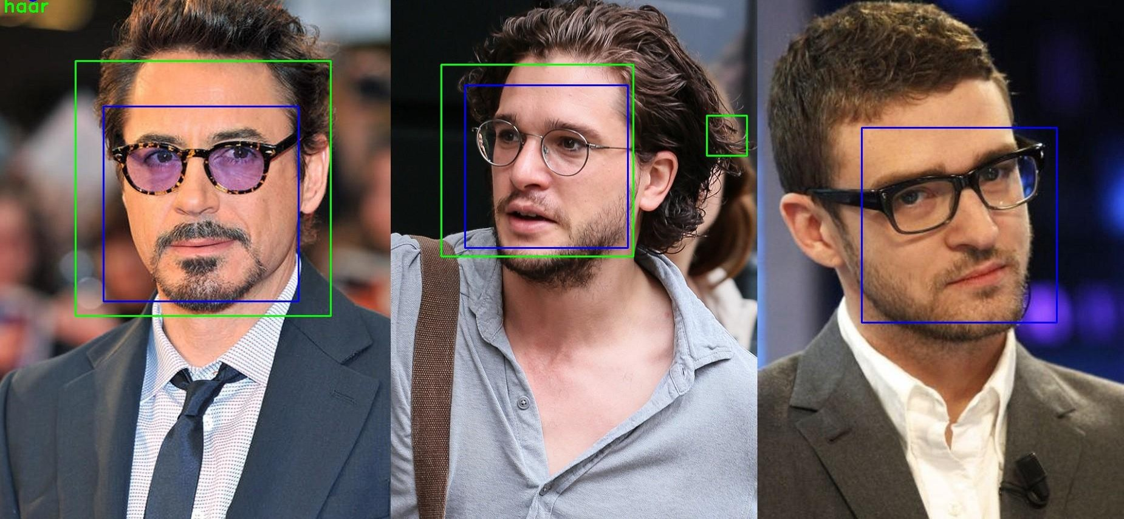
Face Detection
Oleh :
Rahmat Robi Waliyansyah, M.Kom.

Slide 2
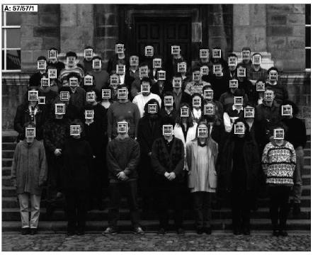
Face detection results produced by Rowley, Baluja, and Kanade (1998a)

Slide 3
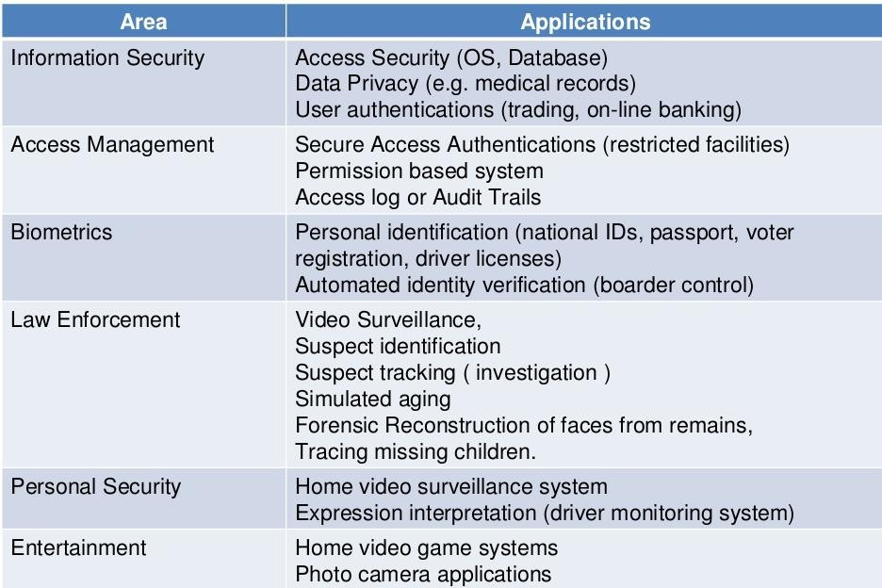
Application face detection

Slide 4
Introduction
Before face recognition can be applied to a general image, the locations and sizes of any faces must first be found
Face detection techniques can be classified as feature-based, template-based, or appearance-based (Yang, Kriegman, and Ahuja (2002))

Slide 5
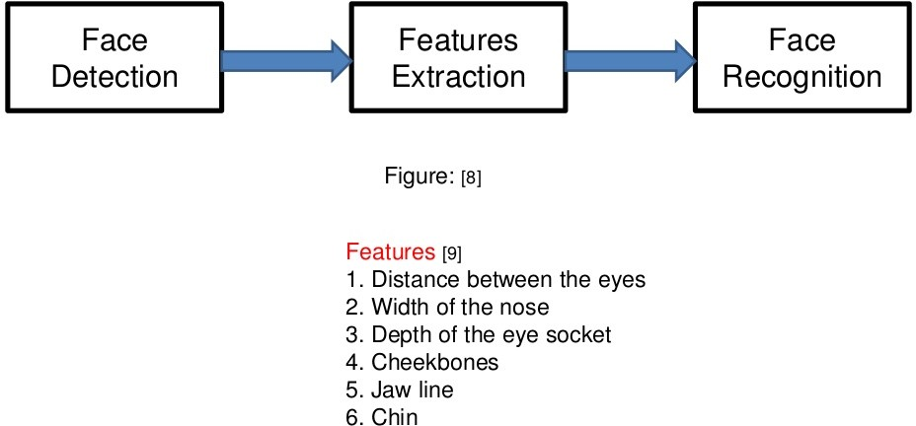
Cara kerja

Slide 6
Feature-Based Methods
Bottom-up approach: Detect facial features (eyes, nose, mouth, etc) first
Facial features: edge, intensity, shape, texture, color, etc
Aim to detect invariant features
Group features into candidates and verify them

Slide 7
Feature-Based Methods: Summary
Pros: Features are invariant to pose and orientation change
Cons:
  Difficult to locate facial features due to several corruption (illumination, noise, occlusion)
  Difficult to detect features in complex background

Slide 8
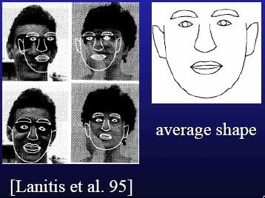
Template Matching Methods
Store a template
  Predefined: based on edges or regions
Deformable: based on facial contours (e.g., Snakes)
Templates are hand-coded (not learned)
Use correlation to locate faces

Slide 9
Template-Based Methods: Summary
Pros:
  Simple
Cons:
  Templates needs to be initialized near the face images
  Difficult to enumerate templates for different poses (similar to knowledge-based methods)

Slide 10
Appearance-Based Methods: Classifiers
Neural network
  Multilayer Perceptrons
Princiapl Component Analysis (PCA), Factor Analysis
Support vector machine (SVM)
Mixture of PCA, Mixture of factor analyzers
Distribution Distribution-based method
Naïve Bayes classifier
Hidden Markov model
Sparse network of winnows (SNoW)
Kullback relative information
Inductive learning: C4.5
Adaboost

Slide 11
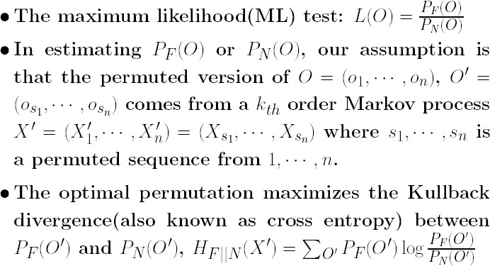
Theory of Our Algorithm

Slide 12
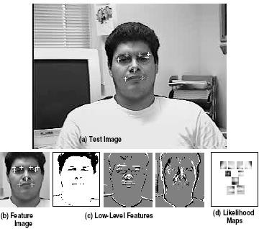
Facial Features Detection
Region search

Slide 13
Face and Facial Feature Detection
The algorithm is also used to detect 9 facial features: 2 outer mouth corners, 2 outer eye corners, 2 outer eye-brow corners, 2 inner eye-brow corners and the center of the nostrils.

Slide 14
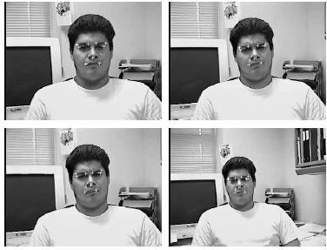
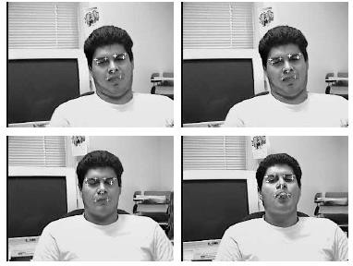
Results

Slide 15
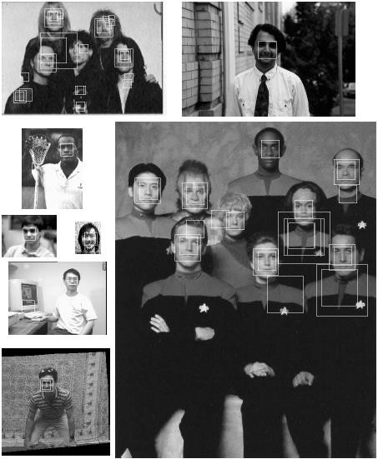
Detection Results

Slide 16
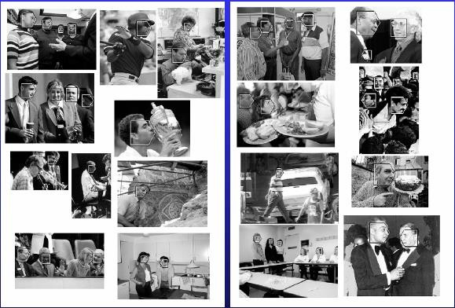
Side-View Face Detection

Slide 17
Appearance-Based Methods: Summary
Pros:
  Use powerful machine learning algorithms
  Has demonstrated good empirical results
  Fast and fairly robust
  Extended to detect faces in different pose and orientation
Cons:
  Usually needs to search over space and scale
  Need lots of positive and negative examples
  Limited view-based approach

Slide 18
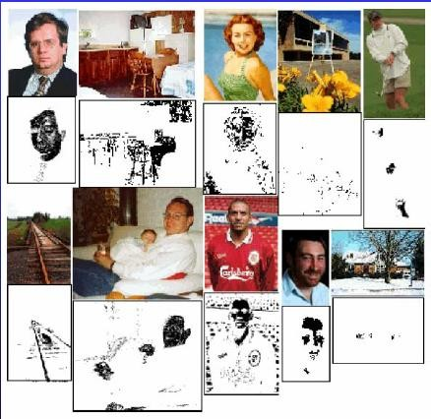
Color-Based Face Detector
Pros:
  Easy to implement
  Effective and efficient in constrained environment
  Insensitive to pose, expression, rotation variation
Cons:
  Sensitive to environment and lighting change
  Noisy detection results (body parts, skin-tone line tone line regions)

Slide 19
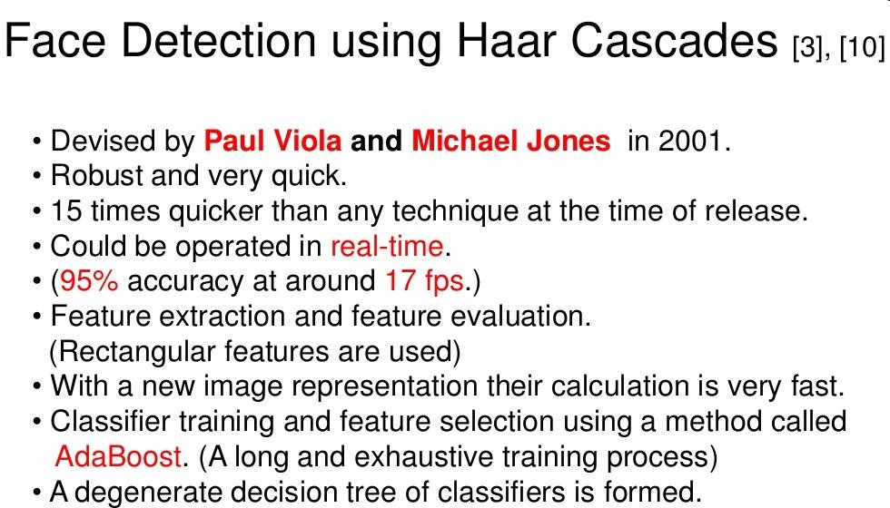

Slide 20
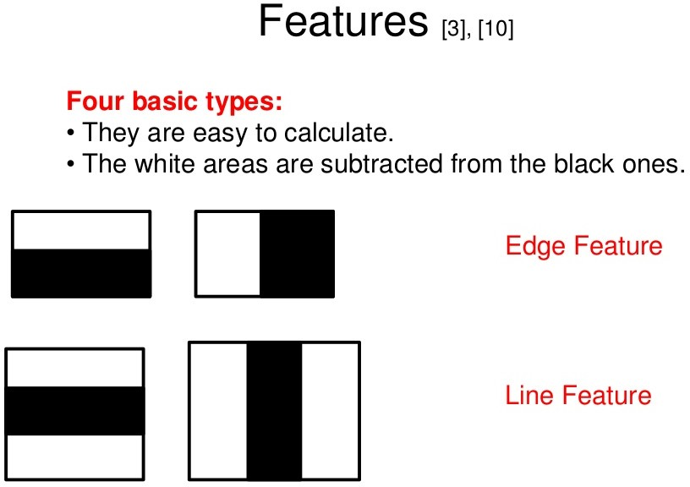
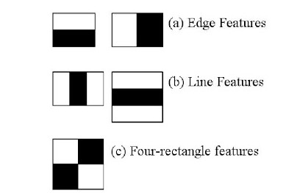

Slide 21
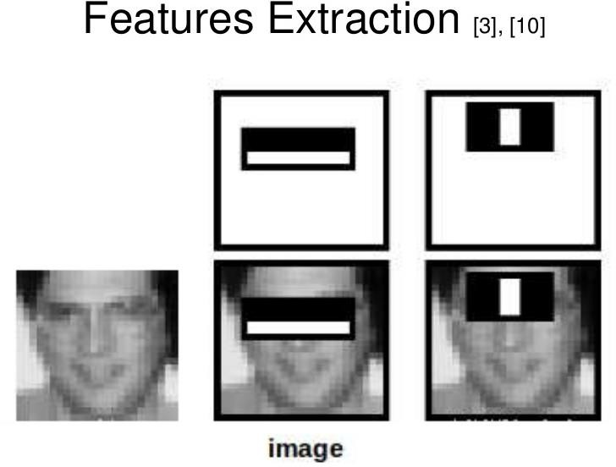

Slide 22
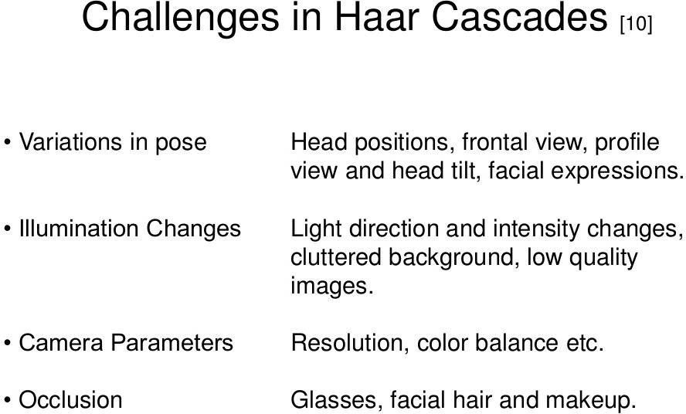

Slide 23
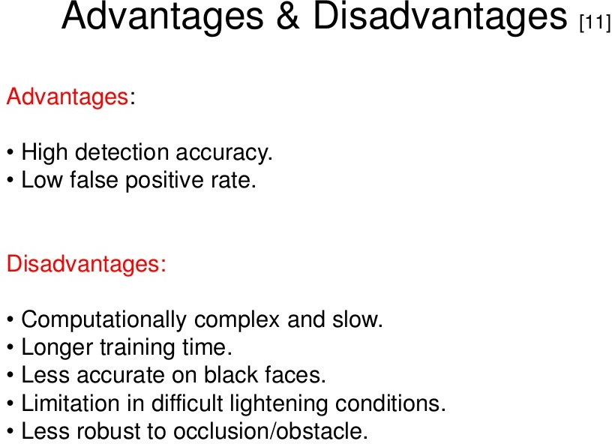

Slide 24
Face detection technique
Templates
PCA (Principle Component Analysis)
LDA (Liniear Discriminant Analysis)
Neural Networks
SVM (Support Vector Machine)
ICA (Independent Component Analysis)

Slide 25
Hal lain dalam face detection
Face contours
Facial features (geometry)
Motion detection
Color

Slide 26
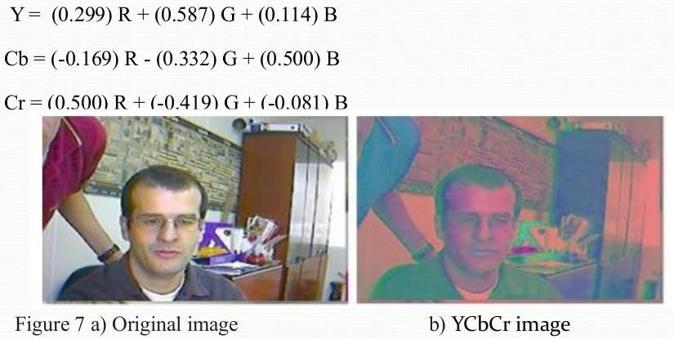
Human skin color based face detection
1. Filtering, untuk menemukan area warna kulit manusia. Dilakukan dengan cara :
RGB -> YCbCr color format

Slide 27
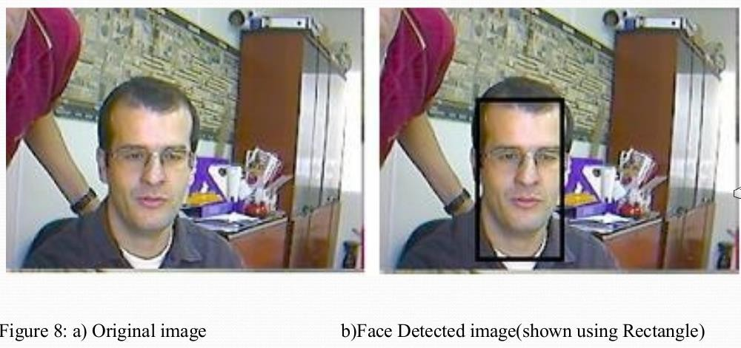
Human skin color based face detection
2. Temukan area yang berisi bagian wajah

Slide 28
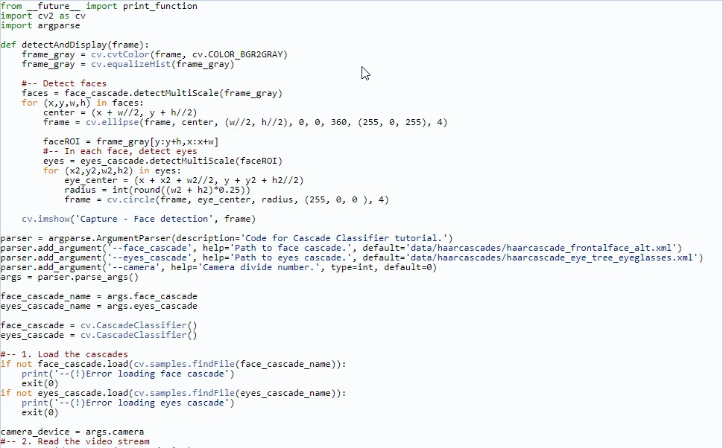
Haar-cascade Detection in OpenCV

Slide 29
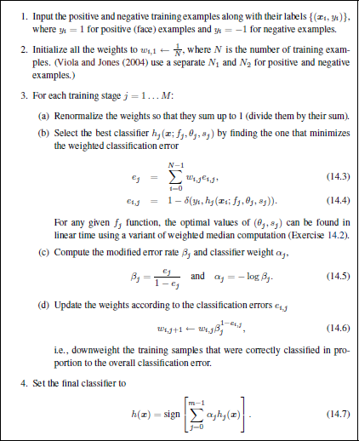
Algoritma Adaboost

Slide 30
