Slide 1
ECOLOGICAL COMMUNITY

Slide 2
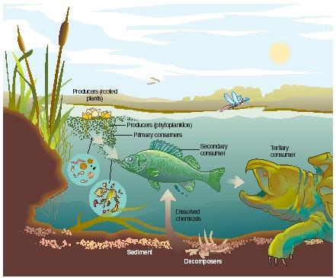
Biological community interactions & interdependence of organisms living in it.
Ecosystem functioning depends on complex interactions btwn its community of organisms and the physical environment

Slide 3
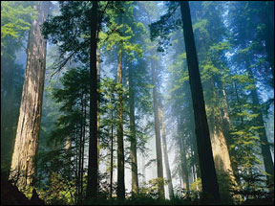
A community = all organisms inhabiting a particular area
Several factors characterize every community
  Biodiversity
  Prevalent form of
  vegetation (& its levels)
  Response to disturbances
  Trophic structure
  (feeding relationships)

Slide 4
Biodiversity = variety of different kinds of organisms that make up a community
two major components:
  Species richness, or total # of different species in the community
  Relative abundance of different species

Slide 5
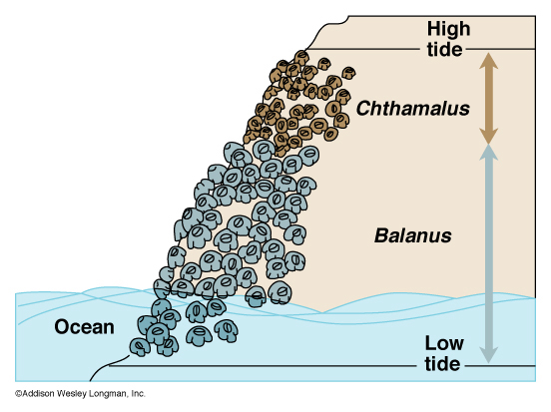
Interspecific interactions: (+), (-), neutral
Competition (-)/(-) occurs btwn 2 populations if
they both require same limited resource

Slide 6
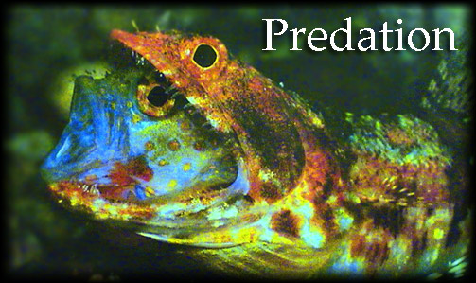
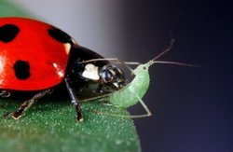
Interspecific interactions: (+), (-), neutral
Predation (+)/(-) one species kills & eats other
species

Slide 7
Symbiosis
A symbiotic relationship is an interaction between two or more species that live together in direct contact
3 main types of symbiotic relationships within communities

Slide 8
Symbiosis
  Mutualism
    Both partners benefit
  Commensalism
    One partner benefits and the other is unaffected
  Parasitism
    One partner benefits while the other is harmed

Slide 9
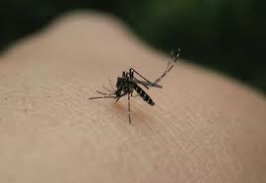
Interspecific interactions: (+), (-), neutral
Parasitism (+)/(-) one species is nourished by
another species; harms other species.

Slide 10
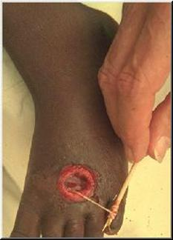
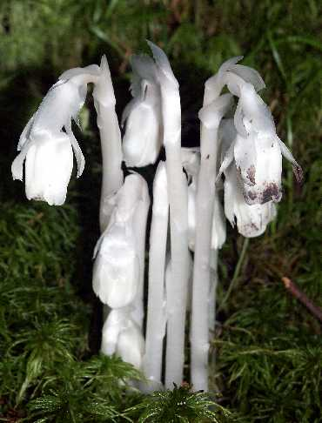
Parasitism: type of predator-prey relationship
  parasite benefits and host is harmed
  parasite obtains food at expense of host
  Parasites are typically smaller than their hosts

Slide 11
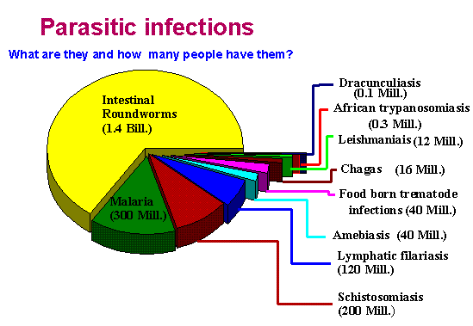
Worldwide, 25% of all deaths result from parasite infections

Slide 12
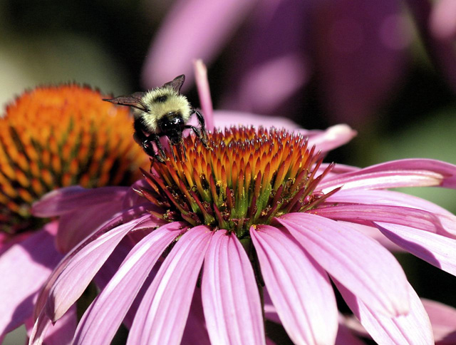
Interspecific interactions: (+), (-), neutral
Mutualism (+)/(+) both species benefit

Slide 13
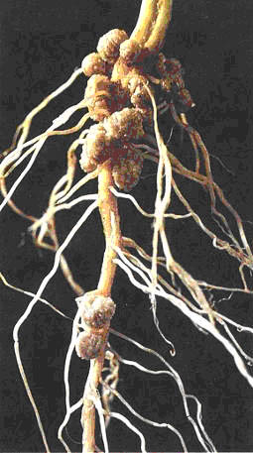
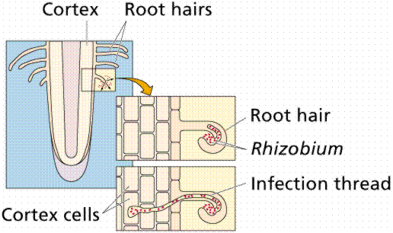
Examples of mutualism
  Nitrogen-fixing bacteria and legumes

Slide 14
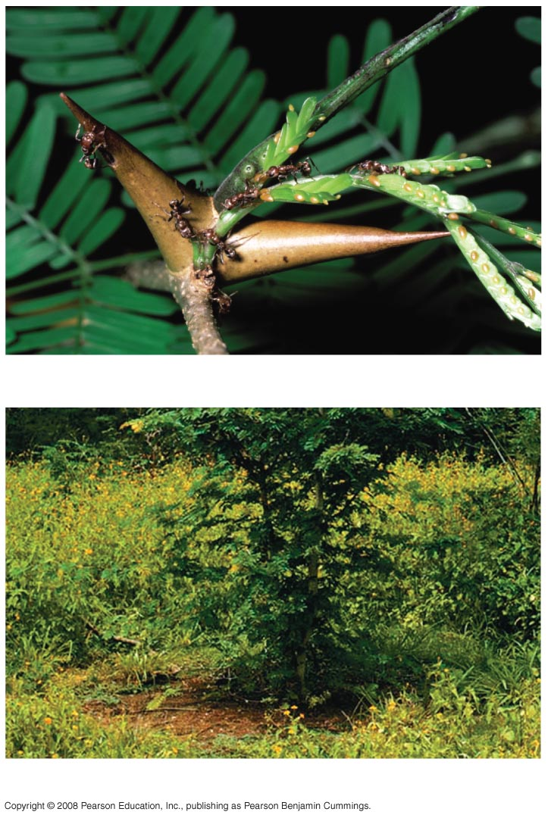
Mutualism can be
Obligate:
one species cannot
survive without the
other
Facultative:
both species can
survive alone

Slide 15
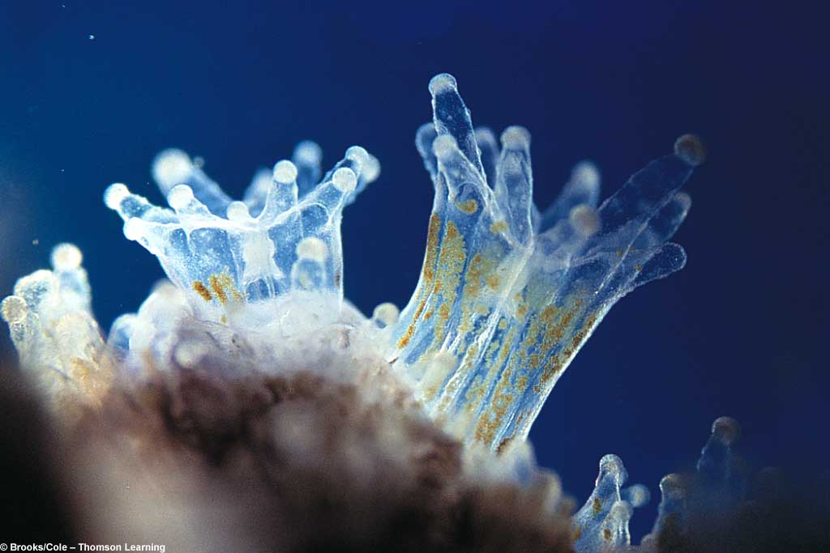
Mutualism: Algae in coral polyps give C and N compounds, get N in return (NH₃) from coral waste.
Obligate or Facultative?

Slide 16
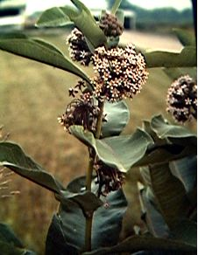
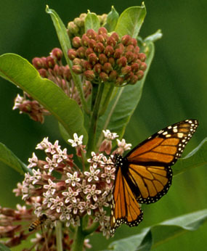
Pollination is mutualism: e.g. Milkweed (Asclepias) is pollinated by butterflies

Slide 17
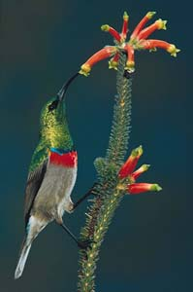
mutualism often demonstrates coevolution
Each party evolves features
that take advantage of the association,
but also provides them with an encouraging reward.

Slide 18
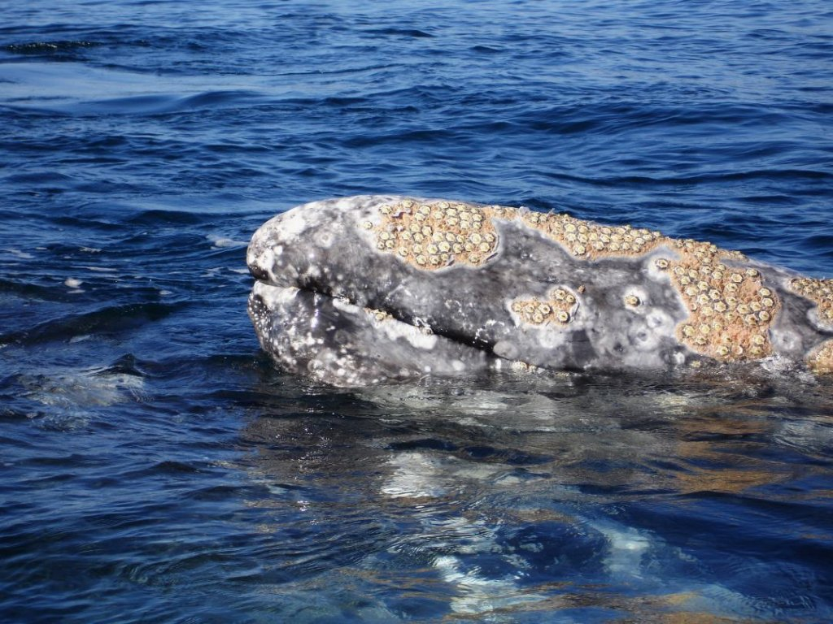
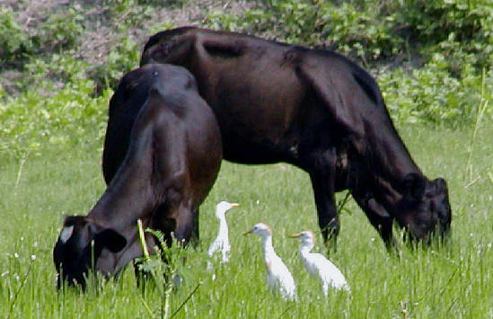
Interspecific interactions: (+), (-), neutral
Commensalism (+)/(0) only 1 species
benefits; other species is not harmed

Slide 19
Commensalism - symbiotic relationship where one partner benefits and other is unaffected
e.g. of commensalism
  Algae growing on shells of sea turtles
  Barnacles that attach to whales
  Birds that feed on insects flushed out of grass by grazing cattle

Slide 20
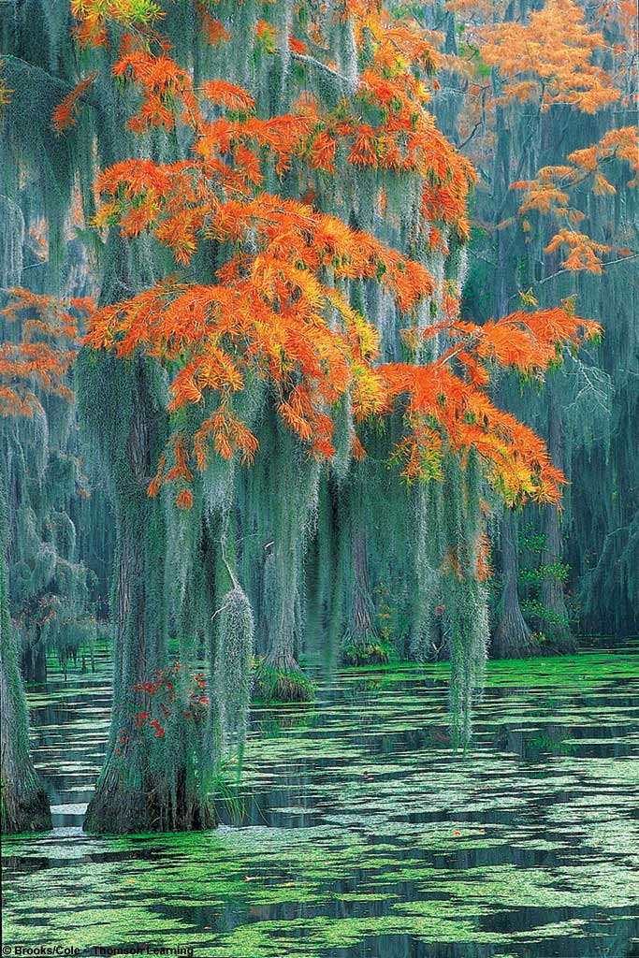
Commensalism
Spanish “moss”
and southern
trees
(e.g. Golden Larch)
One benefits, the
other isn’t helped
or harmed

Slide 21
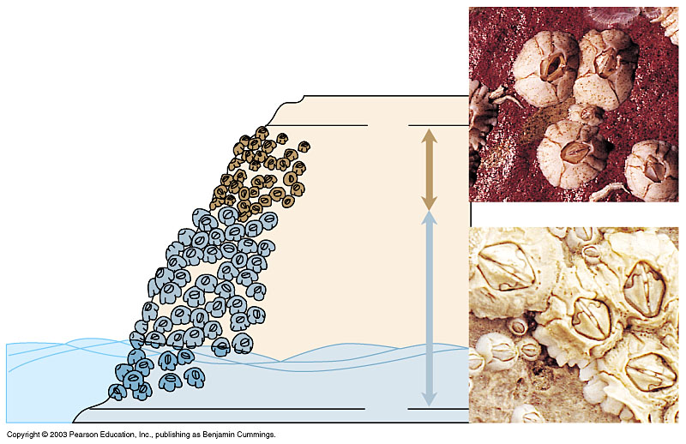
Competitive exclusion principle
  Populations of 2 species cannot co-exist
  in a community if their niches
  are nearly identical
Resource partitioning or character displacement occurs
(or extinction of one species)
High
tide
Chthamalus
Balanus
Ocean
Low
tide

Slide 22
Competition btwn species with identical niches has two possible outcomes
  One population survives:
    more efficient using resources
    reproductive advantage,
    may eventually eliminate other (difficult to observe).
  resource partitioning

