Slide 1
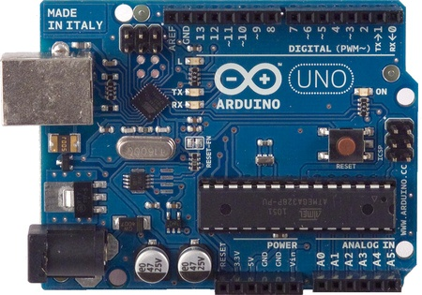
Komponen Elektronika dalam Robotika
Robotika
Memperkenalkan Arduino:
Arduino is a single-board microcontroller to make using electronics in multidisciplinary projects more accessible.
The hardware consists of a simple open source hardware board designed around an 8-bit Atmel AVR microcontroller, or a 32-bit Atmel ARM.

Slide 2
Komponen Elektronika dalam Robotika
Microcontroller: ATmega328
Operating Voltage: 5V Input Voltage (recommended):7-12V
Input Voltage (limits): 6-20V
Digital I/O Pins: 14 (of which 6 provide PWM output)
Analog Input Pins: 6
DC Current per I/O Pin: 40 mA
DC Current for 3.3V Pin: 50 mA
Flash Memory: 32 KB (ATmega328)
SRAM: 2 KB (ATmega328)
EEPROM: 1 KB (ATmega328)
Clock Speed: 16 MHz
Hardware Specifications:

Slide 3
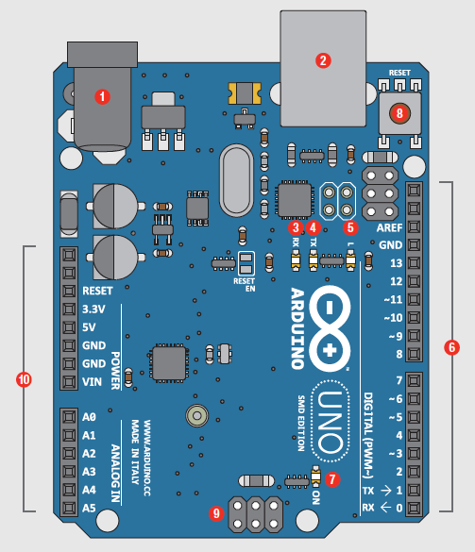

Power In (Barrel Jack)
Power In (USB Port)
LED (RX-Receiving)
LED (TX-Transmitting)
LED (Pin 13: Troubleshooting)
Pins (Aref, Ground, Digital, Rx, Tx)
LED (Indicates Arduino is ON)
Reset Button
ICSP Pins (Uploading Code without Bootloader)
Pins (Analog In, Power In, Ground, Power Out, Reset)
Arif Wibisono
arif@upgris.ac.id
0821.374.28.349
arifwibisono.
wordpress.com

Slide 4
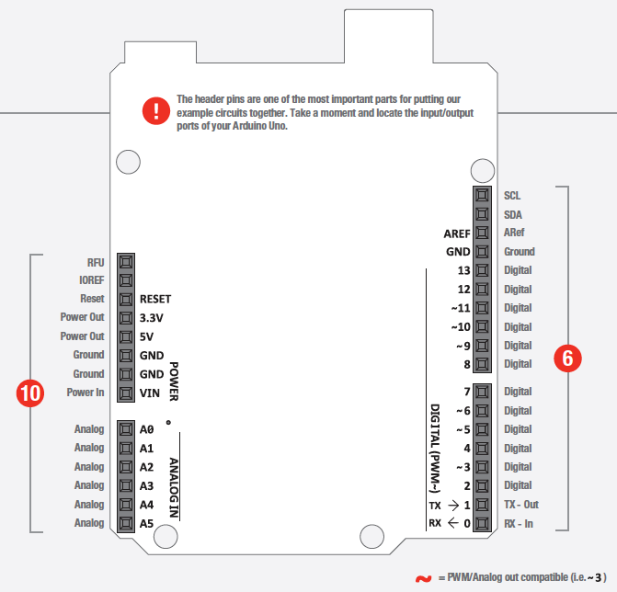

Slide 5
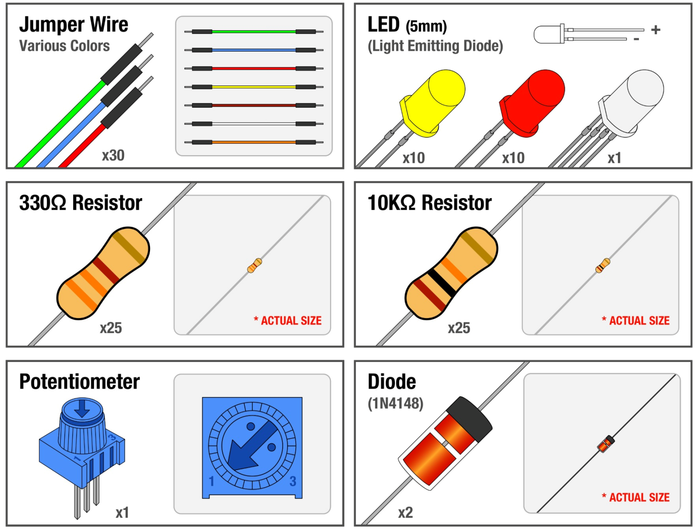
Sensor & Actuators
Robotika

Slide 6
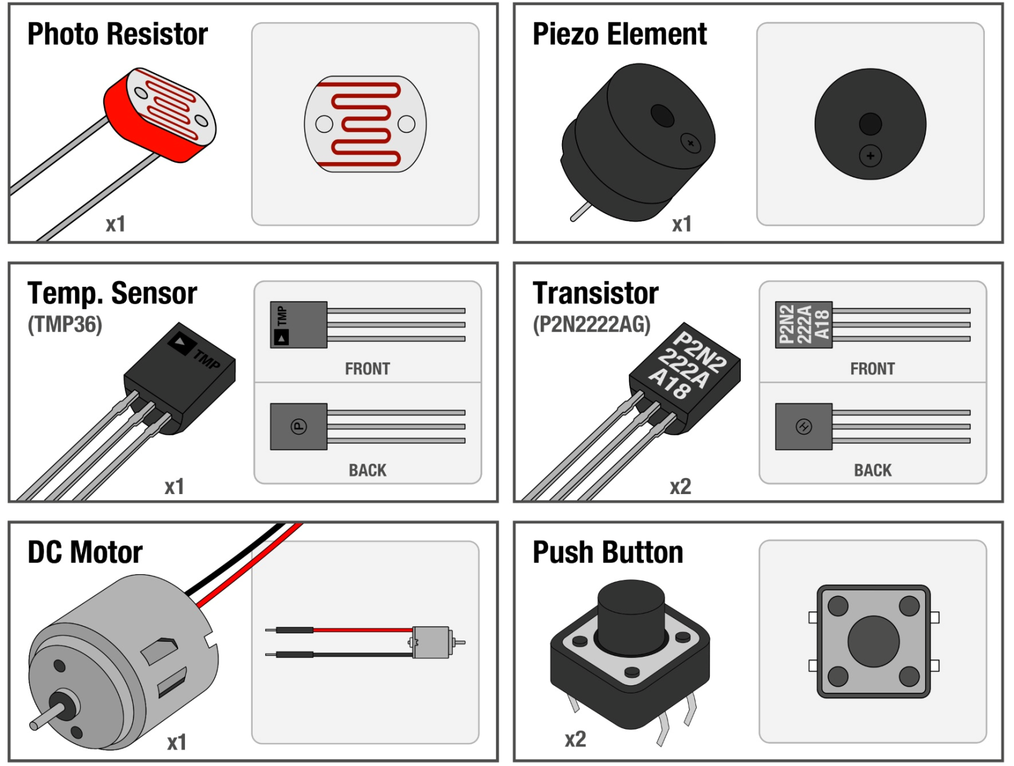
Sensor & Actuators
Robotika

Slide 7
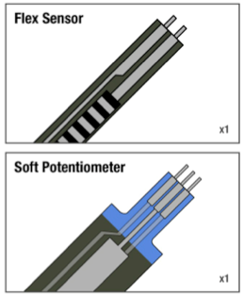
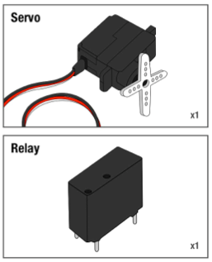
Sensor & Actuators
Robotika

Slide 8
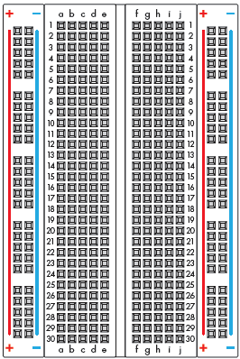
Breadboard
Robotika

Slide 9
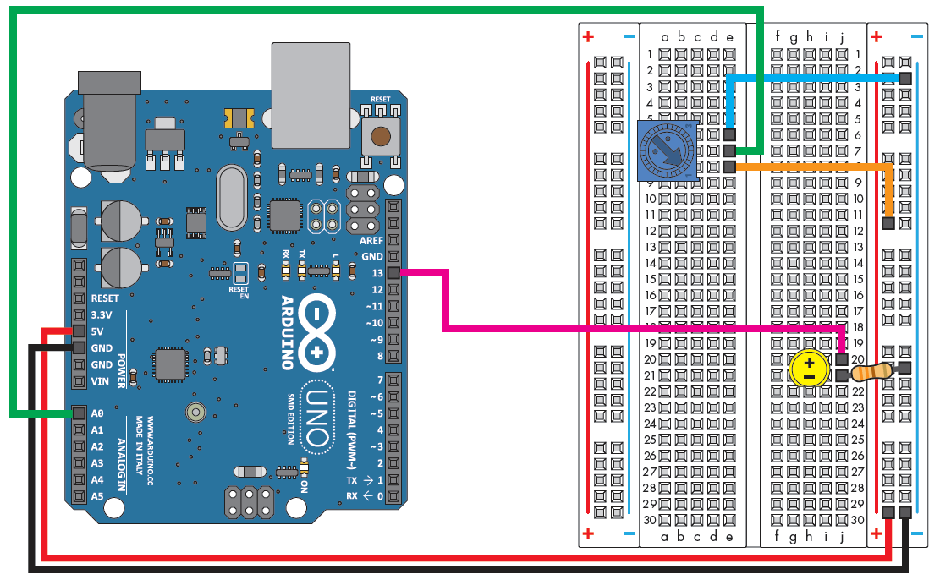
Contoh Aplikasinya
Robotika

Slide 10
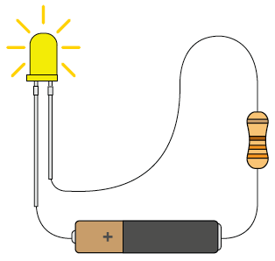
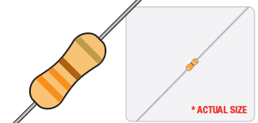


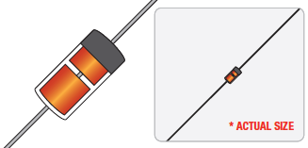
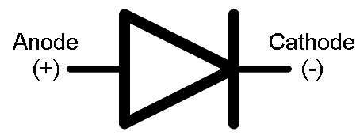
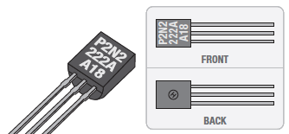
Electronics
Ohms Law
U=RI
Resistor
Diode
Transistor

Slide 11


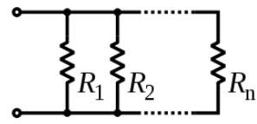


Resistors
Robotika
Serial:
Pararel:
If we have 2 in pararel:

Slide 12
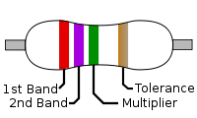
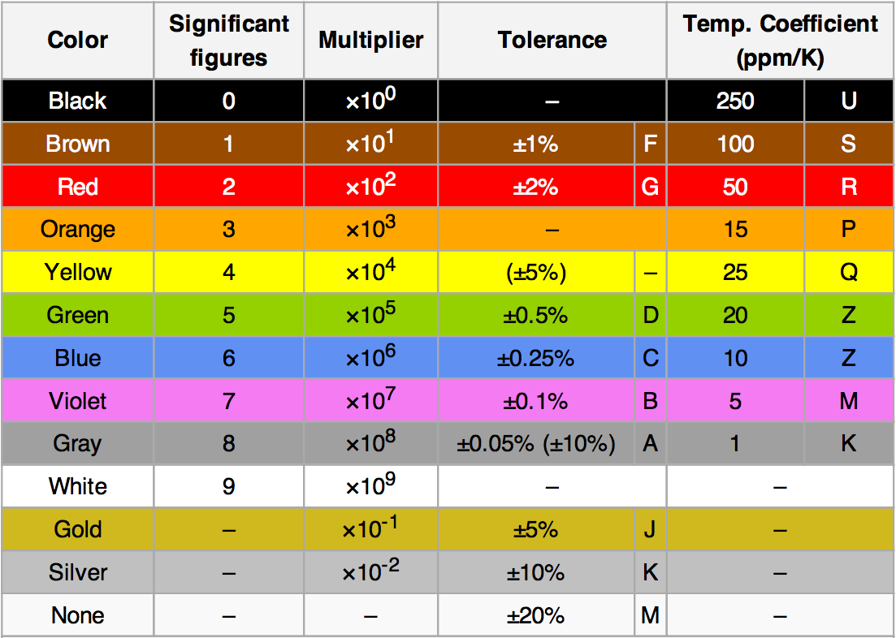
Resistors
Robotika
For example, a resistor with
bands of yellow, violet, red,
and gold will have
first digit (yellow),
second digit (violet),
followed by (red)
result : 4,700 ohms.
Gold signifies that the
tolerance is ±5%, so the
real resistance could lie
anywhere between 4,465
and 4,935 ohms.

Slide 13
Akhirul kalam
Robotika
“Sekian dan Terima Kasih”
Arif Wibisono
arif@upgris.ac.id
0821.374.28.349

