Slide 1
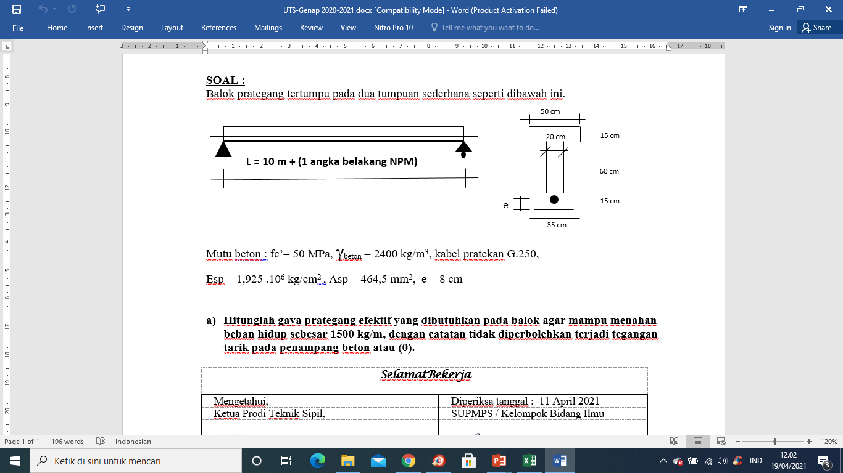
JAWABAN SOAL UTS SMSTR GENAP 2020-2021

Slide 2
Mencari Titik Berat Penampang
A1 = 50 x 15 = 750 cm2
A2 = 20 x 60 = 1200 cm2
A3 = 35 x 15 = 525 cm2
Atot = 2475 cm2
Y1 = (0,75+ 75) = 75,75 cm
Y2 = (30 + 15) = 45 cm
Y3 = 0,75 cm
Y = (A1.y1 +A2.y2 +A3.y3)/Atot
= (56812,5 + 54000 + 393,75)/2475
= 44,93 cm
1
Ya =(90-44,93)=45,07
2
Y = yb= 44,93
3
2. Momen Inersia Ix
Ix = ∑(Ix⁰ + An.yn^2)
Ix1 = (14062,5 + (750. 44,32^2) = 14,9 . 10^5 cm^4
Ix2 = (360000 + (1200 . 0,07^2) = 3,6 . 10^5 cm^4
Ix3 = (9843,75 + (525 . 44,18^2) = 10,3.10^5 cm^4
Ix total = 28,8.10^5 cm^4
Ix1⁰ = 1/12 b1.h1^3 = 14062,5 cm4
Ix2⁰ = 1/12 b2.h2^3 = 360000 cm4
Ix3⁰ = 1/12 b3.h3^3 = 9843,75 cm4
Y1 = (45,07 -0,75) = 44,32 cm
Y2= (45,07-15-30) = 0,07 cm
Y3= (44,93 -0,75) = 44,18 cm

Slide 3
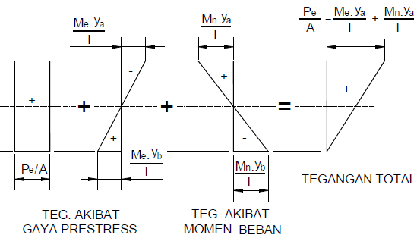
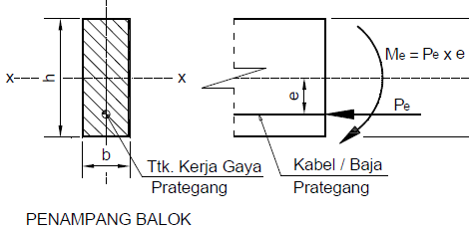
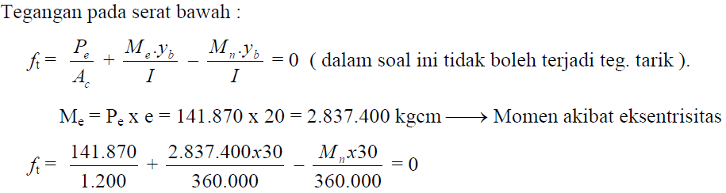
1
Ya =45,07
36,93 cm
2
Yb = 44,93
3

Slide 4
Mencari Momen akibat beban (Mu)
Beban mati :
WD = Atot . Bj beton = 2475 . 10^-4 m^2 . 2400 kg/m3 = 594 kg/m’
WL = 1500 kg/m’
Wu = 1,2.WD + 1,6.WL = 3112,8 kg/m’
L bentangan = 12 m
Mu = 1/8. Wu.L^2 = 56030,4 kg.m
Mn= Mu/Φ = 56030,4/0,65 = 86200,6 kg.m = 8,62.10^6 kg.cm
Me = Pe. 36,93 (kg.cm)
Serat bawah = 0
Pe/(2475) + (36,93.Pe). 44,93 /28,8.10^5 - 8,62.10^6 . 44,93/28,8.10^5 = 0
40,4.10^-5. Pe + 57,6.10^-5. Pe= 134,5
98. 10^-5 . Pe = 134,5
Pe = 1,372.10^5 kg
Me= 36,93.Pe
= 36,93 x 1,372.10^5
= 50,668.10^5 kg.cm

Slide 5
Serat atas tegangan yang terjadi =
Pe/Ac = (1,372.10^5 / 2475) = 55,434 kg/cm^2
Me.ya/Ix = 50,668.10^5 . 45,07 / 28,8.10^5 = 79,292 kg/cm^2
Mn.ya/Ix = 8,62.10^6 . 45,07 / 28,8. 10^5 = 134,9 kg/cm^2
fca’ = Pe/Ac – Me.ya/Ix + Mn.ya/Ix
= 55,434 – 79,292 + 134,9
= 111,042 kg/cm^2
1 kg = 10 N
Mutu beton fc’ = 50 Mpa = 50 N/mm^2
= 500 kg/cm^2
fcu’ = 0,60 x 500 kg/cm^2 = 300 kg/cm^2
Kontrol :
fca’ < fcu’ → 111,042 kg/cm^2 < 300 kg/cm^2 (oke)
Kesimpulan :
Jadi Gaya prategang efektif yang harus diberikan agar mampu menahan beban hidup WL = 1500 kg/m’ sebesar
Pe = 1,372.10^5 kg atau 137,2 ton

