Slide 1
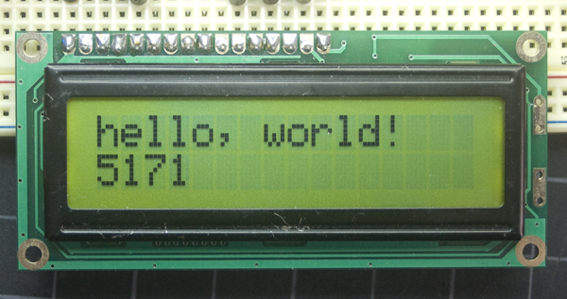

LCD Display Project <Hello World!>
Robotika
LCD Display:
Arif Wibisono
arif@upgris.ac.id
0821.374.28.349

Slide 2
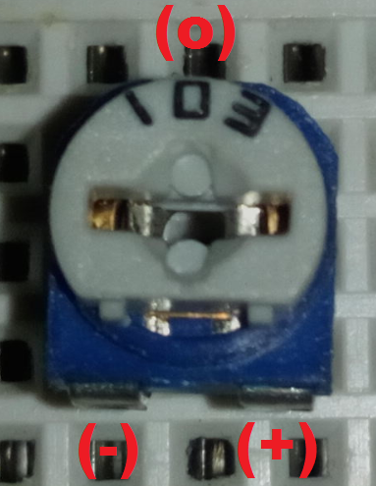
1)Persiapan Hardware
Potensiometer (Trimpot):
Dalam Praktik #6 komponen elektronika yang perlu dipersiapkan adalah :
Arduino Uno
LCD Screen
Potensiometer 10K
Resistor 330 Ohm
Kabel Jumper 16 pcs
Breadboard
Obeng (-) / Tespen
Tang Lancip
I- | Output | E+

Slide 3
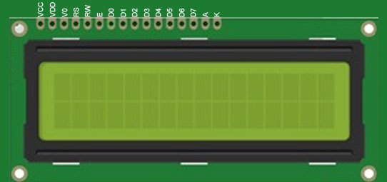
1)Persiapan Hardware
Robotika
LCD Screen PINs:
VCC | VDD | V0 | RS | RW | E | D0 | D1 | D2 | D3 | D4 | D5 | D6 | D7 | A+ | K-

Slide 4
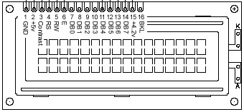
1)Persiapan Hardware
Robotika
LCD Screen PINs:
VCC | VDD | V0 | RS | RW | E | D0 | D1 | D2 | D3 | D4 | D5 | D6 | D7 | A+ | K-

Slide 5
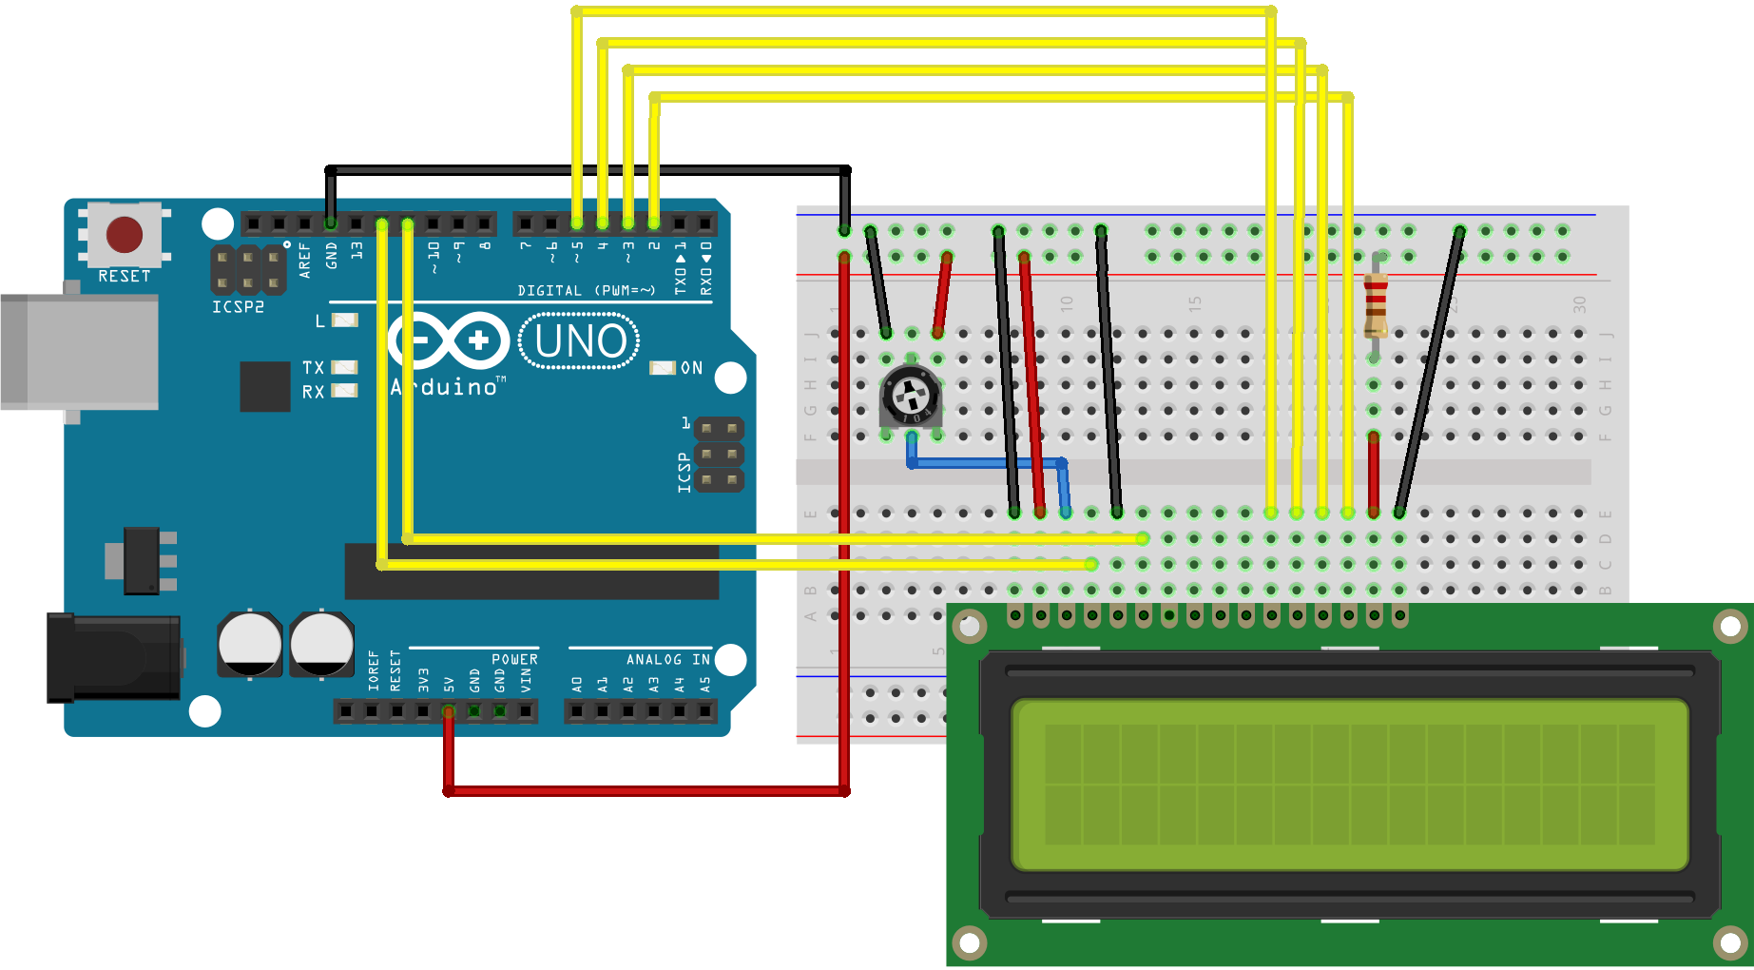
1)Persiapan Hardware
Robotika
LCD PIN | ARDUINO PIN
RS | 12
E | 11
D4 | 5
D5 | 4
D6 | 3
D7 | 2
Schematic:
Selain itu, hubungkan potensio 10K ke +5V dan GND arduino dengan pin V0 LCD screen.
Jangan lupa tambahkan resistor 330 ohm untuk ( + ) backlight LCD screen di pin Anoda

Slide 6
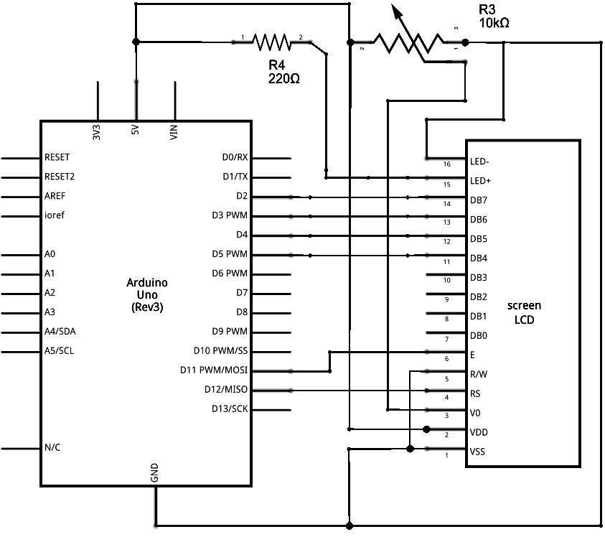
1)Persiapan Hardware
Robotika
Schematic:

Slide 7
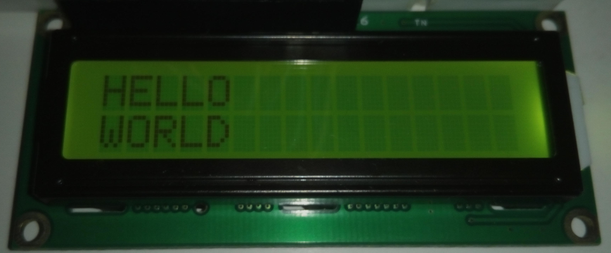
2)Programming
Robotika
Coding:
#include <LiquidCrystal.h>
LiquidCrystal lcd(12, 11, 5, 4, 3, 2);
void setup () {
// pengaturan baris dan kolom LCD screen;
lcd.begin (16, 2); // lcd yang digunakan 16 x 2
lcd.setCursor (0, 1); // baris pertama
lcd.print (“WORLD");
lcd.setCursor (0, 0); // baris kedua
lcd.print (“HELLO");
}
void loop () {}

Slide 8
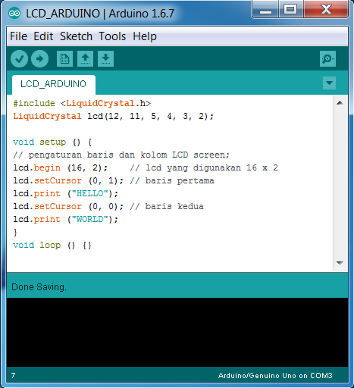
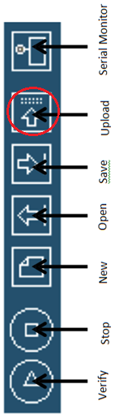
2)Programming
Robotika
Arduino IDE:

Slide 9
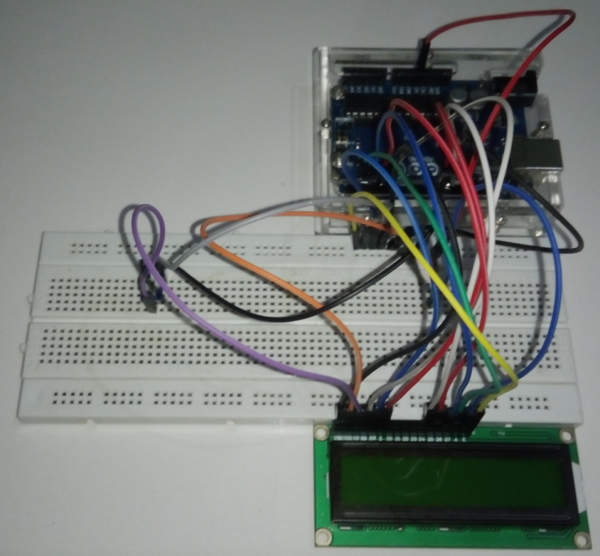
2)Programming
Robotika
Assembly Result:

Slide 10
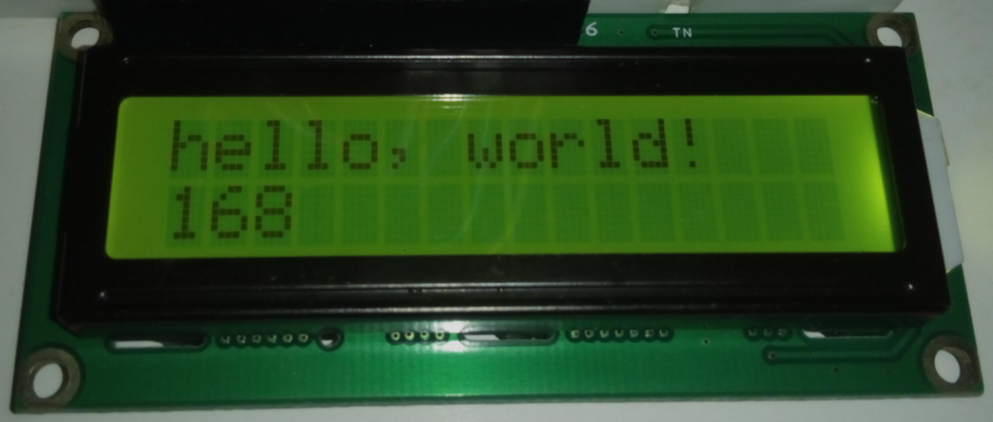
3)Hello World<Timer>
#include <LiquidCrystal.h>
LiquidCrystal lcd(12, 11, 5, 4, 3, 2);
void setup() {
// set up the LCD's number of columns and rows:
lcd.begin(16, 2);
// Print a message to the LCD.
lcd.print("hello, world!");
}
void loop() {
// set the cursor to column 0, line 1
// (note: line 1 is the second row, since counting begins with 0):
lcd.setCursor(0, 1);
// print the number of seconds since reset:
lcd.print(millis() / 1000);
}

Slide 11
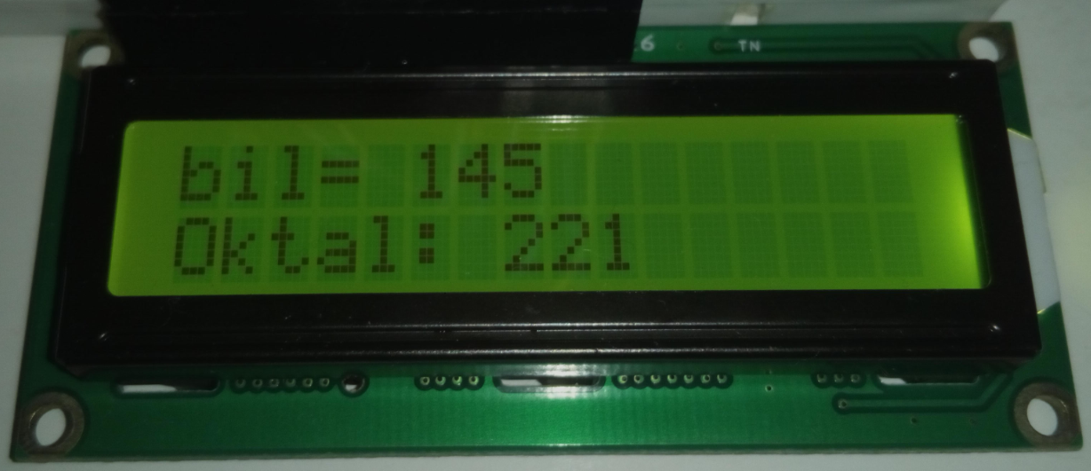
4)<bil><oktal>
#include <LiquidCrystal.h>
LiquidCrystal lcd(12, 11, 5, 4 , 3, 2);
const int PIN_RS = 12;
const int PIN_E = 11;
const int PIN_DB_4 = 5;
const int PIN_DB_5 = 4;
const int PIN_DB_6 = 3;
const int PIN_DB_7 = 2;
void setup(){
lcd.begin(16,2);
}
void loop(){
int bil = 145;
lcd.setCursor(0,0);
lcd.print("bil= ");
lcd.print(bil);
delay(1000);
lcd.setCursor(0,1);
lcd.print("Oktal: ");
lcd.print(bil,OCT);
delay(1000);
}

Slide 12
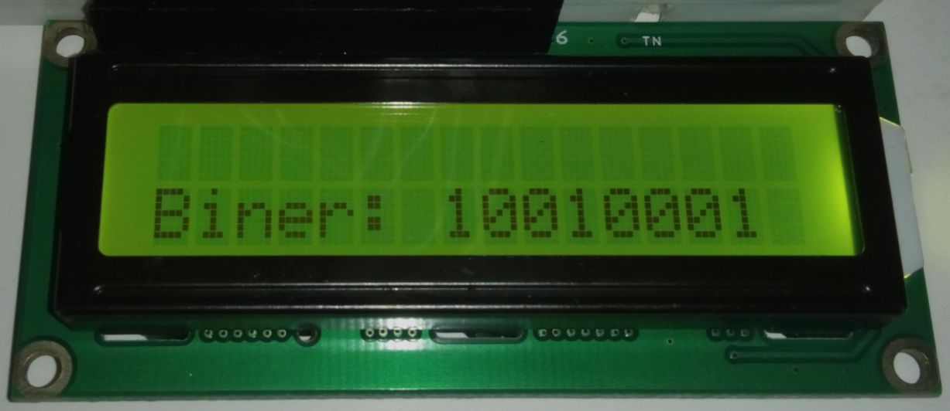
2)<Dec><Biner>
#include <LiquidCrystal.h>
const int PIN_RS = 12;
const int PIN_E = 11;
const int PIN_DB_4 = 5;
const int PIN_DB_5 = 4;
const int PIN_DB_6 = 3;
const int PIN_DB_7 = 2;
//buat objek
LiquidCrystal lcd(PIN_RS, PIN_E, PIN_DB_4, PIN_DB_5, PIN_DB_6, PIN_DB_7);
void setup ()
{
//tentukan ukuran LCD
lcd.begin(16, 2);
}
void loop()
{
int bil = 145;
lcd.clear();
lcd.setCursor(0,0);
lcd.print("bil= ");
lcd.print(bil);
delay(5000);
lcd.clear();
lcd.setCursor(0,1);
lcd.print("Biner: ");
lcd.print(bil,BIN);
delay(5000);
}

Slide 13
Akhirul kalam
Robotika
“Sekian dan Terima Kasih”
Arif Wibisono
arif@upgris.ac.id
0821.374.28.349

