Slide 1
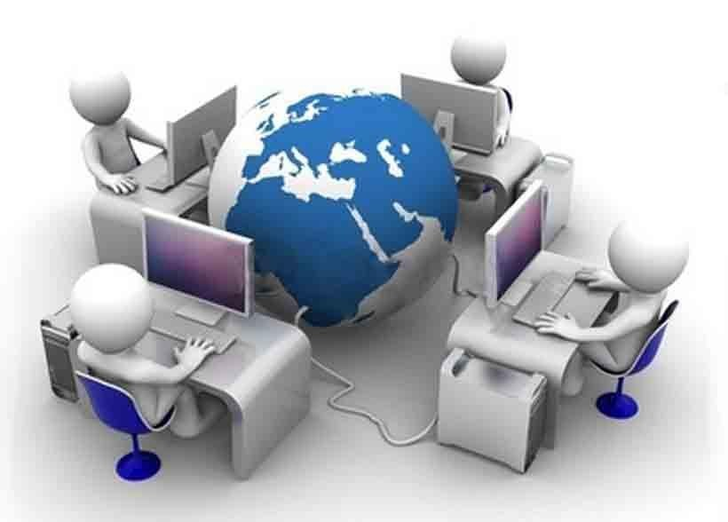







Komunikasi Data
Konsep Sistem Jaringan Komputer
Part-14

Slide 2
Pendahuluan for Outline
Perangkat yang membentuk sistem jaringan
Media yang menghubungkan perangkat jaringan
Bagaimana pesan dikirimkan didalam jaringan
Aturan dalam proses komunikasi sistem jaringan
Peralatan komunikasi jaringan dan aturan untuk membangun dan memelihara sistem jaringan

Slide 3
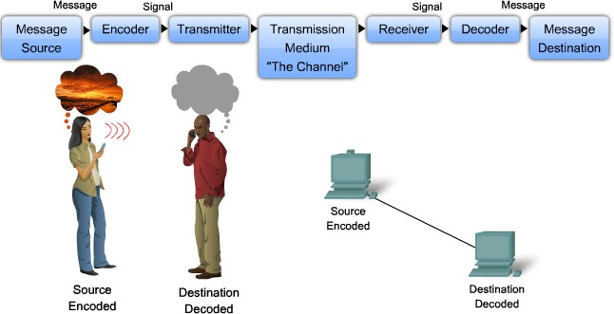
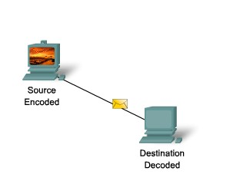
Elemen Dalam Komunikasi

Slide 4
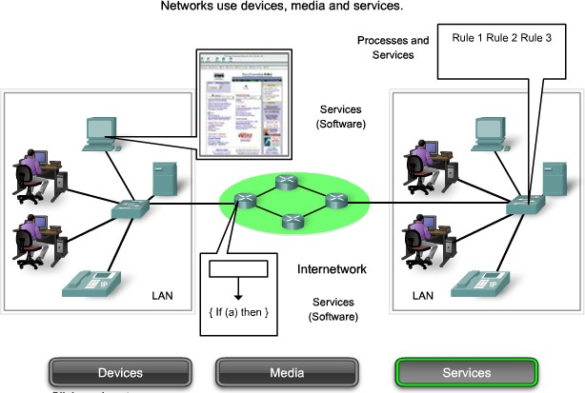
Komponen Pada Sistem Jaringan

Slide 5
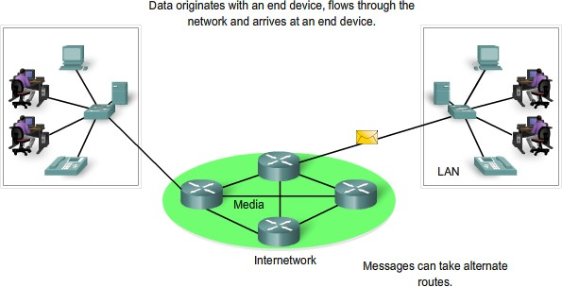
1. End Devices & Their Role On The Network
End Device example;
Computers (work stations, laptops, file servers, web servers)
Network printers
VoIP phones
Security cameras
Mobile handheld devices (such as wireless barcode scanners, PDAs)
Note: In the context of a network, end devices are referred to as hosts

Slide 6
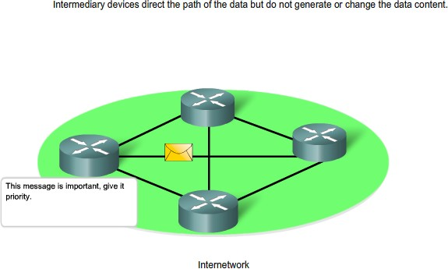
2. Intermediate Devices & Their Role On The Network
Examples of intermediary network devices are:
Network Access Devices (Hubs, switches, and wireless access points)
Internetworking Devices
(routers)
Communication Servers and Modems
Security Devices
(firewalls)

Slide 7
Fungsi Utama Intermediate Devices
Regenerate and retransmit data signals
Maintain information about what pathways exist through the network and internetwork
Notify other devices of errors and communication failures
Direct data along alternate pathways when there is a link failure
Classify and direct messages according to QoS priorities
Permit or deny the flow of data, based on security settings

Slide 8
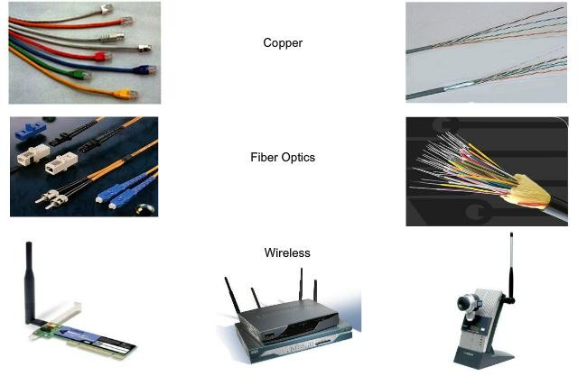
3. Medium (Network Media)
Criteria for choosing a network media are:
The distance the media can successfully carry a signal.
The environment in which the media is to be installed.
The amount of data and the speed at which it must be transmitted.
The cost of the media and installation

Slide 9
LAN, WAN & Internet
Networks infrastructures can vary greatly in terms of:
The size of the area covered
The number of users connected
The number and types of services available

Slide 10
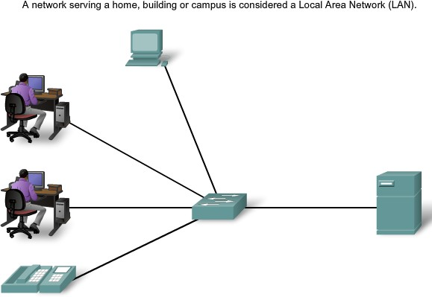
LAN (Local Area Network)

Slide 11
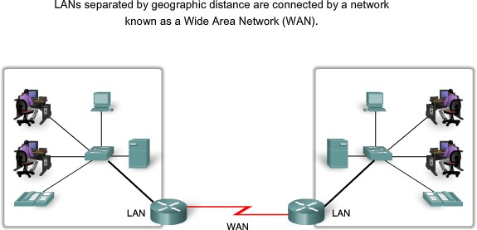
WAN (Wide Area Network)

Slide 12
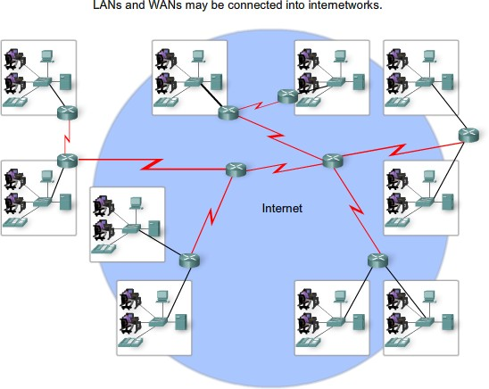
Internet
Examples of this type of communication include:
Sending an e-mail to a friend in another country
Accessing news or products on a website
Getting a file from a neighbor's computer
Instant messaging with a relative in another city
Following a favorite sporting team's performance on a cell phone

Slide 13
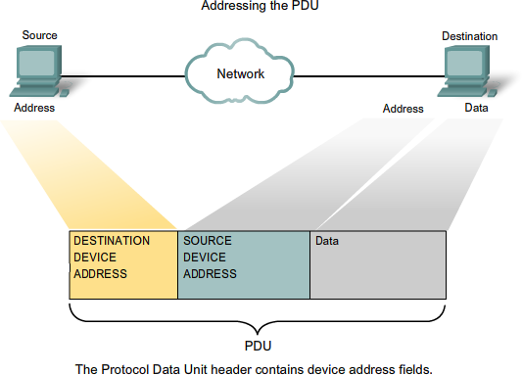
Getting The Data to The End Device
During the process of encapsulation, address identifiers are added to the data as it travels down the protocol stack on the source host.
Just as there are multiple layer of protocols that prepare the data for transmission to its destination, there are multiple layers of addressing to ensure its delivery.
s

Slide 14
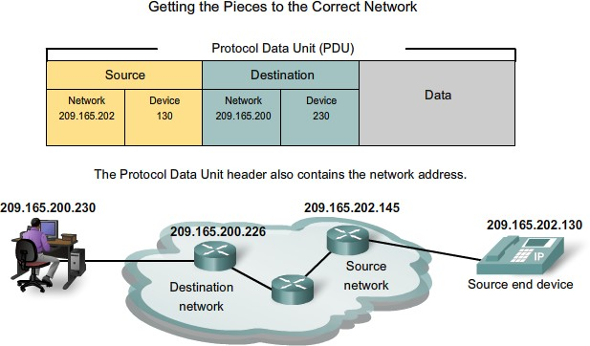
Getting The Data Through to The Internetworking

Slide 15
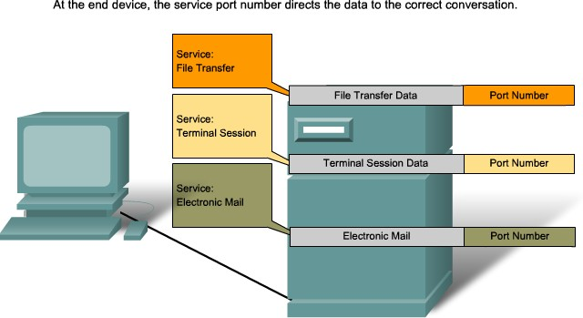
Getting The Data Through to The Right Application

Slide 16
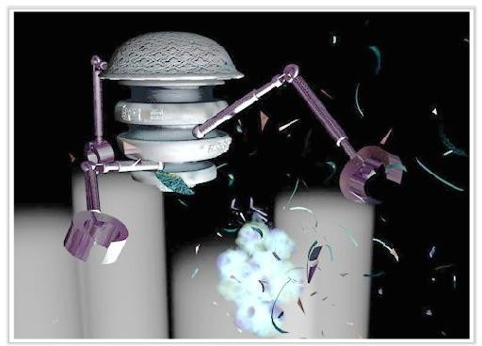
Warriors of The Net
The Video of concepts you have learned in this chapter, think about when in the video you are on the LAN, on WAN, on intranet, on Internet; and what are end devices versus intermediate devices;
Download the movie from http://www.warriorsofthe.net

Slide 17
Kesimpulan
Describe the structure of a network, including the devices and media that are necessary for successful communications.
Describe the importance of addressing and naming schemes in network communications.

