Slide 1


Balok Diatas Dua Perletakan (tumpuan)

Slide 2





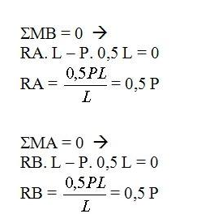


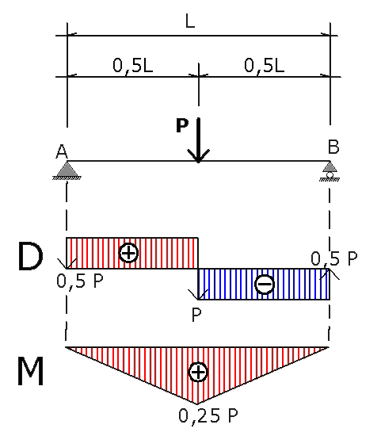
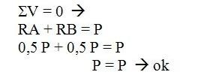
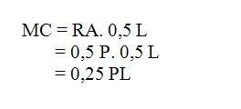
Balok Diatas Dua Perletakan (tumpuan).
Dengan Beban Terpusat

Slide 3

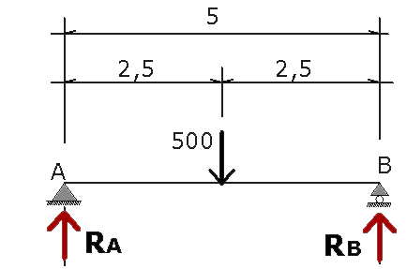
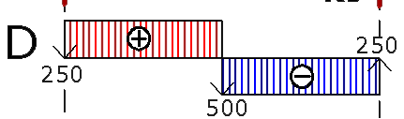

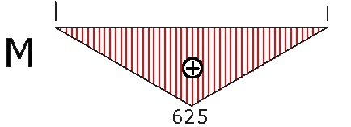
ΣMB = 0 →
RA. 5 – 500. 2,5 = 0
5) Gambar bidang momen, gaya lintang. P = 500 Kg
5 RA – 1250 = 0 RA = 250 kg
ΣMA = 0 →
RB. 5 – 500. 2,5 = 0
5 RB – 1250 = 0 RB = 250 kg
ΣV = 0 → RA + RB = P 250 + 250 = 500
500 = 500 → ok
MC = RA. 2,5
= 250. 2,5
= 625 kgm

Slide 4
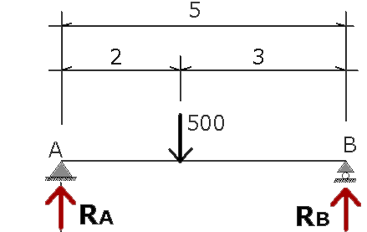
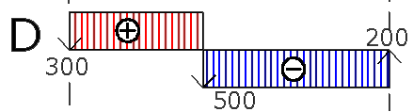
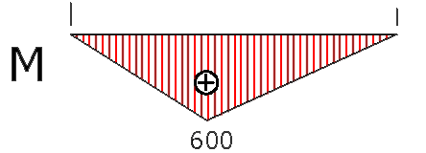
6) Gambar bidang momen, gaya lintang. P = 500 Kg
ΣMB = 0 →
RA. 5 – P. 3 = 0
RA. 5 – 500. 3 = 0
5 RA – 1500 = 0
RA = 300 kg
ΣMA = 0 →
RB. 5 – P. 2 = 0
RB. 5 – 500. 2 = 0
5 RB – 1000 = 0
RB = 200 kg
ΣV = 0 → RA + RB = P 300 + 200 = 500
500 = 500 → ok
MC = RA. 2
= 300. 2 = 600 kgm atau
MC = RB. 3
= 200. 3 = 600 kgm

Slide 5
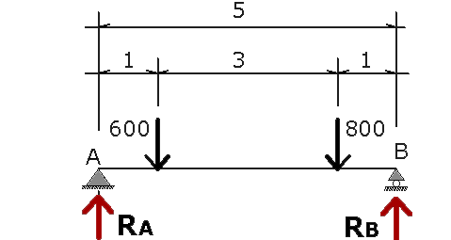
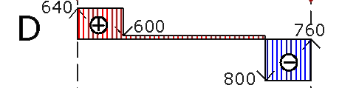
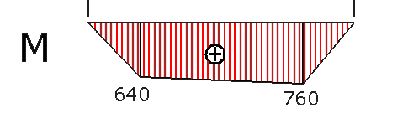
7) Gambar bidang momen, gaya lintang. P1 = 600 Kg, P2 = 800 Kg
ΣMB = 0 →
RA. 5 – P₁. 4 – P₂. 1 = 0
RA. 5 – 600. 4 – 800. 1 = 0
5 RA – 2400 – 800 = 0
5 RA – 3200 = 0
RA = 640 kg
ΣMA = 0 →
RB. 5 – P₁. 1 – P₂. 4 = 0
RB. 5 – 600. 1 – 800. 4 = 0
5 RB – 600 – 3200 = 0
5 RB – 3800 = 0
RB = 760 kg
ΣV = 0 →
RA + RB = P₁ + P₂ 640 + 760 = 600 + 800
1400 = 1400 → ok
MC = RA. 1
= 640. 1
= 640 kgm
MD = RB. 1 = 760. 1
= 760 kgm

Slide 6

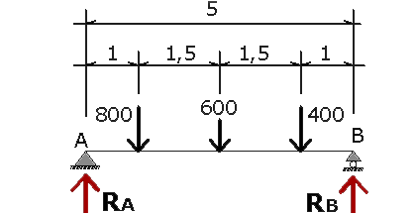
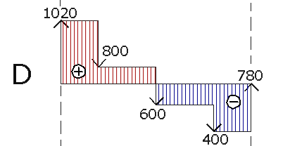
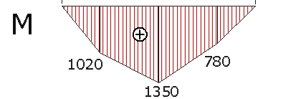
8) Gambar bidang momen, gaya lintang. P1 = 800 Kg, P2 = 600 Kg, P3 = 400 Kg
ΣMB = 0 →
RA. 5 – P₁. 4 – P₂. 2,5 – P₃. 1 = 0
RA. 5 – 800. 4 – 600. 2,5 –
400. 1 = 0
5 RA – 3200 – 1500 – 400 = 0
5 RA – 5100 = 0
RA = 1020 kg
ΣMA = 0 →
RB. 5 – P₁. 1 – P₂. 2,5 – P₃. 4 = 0
RB. 5 – 800. 1 – 600. 2,5 – 400. 4 = 0
5 RB – 800 – 1500 – 1600 = 0
5 RB – 3900 = 0
RB = 780 kg
C
D
E
ΣV = 0 →
RA + RB = P₁ + P₂ + P₃
1020 + 780 = 600 + 800 + 400
1800 = 1800 → ok
MC = RA. 1
= 1020. 1 = 1020 kgm
MD = RA. 2,5 – P₁. 1,5
= 1020. 2,5 – 800. 1,5
= 1350 kgm
ME = RB. 1
= 780. 1 = 780 kgm

Slide 7



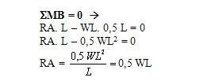

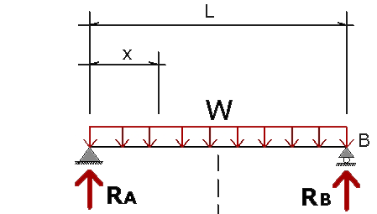
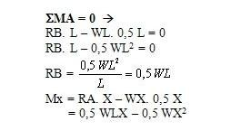

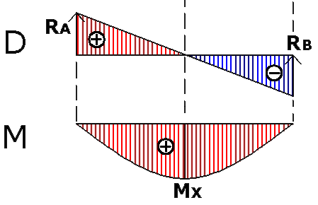
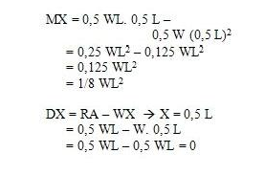
STATIKA BEBAN TERBAGI RATA
A

Slide 8

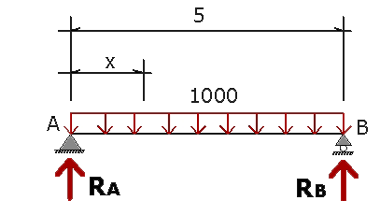
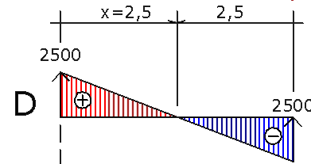

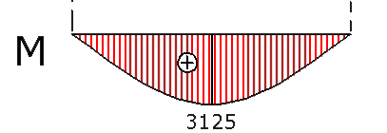
9) Gambar bidang momen, gaya lintang. W = 1000 Kg/m
ΣMB = 0 →
RA. 5 – W. 5. 2,5 = 0
RA. 5 – 1000. 12,5 = 0
5 RA – 12500 = 0
RA = 2500 kg
ΣMA = 0 →
RB. 5 – W. 5. 2,5 = 0
RB. 5 – 1000. 12,5 = 0
5 RB – 12500 = 0
RB = 2500 kg
ΣV = 0 →
RA + RB = W. 5
2500 + 2500 = 1000. 5
5000 = 5000 → ok
MX = RA. X – WX. 0,5 X
= 2500 X – 0,5. 1000 X²
1000 X = 2500
X = 2,5 m
M maks = 2500. 2,5 – 500. 2,5²
= 6250 – 3125
= 3125 kgm

Slide 9



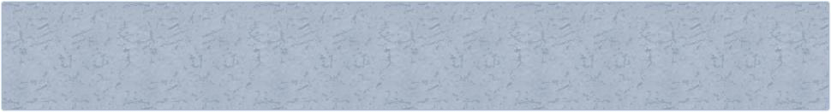
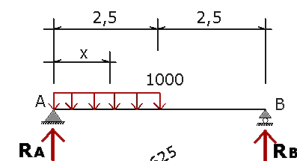
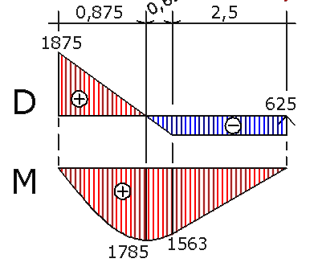
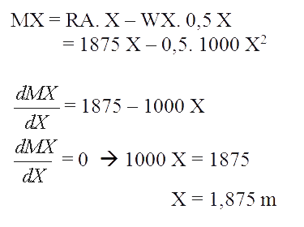
10) Gambar bidang momen, gaya lintang. W = 1000 Kg/m
MB = 0 →
RA. 5 – W. 2,5. 3,75 = 0
5 RA – 1000. 9,375 = 0
5 RA – 9375 = 0 → RA = 1875 kg
ΣMA = 0 →
RB. 5 – W. 2,5. 1,25 = 0
5 RB – 1000. 3,125 = 0
5 RB – 3125 = 0 → RB = 625 kg
ΣV = 0 →
RA + RB = W. 2,5 1875 + 625 = 1000. 2,5
2500 = 2500 → ok
M maks = 1875. 1,875 – 500. 1,875²
= 3516 – 1758 = 1758 kgm
MC = RB. 2,5 = 625. 2,5
= 625. 2,5 = 1563 kgm

Slide 10
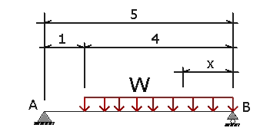
11) Gambar bidang momen, gaya lintang. W = 1000 Kg/m
ΣMB = 0 →
RA. 5 – W. 4. 2 = 0
RA. 5 – 1000. 8 = 0
5 RA – 8000 = 0
RA = 1600 kg
ΣMA = 0 →
RB. 5 – W. 4. 3 = 0
5 RB – 12000 = 0
RB = 2400 kg
ΣV = 0 →
RA + RB = W. 4 1600 + 2400 = 1000. 4
4000 = 4000 → ok

Slide 11

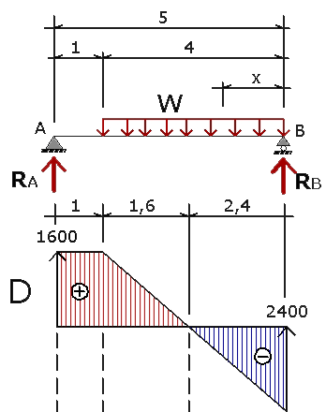
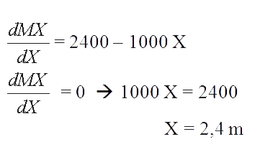
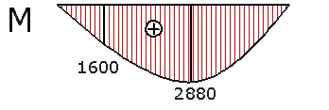
MX = RA. X – WX. 0,5 X
= 2400 X – 0,5. 1000 X²
M maks = 2400. 2,4 – 500. 2,4²
= 5760 – 2880
= 2880 kgm
MC = RA. 1
= 1600. 1
= 1600 kgm

Slide 12

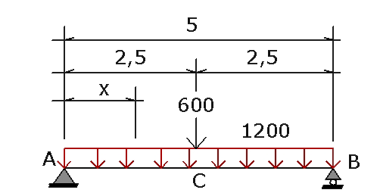
KOMBINASI BEBAN TERPUSAT dengan BEBAN TERBAGI RATA
12) Gambar bidang momen, gaya lintang.
P = 600 Kg, W = 1000 Kg/m
ΣMB = 0 →
RA. 5 – P. 2,5 – W. 5. 2,5 = 0
5 RA – 600. 2,5 – 1200. 12,5
5 RA – 1500 – 15000 = 0
5 RA – 16500 = 0
RA = 3300 kg
ΣMA = 0 →
RB. 5 – P. 2,5 – W. 5. 2,5 = 0
5 RB – 1500 – 15000 = 0
5 RB – 16500 = 0
RB = 3300 kg
ΣV = 0 →
RA + RB = W. 5 + P
3300 + 3300 = 1200. 5 + 600
6600 = 6600 → ok

Slide 13

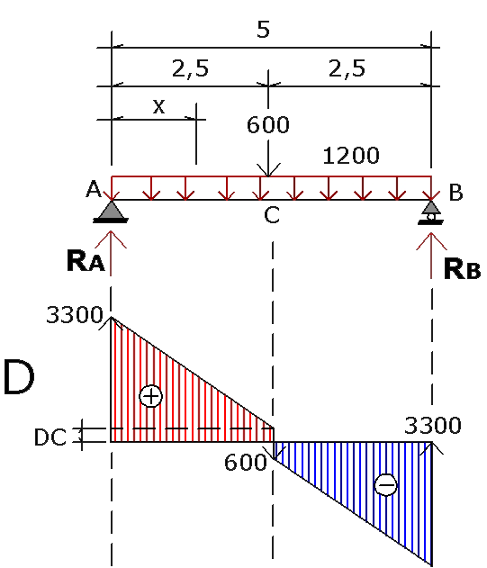
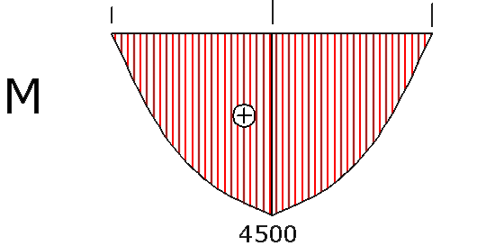
MX = RA. X – WX. 0,5 X
= 3300 X – 0,5. 1200 X²
dMX
= 3300 – 1200 X
dX
^{dMX} = 0 → 1200 X = 3300
dX
X = 2,75 m > 2,5 m → tidak mungkin
M maks = MC = RA. 2,5 – W. 2,5. 1,25
= 3300. 2,5 – 1200. 3,125
= 8250 – 3750
= 4500 kgm
DC = RA – W. 2
= 3300 – 1200. 2,5
= 300 kg

Slide 14



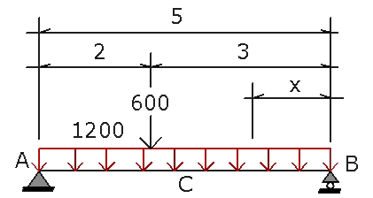
ΣMB = 0 →
RA. 5 – P. 3 – W. 5. 2,5 = 0
12) Gambar bidang momen, gaya lintang. P = 600 Kg, W = 1000 Kg/m
5 RA – 600. 3 – 1200. 12,5 = 0
5 RA – 1800 – 15000 = 0
RA = 3360 kg
ΣMA = 0 →
RB. 5 – P. 2 – W. 5. 2,5 = 0
5 RB – 600. 2 – 1200. 12,5 = 0
5 RB – 1200 – 15000 = 0
RB = 3240 kg
ΣV = 0 →
RA + RB = W. 5 + P
3360 + 3240 = 1200. 5 +
600
6600 = 6600 → ok

Slide 15
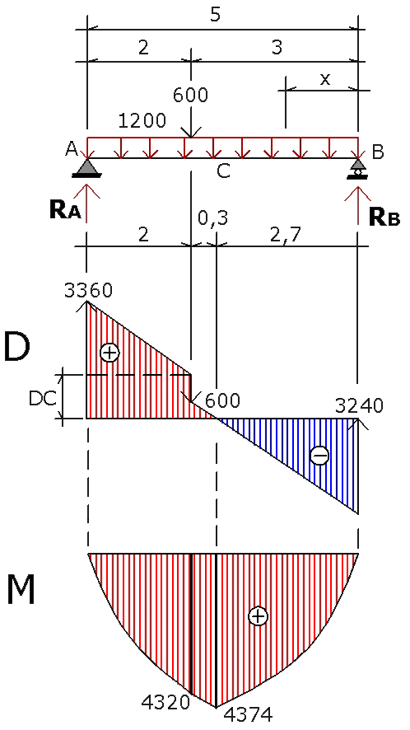
DC = RA – W. 2
= 3360 – 1200. 2
= 960 kg
MX = RB. X – WX. 0,5 X
= 3240 X – 0,5. 1200 X²
^{dMX} = 3240 – 1200 X
dX
^{dMX} = 0 → 120 X = 2,70 m
dX
X = 2,70 m
M maks = 3240. 2,70 – 600. 2,70²
= 8748 – 4374
= 4374 kgm
MC = RA. 2 – W. 2. 1
= 3360. 2 – 1200. 2
= 6720 – 2400
= 4320 kgm

