Slide 1
Matematika

Slide 2
Matematika
1. Bilangan dan operasi bilangan | 2. Aljabar | 3. Geometri | 4. Pengukuran | 5. Data dan Analisis
membandingkan | Memilah | Geometri lebih dari sekedar menamai bentuk-bentuk.geometri termasuk memahami hubungan spasial, posisi, benda 2 dimensi dan 3 dimensi | Memahami atribut benda-benda | Mengumpulkan informasi
Urutan (ke satu-kedua-ketiga) | Mengelompokan |  | Membangun konsep pengukuran tidak baku | Mengorganisasi informasi secara sederhana
Membagi material diantara teman | Membuat pola |  | Aplikasi bilangan untuk mengukur | Bertanya dan menjawab pertanyaan sehubungan dengan informasi yang di kumpulkan dengan organisasi
Menghitung | Memecahkan masalah |  | Membandingkan pengukuran
Hubungan satu-satu |  |  | seriasi

Slide 3
Bermain
STEAM
APE dari Bahan Lokal
Interaksi dengan Anak
Jenis Permainan & Kegiatan Main
Jadwal Harian dan Penataan Lingkungan Main

Slide 4
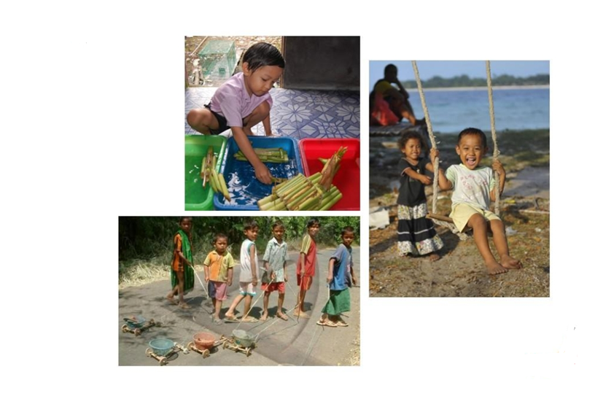
Apa yang Disebut Bermain dan Mengapa Penting bagi AUD?

Slide 5
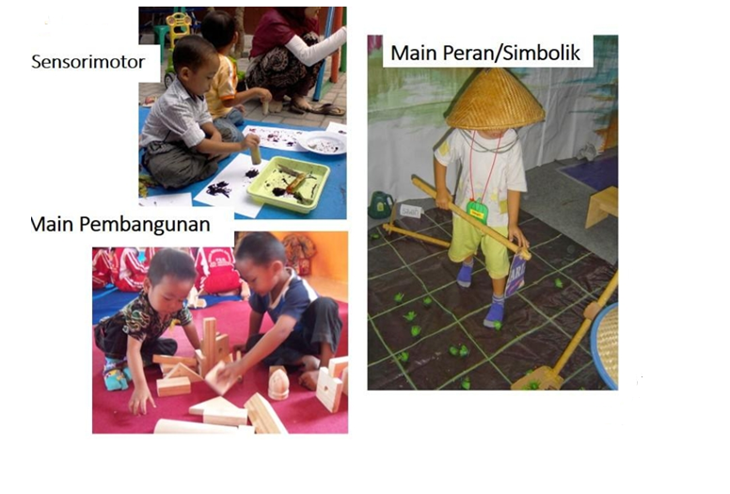
TIGA JENIS MAIN
Notes:
Minta peserta menjelaskan

Slide 6
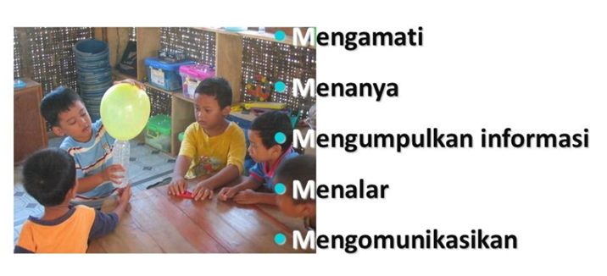
PENDEKATAN SAINTIFIK DALAM BERMAIN
Notes:
Minta peserta menjelaskan

Slide 7

Why is Math Important?
Students need to connect math to everyday living. Math is everywhere.
Notes:
Math skills are important to a child’s success – success at school and in everyday experiences. Understanding math builds confidence and gives students more options in their career choices. Children learn best when they can connect math to their own experience. We can help children recognize how math is used all around them and in our daily lives. Helping to engage them in games and activities that encourage mathematical thinking and the use of numbers.
In our everyday experiences, understanding math lets us, manage our money, manage time, figure out how much money we need for groceries and everyday expenses, allows us to create household budgets, figure how much time to get to work, and calculate sales taxes.
In 1970, only nine percent of all jobs in the U.S. were considered technical. today, technical jobs make up nearly one-third of all employment opportunities. (Source: The Importance of Mathematics www.pbs.org).
Parents often think that struggling in math is a normal part of life, particularly if they struggled with math when they were in school. We often think that math is a subject that either comes naturally or in other words either you get it or you don’t. But being successful in math is more about practice. It’s important for parents to be positive…
Source: Center on School, Family, and Community Partnerships at Johns Hopkins University and MDRC. The Impact of Family Involvement on the Education of Children, Ages 3-8: A Focus on Literacy and math Achievement Outcomes and Social Emotional Skills. NY

Slide 8
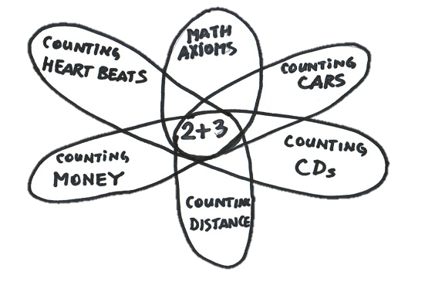
Connecting Math to Everyday Living
Math at Home
Math On the Go
Just for the Fun of it
Math at the Grocery Store
Math and Money
Notes:
. Research has shown that the amount of “Math Talk” is linked to children’s readiness for and success in math learning in kindergarten and elementary (The Impact of family Involvement on the Education of Children). Let’s talk about how to weave math activities and math language into your families daily routines that will show your child how math works in their everyday life, such as buying items, measuring ingredients, counting plates and utensils for dinner.
Give families handouts for each of the titles below. At least two activities would be demonstrated and parents would receive handouts.
Math in the Home: Your home is a great place for you to begin to explore and “talk” mathematics with your child.
Math at the Grocery Store: The grocery store is one of the best examples of a place where the ability to use mathematics is put to work in the “real world.” It’s a great place to practice measurement and estimation.
Math On the Go: In this busy world , we spend a lot of time moving from place to place in our cars, on buses and trains, and on foot. Not only will your child learn and practice math skills, but the time you spend traveling will go by more quickly as well.
Math for the fun of it: During summer vacations, on rainy days, while waiting at the doctor’s office, or on a stroll in the neighborhood learning never ends. Your child can explore math in the world around them, just for the fun of it.
Math and Money : Let’s face it—kids like money. So, what better way to help young people embrace math than by teaching them about money.
Source: Us Department of Education, Office of Communications and Outreach, Helping Your Child Learn Mathematics, Washington, D.C., 2005
Helping Your Child Learn Math: A Parent’ Guide 2004, Manitoba Education, citizenship and youth.

Slide 9
Metode Pembelajaran STEAM
Mulai dengan ‘IDE BESAR’. Misal: bunyi
Pertanyaan penting:
Bagaimana kalian mengalami bunyi? Bunyi apa saja yang pernah kalian dengar?
Bagaimana membuat bunyi dengan tubuh kita?
Bagaimana kita membuat bunyi dengan benda-benda?
Pengalaman Pembelajaran
Field trip ke toko alat musik
Menyeleksi bunyi yang didengar anak di alam terbuka
Presentasi Pembelajaran
Menciptakan bunyi mengunakan air

Slide 10
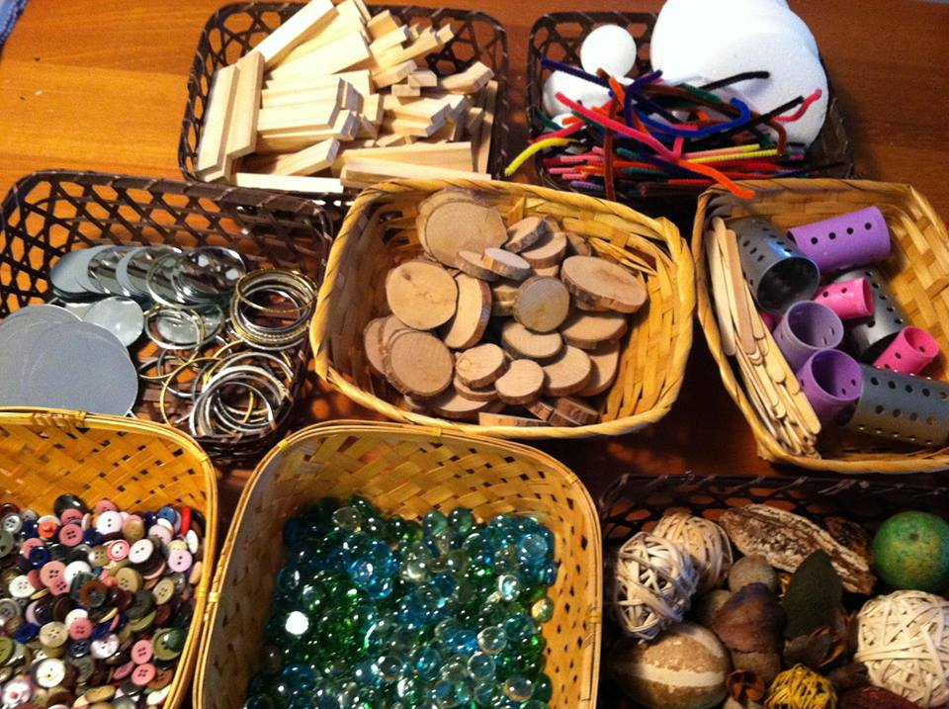
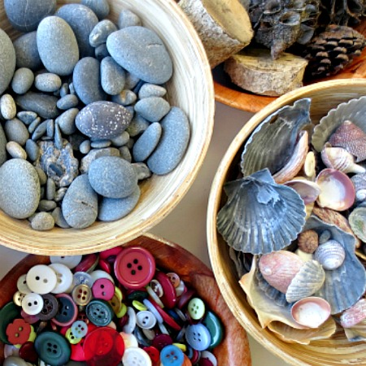
Alat dan Bahan
Loose Part (Barang Lepasan)
Indonesia kaya akan loose parts
Ada di lingkungan sekitar
Identifikasi dan jadikan sebagai alat dan bahan main

Slide 11
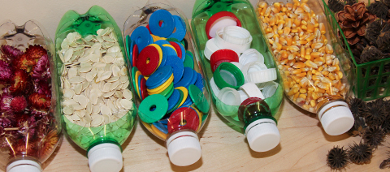
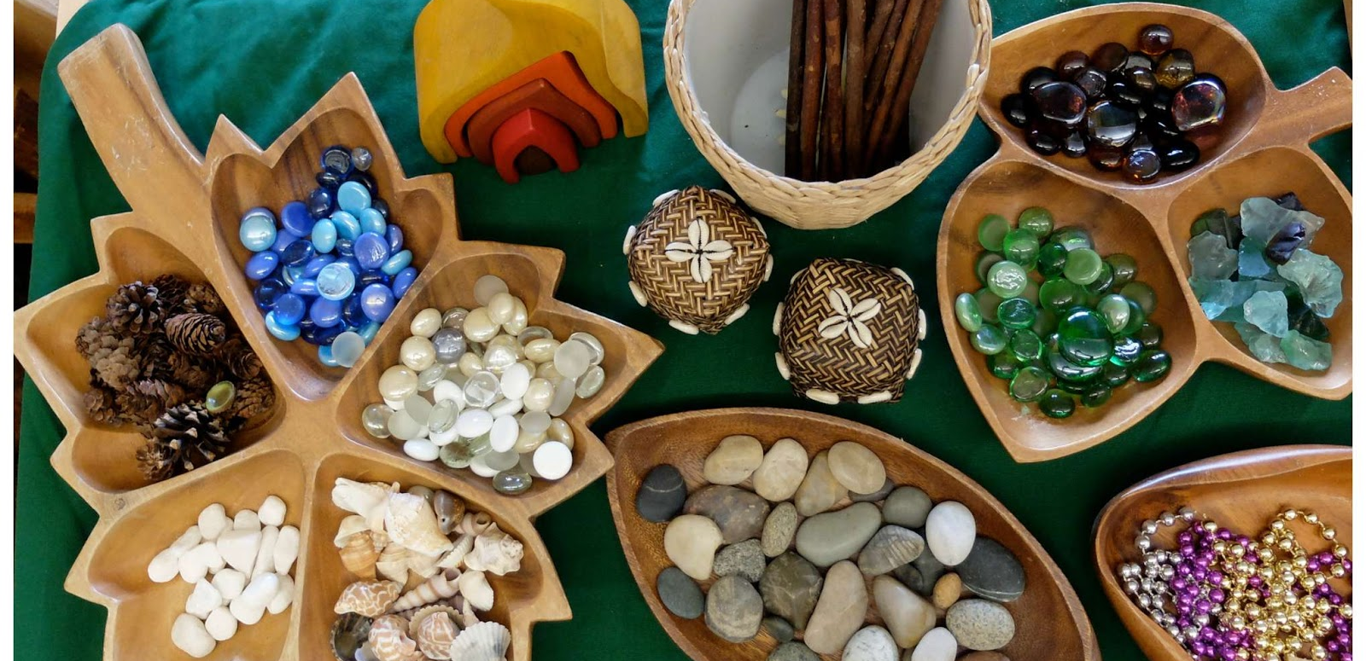
Loose Parts
APE di sekitar anak yang berupa bahan-bahan yang terbuka, dapat terpisah, dapat disatukan kembali, dibawa, digabungkan, dijajar, dipindahkan, dan digunakan sendiri ataupun digabungkan dengan bahan-bahan lain. Dapat berupa benda alam atau sintetis.
s

Slide 12
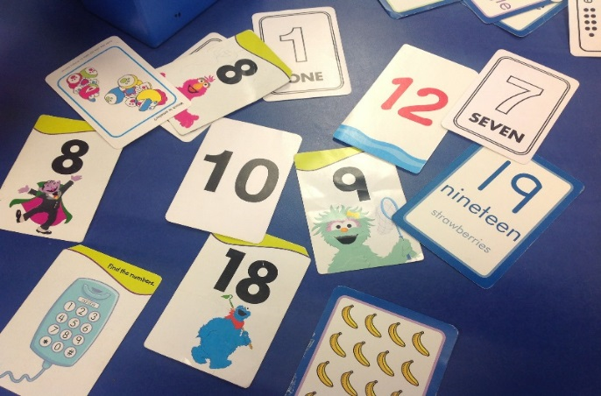
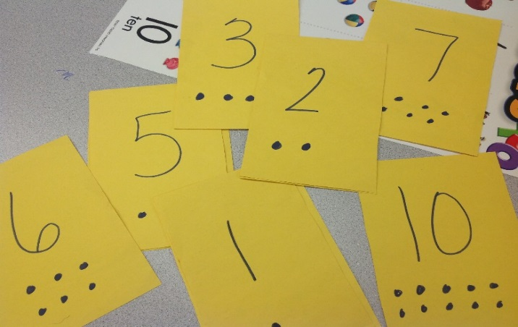
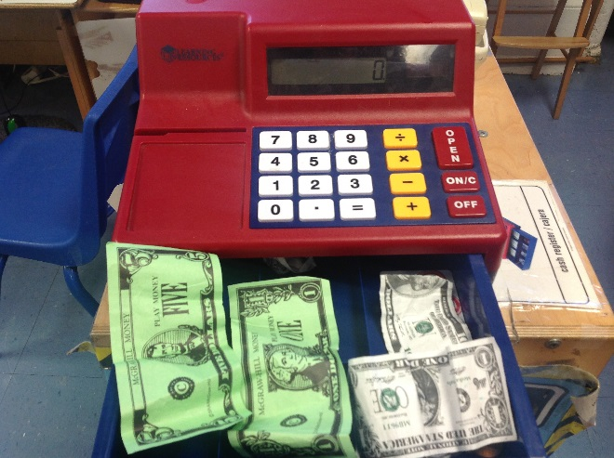
Recommended Materials for Number Sense
Notes:
As highlighted in the Preschool Teaching Practices, it is important to expose children to numerals in the classroom environment. Things with numerals on them, such as calculators, playing cards, thermometers, and simple board games with spinners and dice help children recognize numerals. Teachers should provide children with time during the day for children to use these kinds of materials in open-ended ways.

Slide 13
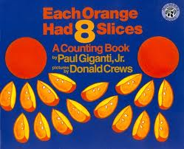
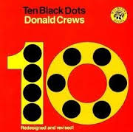
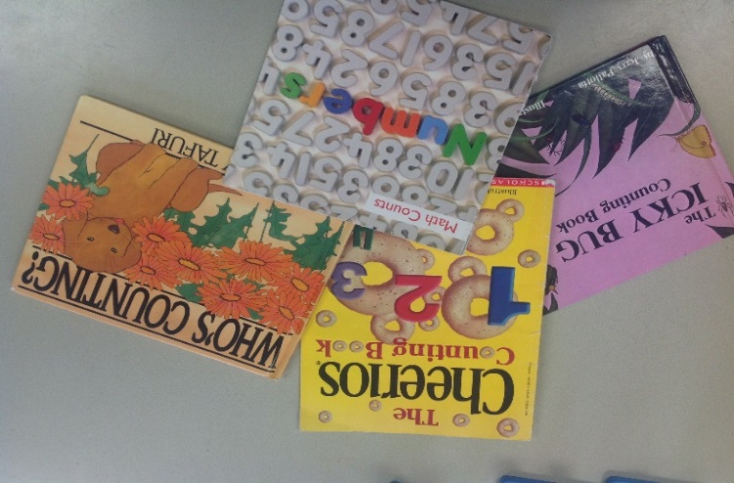
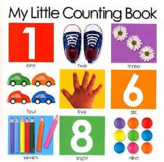
Books About Numbers
Notes:
The preschool classroom should have many examples of counting books and books with numbers in them. The table toy, math, discovery, and block areas are good places to have a basket full of counting books, and books relating to other math concepts. Teachers can also help children make their own counting books.

Slide 14
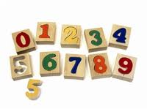
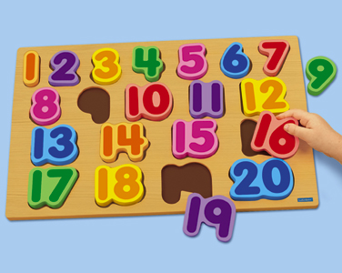
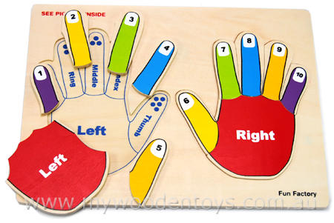
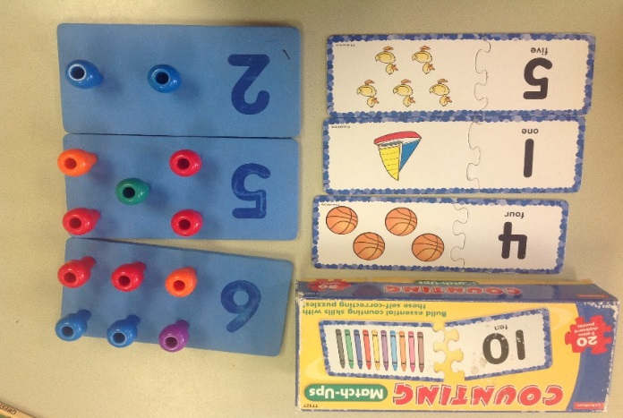
Puzzles and Manipulatives
Notes:
Puzzles, games, and other manipulatives can be used by children in open-ended ways. Children can hold them, explore quantity, and use them as models when writing numerals. Teachers should observe children using manipulatives, support their ideas and gently extend those emerging ideas about number sense.

Slide 15
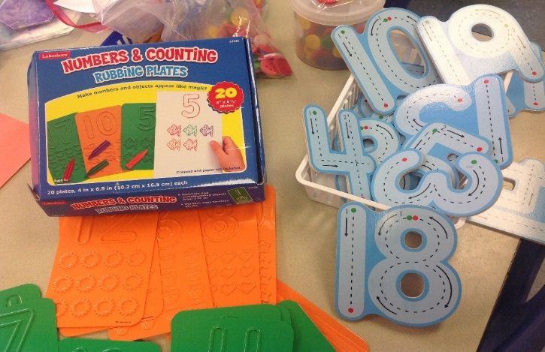
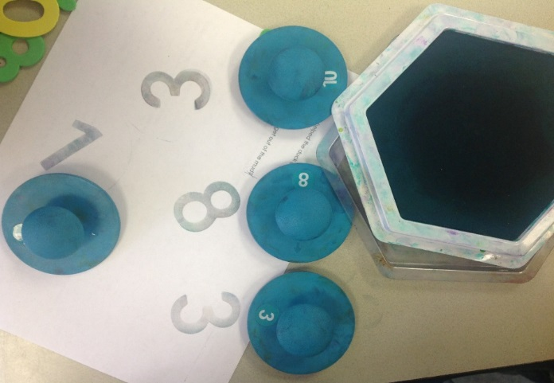
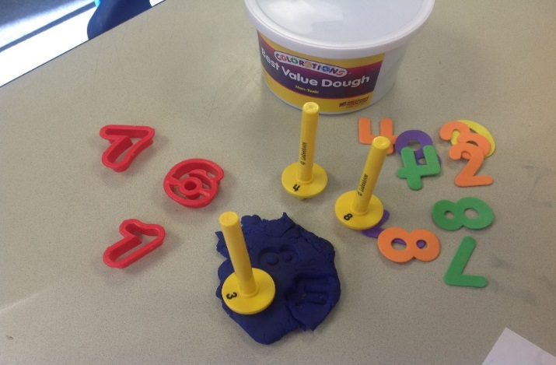
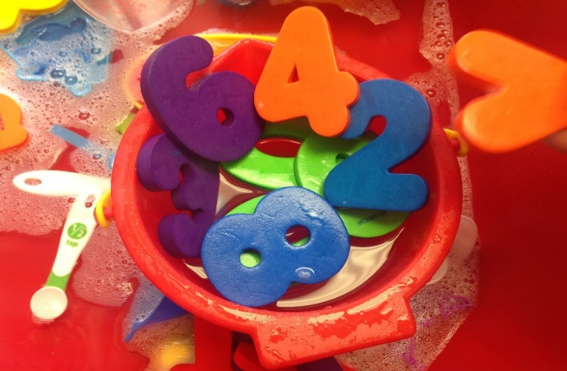
Materials for Making and Writing Numerals
Notes:
Numerals made of wood, plastic, or heavy cardboard are optimal so children can sort, copy, and trace them. The larger the object is, the easier it will be for children to use it. Either store bought or teacher made materials will do the job. Again, children need time to explore these materials in open-ended ways, but also benefit from adult interactions. Teachers should encourage children to use these materials and support the unique ways children choose to use them.

Slide 16
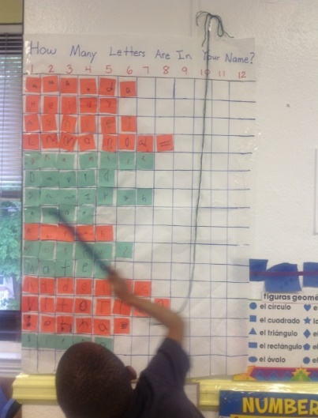
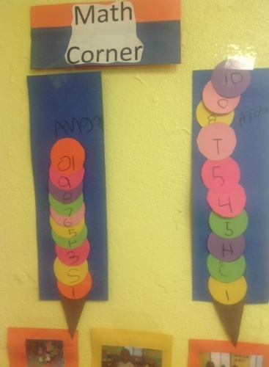
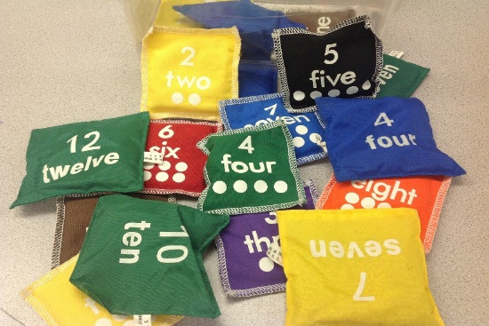
Using the Daily Routine
Notes:
The daily routine offers many opportunities to expose children to numerals. The examples here show ways for teachers to plan both large and small group activities, such as children adding scoops on to their ice cream cones and writing the numerals, making a graph of the number of letters in their name, and using number beanbags at large group time.

Slide 17
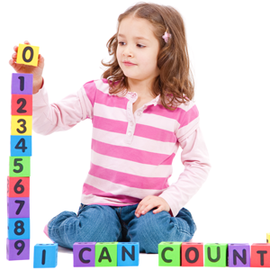
Taking A Closer Look at the Parts of Standard 4.1
Notes:
Presenter Notes: The following slides include activities, discussions, and video material for Standards 4.1.1, 4.1.2, 4.1.3, and 4.1.4., followed by a culminating activity. You should choose which standards and activities to cover based on the allotted time for your workshop.

