Slide 1



Tingkat
Kerawanan Geologis terhadap
Kondisi Kebencanaan di Indonesia: “Jalur
Sesar Aktif dan Antisipasi
Bahaya
nya”
PusGeN
(Pusat Studi Gempa Nasional)
Lembaga Ilmu Pengetahuan Indonesia (LIPI)
Head of Geology Working Group - National Center for Earthquake Study (PuSGeN)

Slide 2
Updating Indonesian Seismic Hazard Map (2015-2017)
UPDATING ACTIVE FAULT DATA
•
•
•
•
•
•
LOCATIONS
SEGMENTATIONS → MAX.MAGNITUDE SLIP RATE → Data still less than 5% PALEOSEISMIC→ data still less than 2%
FAULT TYPE
and GEOMETRY
ADDING
NEW FAULTS

Slide 3
UPDATING INDONESIAN ACTIVE FAULTS FOR SEISMIC HAZARDS
.
• SUMATRA: 19 → 55 segmen sesar aktif
• JAWA: 6 → 37 segmen sesar aktif
..'
•
PHILIPINE
'; ' .·i
~ : ~' ; ~:-~
' ' ...:~ ~ ..
• SULAWESI: 12 →48 segmen sesar aktif
PLATE
1--t---7\-f-:cr-------t---------+-----------l-------\---..J--------..J--1--1-10•0·0"N
~ { ; v-
';~
". '
• PAPUA-MALUKU: 16 → 80
• NUSA TENGGARA – BANDA: 4 →49
PACIFIC PLATE
12
cm/yr
EURASIA
PLATE
7
cm/yr
HINDIA-AUSTRALIAN PLATE
100°0'0"E
110'0'0"E
120°0'0"E
130'0'0"E
140°0'0"E

Slide 4
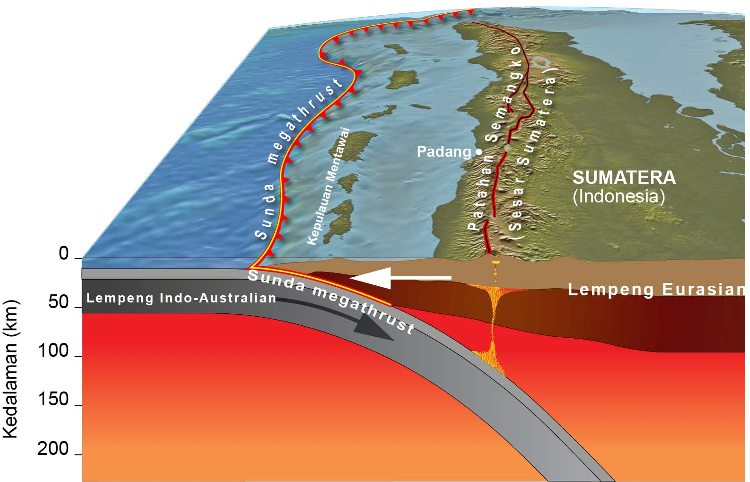
MENTAWAI BACKTHRUST
2009 EQ: INTRACRUSTAL FAULT

Slide 5
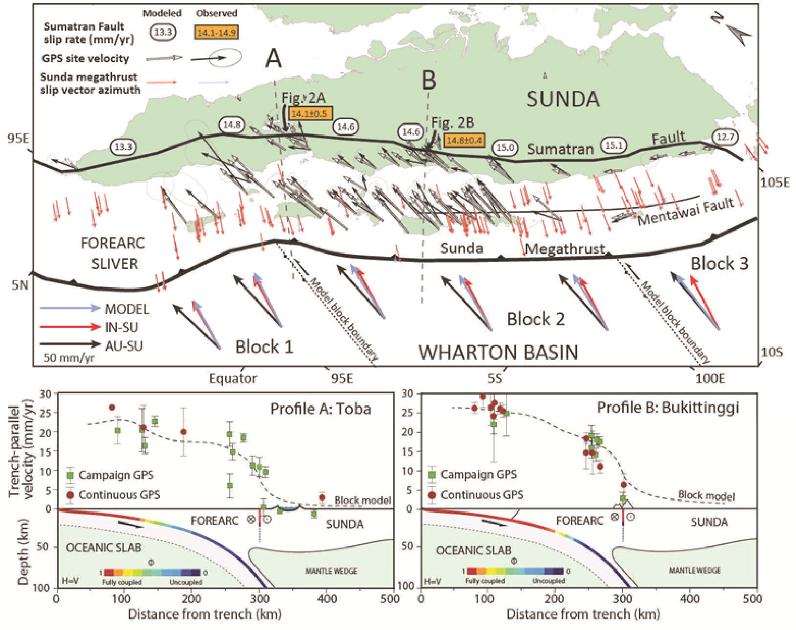
MEASURING SLIP RATES ON SUMATRAN FAULT FROM cGPS SuGAr Network
Bradley, et al, 2017 JGR

Slide 6
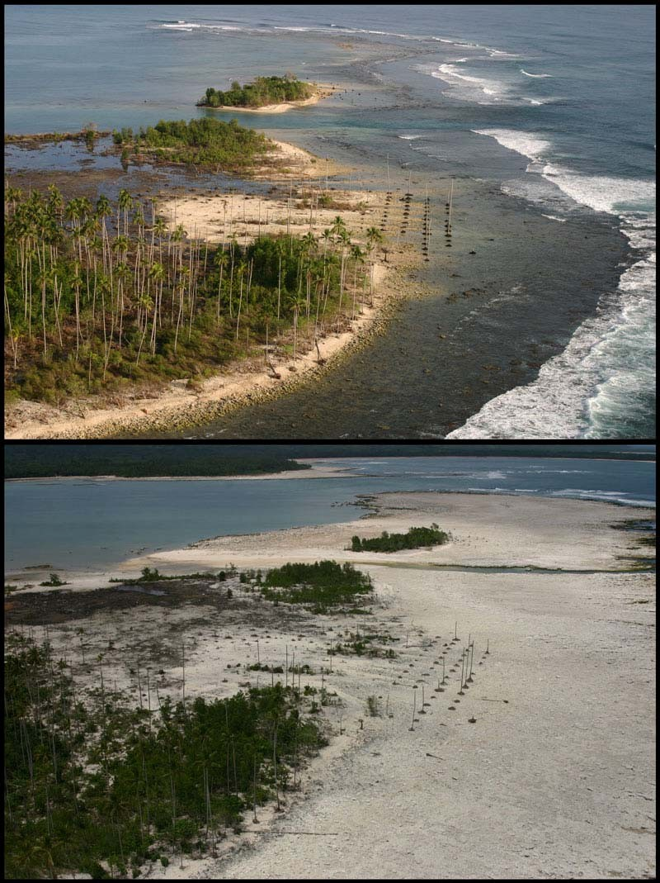
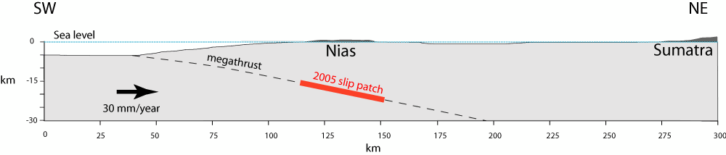
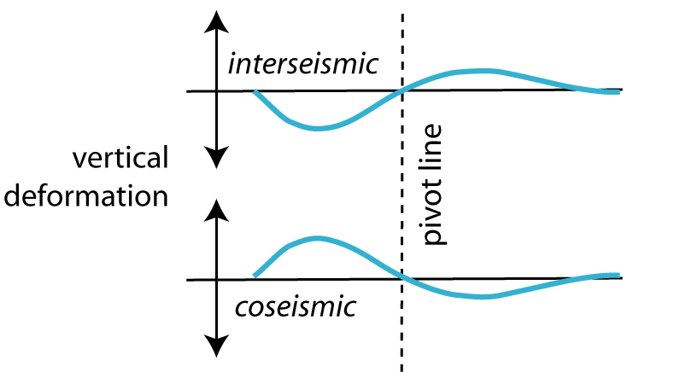
Deformation associated with the megathrust earthquake cycle
Long-term
slow
subsidence
Before 2005
earthquake
January 2005
After 2005
earthquake
Sudden uplift
May 2005

Slide 7
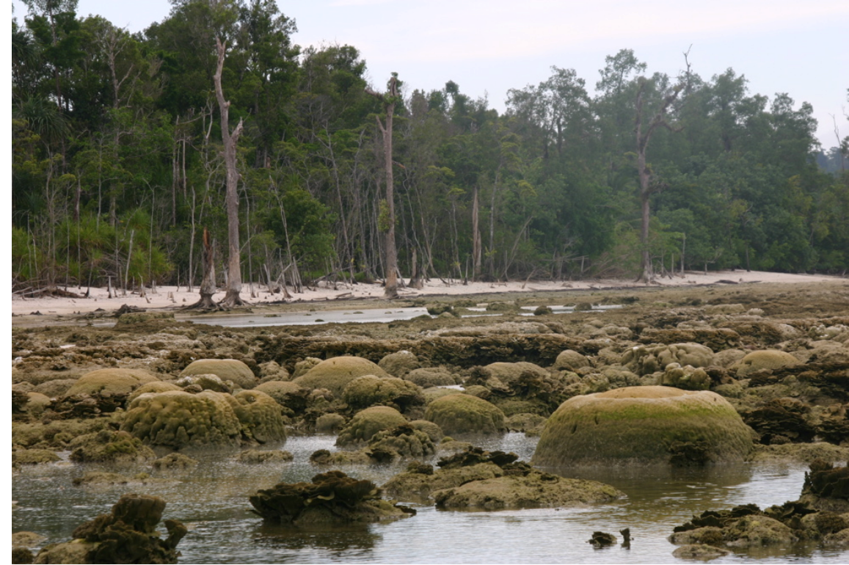
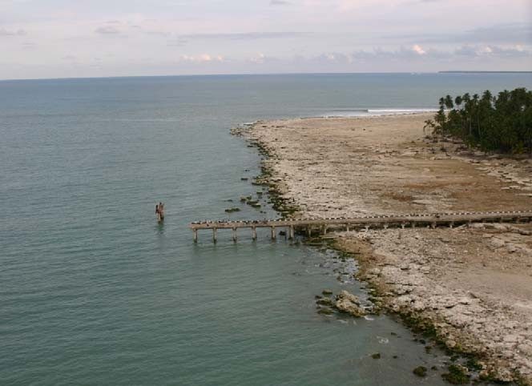
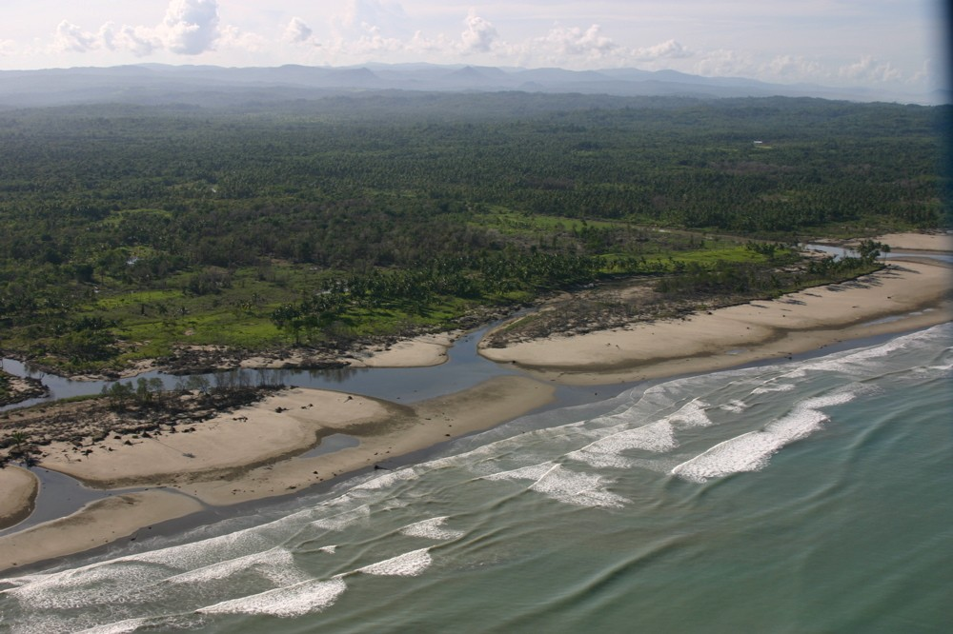
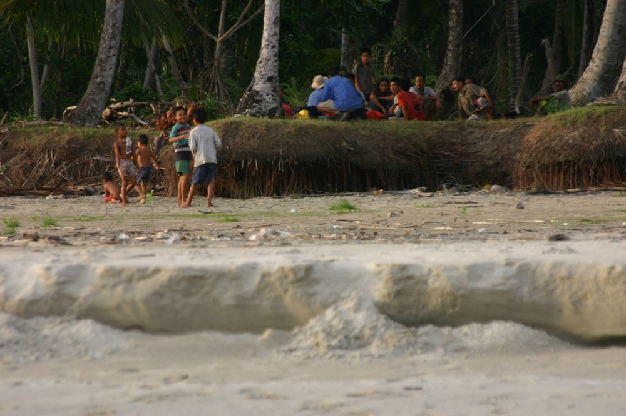
The
March 2005 event resulted
in
impressive
uplift
…
Old high tide
Old low tide
Examples from Nias, Simeulue and the Banyak islands
Old high tide
New high tide

Slide 8
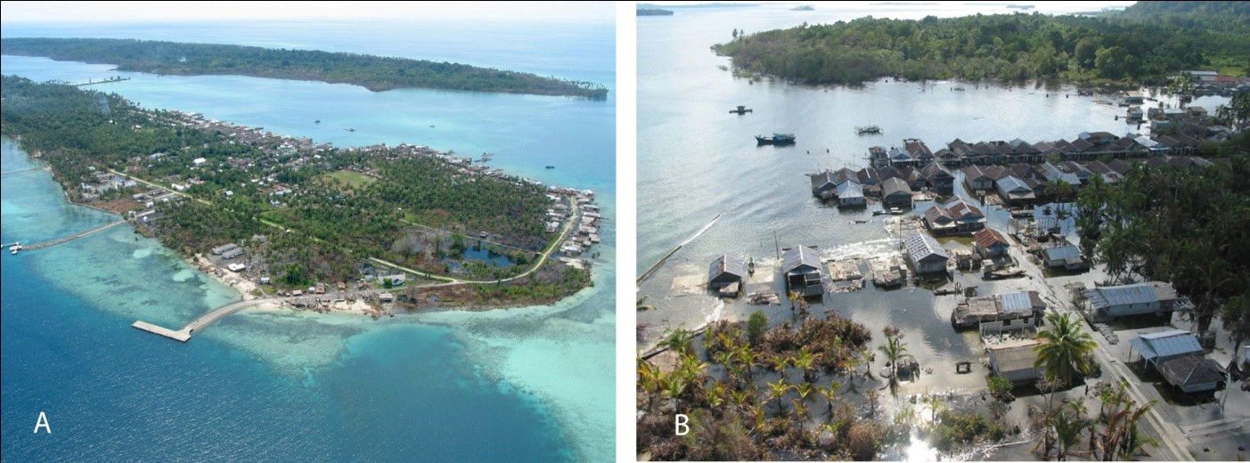
MEGATHRUST
Nias earthquake 2005 M_{w}8.7
Pulau Bale Haloban
….AND SUBSIDENCES

Slide 9
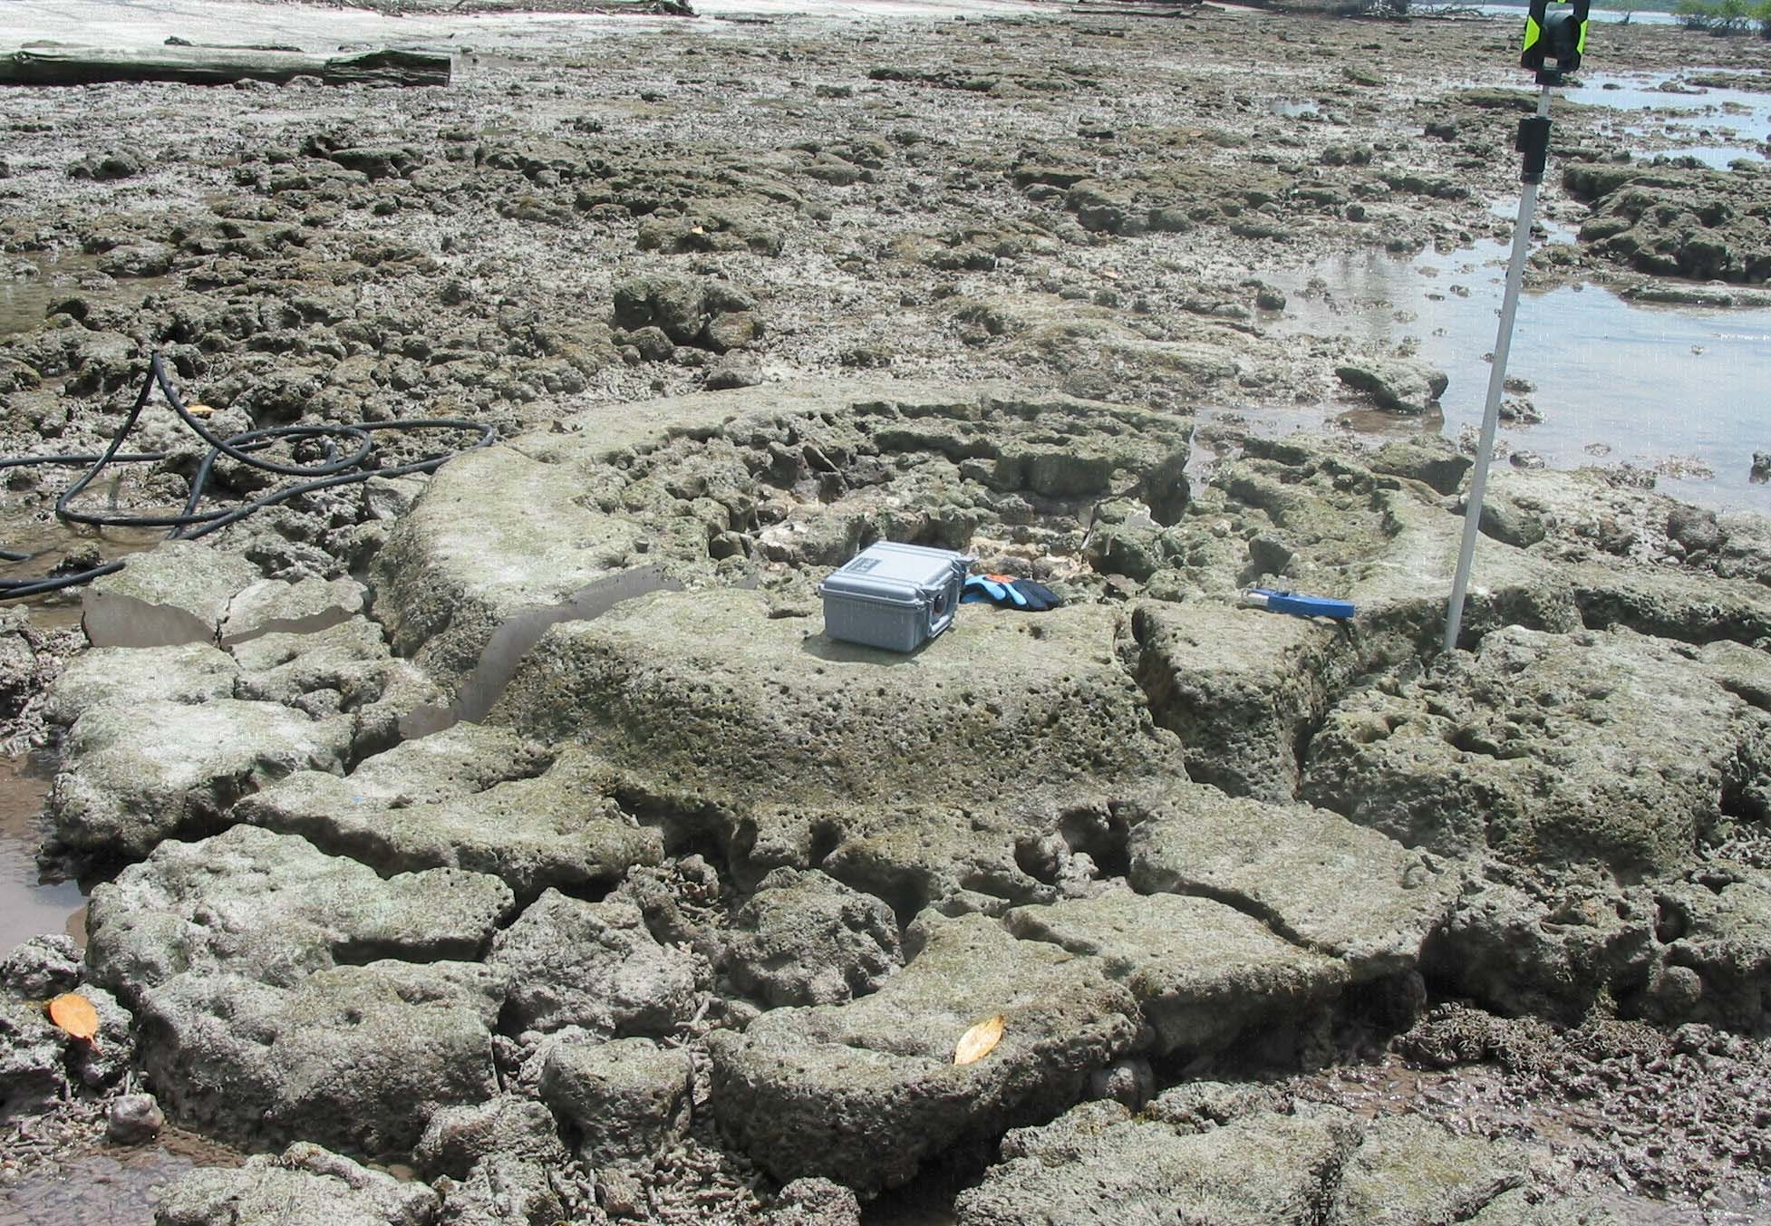
And Past Earthquake and interseismic deformations from Fossil Corals
Pre-1600s
1605
event
1650 event

Slide 10
WORST CASE: TSUNAMI SELAT SUNDA - JAKARTA
Subduction Zone Source Zone1
10
-3 ₈
-4 ₆
-5 ₄
_. ()
-6 2
-7 0
-8 -2
-9 -4
-10 -6
⁻¹¹ SOURCE: Megathrust Mw 9.5 ⁻⁸
-10
Tsunami Model by Dr. Gegar Prasetya
(50 m slip on the megathrust ~ Mw9.3)
·.
00:00:00.00
-c:
~
100
102
104
106
108
110
112

Slide 11
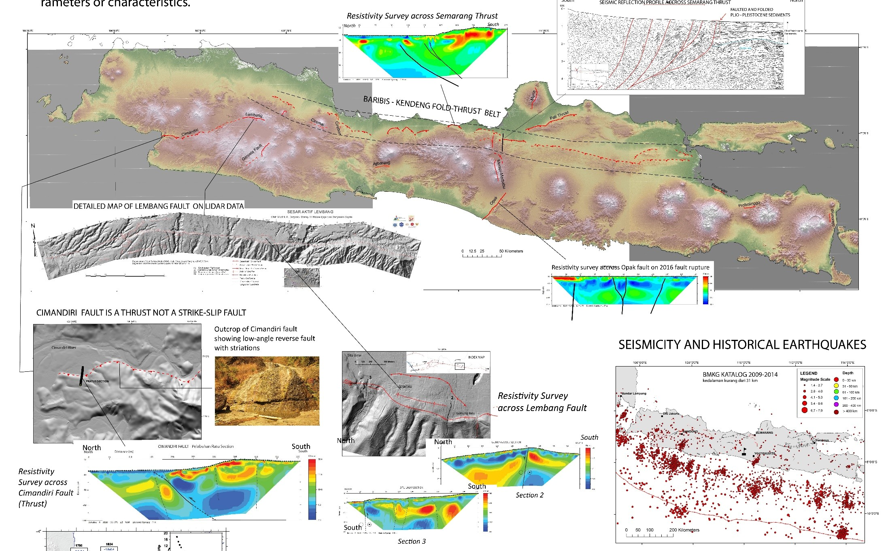
UPDATING SESAR AKTIF DI PULAU JAWA
SESAR BARIBIS AKTIF? DAN TERUS KE JAKARTA???

Slide 12
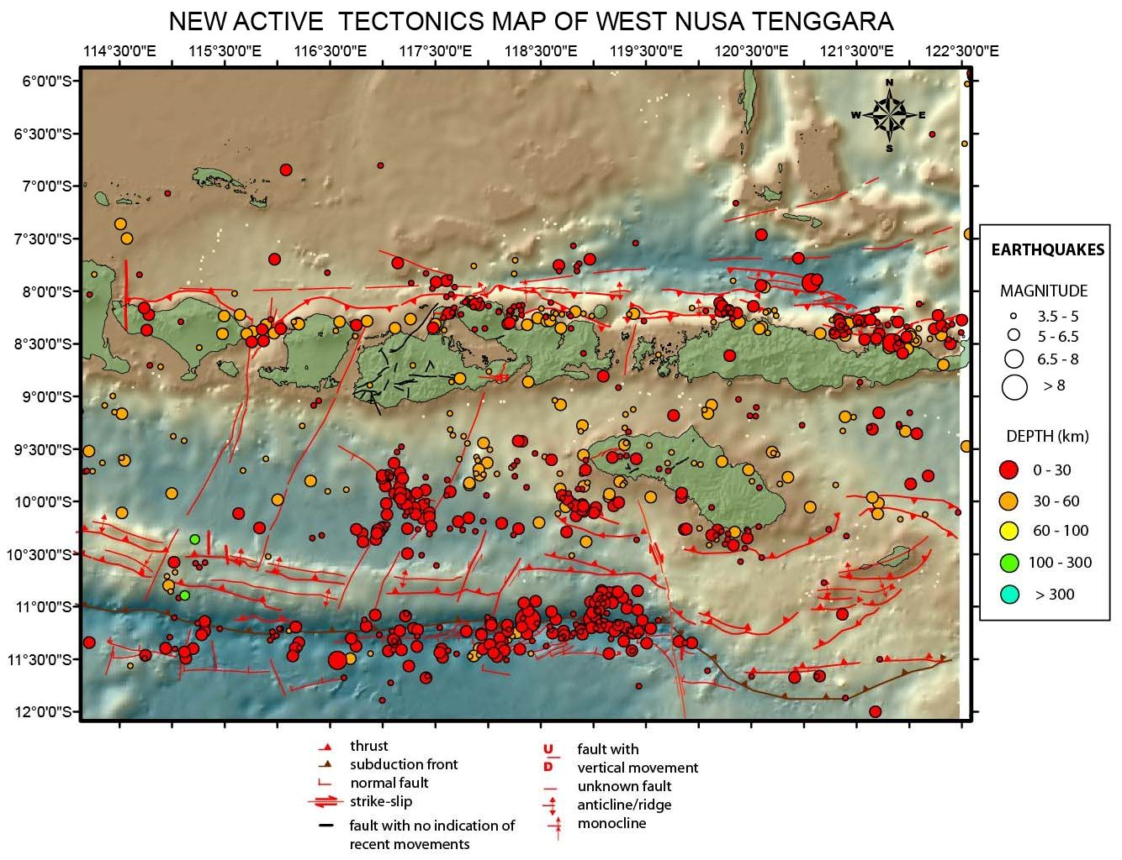

Slide 13
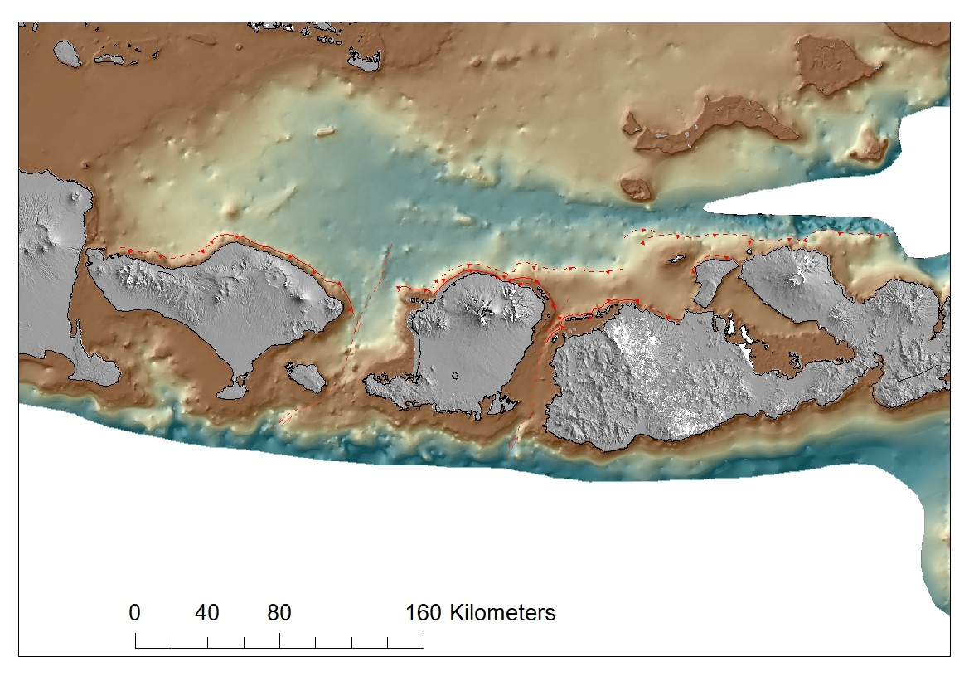
BACK-ARC THRUST SYSTEM
OF
NUSA TENGGARA
BALI
LOMBOK
SUMBAWA

Slide 14
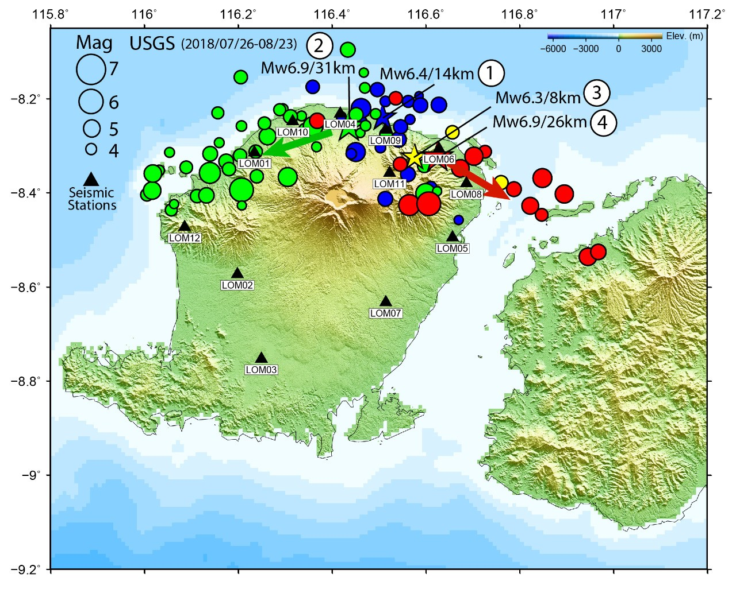
RECENT LOMBOK EARTHQUAKES: 29July (M6.4), 5 August
(M7.0), 19 August (M6.3 and M6.9) (From BMKG DATA)

Slide 15
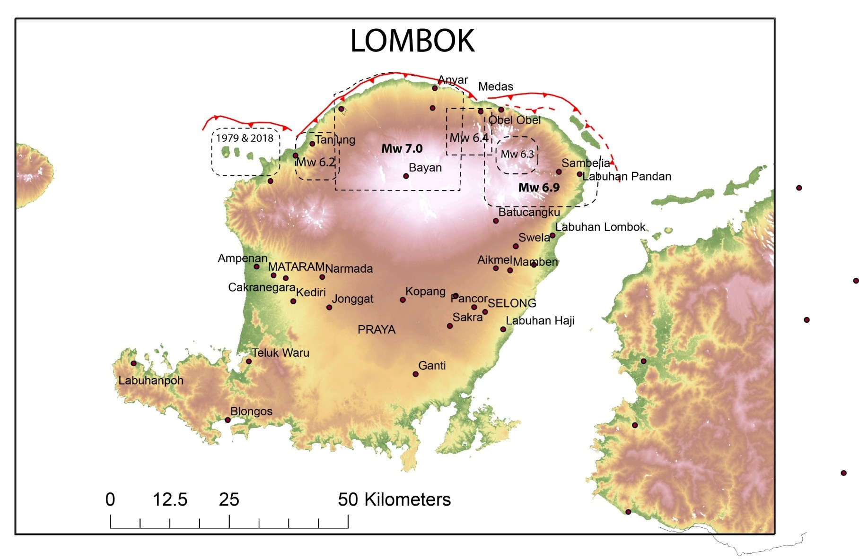
Relationships between Recent Earthquakes in Lombok and Fault
Segmentation on the Lombok Back-arc Thrust
EAST
WEST
CENTRAL

