Slide 1



Food fortification: basic principles
By Fafa Nurdyansyah
Department of Food Tech.
UPGRIS 2018

Slide 2
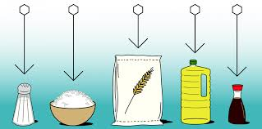
What is fortification?
OBJECTIVES????

Slide 3
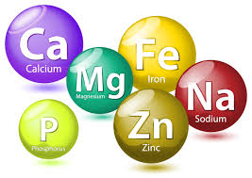

Types of fortification
Food fortification can take several forms :
Mass fortification is sometimes called “universal fortification”.
Targetted fortification→specific population or displaced population
Market-driven fortification is sometimes called “industry-driven fortification”, “open-market” or “free-market” fortification

Slide 4
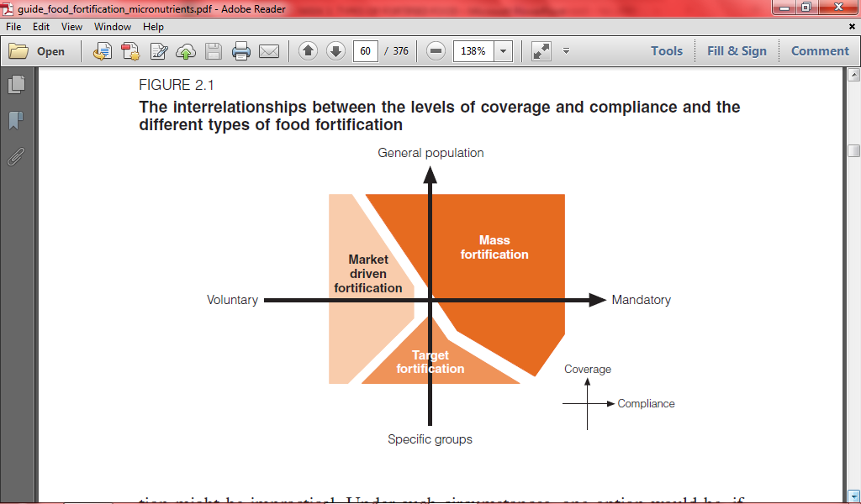

Slide 5

MASS FORTIFICATION
The addition of one or more micronutrients to foods commonly consumed by the general public, such as cereals, condiments and milk.

Slide 6

In others, the population may not actually be deficient according to usual biochemical or dietary criteria, but are likely to benefit from fortification.
The mandatory addition of folic acid to wheat flour with a view to lowering the risk of birth defects

Slide 7
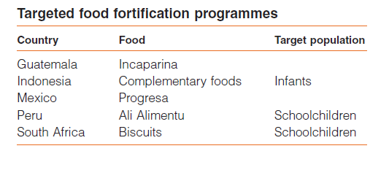
Targeted fortification
foods aimed at specific subgroups of the population are fortified

Slide 8
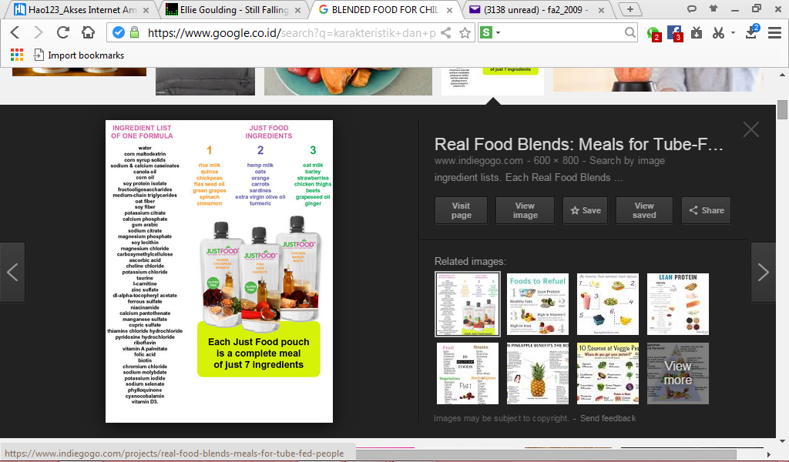
Blended foods usually supply all or nearly all of the energy and protein intake of refugees and displaced individuals, especially in the earlier stages of dislocation, for historical reasons such foods may not always provide adequate amounts of all micronutrients.
Fortified foods for displaced persons are often targeted at children and pregnant or lactating women

Slide 9
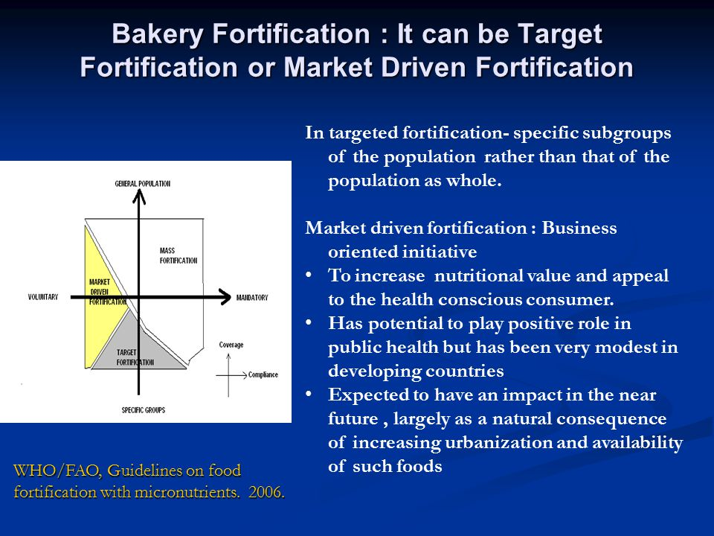

Slide 10
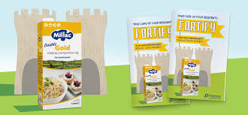
Market-driven fortification is more widespread in industrialized countries, whereas in most developing countries the public health impact of market-driven food interventions is still rather limited

Slide 11
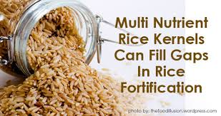

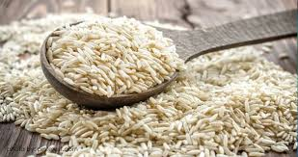
Other types of fortification
Household and community fortification
Biofortification of staple foods

Slide 12
Household and community fortification
“Complementary Food Supplementation”
soluble or crushable tablets
micronutrient-rich spreads
micronutrient-based powder

Slide 13
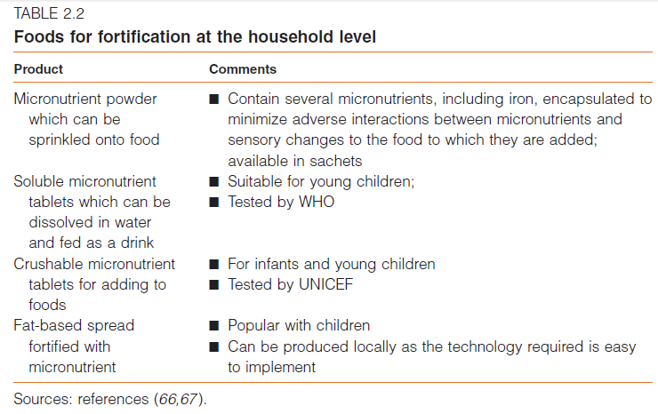

Slide 14

Biofortification of Staple
Food
The breeding and genetic modification of plants so as to improve their nutrient content and/or absorption is another novel approach that is currently being considered.

Slide 15
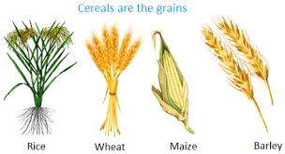
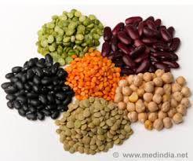
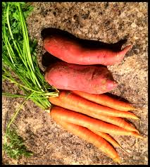
High Iron Content
Safety,
Cost and Impact
on The Environment
β-carotene
High Zinc

Slide 16

Legal considerations:
mandatory versus voluntary fortification

